Slide 1
Shiny App for Data Exploration
Ted Laderas

Slide 2
Shiny App
Ask: We would like to deploy the Shiny Visualization App so we can show how the data exploration works for the workshop

Slide 3
What is Shiny?
Interactive visualization application
hosted on http://shinyapps.io
Individual patient data is not exposed, just aggregate visualizations
Example (synthetic dataset): https://tladeras.shinyapps.io/cvdnight1/

Slide 4
Covariates used in the app
Demographics:age_s1, gender, smokstat_s1, bmi_s1, race
Hypertension: srhype, ace1, beta1, htnderv_s1, systbp
Labs: hdl, chol
Cvd: any_cvd
Sleep: ahi_a0h3,ahi_a0h4, oahi, neck20.

Slide 5
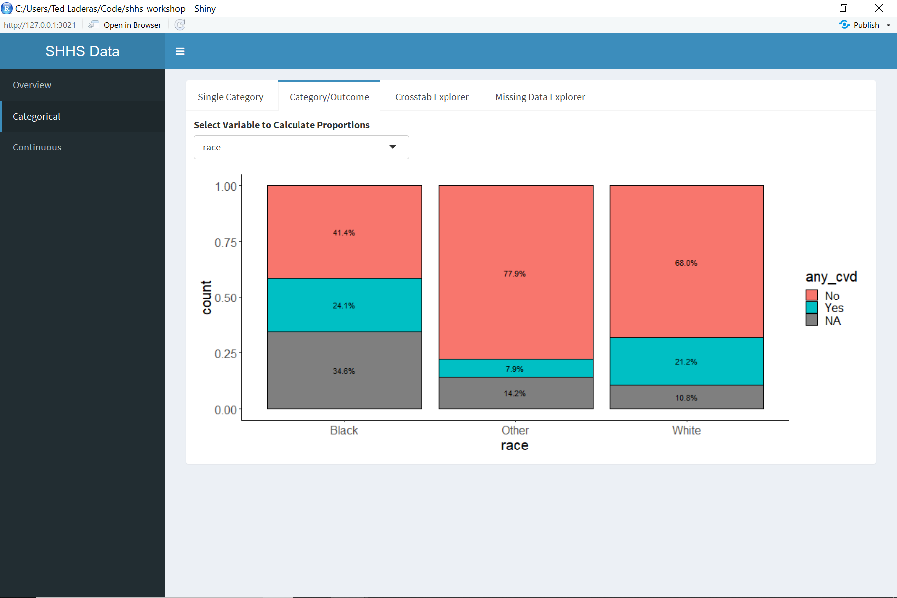
Visualization Example (visdat)
visdat example

Slide 6
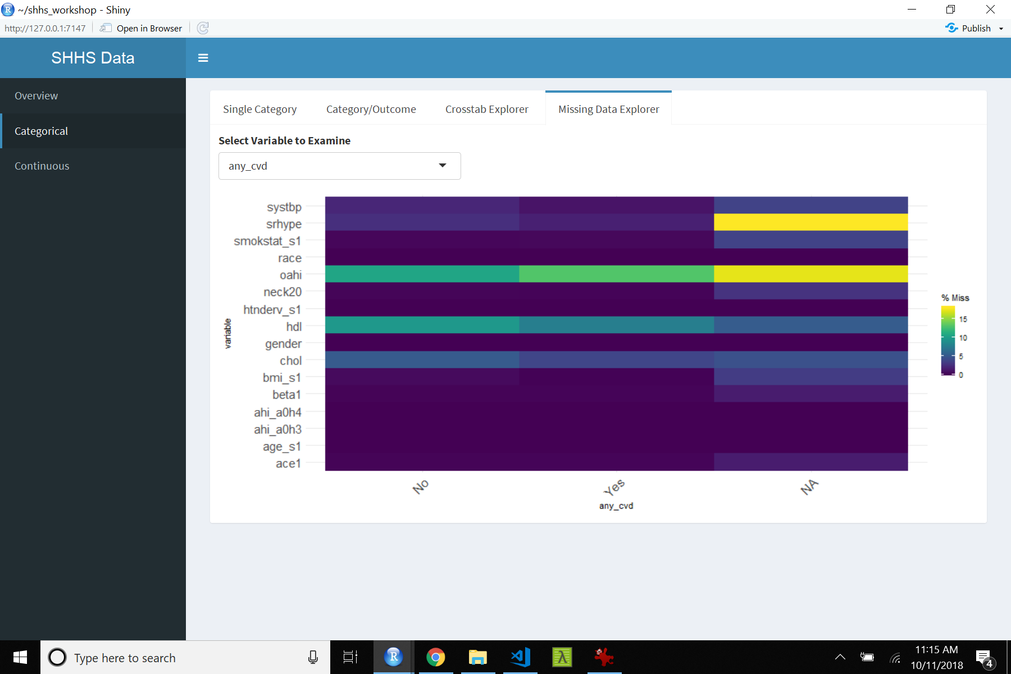
Vis example 2

Slide 7
Vis example 3

