Slide 1
Shiny App for Data Exploration
Ted Laderas

Slide 2
Shiny App
Asks:
We would like to deploy the Shiny App so we can show how the data exploration works for the workshop
Can we make the limited dataset sharable? If not, what would be required to make it sharable?
What visualizations of the data can we share?

Slide 3
What is Shiny?
Interactive visualization application
hosted on http://shinyapps.io
Individual patient data is not exposed, just aggregate visualizations
Example (synthetic dataset): https://tladeras.shinyapps.io/cvdnight1/

Slide 4
Covariates used in the app
Only 17 covariates used in the app
Full Data Dictionary is used, but can be restricted
Demographics:age_s1, gender, smokstat_s1, bmi_s1, race
Hypertension: srhype, ace1, beta1, htnderv_s1, systbp
Labs: hdl, chol
Cvd: any_cvd
Sleep: ahi_a0h3,ahi_a0h4, oahi, neck20.

Slide 5
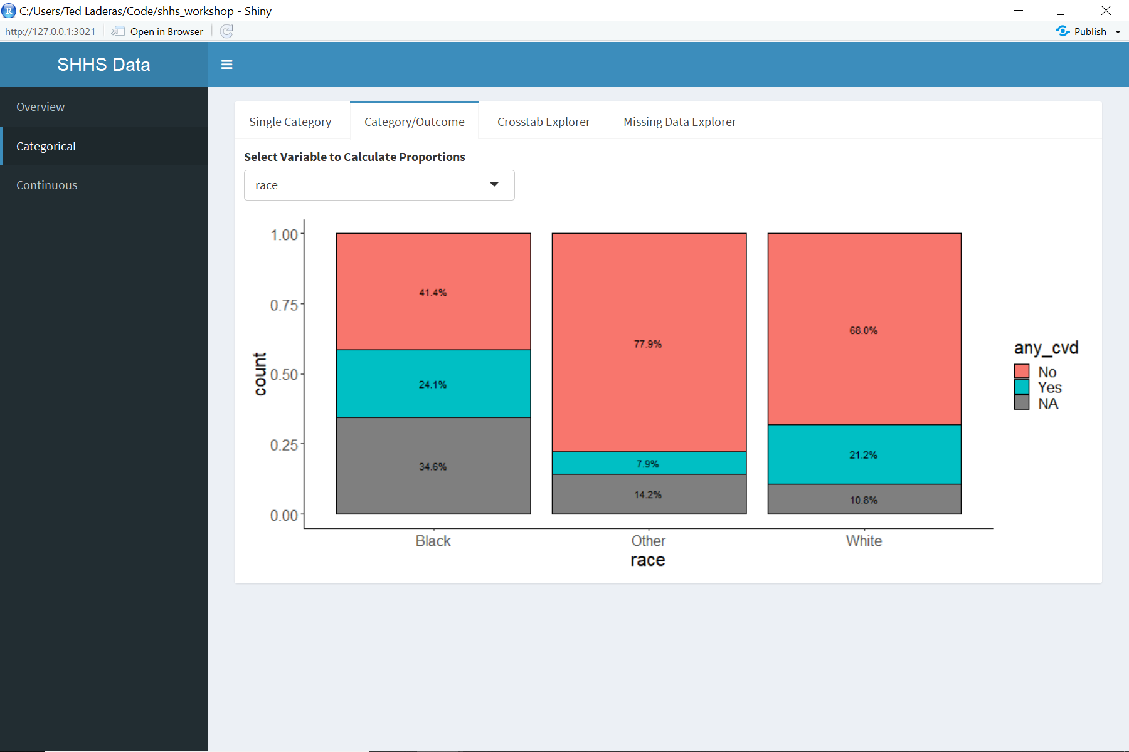
Visualization Example
race versus outcome

Slide 6
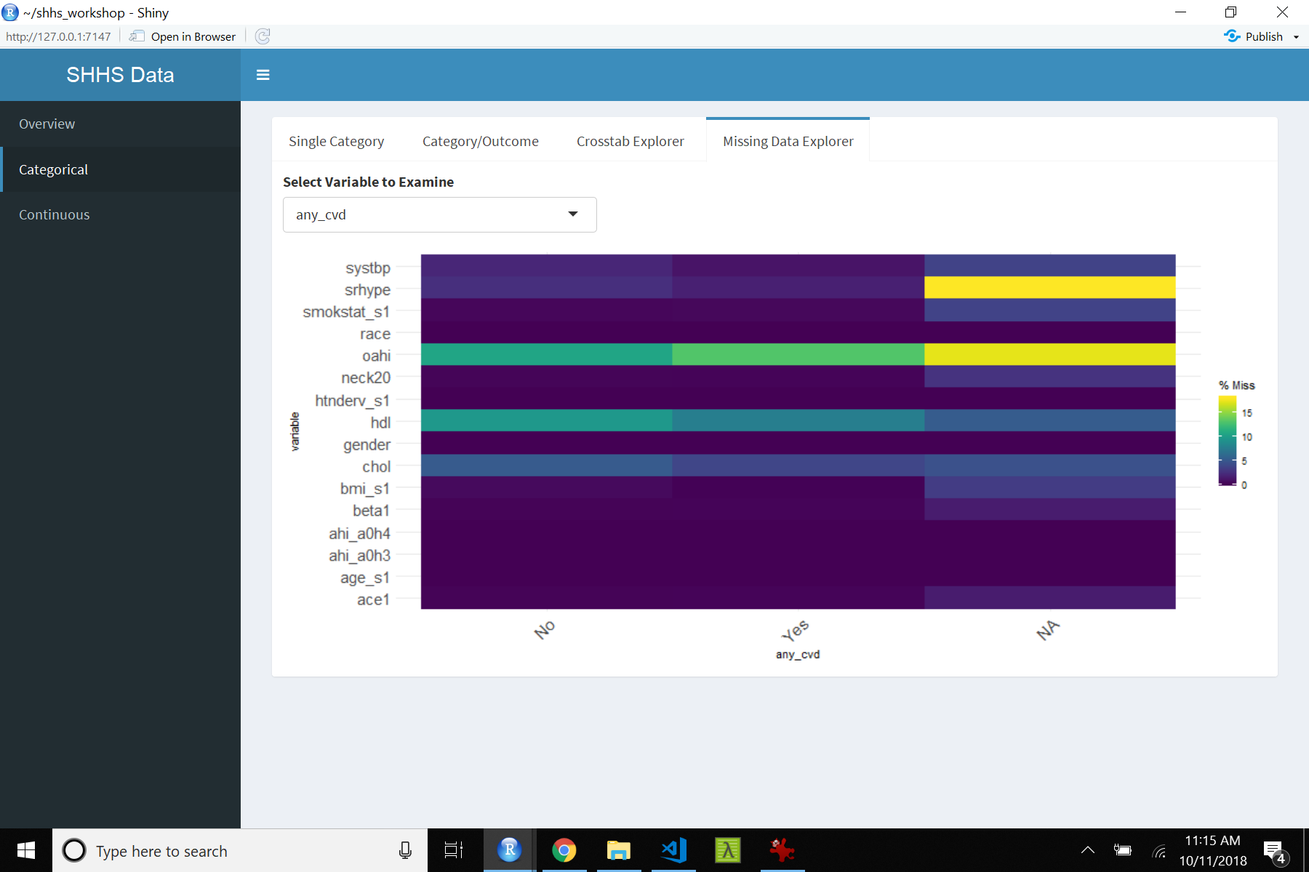
Vis example 2: Missing Data

Slide 7
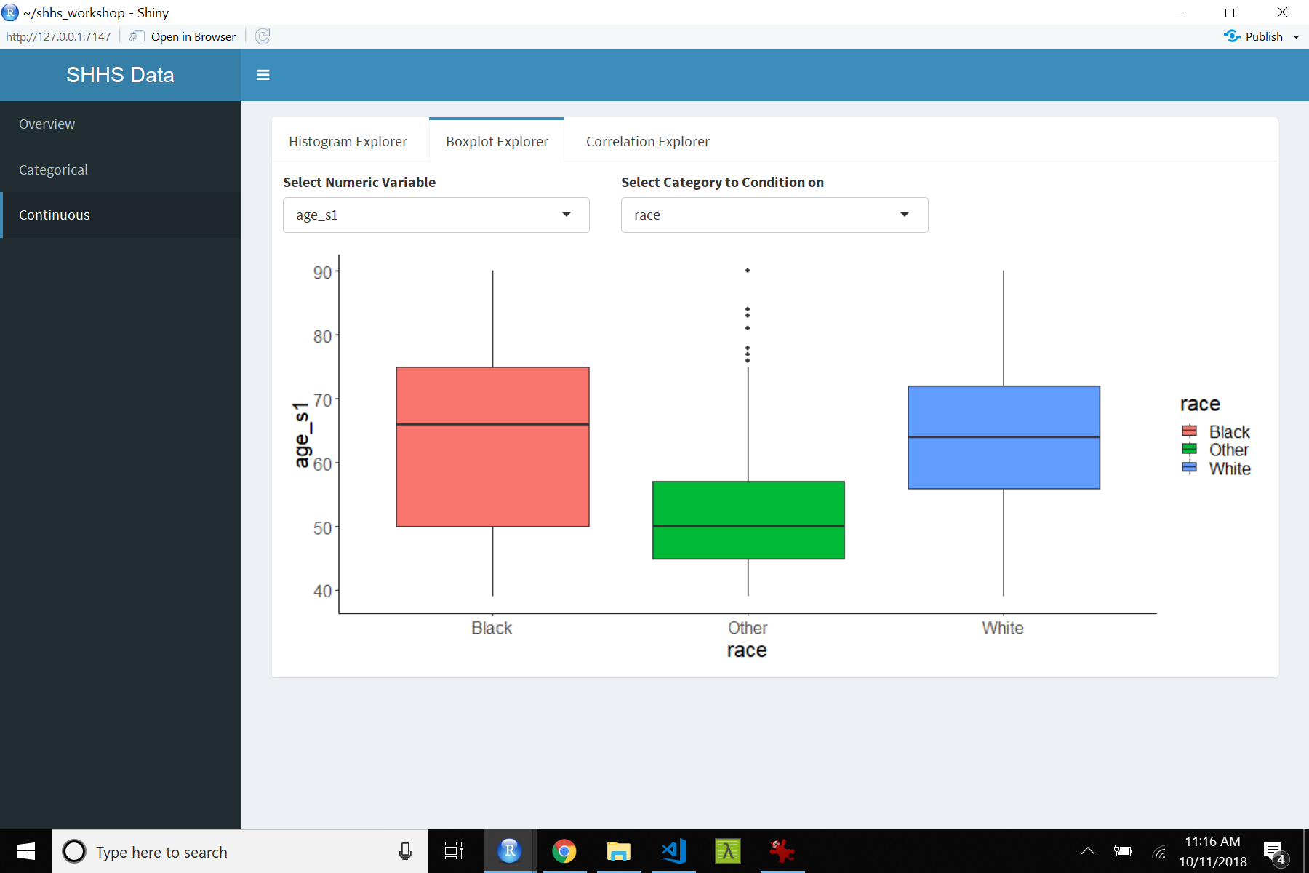
Vis example 3: Boxplots
age versus race

Slide 8
Links to Workshop Materials
Blog post: http://laderast.github.io/2018/10/15/clinical-data-wrangling/
Github Repository: https://github.com/laderast/clinical_data_wrangling
Website: https://laderast.github.io/clinical_data_wrangling/

