Slide 1
Hands on Risk Scores: knowing your data and methods
David Dorr, MD, MS

Slide 2
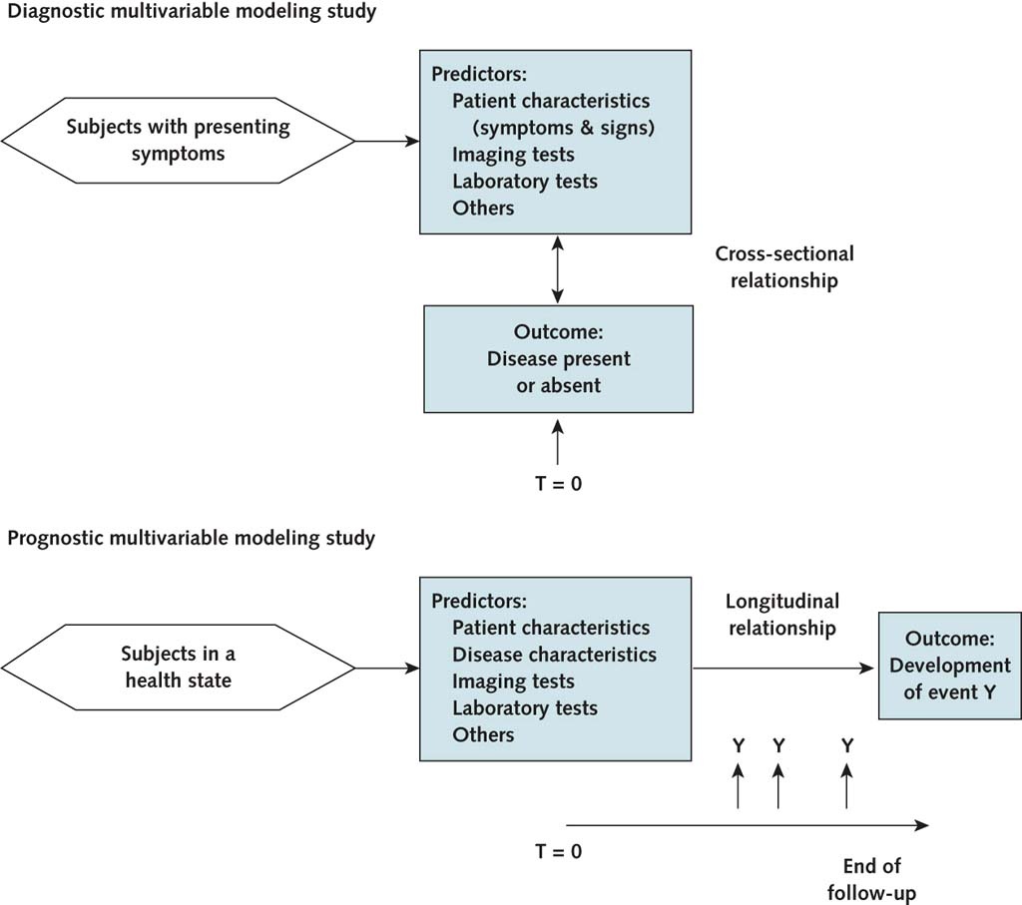
Defining risk prediction – what you report
TRIPOD group (Collins et al), Annals, 2015. http://annals.org/aim/article/2088549/transparent-reporting-multivariable-prediction-model-individual-prognosis-diagnosis-tripod-tripod

Slide 3
CV risk scoring
Model | 1 Framingham (D’Agostino) | 2 ASCVD risk (Muntner) | 3 Jackson Heart Study (Fox)
WHY | Heart attack and stroke risk could be identified | Variation by race and geography | Models don’t capture race or new variables
HOW: General Model development Model validation | Use Heart Study to predict outcomes Cox proportional-hazards regression Limited; no training set | Used REGARDS study Stratified logistic regression Separate data set (the ref) | Jackson Study all black Cox proportional-hazards regression Separate sets
WHAT they found: Participants | 8491 in Framingham study | 18500 Medicare eligible patients in study | 2200 (Training) + 2300 (Validation)
Model specification | Gender stratified, uses Age, Total Cholesterol, HDL, SBP, Diabetes, Smoking, Treatment for HTN | Separates Race, Gender, treatment for HTN, uses Age, Total Cholesterol, HDL, SBP, Diabetes, Smoking | 6 models; as left but no stratification + GFR; added BNP, CIMT, ABI, Echo of heart failure, A1c
Model performance | C-stat: men .749, women .785 Hosmer-Lemeshow p=.08-.41 | C-Stat: 0.71 (.66-.75) H-L p=.14-.56 | C-stat: 0.77-0.83; Validation: .70-.77 ; no sig improvement
WHAT it means | Moderate but variable performance
Framingham RS, http://circ.ahajournals.org/cgi/pmidlookup?view=long&pmid=18212285
ASCVD, https://www.ncbi.nlm.nih.gov/pmc/articles/pmid/24682252/
JHS, http://jamanetwork.com/journals/jamacardiology/fullarticle/2492417

Slide 4
CV risk scoring
Model | 4 Mesa
WHY | Increase ethnicity mix in scoring; add coronary artery calcium (CAC) + other data
HOW: General Model development Model validation | Cohort study from 2000-present Cox proportional-hazards regression Unusual – repeat lots of other risk scores, add in CAC
WHAT they found: Participants | 6184 persons – Caucasian, Chinese, African American, Hispanic
Model specification | Add CAC, CRP to standard scores
Model performance | C-stat not available; increase risk in intermediate group
WHAT it means | Add CAC, CRP if intermediate risk
Mesa, https://www.ncbi.nlm.nih.gov/pubmed/25686167, http://www.sciencedirect.com/science/article/pii/S0021915006004047

Slide 5
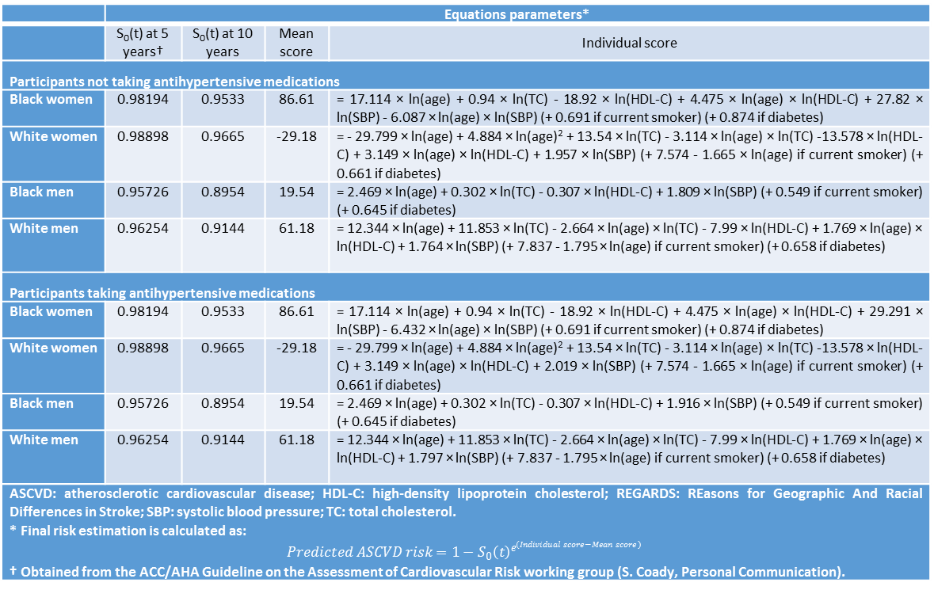
Let’s take a look at the ASCVD risk scores!
 | Equations parameters*
 | S₀(t) at 5 years† | S₀(t) at 10 years | Mean score | Individual score
Participants not taking antihypertensive medications
Black women | 0.98194 | 0.9533 | 86.61 | = 17.114 × ln(age) + 0.94 × ln(TC) - 18.92 × ln(HDL-C) + 4.475 × ln(age) × ln(HDL-C) + 27.82 × ln(SBP) - 6.087 × ln(age) × ln(SBP) (+ 0.691 if current smoker) (+ 0.874 if diabetes)
White women | 0.98898 | 0.9665 | -29.18 | = - 29.799 × ln(age) + 4.884 × ln(age)² + 13.54 × ln(TC) - 3.114 × ln(age) × ln(TC) -13.578 × ln(HDL-C) + 3.149 × ln(age) × ln(HDL-C) + 1.957 × ln(SBP) (+ 7.574 - 1.665 × ln(age) if current smoker) (+ 0.661 if diabetes)
Black men | 0.95726 | 0.8954 | 19.54 | = 2.469 × ln(age) + 0.302 × ln(TC) - 0.307 × ln(HDL-C) + 1.809 × ln(SBP) (+ 0.549 if current smoker) (+ 0.645 if diabetes)
White men | 0.96254 | 0.9144 | 61.18 | = 12.344 × ln(age) + 11.853 × ln(TC) - 2.664 × ln(age) × ln(TC) - 7.99 × ln(HDL-C) + 1.769 × ln(age) × ln(HDL-C) + 1.764 × ln(SBP) (+ 7.837 - 1.795 × ln(age) if current smoker) (+ 0.658 if diabetes)
Participants taking antihypertensive medications
Black women | 0.98194 | 0.9533 | 86.61 | = 17.114 × ln(age) + 0.94 × ln(TC) - 18.92 × ln(HDL-C) + 4.475 × ln(age) × ln(HDL-C) + 29.291 × ln(SBP) - 6.432 × ln(age) × ln(SBP) (+ 0.691 if current smoker) (+ 0.874 if diabetes)
White women | 0.98898 | 0.9665 | -29.18 | = - 29.799 × ln(age) + 4.884 × ln(age)² + 13.54 × ln(TC) - 3.114 × ln(age) × ln(TC) -13.578 × ln(HDL-C) + 3.149 × ln(age) × ln(HDL-C) + 2.019 × ln(SBP) (+ 7.574 - 1.665 × ln(age) if current smoker) (+ 0.661 if diabetes)
Black men | 0.95726 | 0.8954 | 19.54 | = 2.469 × ln(age) + 0.302 × ln(TC) - 0.307 × ln(HDL-C) + 1.916 × ln(SBP) (+ 0.549 if current smoker) (+ 0.645 if diabetes)
White men | 0.96254 | 0.9144 | 61.18 | = 12.344 × ln(age) + 11.853 × ln(TC) - 2.664 × ln(age) × ln(TC) - 7.99 × ln(HDL-C) + 1.769 × ln(age) × ln(HDL-C) + 1.797 × ln(SBP) (+ 7.837 - 1.795 × ln(age) if current smoker) (+ 0.658 if diabetes)
ASCVD: atherosclerotic cardiovascular disease; HDL-C: high-density lipoprotein cholesterol; REGARDS: REasons for Geographic And Racial Differences in Stroke; SBP: systolic blood pressure; TC: total cholesterol. * Final risk estimation is calculated as: $$Predicted ASCVD risk=1−S_{0}{\left(t\right)}^{e^{(Individual score−Mean score)}}$$ † Obtained from the ACC/AHA Guideline on the Assessment of Cardiovascular Risk working group (S. Coady, Personal Communication).

Slide 6
Common data elements worth knowing
Age
Diabetes
Hypertension
SBP
Tchol
LDL
Smoking
Treatment for HTN
Newer
CAC – Mesa study¹
SBP
Tchol
LDL
Smoking
Treatment for HTN
¹http://www.sciencedirect.com/science/article/pii/S0735109715049761

Slide 7
Try it yourself – what do you expect? What factors increase risk?
Case examples | Framingham¹ | ASCVD² | Mesa³
Smythe 68 year old white male with Chol of 250, HDL of 40, LDL 120, SBP 123, no other illnesses - what if black male? - what if white female? - what if smoker?
Chavez 45 year old Hispanic female with Chol of 200, HDL 40, LDL 101 SBP 150 Diabetes and smoker. Not treated for HTN. - what if CAC is 350 Agatston units? - what if 39?
Lee 55 year old Asian male with Chol of 130 LDL 50 HDL 50 SBP 170 treated for HTN (not well) no diabetes and never smoked
1 https://www.mdcalc.com/framingham-coronary-heart-disease-risk-score
2 http://professional.heart.org/professional/GuidelinesStatements/PreventionGuidelines/UCM_457698_Prevention-Guidelines.jsp
3 https://www.mesa-nhlbi.org/MESACHDRisk/MesaRiskScore/RiskScore.aspx

Slide 8
Initial Answers
Case examples | Framingham¹ | ASCVD² | Mesa³
Smythe 68 year old white male with Chol of 250, HDL of 40, LDL 120, SBP 123, no other illnesses - what if black male? - what if white female? - what if smoker? | 16.8% 16.8%? 5.2% 18.3% | 18.7% 11.7% 8.5% 23.6% | 10.1% 8.3% 4.9% 15.7%
Chavez 45 year old Hispanic female with Chol of 200, HDL 40, LDL 101 SBP 150 Diabetes and smoker. Not treated for HTN. - what if CAC is 350 Agatston units? - what if 39? | 4.7% 4.7%? 3.6% | 11.6% 11.6%? N/A | 3.7% 14.2% N/A
Lee 55 year old Asian male with Chol of 130 LDL 50 HDL 50 SBP 170 treated for HTN (not well) no diabetes and never smoked | 6.1% | 6.6% | 3.4%
1 https://www.mdcalc.com/framingham-coronary-heart-disease-risk-score
2 http://professional.heart.org/professional/GuidelinesStatements/PreventionGuidelines/UCM_457698_Prevention-Guidelines.jsp (select launch web version)
3 https://www.mesa-nhlbi.org/MESACHDRisk/MesaRiskScore/RiskScore.aspx

Slide 9
How do you minimize risk?
Case examples | Framingham¹ | ASCVD² | Mesa³
Smythe 68 year old white male with Chol of 250, HDL of 40, LDL 120, SBP 123, no other illnesses | 16.8% | 18.7% | 10.1%
Chavez 45 year old Hispanic female with Chol of 200, HDL 40, LDL 101 SBP 150 Diabetes and smoker. Not treated for HTN. | 4.7% | 11.6% | 3.7%
Lee 55 year old Asian male with Chol of 130 LDL 50 HDL 50 SBP 170 treated for HTN (not well) no diabetes and never smoked | 6.1% | 6.6% | 3.4%
1 https://www.mdcalc.com/framingham-coronary-heart-disease-risk-score
2 http://professional.heart.org/professional/GuidelinesStatements/PreventionGuidelines/UCM_457698_Prevention-Guidelines.jsp
3 https://www.mesa-nhlbi.org/MESACHDRisk/MesaRiskScore/RiskScore.aspx

Slide 10
How do you minimize risk?
Case examples | Framingham¹ | ASCVD² | Mesa³
Smythe 68 year old white male with Chol of 250, HDL of 40, LDL 120, SBP 123, no other illnesses Start/continue aspirin + start/intensify statin + start/add BP-lowering drug now | 16.8% ??? | 18.7% 10.3% | 10.1% ?? 17.4%
Chavez 45 year old Hispanic female with Chol of 200, HDL 40, LDL 101 SBP 150 Diabetes and smoker. Not treated for HTN. Add Aspirin, Statin, BP lowering drug, stop smoking | 4.7% ??? | 11.6% 4.2% | 3.7%
Lee 55 year old Asian male with Chol of 130 LDL 50 HDL 50 SBP 170 treated for HTN (not well) no diabetes and never smoked | 6.1% ??? | 6.6% | 3.4% 4.3%??
1 https://www.mdcalc.com/framingham-coronary-heart-disease-risk-score
2 http://professional.heart.org/professional/GuidelinesStatements/PreventionGuidelines/UCM_457698_Prevention-Guidelines.jsp
3 https://www.mesa-nhlbi.org/MESACHDRisk/MesaRiskScore/RiskScore.aspx

Slide 11
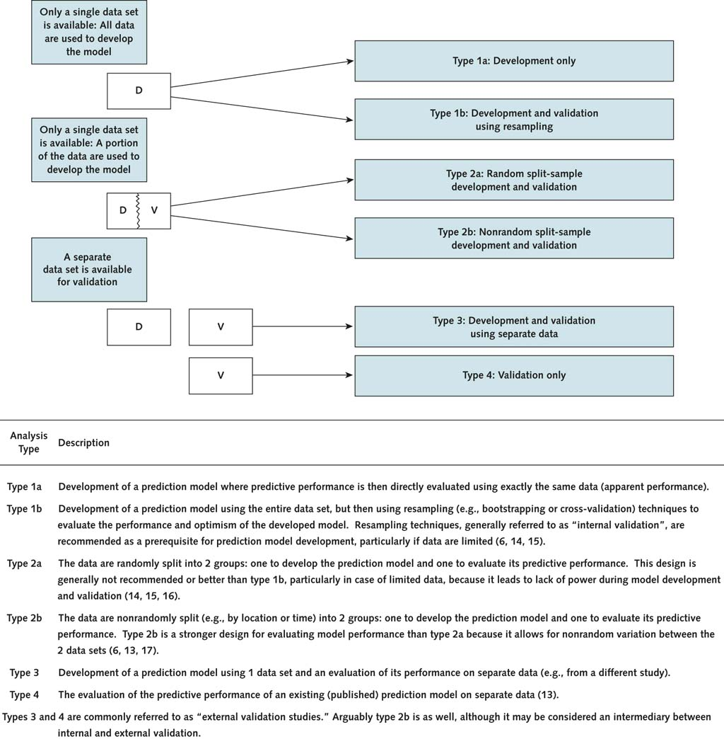

Slide 12
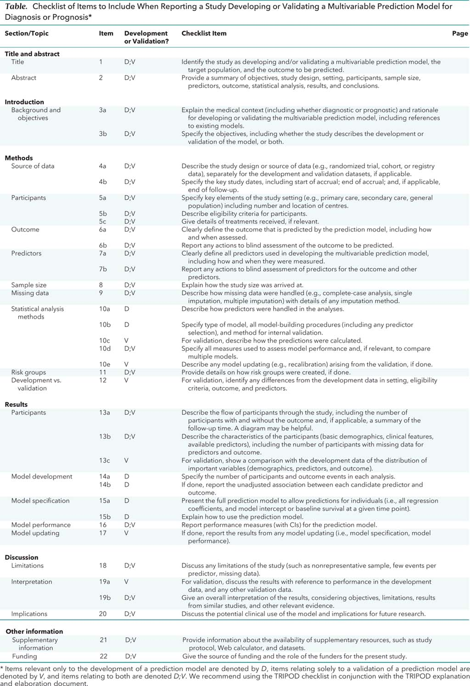
WHY
TRIPOD group (Collins et al), Annals, 2015.

Slide 13
HOW
TRIPOD group (Collins et al), Annals, 2015.

Slide 14
WHAT you found
TRIPOD group (Collins et al), Annals, 2015.

Slide 15
WHAT it means
TRIPOD group (Collins et al), Annals, 2015.

Slide 16
TRIPOD group (Collins et al), Annals, 2015.

