Slide 1
Clinical Data Wrangling
Ted Laderas, Nicole Weiskopf and Eilis Boudreau

Slide 2
Introduction: Ted Laderas
.pull-left[ - Assistant Professor - Division of Bioinformatics and Computational Biomedicine - Department of Medical Informatics and Clinical Epidemiology - Oregon Health & Science University - Research Interests - Education (active learning) - Interactive Visualization - Immunoinformatics - Drug Sensitivity/Resistance in Cancer ]
.pull-right[]

Slide 3
Overview
Why clinical data wrangling?
Why the workshop?
What is the workshop?
Components of the workshop
Extensions
Availability

Slide 4
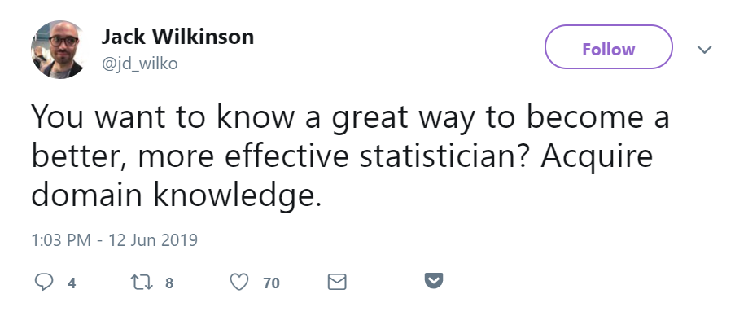
Motivation: Why?
https://twitter.com/jd_wilko/status/1138899593826131973

Slide 5
Research is multi-disciplinary
Need for Translational Research Workforce
Bridge gaps between computational biology and clinical realms

Slide 6
Wilkinson: Regression and Domain Knowledge
Emphasize successful informatics being collaboration

Slide 7
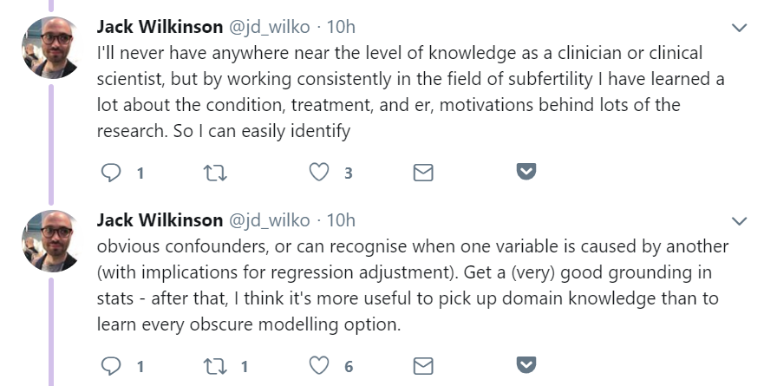

Slide 8
Clinical Data Wrangling
For: incoming graduate students
Designed for both clinical and bioinformatics students
Assumes no expertise with R/RStudio
Introduce students to data quality issues with clinical data

Slide 9
Learning Objectives
Understand the biology of sleep and sleep apnea and how the biology informs the covariates measured in the Sleep Heart Health Study
Understand the usefulness and challenges with working with clinical data
Learn Exploratory Data Analysis techniques and use them to inform/analyse model building
Evaluate a predictive model (logistic regression) using simple diagnostics.
Communicate your findings in a team setting.

Slide 10
Challenges: Where to get data?
Partnership with National Sleep Research Resource
http://sleepdata.org
Sleep Heart Health Study data
~5700 patients, 1200 covariates
Requires students to sign data use agreement

Slide 11
Sleep Covariates
X
Covariate
Description
1
any_cvd
Any Cardiovascular Disease (CVD) Since Baseline?
2
age_s1
Age at Sleep Heart Health Study Visit One (SHHS1)
3
gender
Gender
4
race
Race
5
bmi_s1
Body mass index (BMI) (Sleep Heart Health Study Visit One (SHHS1))
6
neck20
Neck Circumference (Sleep Heart Health Study Visit One (SHHS1))
7
systbp
Average Systolic blood pressure (BP) (Sleep Heart Health Study Visit One (SHHS1))
8
chol
Cholesterol
9
hdl
High-density lipoprotein (HDL) cholesterol
10
ahi_a0h3
Apnea-Hypopnea Index (AHI) >= 3% - number of [all apneas] and [hypopneas with >= 3% oxygen desaturation] per hour of sleep
11
ahi_a0h4
Apnea-Hypopnea Index (AHI) >= 4% - number of [all apneas] and [hypopneas with >= 4% oxygen desaturation] per hour of sleep
12
oahi
Obstructive Apnea-Hypopnea Index (OAHI) at >=4% oxygen desaturation
13
htnderv_s1
Hypertension (HTN) (Sleep Heart Health Study Visit One (SHHS1))
14
srhype
Self-reported hypertension (HTN) (Sleep Heart Health Study Visit One (SHHS1))
15
ace1
angiotensin-converting-enzyme inhibitor (ACE) inhibitors without diuretics (Sleep Heart Health Study Visit One (SHHS1))
16
beta1
Beta-blockers without diuretics (Sleep Heart Health Study Visit One (SHHS1))
17
smokstat_s1
Smoking Status at Sleep Heart Health Study Visit One (SHHS1)

Slide 12
Workshop is split over multiple days
.pull-left[ - Day 1 (8 Hrs): - Logistics - Intro to sleep data - Intro to data reuse and data quality - Data exploration of sleep data - Intro to logistic regression ] .pull-right[ - Day 2 (2 hrs): - Logistic regression Q&A - Assignment: Is Race appropriate? - Day 3 (2 hrs): - Is hypertension appropriate? - Final presentation prep - Day 4 (1.5 hrs): - Final Presentation by groups]

Slide 13
Social Learning
Code of Conduct
Introduce students to each other
Psychological Safety
Diverse/Heterogeneous teams
What Every Data Scientist Should Know about Education

Slide 14
Lecture: Background about Sleep
Eilis Boudreau: Sleep Neurologist
Role of sleep disorders in cardiovascular disease
How we measure sleep disorders

Slide 16
https://en.wikipedia.org/wiki/Sleep_apnea#/media/File:Obstruction_ventilation_apn%C3%A9e_sommeil.svg

Slide 17
Lecture: Data Reuse and Data Quality Issues
Nicole Weiskopf
Expose students early on to data quality issues
Hazards and bonuses of data reuse
Biases of Clinical Data

Slide 18
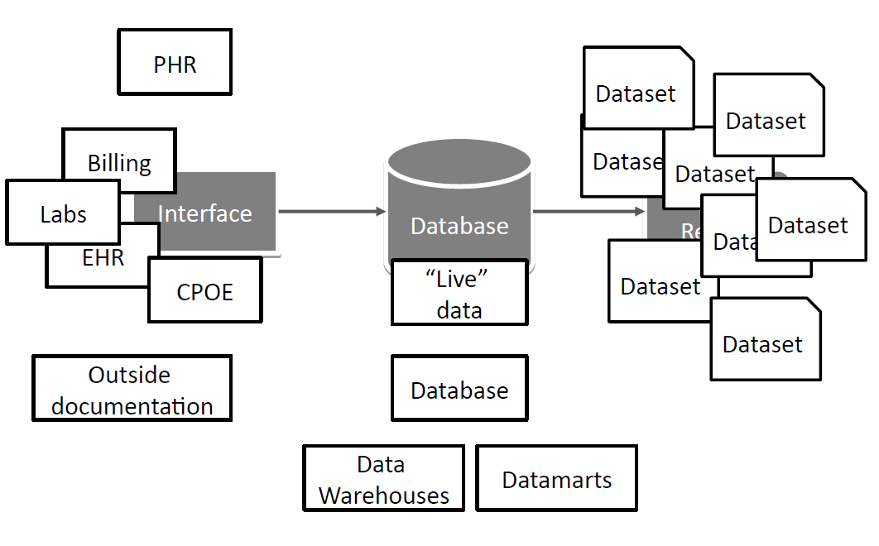

Slide 19
Making Decisions by Exploring Data
.pull-left[ - Shiny app (burro) that lets students explore dataset - Code-less, assumes no coding expertise - Can be deployed as a website]

Slide 20
burro: Exploring Relationships in Data

Slide 21
Building Predictive Models by Making Decisions
Rstudio notebook that guide students through modeling process
Choice of covariates
Simple data cleaning/impact on dataset

Slide 22
Modeling the Data
Assessing Impact of logistic regression
Test/Train Datasets
Diagnostic Testing and their uses
Encourage them to think about how test would be used

Slide 23
Iterating your model: what about Race/Hypertension?
Understanding the contributions of race
How is it defined?
How does our study population compare to the US?
Understanding including hypertension as a variable
Medication Lists
Blood pressure measurements

Slide 24
Final Analysis: Making and Documenting Critical Decisions
Final presentation is an R Notebook
What variables did you use at each step?
Why did you include them?
What were your values?
How did that affect your results?

Slide 25
Challenges: There is no right answer
Students wanted to choose an “optimal” threshold
Challenges in understanding importance of how a clinical test would be used

Slide 26
Outcomes
Sets the tone for our program
Good opportunity for clinical/bioinformatics students to meet
Currently assessing impact on students

Slide 27
Extensions: Data Science for MD/PhDs
Reframe as clinical case

Slide 28
Extensions: Data Scavenger Hunts
Exploring the NHANES dataset

Slide 29
Acknowledgements:
T15 NLM Training Supplement Grant: 5T15LM007088
Susan Redline/Dan Mobley at NSRR
Incoming class of 2018 informatics students

Slide 30
Are you interested?
Keep in touch! We want others to utilize the workshop!
laderast@ohsu.edu | @tladeras | http://laderast.github.io
Burro: http://laderast.github.io/burro
Workshop: http://laderast.github.io/clinical_data_wrangling/

