Slide 2
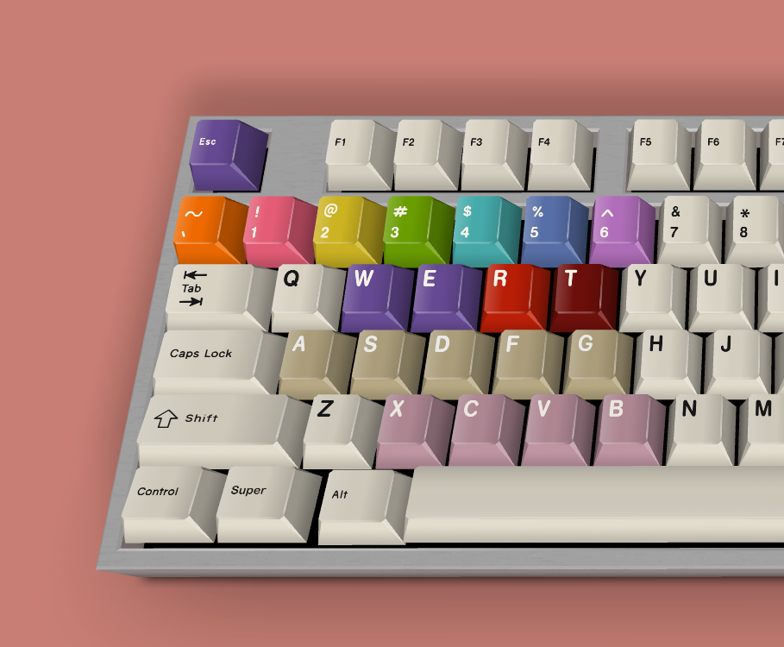
Escape Drawing Mode
Select Color
Clear
Drawing Mode / Select Pen
Erase
Shape
Stamp
pictured by https://keyboardsimulator.xyz/

