Slide 2
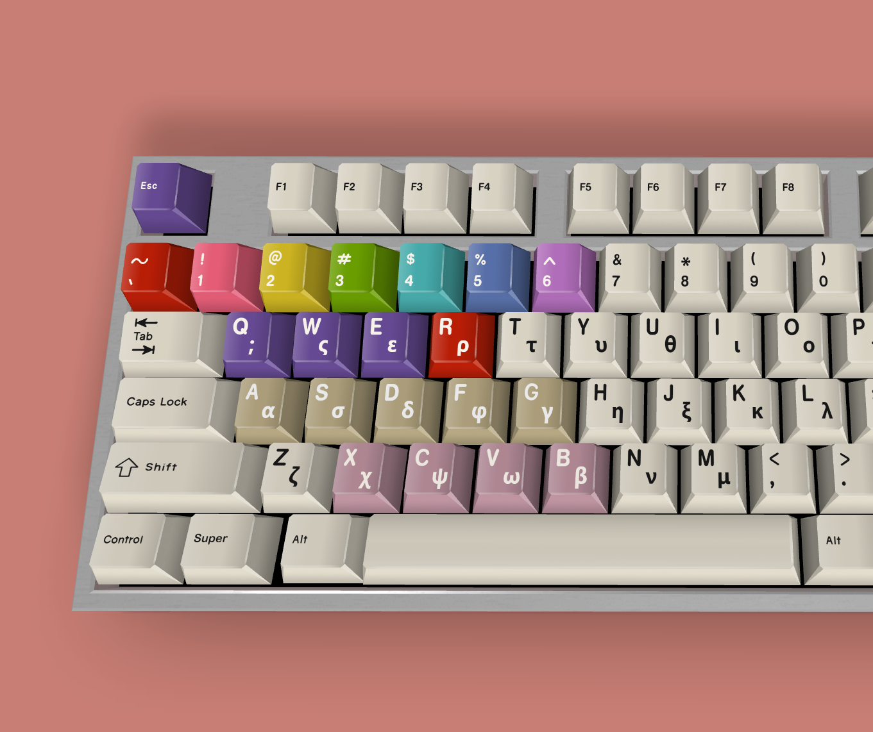
Escape Drawing Mode
Select Color
Clear
Erase
Select Pen
Shape
Stamp

