Slide 1
Project on
High Court Pending Cases
SR NO | NAME | ENROLLMENT NO
1. | Sumit Kumar Mahato | 20252048
2. | Meet Ladola | 20252025
3. | Rahul Mandal | 20252035
4. | Vidit Konkani | 20252052
5. | Dhruv C Patel | 20252009

Slide 2
Project Objective
The primary goal of this project is to systematically assess and quantify judicial backlog and disposal efficiency across Indian High Courts in 2025.
It aims to understand how backlogs are building up and how effectively cases are being cleared. The focus is on identifying benches under pressure where a large number of old cases, combined with high new case inflow, make it difficult to keep pace.
Ultimately, the project seeks to measure backlog pressure and disposal performance, identify high-risk benches where old pendency and net inflow jointly threaten clearance, and prioritize interventions using a composite risk score.

Slide 3
Analytical Workflow (Methodology)
1) Data Import: By connecting, HighCourtDB1 in Python Jupyter Notebook directly on SQL.
2) Data Preprocessing: By checking the structure of the dataset.
3) High court Net Flow (Monthly): Check if backlog is growing or shrinking per bench.
4) Disposal Ratio (Monthly & YTD): Compare disposal pace vs inflow.
5) Backlog Age Distribution: Share of cases >3 years and >10 years.
6) Months-to-Clear: Pending ÷ last month’s disposal rate.
7) Case-Type Composition: Identify dominance (writ, appeal, petition).

Slide 4
Analytical Workflow (Methodology)
8) Backlog Pressure Ratio: Pending vs last month disposed.
9) Risk Flags: Low clearance + high pressure.
10) Composite Risk Score: Weighted old-age pendency + low clearance.
10) Level Aggregation: Composite Risk Score across all benches
11) Findings
12) Key Learnings

Slide 5
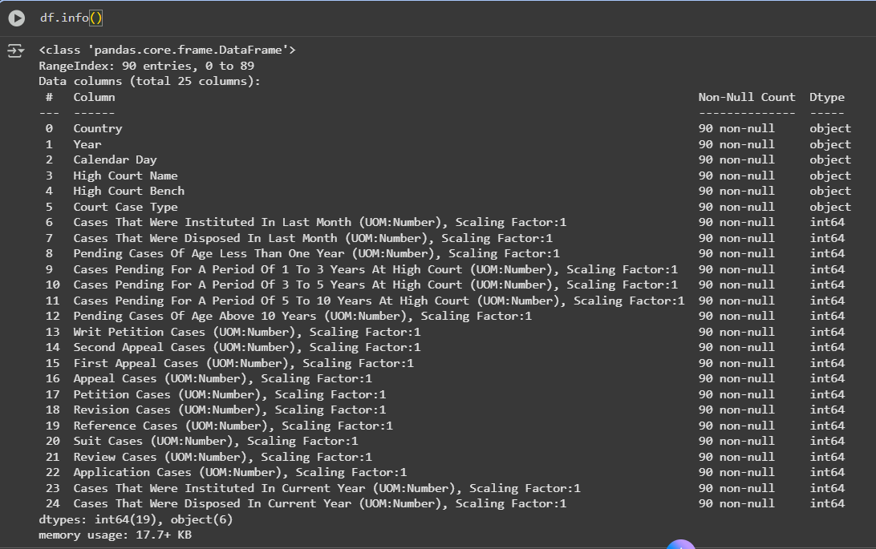
Dataset Overview

Slide 6
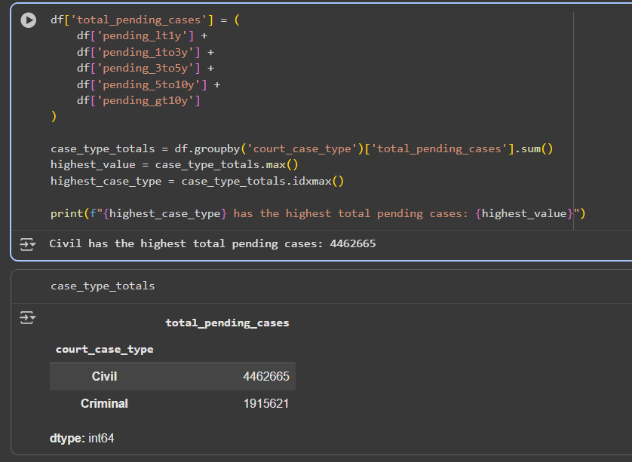
Court Case Type
Our dataset consist of two types of cases:
Civil: It consist of cases such as Property disputes, contracts, family disputes, etc.
Criminal: Crime related cases like theft, murder, fraud etc.

Slide 7

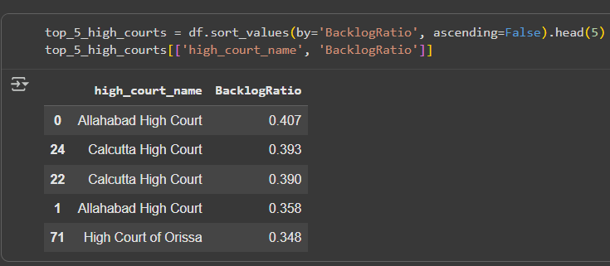
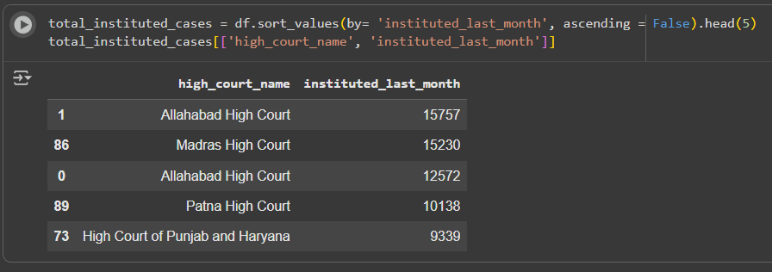
Backlog Ratio
It shows the courts which are having highest number of pending cases > 10 years.
The top 5 High Courts are shows in the table.
Also the number of instituted cases last month is shown.

Slide 8
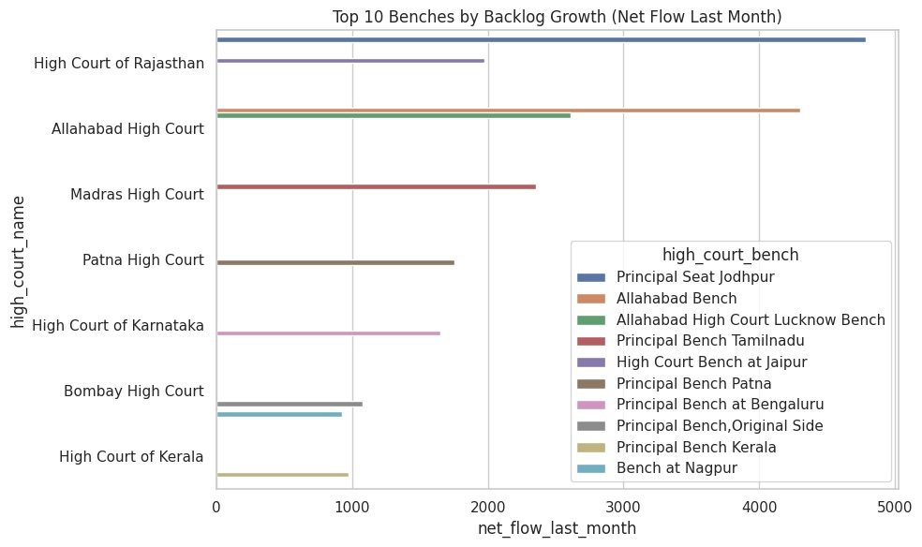
High Court Net Flow (Monthly)
Top benches by net inflow = Cases Instituted Last Month − Cases Disposed Last Month
What It Shows:
Benches with positive net flow are actively accumulating backlog; negative net flow indicates reduction.

Slide 9
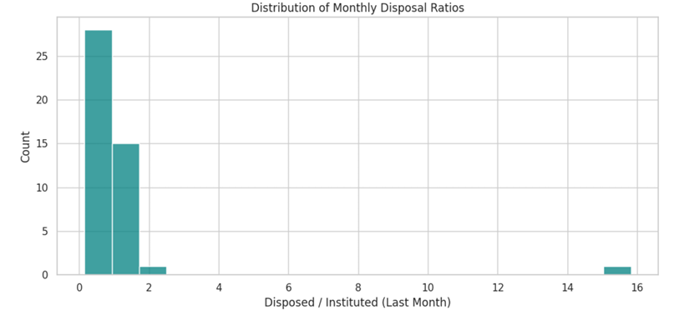
Monthly Disposal Ratio
Distribution of Last Month’s disposal ratio = Disposed_Last_Month ÷ Instituted_Last_Month
What It Shows:
Variation in short-term efficiency; several benches dispose less than 50% of new cases, whereas a few handle well over 100%.

Slide 10
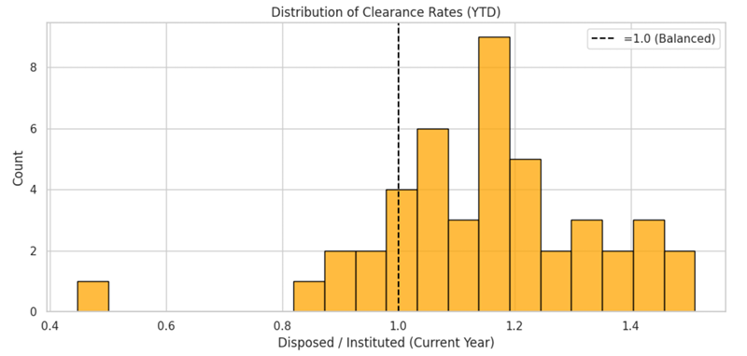
Clearance Rate (YTD)
Distribution of year-to-date clearance rates, calculated as Disposed_Current_Year ÷ Instituted_Current_Year, with a dashed reference line at 1.0
What It Shows:
Clearance rates below 1.0 indicate benches cumulatively adding to backlog this year.
Rates above 1.0 signify benches disposing more cases than they receive, reducing their backlog.

Slide 11
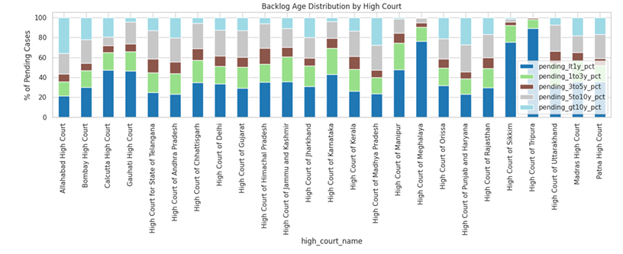
Backlog age structure (Stacked bars)
Stacked bars showing percent share of pending case age bands (<1 year, 1–3 years, 3–5 years, 5–10 years, >10 years) for each High Court.
What It Shows:
Structural aging of backlog—larger courts often have over 30% of pending cases older than 10 years, indicating chronic delays.

Slide 12
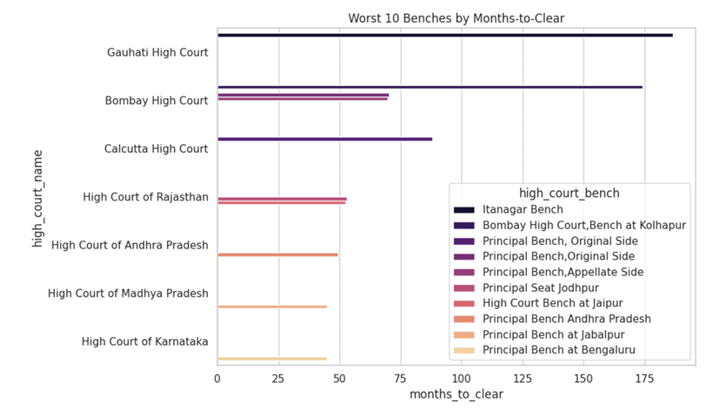
Months-to-clear
Calculated as total_pending ÷ disposed_last_month for the benches with the highest values.
What It Shows:
At current disposal rates, these benches require many months—or even years—to clear their existing backlog, highlighting critical operational time horizons.

Slide 13
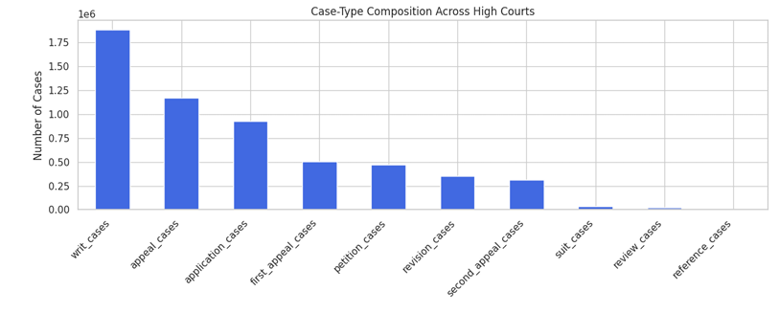
Case-type composition
Aggregate counts of case types (writs, appeals, applications, petitions, revisions, etc.) across all High Courts, highlighting benches that are writ-heavy versus appeal-heavy.
What It Shows:
Writ cases dominate overall, but the dominant case type varies by bench—some benches focus primarily on writ petitions while others handle higher volumes of appeals.

Slide 14
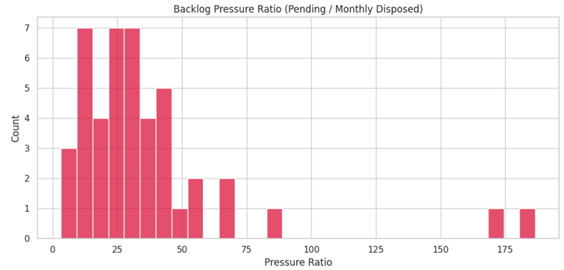
Backlog Pressure Ratio
Distribution of backlog pressure ratios, calculated as Total_Pending ÷ Disposed_Last_Month for each bench.
What It Shows:
The magnitude of stock relative to monthly throughput—benches with very high ratios face severe overload and may require urgent intervention.

Slide 15
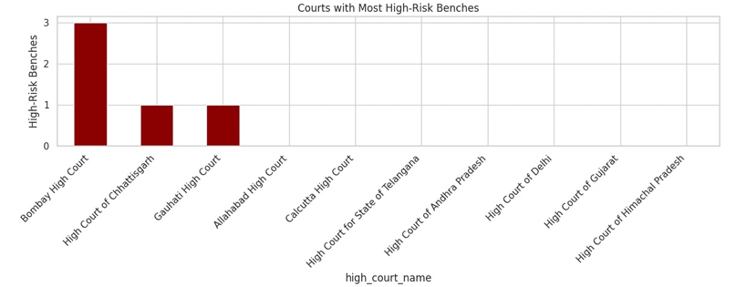
Risk Flags (Binary)
Count of high-risk benches per High Court using defined thresholds (e.g., clearance_rate_ytd < 0.9 or pressure_ratio > 100).
What It Shows:
Courts with clusters of flagged benches indicate systemic issues requiring court-wide reforms, while isolated flags suggest bench-specific problems.

Slide 16
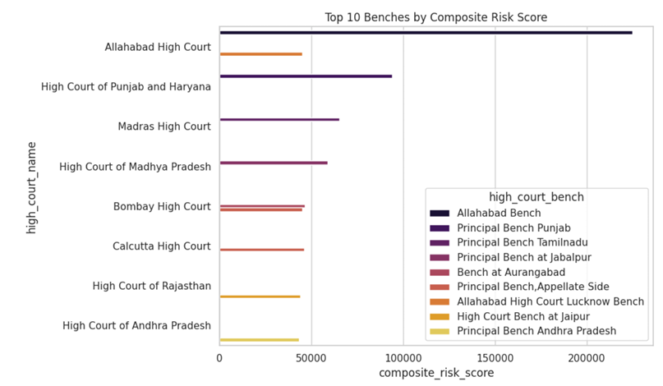
Composite Backlog Risk Score
Top 10 benches ranked by a weighted composite score, combining case aging (heavier weight for >10 years, then 5–10, 3–5) with penalties for low clearance rates.
What It Shows:
A prioritized list where both aging backlog and disposal inefficiency jointly elevate overall risk, identifying the most critical benches requiring urgent intervention.

Slide 17
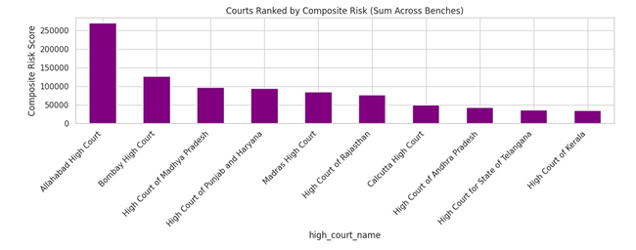
Court-Level Aggregation
High Courts ranked by summed composite risk scores across all their benches, incorporating total pending cases, risk flags, and net flow.
What It Shows:
Systemic contributors (e.g., Allahabad High Court) where multiple benches and large case stocks combine to create exceptionally high aggregate risk, requiring court-wide reforms.

Slide 18
Findings
1) Net Flow: Allahabad, Punjab & Haryana, Rajasthan benches show large positive net inflows → backlog is actively growing.
2) Clearance Rate: Smaller courts (Sikkim, Meghalaya) ≈1.0; large courts <0.9 → systemic imbalance.
3) Disposal Ratio Spread : Wide variation; some benches dispose <50% of inflow.
4) Backlog Age : >30–40% of pending cases are >10 years in large courts → structural bottleneck.
5) Months to Clear : Some benches exceed 100 months → impossible without extraordinary measures.

Slide 19
Findings
6) Case Type Composition: Allahabad writ heavy (>50%); Rajasthan appeal heavy → specialization needed.
7) Pressure Ratio : Ratios >100 in large courts → disposal pace dwarfed by stock.
8) Risk Flags: Allahabad, Punjab & Haryana, Rajasthan have the most flagged benches.
9) Composite Risk: Allahabad benches dominate top risk rankings due to both volume and aging.
10) Court Aggregation: Allahabad High Court emerges as the single largest systemic risk contributor.

Slide 20
Key Learnings
Counting backlog isn’t enough; pace, age, and composition together define real risk. The composite score captures this multidimensional reality and is more actionable than any single metric.
Net flow is a necessary near-term signal; even courts with decent YTD clearance can be slipping month-to-month and silently growing future backlog.
Aging skews harm. Addressing >10-year cases first produces disproportionate gains in public trust and throughput—backlog reduction should be age-aware, not purely volume-driven.

Slide 21
Conclusion
Months-to-clear is a powerful stakeholder communication tool; translating stock and flow into time makes the urgency tangible for administrative decisions.
Case-type specialization is not cosmetic—it’s throughput. Aligning bench focus to dominant case-types (writs, appeals) materially improves clearance.
Systemic hotspots exist where multiple benches are flagged. Interventions must operate at the High Court level: additional rosters, cross-bench redistribution, tech-enabled listing discipline, and ADR expansion.
Data hygiene matters. Consistent column naming and safe division guards prevented silent errors and made insights reproducible—critical for a formal project.

Slide 22
THANK YOU

