Slide 1
Student Reward system
Group 2 – SWA

Slide 2
AGENDA
Introduction
Services of the system
Arch. diagram
Class diagram
Summary

Slide 3
Introducing web-based : "Student reward system" empowers school students to earn rewards by using their scores. Admins add schools and teachers, while teachers set up students. Students can customize avatars using avatar elements and purchase various rewards. Implemented with microservices, MongoDB, Kafka for messaging, and an API gateway for seamless interactions.

Slide 4
Api Gateway
A user will go through the api gateway to access all the services. Here keep in mind we have three actors in this system who are registered with a username and password by the admin. The admin is hardcoded user on our DB. Each user will sign in using their username and password

Slide 5
Eureka
All services self register their address to this eureka service which is connected to the api gateway. And the user will be directed to a specific service based on his/her request.

Slide 6
Feign client
Avatar builder service communicates with elementService, AvatarService, studentService through feign client for a student to be able to create his avatar based on his score.

Slide 7
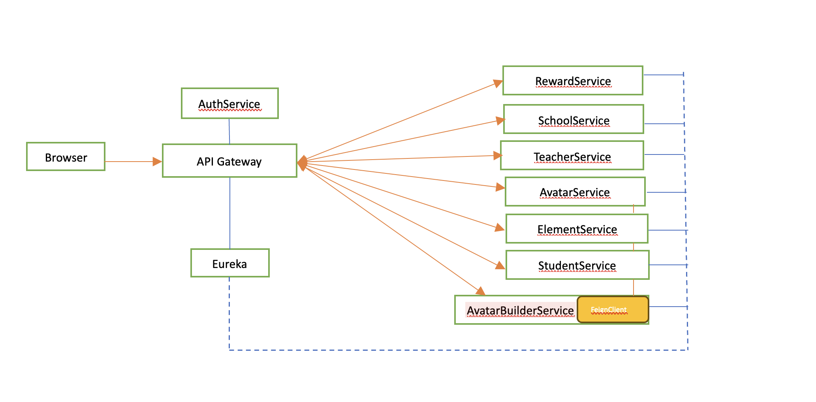
System Design

Slide 8
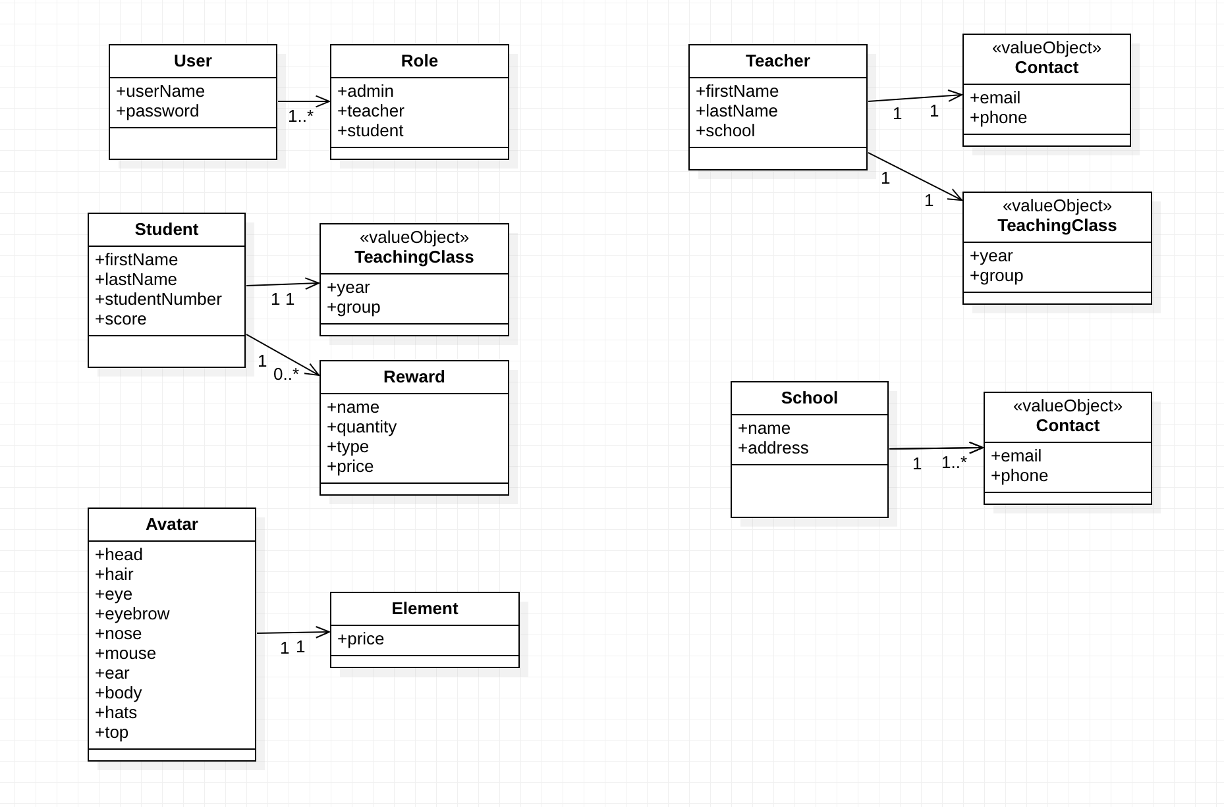
Class Dig.

Slide 9
Thank you!!

