Slide 1
Chapter 14
The User View of Operating Systems
The Architecture of Computer Hardware and Systems Software:
An Information Technology Approach
3rd Edition, Irv Englander
John Wiley and Sons ©2003

Slide 2
User Interface
Help the user use the computer system productively
Provide consistent user interface services to application programs to lower learning curves and increase productivity
Choice of user interface depends on the kind of user
  Writing programs vs. running applications

Slide 3
User Functions
Program execution
File commands
Mount and unmount devices
Printer spooling
Security
Inter-user communication
System Status
Program Services
  DCOM, CORBA, Remote Procedure Call (RPC)

Slide 4
Interface Design
CLI - Command Line Interface
Batch System Commands
Menu-Driven Interfaces
GUI - Graphical User Interface

Slide 5
Command Line Interface
command <operand1> <operand2> …
<switch1> <switch2> …
Operands
  keyword (switches) and/or positional
Advantages
  More flexible and powerful
  Faster for experienced users
  Can combine commands

Slide 6
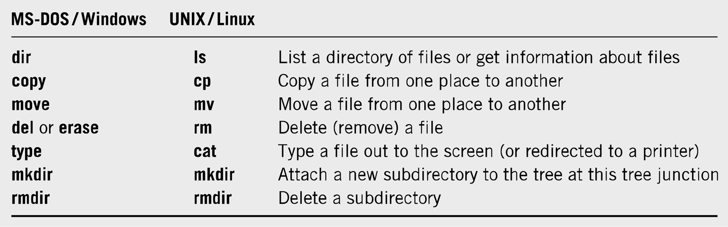
Command Line Interfaces

Slide 7
Command Languages
Provide a mechanism to combine sequences of commands together. These pseudo-programs are known as scripts or batch files.
Startup files – OS configuration, user preferences
Features of Command Languages
  Can accept input from the user and can output messages to I/O devices
  Provide ability to create and manipulate variables
  Include the ability to branch and loop
  Ability to specify arguments to the program command and to transfer those arguments to variables within the program
  Provide error detection and recovery

Slide 8
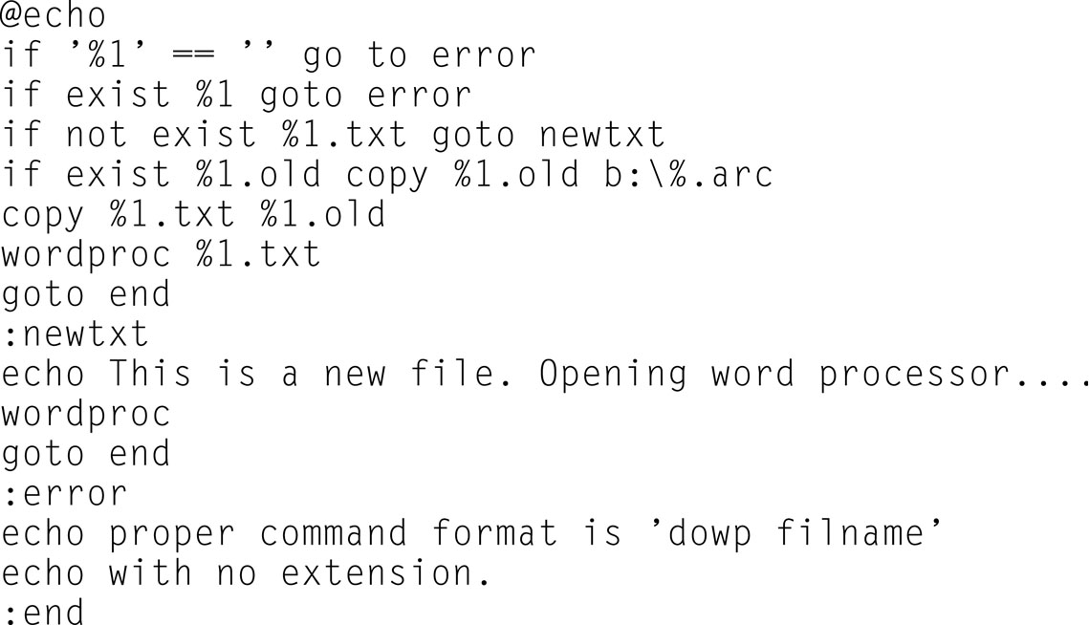
DOS Batch File

Slide 9
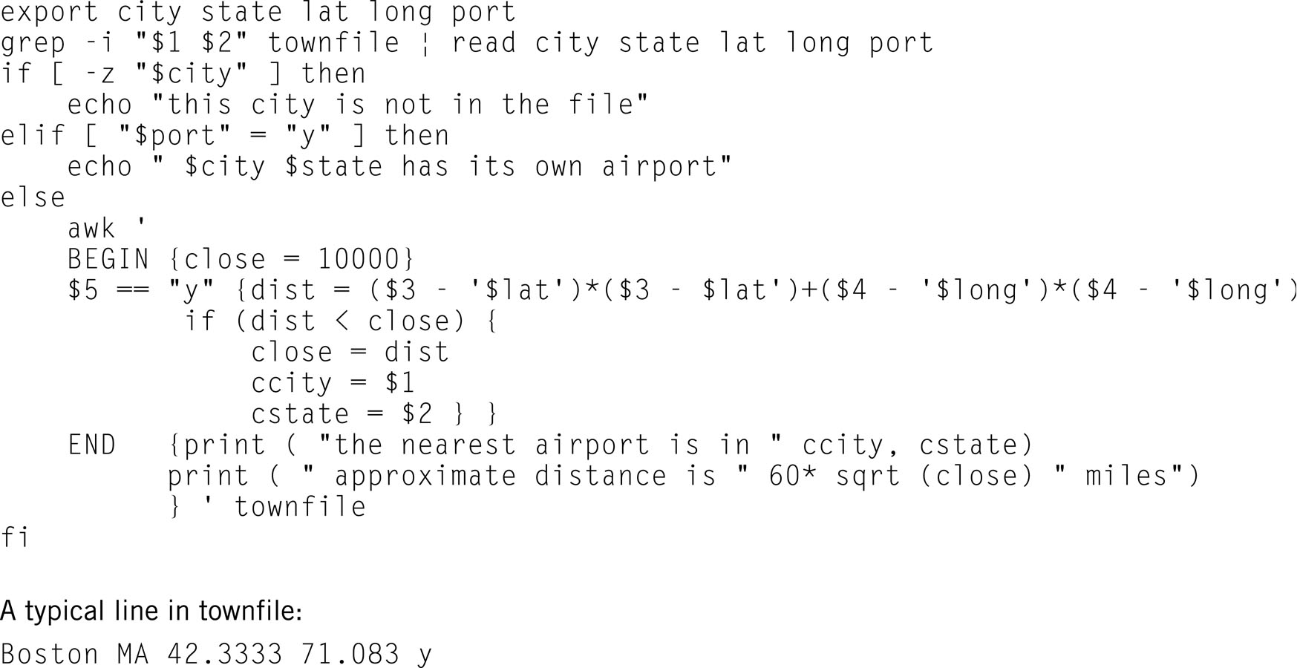
UNIX Shell Script

Slide 10
Menu-Driven Interface
No need to memorize commands
All available commands are listed
Menus can be nested
Low data requirements
Still used in many ATM and Point-of-Sale systems

Slide 11
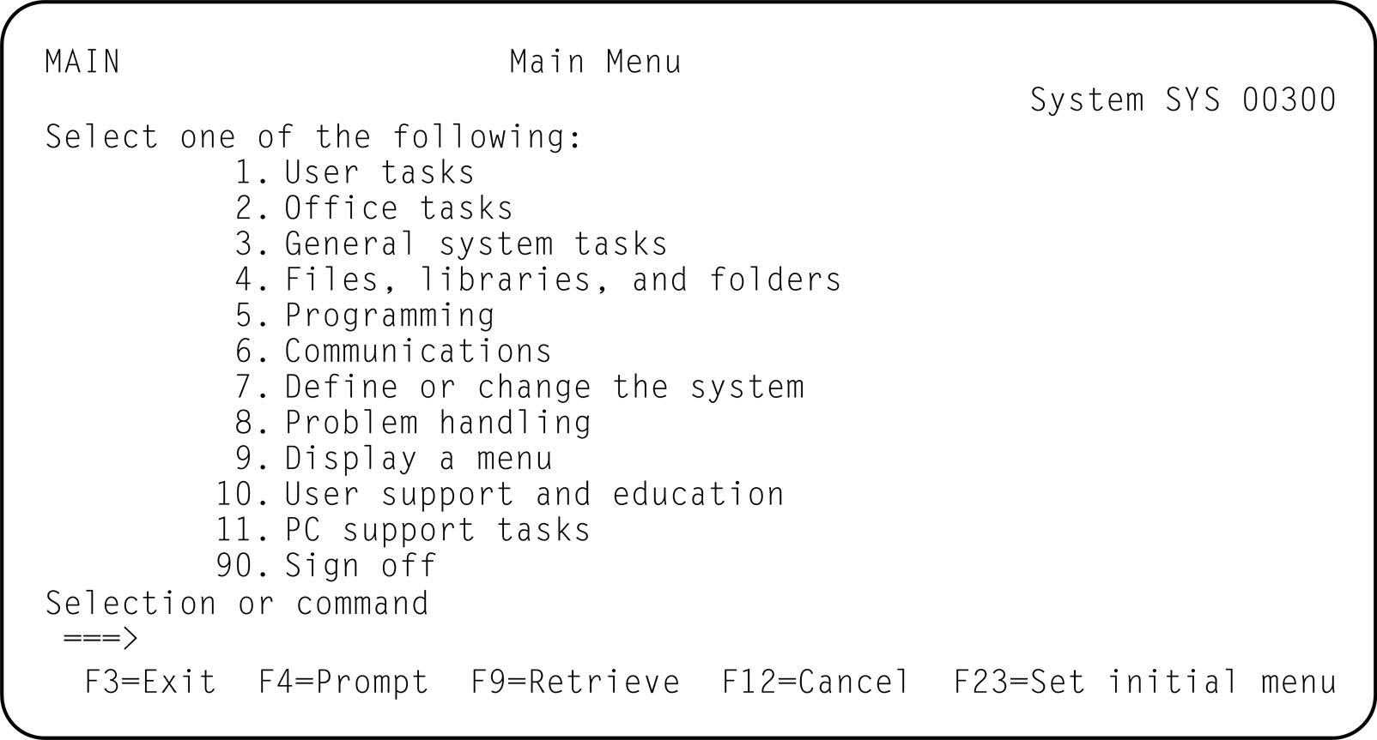
Menu Driven Interface

Slide 12
Windows Interfaces
Also known as Graphical User Interfaces (GUIs)
Mouse-driven and icon-based
Windows
  Are allocated to the use of a particular program or process
  Contain a title bar, menu bar, and widgets

Slide 13
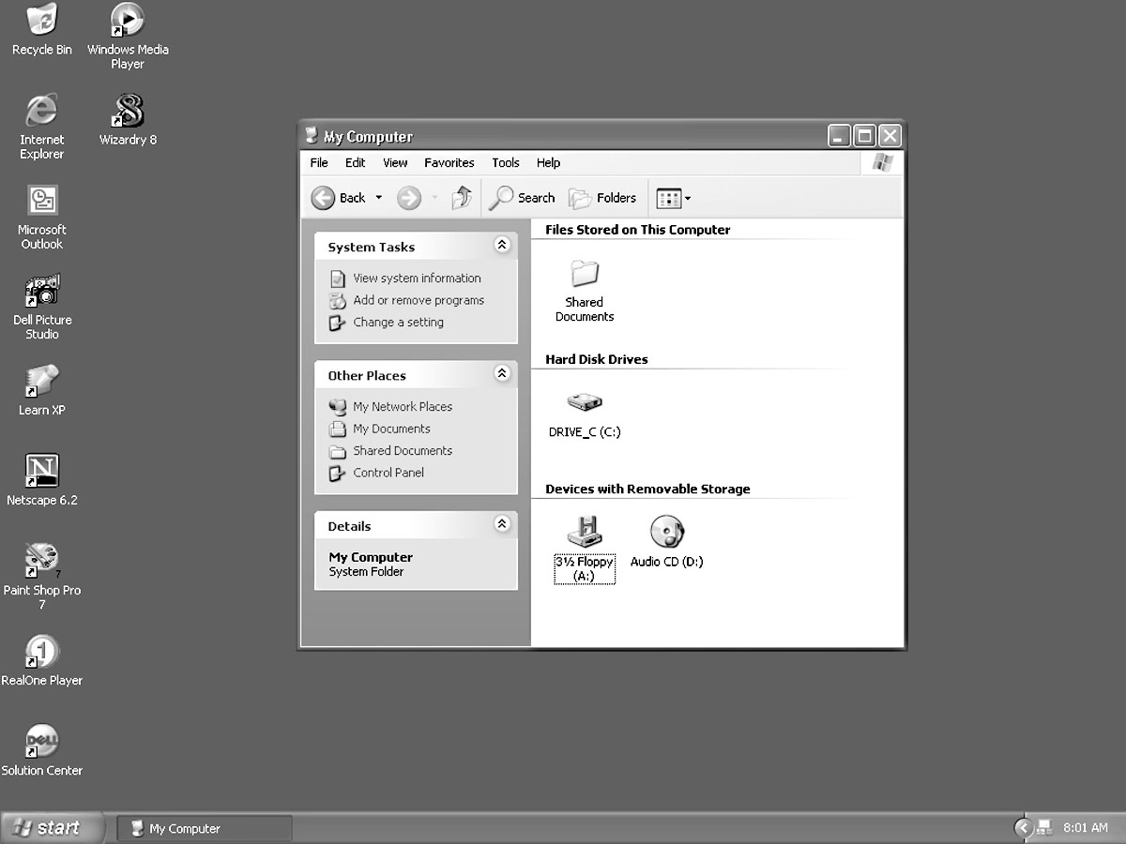
GUI Interface – Windows XP

Slide 14
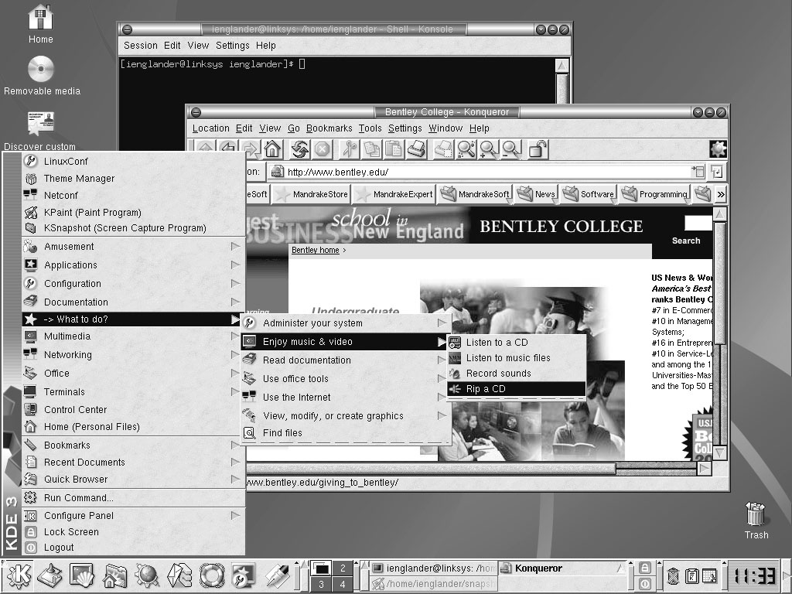
GUI Interface – Linux KDE

Slide 15
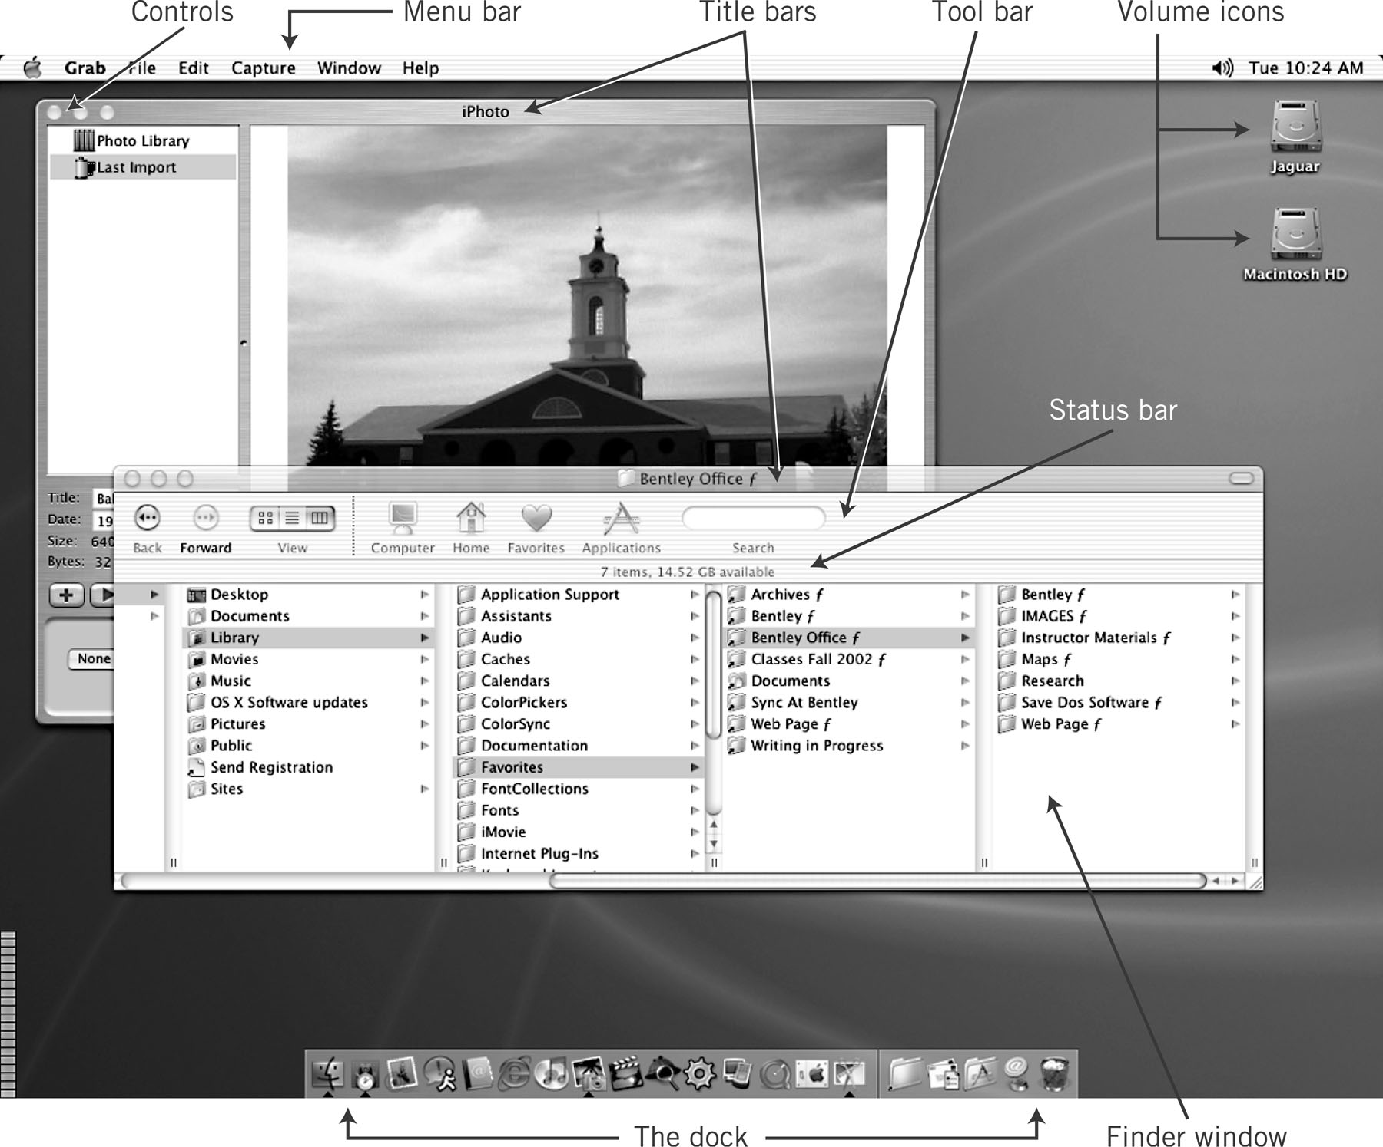
GUI Interface - MacIntosh

Slide 16
GUI vs. CLI
GUI
Advantages
  Easy to learn and use
  Little training
  Amenable to multi-tasking
Disadvantages
  Harder to implement
  More HW/SW requirements
  Requires lots of memory
  SW is complex and difficult to write
CLI
Advantages
  More flexible and powerful
  Faster for experienced users
  Can combine commands
Disadvantages
  More difficult to learn and use

Slide 17
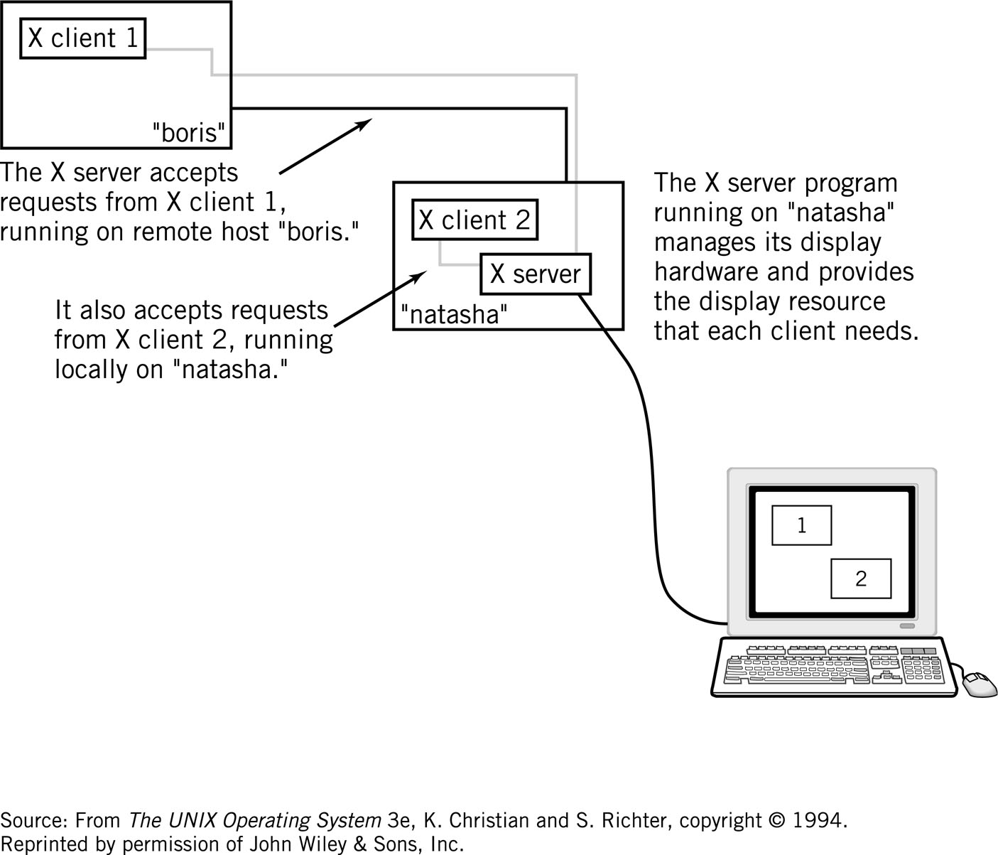
X-Windows

Slide 18
Duocentric Interface
Focus on the document rather than the application being executed
Expand role of OS by moving capabilities from the application to system services
  Example: click on document to run program
  Effort to assure that every application program responds in similar ways to user actions.

