Slide 1
SOFTWARE DESIGN BASICS
5
Software Design
Is a process to transform user requirements into some suitable form, which helps the programmer in software coding and implementation.
Software Design Levels
Architectural Design : defines the software as a system with many components interacting with each other
High-level Design : breaks the “single entity-multiple component” concept of architectural design into less abstracted view of sub-systems and modules and depicts their interaction with each other
Detailed Design : deals with the implementation part of what is seen as a system and its sub-systems. It is more detailed towards modules and their implementations.

Slide 2
Modularization
Is a technique to divide a software system into multiple discrete and independent modules, which are expected to be capable of carrying out task(s) independently.
Advantages of modularization
Concurrent execution can be made possible
Easy to maintain
Components with high cohesion can be re-used again
Program can be divided based of functional aspects
Concurrency: is implemented by splitting the software into multiple independent units of execution, like modules and executing them in parallel.
Measuring The Quality of Modularization
Cohesion
Coupling

Slide 3
Cohesion : is a measure that defines the degree of intra-dependability within elements of a module. The greater the cohesion, the better the program design.
Types Of Cohesion
Co-incidental cohesion
Logical cohesion
Emporal cohesion
Procedural cohesion
Communicational cohesion
Sequential cohesion
Functional cohesion
Functional cohesion

Slide 4
Coupling is a measure that defines the level of inter-dependability among modules of a program. The lower the coupling, the better the program.
Types of Coupling
Content coupling
Common coupling
Control coupling
Stamp coupling
Data coupling
Design Verification
The act of ensuring the output of a software based on documentation, pseudo codes, detailed logic diagrams and process diagrams are in alignment with the required software.

Slide 5
SOFTWARE ANALYSIS AND DESIGN TOOLS
6
Software analysis and design includes all activities, which help the transformation of requirement specification into implementation. It serves as an intermediate step which helps human-readable requirements to be transformed into actual code.
Design And Analysis Tools
Data flow diagram
Structural charts
HIPO diagram
Structured English
Pseudo-Code
Decision Tables
Entity-Relationship Model
Data dictionary.

Slide 6
Data Flow Diagram (DFD): is a graphical representation of flow of data in an information system. It is capable of depicting the incoming and outgoing data flow. DFD can either be logical or physical. DFD can represent source, destination, storage and flow of data using the following set of component;
Entities are sources and destinations of information data.
Process activities and actions taken on the data storage. It can also be represented by round edged rectangle.
Data Storage can be represented as a rectangle with absence of both smaller sides or an open sided rectangle
Levels of DFD
The highest abstraction level which depicts the entire information system as one diagram concealing all the underlying details.
Process
Data flow
Entity
Data store

Slide 7
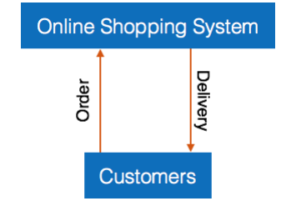
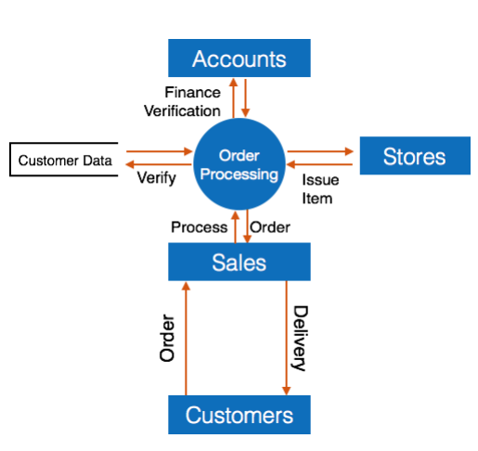
Level 1 – depicts basic modules in the system and flow of data among various modules.
Level 2 – depicts how data flows inside the modules stated in level 1.

Slide 8
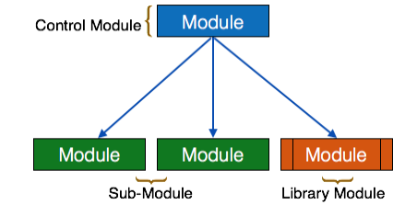
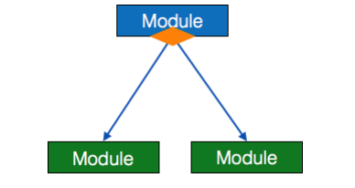
Structured Charts is a chart derived from DFD. It breaks down the entire system into the lowest functional modules describes functions and sub-functions of each module of the system to a greater detail than DFD.
Module represents process or subroutine or task. A control model branches to more than one sub-model. Library modules are re-useable and invokable from any model.
Condition is represented by a small diamond at the base of the module which depicts that control module can select any of the sub-routine based on some condition.

Slide 9
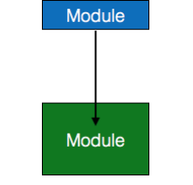
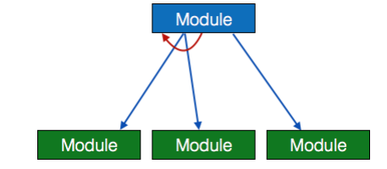
Jump - an arrow pointing inside the module to depict that the control will jump in the middle of the sub-module.
Loop – a curved arrow represents loop in the module. All the sub-models covered by the loop repeat execution of module.

Slide 10
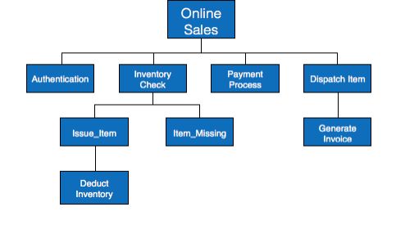
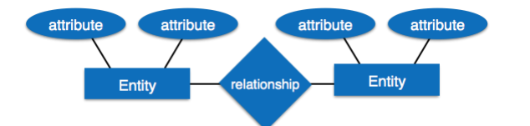
Hierarchical Input Process Output (HIPO) is a combination of two organised methods to analyse the system and provide the means of documentation
Entity-Relationship Model is a type of database model based on the notion of real world entities and relationship among them.

Slide 11
Entity – is a real world being, which has some properties called attributes. Every attribute is defined by its corresponding set of values called domain
Relationship – the logical association among entities. Relationships are mapped with entities in various ways. Mapping cardinalities define the number of associations between two entities.
Mapping Cardinalities:
One to one
One to many
Many to one
Many to many

Slide 12
SOFTWARE DESIGN STRATEGIES
7
Software design takes the user requirements as challenges and tries to find optimum solution. While the software is being conceptualized, a plan is chalked out to find the best possible design for implementing intended solution.
Variants of Software Design:
Structured Design – the divide and conquer method. It conceptualizes the problem into several well-organised elements of solution. It implements coupling and cohesion
Function oriented Design – comprises of many smaller sub-systems known as functions which are able to perform significant task in the system
Object Oriented Design – this design strategy focuses on the entities and its characteristics. Concept of OOD:
Objects : all entities involved in the solution design. Example: Person, Company etc.
Classes: generalized description of an object
Encapsulation : the bonding together of attributes (data variables) and Methods (operation on the data)
Inheritance allows similar classes to stack up in hierarchical manner where the lower or sub-classes can import, implement and reuse allowed variables and methods from their immediate super classes
Polymorphism: provides a mechanism where methods performing similar tasks but vary in arguments, can be assigned same name.

Slide 13
Design Process
Software design an be perceived as series of well-defined steps. It may involve the following steps:
A solution design is created from requirement or previous used system
Objects are identified and grouped into classes on behalf of similarity in attribute characteristics
Lass hierarchy and relationship among them is defined
Application framework is defined
Software Design Approaches
Top Down Design : takes the whole software system as one entity and then decomposes it to achieve more than one sub-system based don some characteristics
Bottom-up Design: It starts with most specific and basic components. It proceeds with composing higher level of components by using basic or lower level components.

