Slide 1
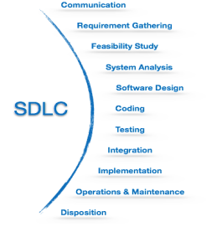
SOFTWARE DEVELOPMENT CYCLE (SDLC)
2
Software Development Life Cycle is a well defined, structured sequence of stages in software engineering to develop the intended software product.
SDLC Activities
SDLC provides a series of steps to be followed to design and develop a software product efficiently. The SDLC framework includes the following steps:

Slide 2
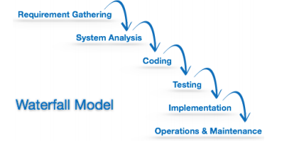
Software Development Paradigm
Helps developers to select a strategy to develop the software. It has its own set of tools, methods and procedures expressed clearly defines SDLC. Examples of software development paradigms or process models:
Waterfall Model : simplest, SDLC in linear manner.

Slide 3
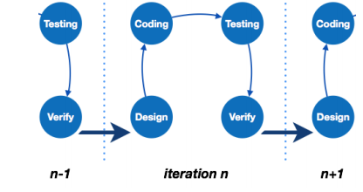
Iterative Model
Leads the software development process in iterations, SDLC in cyclic manner.

Slide 4
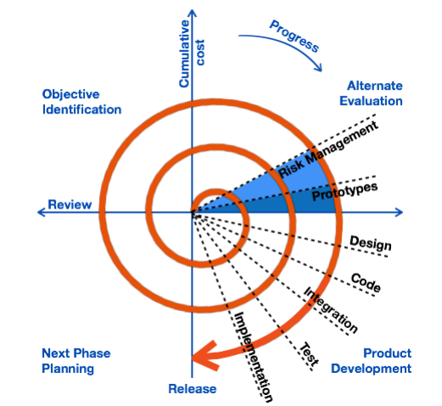
Spiral Model
Is a combination of both, iterative and one of the SDLC model. The model considers risk which is goes unnoticed by the other models.
It begins with determining objectives and constraints of the software at the start of one iteration. The next phase is prototyping the software which includes risk analysis, followed by one standard SDLC model and preparation for next iteration.

Slide 5
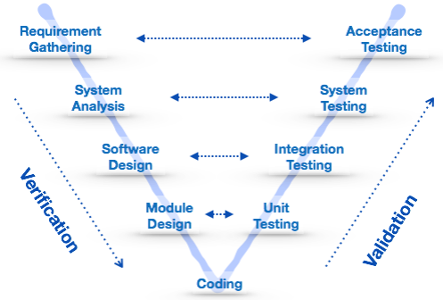
V- Model
Provides a means of testing the software at each stage in reverse manner. At every stage, test plans and test cases are created to verify and validate the product according to the requirement at each stage. Also known as verification & validation model.

Slide 6
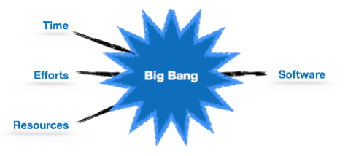
Big Bang Model
The simplest and requires little planning, lots of programming and lots of funds

Slide 7
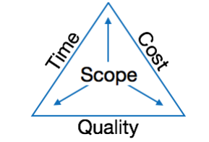
SOFTWARE PROJECT MANAGEMENT
3
Software development can be split into two parts; software creation & software project management.
A project is a well-defined task which is a collection of several operations done in order to achieve a goal.
Characteristics Of A Project:
Unique and distinct
Non routine activity
Timelines specific
Goal oriented
Resources oriented
Triple constraints of software projects

Slide 8
Software Project Manager
A person who undertakes the responsibility of executing the software project. He controls and manages the activities involved in production.
The key role of a manager is to manage the people and the project:
Managing People
Acts as project leader
Negotiates with stakeholders
Manage human resources
Sets up reporting hierarchy
Managing Project
Defines and sets up project scope
Manages project management activities
Risk analysis at every phase
Acts as a spoke person

Slide 9
Software Management Activities
Project Planning
Scope Management
Project Estimation
Project Estimation Techniques
Decomposition
Empirical (COCOMO)

Slide 10
Project Scheduling
Roadmap of all activities to be done with specified order and within time slot allotted to each activity.
In scheduling a project, it is necessary to :
Breakdown the projects task
Find out various tasks and correlate them.
Estimate time frame for each task
Assign adequate number of work-units per task
Calculate total time required for the project
Resource Management
All elements used to develop software product may be assumed as resource for that project, which ay include human resource, productive tools and software libraries and hence the need for management. It includes:
Project organization by building a project team and allocating responsibilities
Determining availability of resources required at a stage
Generating required resource request and de-allocating when not needed.

Slide 11
Project Risk Management
Involves all activities pertaining to identification, analysing and making provision for predictable and non-predictable risks in the project. Risk May include:
Experienced staff leaving the project and new staff coming in
Change in organizational management
Requirement change or misinterpreting requirement
Under-estimation of required time and resources
Technological & environmental changes, business competition.
Risk Management Process
Identification
Categorization
Management
Monitoring

Slide 12
Project Execution & Monitoring
In this phase, the tasks described in project pans are executed according to schedules and observed to check the probability of risk and taking measures to address it. The measures include
Activity Monitoring
Status Reports
Milestones Checklists
Project Communication Management
Effective communication plays a vital role in the success of a project. It bridges the gap between client and the organization, among team members as well other stake holders. Communication management steps includes:
Planning
Sharing
Feedback
Closure

Slide 13
Configuration Management
IEEE defines it as “the process of identifying and defining the items in the system,
controlling the change of these items throughout their life cycle, recording and
reporting the status of items and change requests, and verifying the completeness
and correctness of items”.
Change Control
Is function of configuration management, which ensures that all changes made to software system are consistent and made as per organizational rules and regulations.
Steps involved in Change Control:
Identification
Validation
Analysis
Control
Execution
Close Request

Slide 14
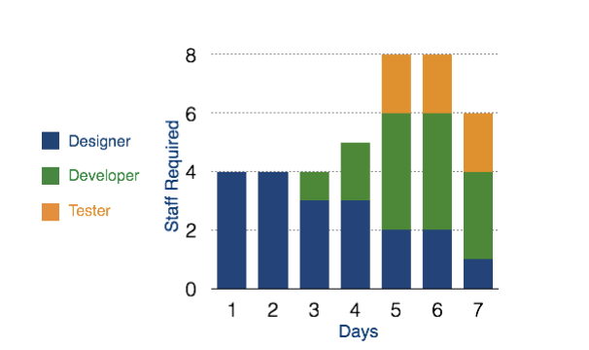
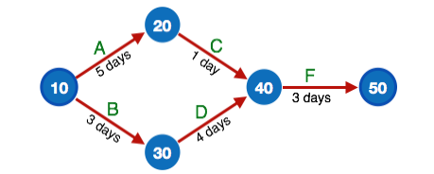
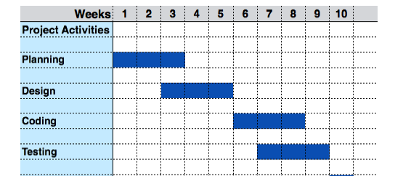
Project Management Tools
The risk and uncertainty rises multi-fold with respect to the size of the project, even when the project is developed according to set methodologies. There are tools available that aids in effective project management:
Resource Histogram
PERT Chart
Gantt Chart

Slide 15
SOFTAWARE REQUIREMENT
4
Requirement Engineering
The process to gather the software requirements from client, analyse, and document. The goal of requirement engineering is to develop and maintain sophisticated and descriptive ‘System Requirements Specification’ document.
Requirement Engineering Process
It is a four step process, which includes:
Feasibility Study
Software Requirement Gathering
Software Requirement Specification(SRS)
Software Requirement Validation(SRV)
Features of SRS
User requirement are expressed in natural language
Technical requirements are expressed in structured language
Design description in a Pseudo code
Format of Forms and GUI screen prints

Slide 16

SRV Conditions
Practically implementable
Valid as per functionality and software domain
Existence of ambiguities
Complete
Can be demonstrated.
Requirement Elicitation Process
Is the process to find out the requirements for an intended software system by communication with client, end users, system users and others who have a stake in the software development.

Slide 17
Requirement Elicitation Techniques
Interviews
Surveys
Questionnaires
Task analysis
Brainstorming
Prototyping
Observation
Characteristics of A Good SRS
Clear
Comprehensible
Unambiguous
Correct
Consistent

Slide 18
Categories Of Software Requirement
Functional requirements
Non- Functional requirements
User interface requirement
Software Metrics and Measures
Size metrics
Quality metrics
Process metrics
Resources

