Slide 1
Captcha Recognition
Tsinghua Summer School 2019

Slide 2
Content
What is Captcha Recognition?
Background: Keras
Task 1: Code Completion
Task 2: Improvement

Slide 3
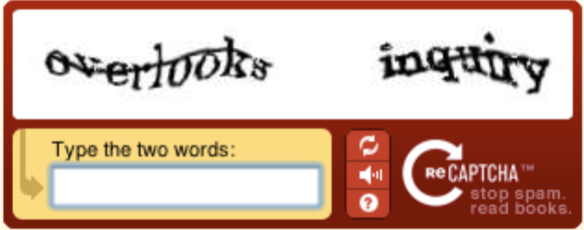

What is Captcha Recognition?
Captcha: A method to distinguish humans from bots.

Slide 4
Captcha Recognition
Captcha Recognition is to train a bot acting as a human to fail the system.
Input: An captcha image.
Output: 4 numbers contained in the captcha.
A deep learning method: CNN for image classification.

Slide 5
Background: Keras
Keras is a high-level neural networks API mainly on top of TensorFlow.
It hides lots of implementation details and enables fast experimentation.

Slide 6
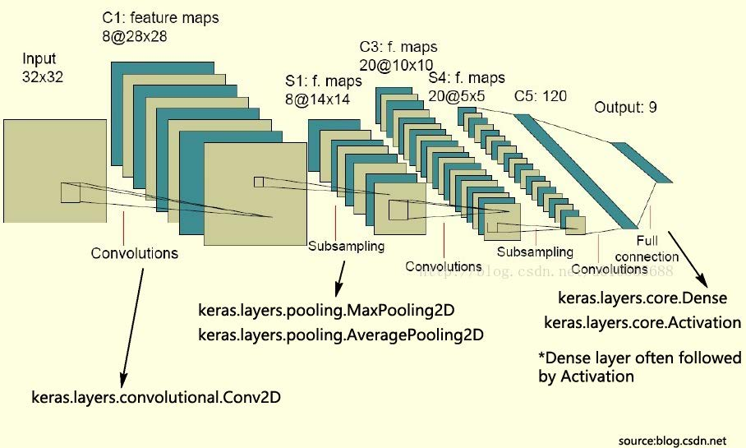
Background: Keras
It has a direct mapping from concept to code.

Slide 7

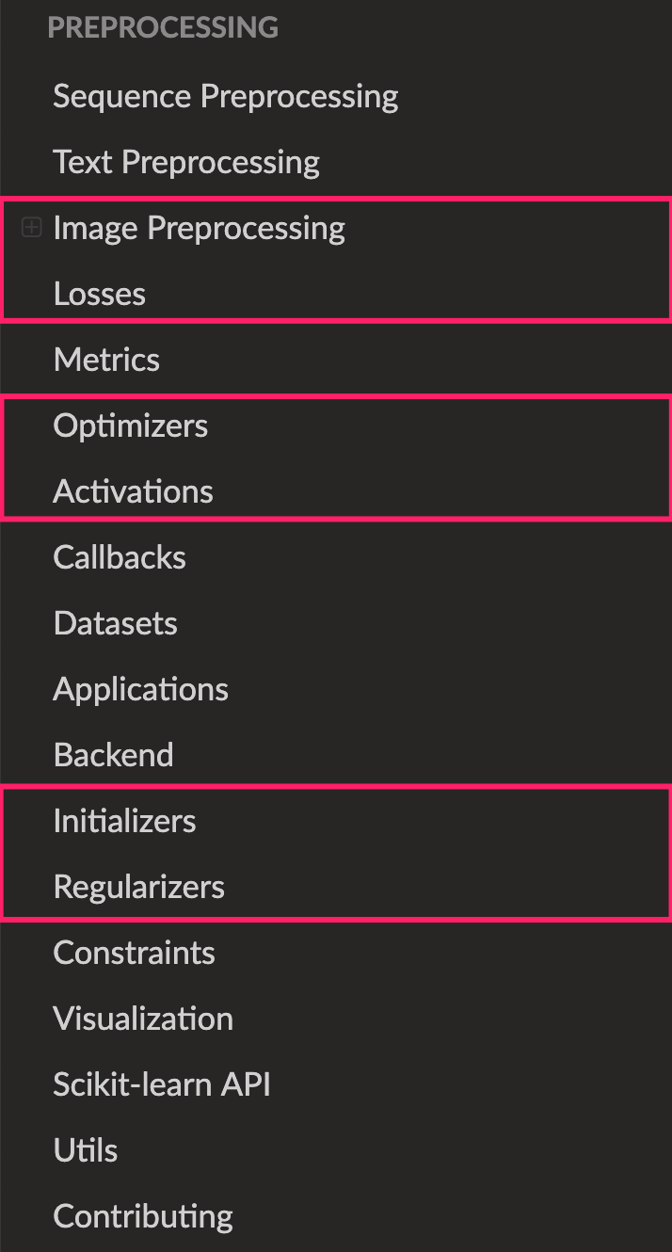
Background: Keras
https://keras.io
Pytorch

Slide 8
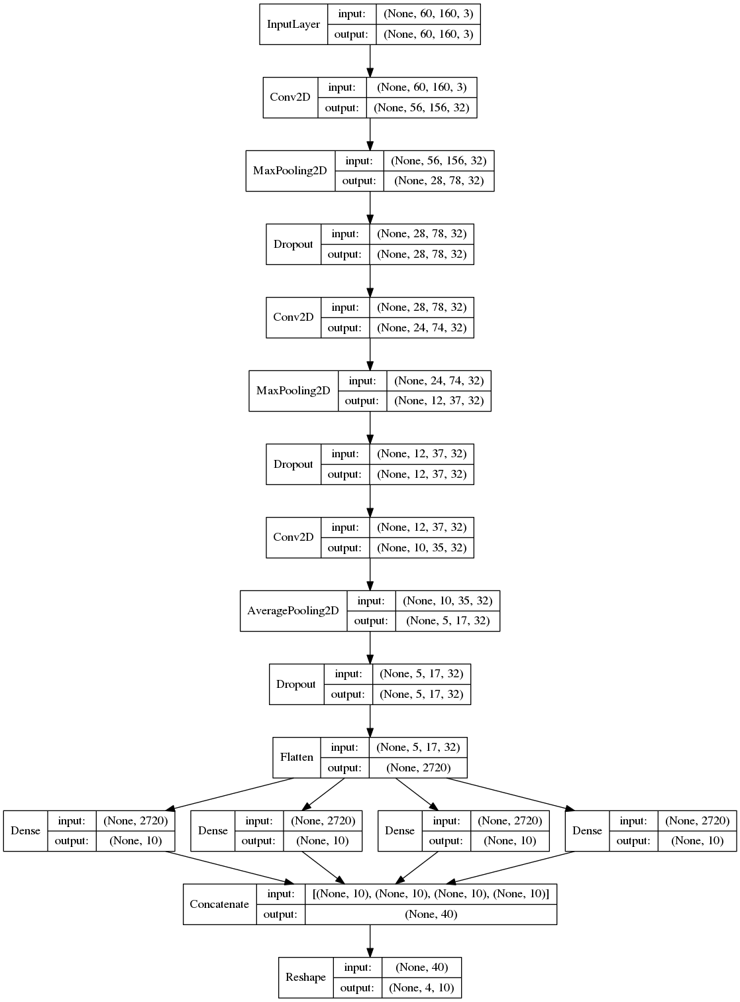
Task 1: Code Completion
Input
Complete the code according to a model architecture
Input
Feature Extractor
Classifier
(Loss)
Feature Extractor
Classifier

Slide 9
Task 1: Code Completion
Input
60 * 160 * 3
Height * Width * Channel

Slide 10
Task 1: Code Completion
Classifier

Slide 11
Task 1: Code Completion
Input
Feature Extractor
Conv + Polling + Dropout
2 layers for your work
Feature Extractor
Classifier

Slide 12
Task 2: Improvement
Try to improve the accuracy
Model
Residual connection / inception block
Could refer to https://keras.io/applications/ for popular model architecture
Normalization
Batch Normalization / Dropout / Weight decay
Optimizer
SGD / Adam / Adadelta
Initialization
Hyperparameter
Batch size / learning rate …

Slide 13
Summary
https://keras.io
Task 1: Code Completion
Task 2: Improvement
Guide and slides: https://github.com/xlthu/Summer-School-2019-2
Submission: Report your result to TA if you finish both tasks.
bing.com (en.bing.com)

