Slide 1
Cold board mount brackets
Lafe Spietz
NIST
Summer 2024

Slide 2
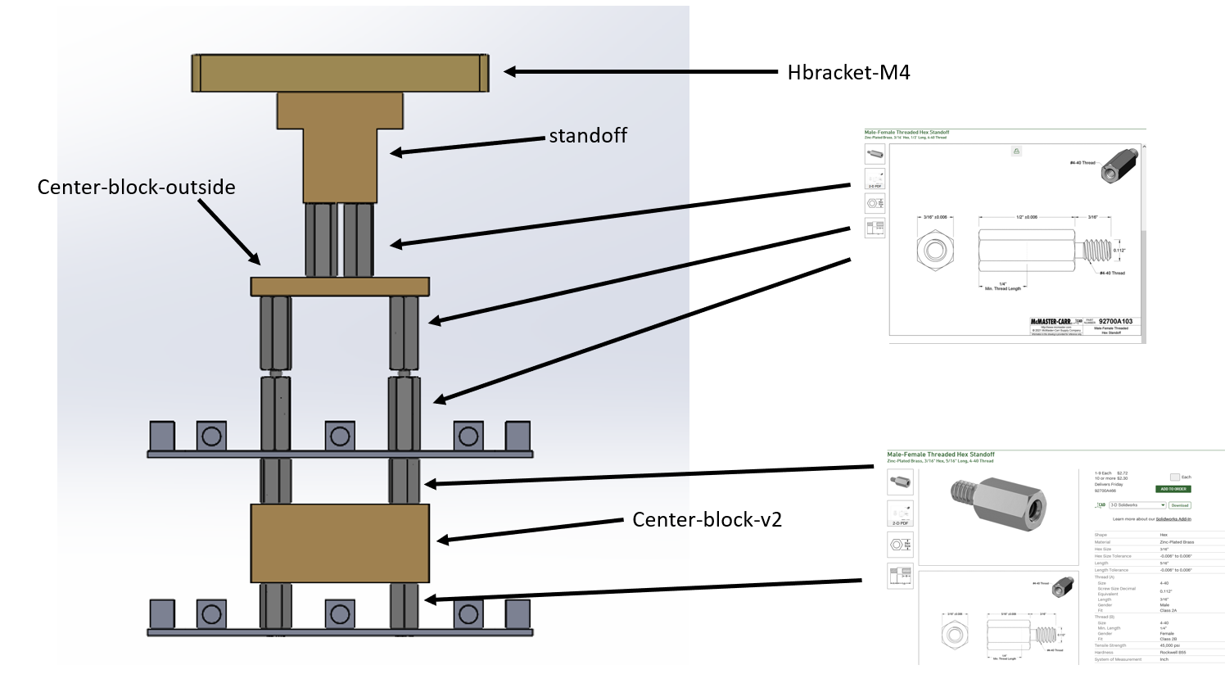
Assembly

Slide 3
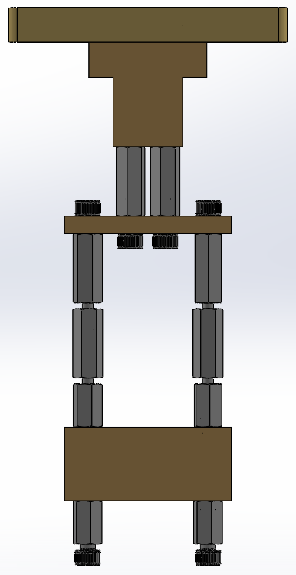

Slide 4
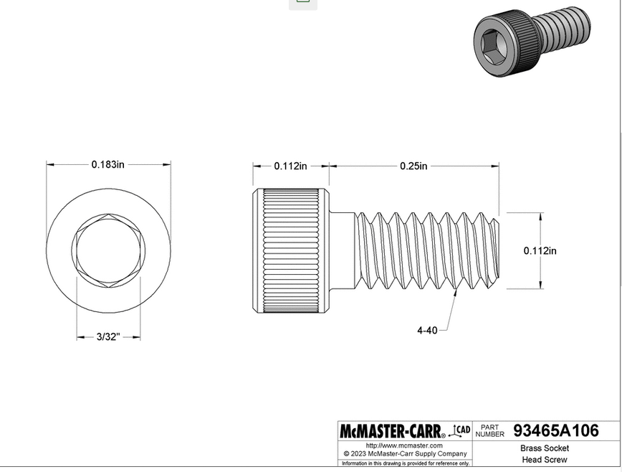
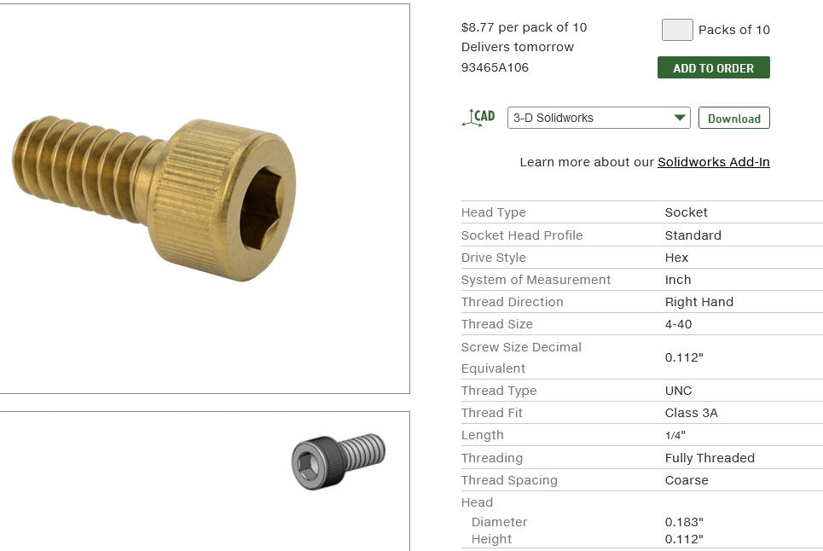
https://www.mcmaster.com/93465A106/

Slide 5
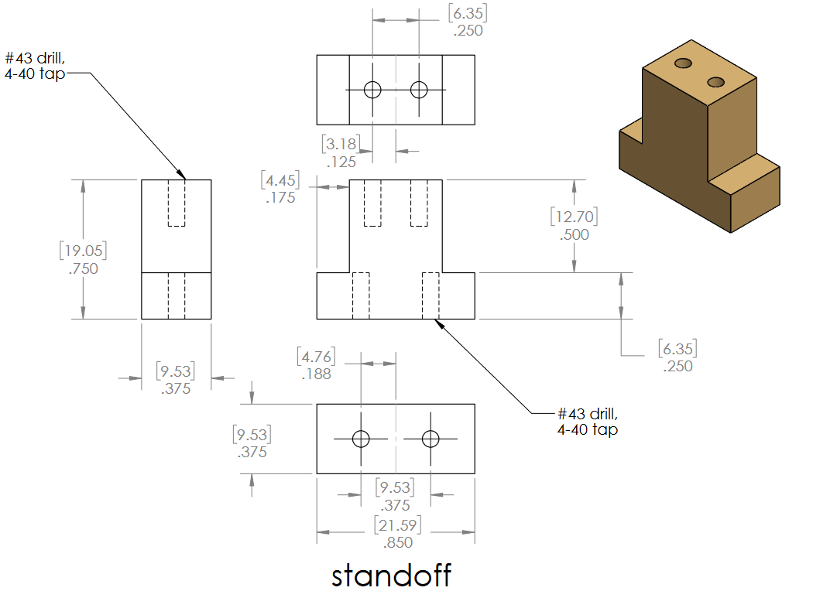

Slide 6
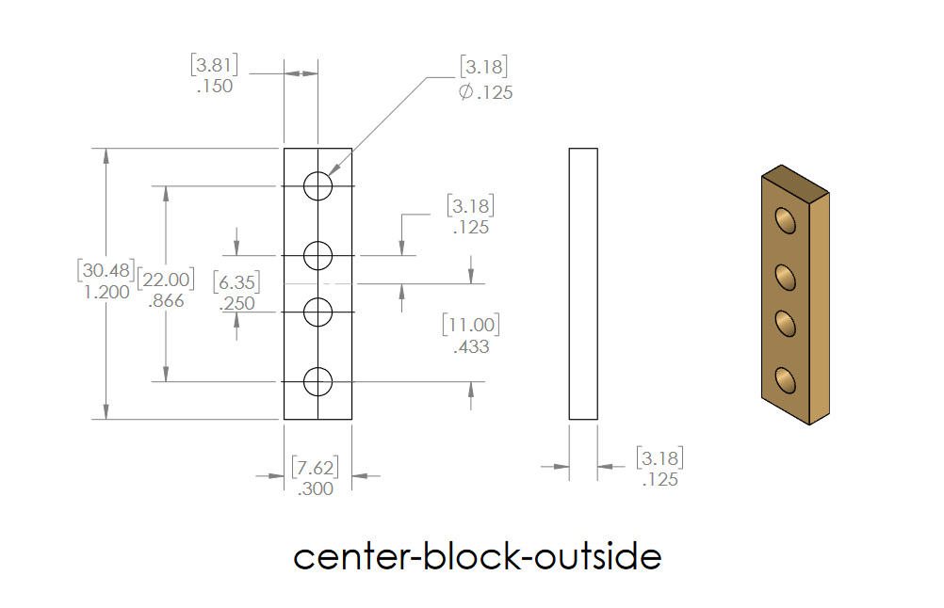

Slide 7
