Slide 1



Arduino Shield Circuit Board
MEMSDuino
Lafe Spietz
NIST
2024

Slide 2
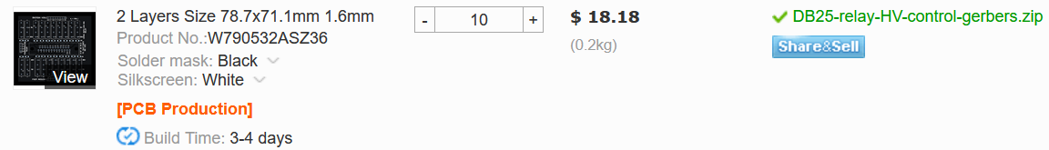
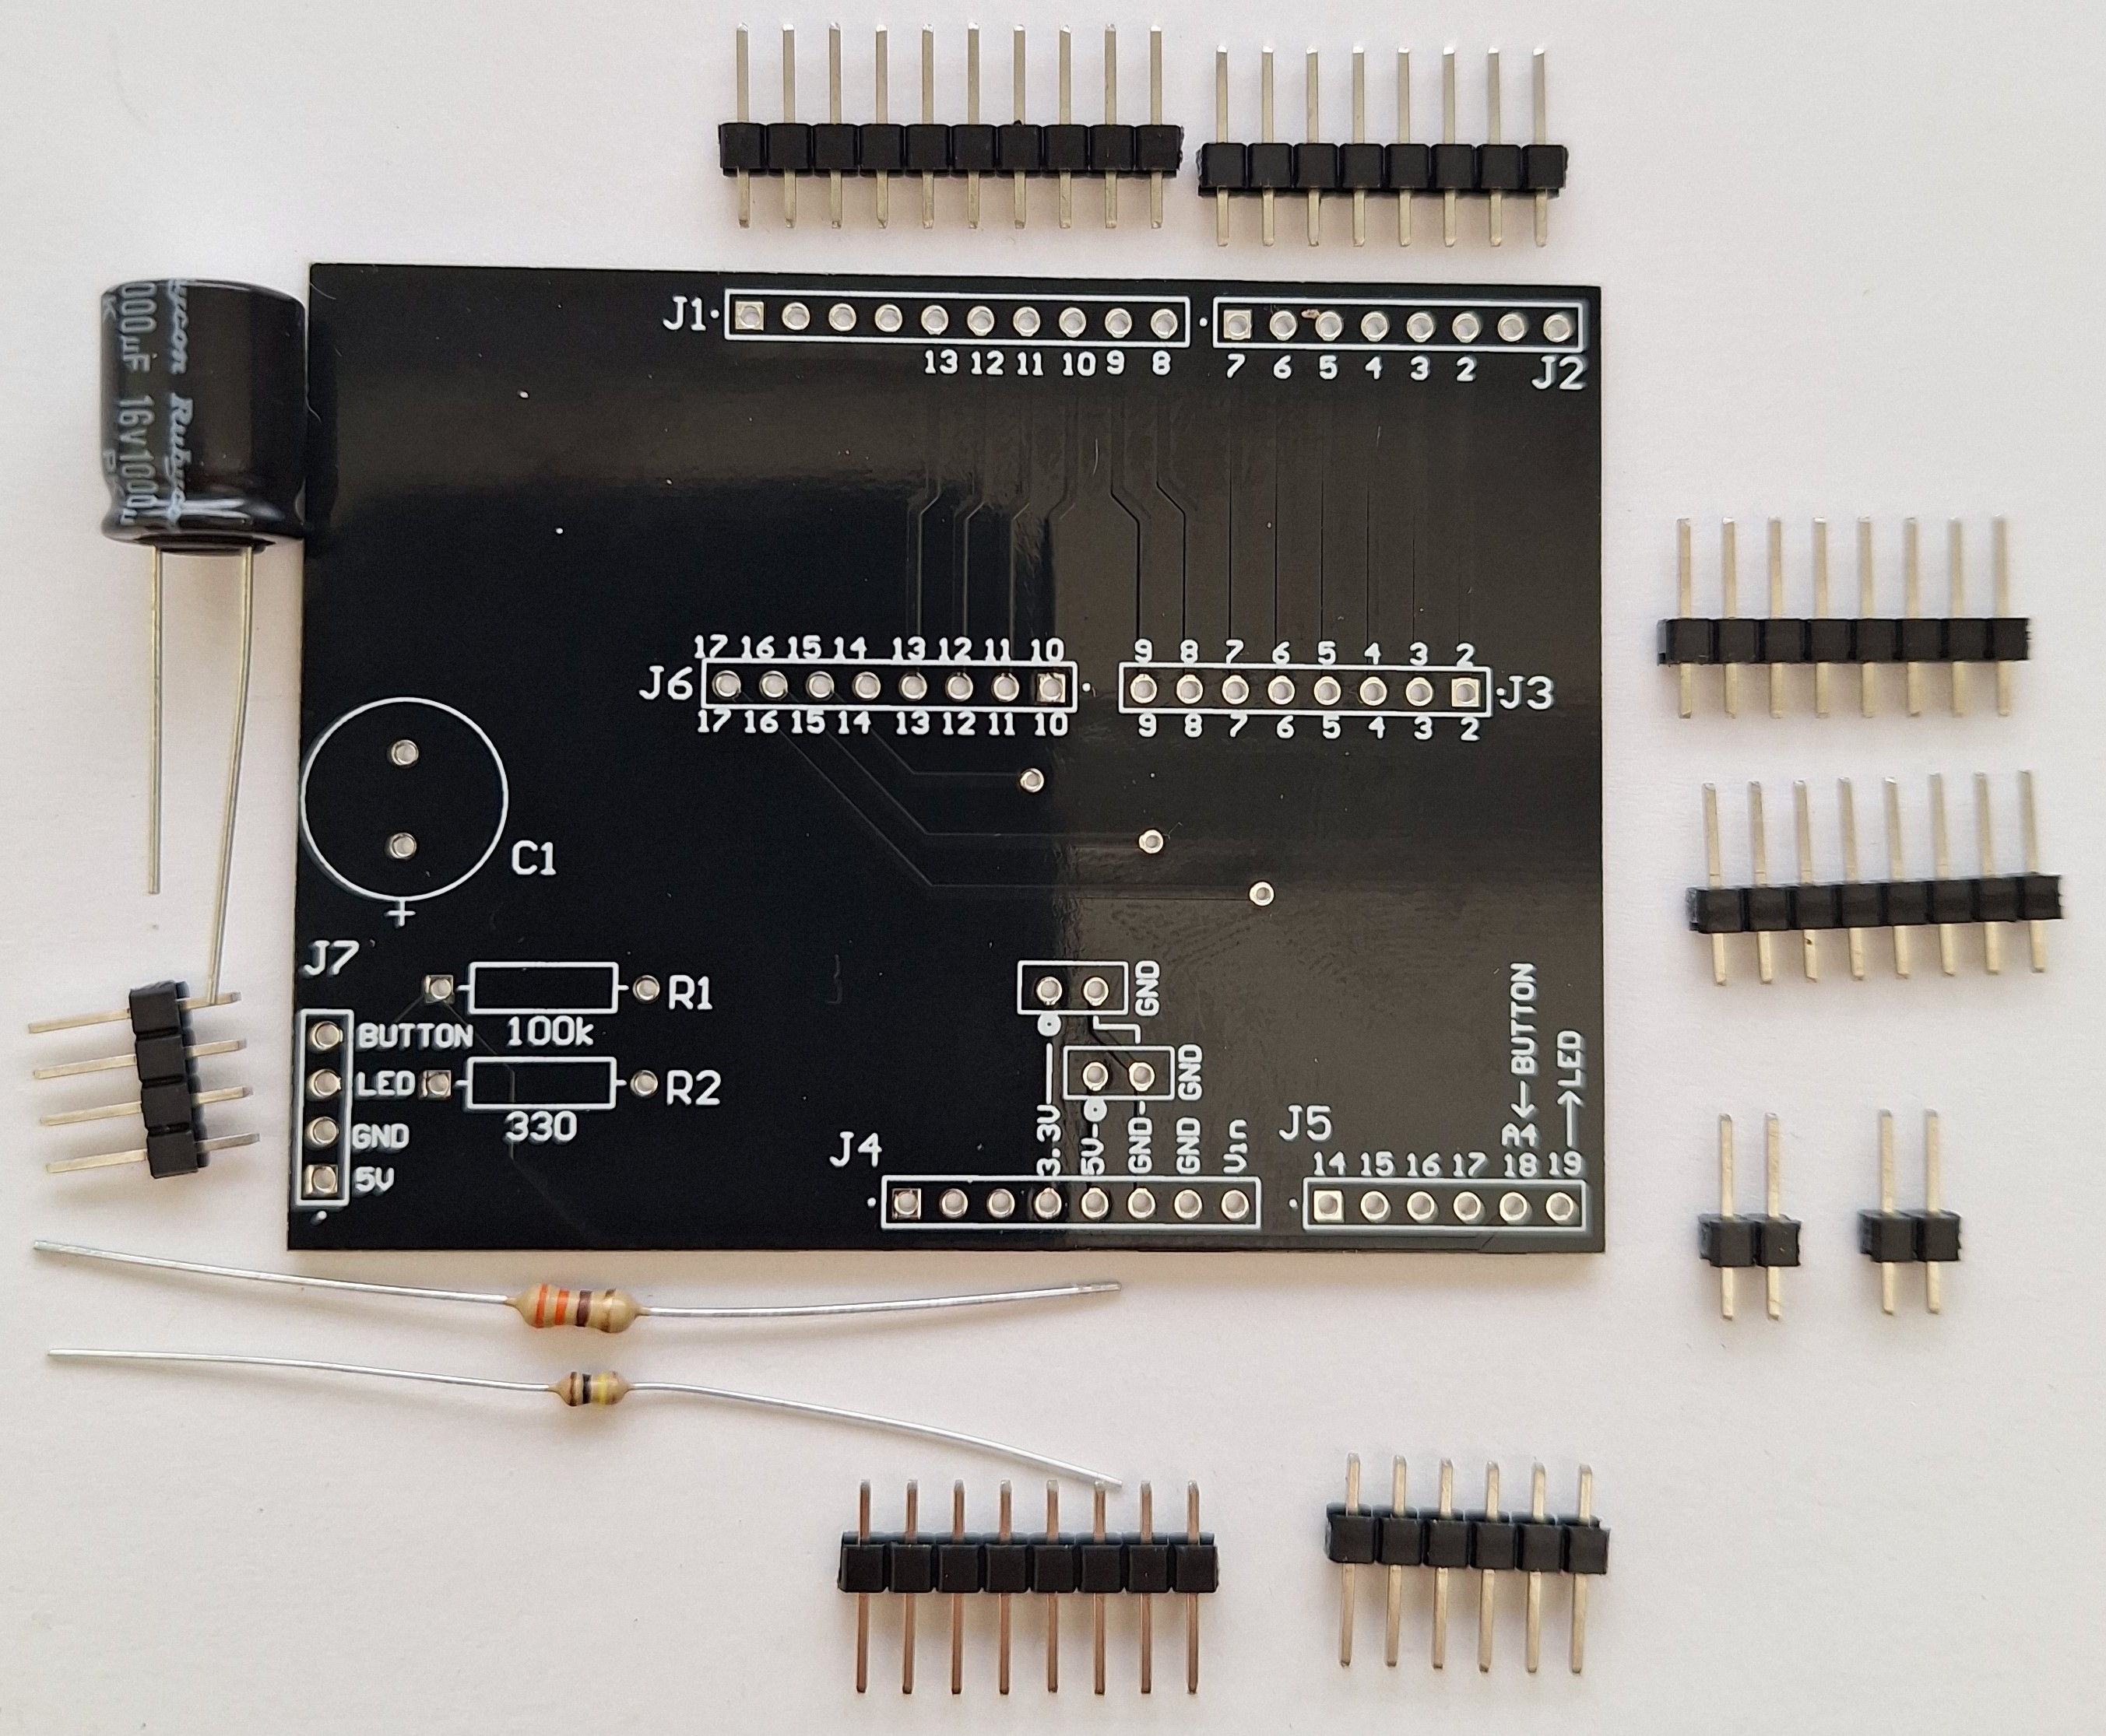
Order Custom Circuit Boards
https://www.pcbway.com
71.12 x 53.34 mm (2.1” x 2.8”) size
Black solder mask
White silkscreen
1.6mm FR4
https://github.com/lafefspietz/MEMSduino/raw/main/PCB_files/arduino-to-headers-shield-gerbers.zip
MEMSDuino

Slide 3
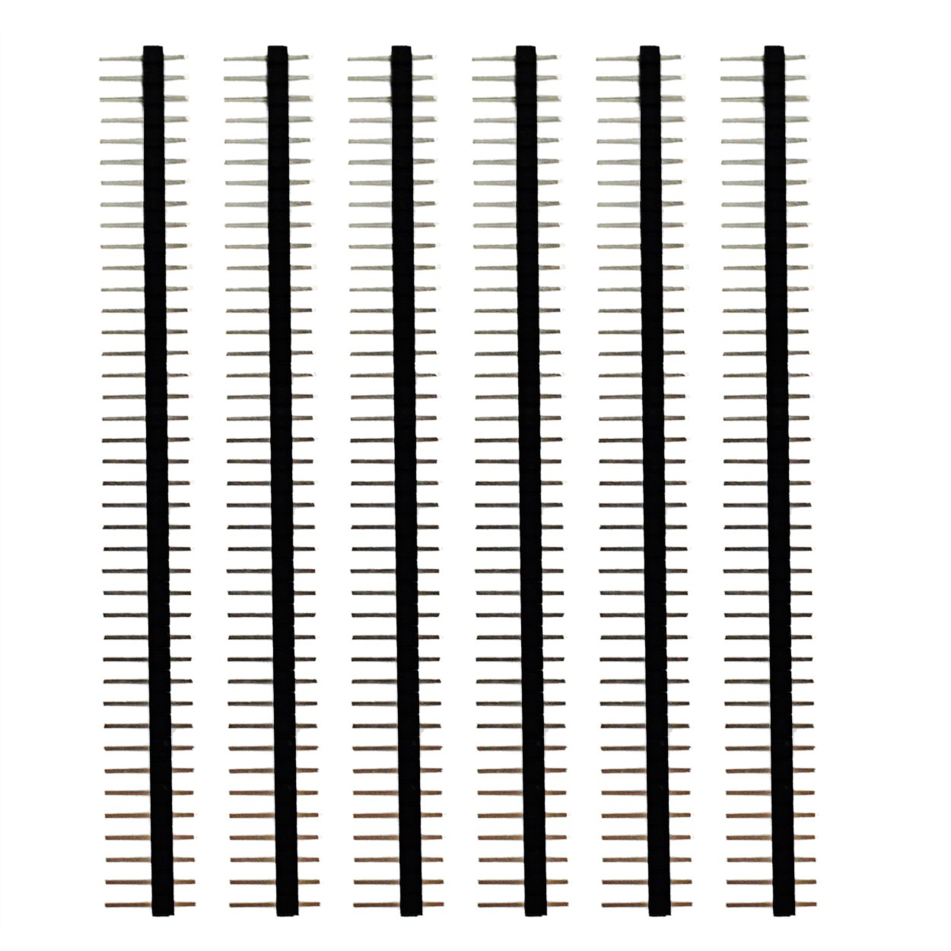
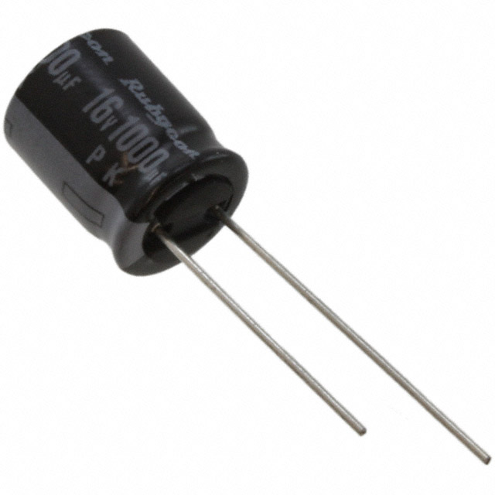
330 Ohm resistor x1
100 kOhm resistor x1
https://www.digikey.com/en/products/detail/stackpole-electronics-inc/RNF14FTD100K/1706591
https://www.digikey.com/en/products/detail/stackpole-electronics-inc/CF18JT330R/1741683
0.1” headers, 40 pin strips x2
1000 uF Capacitor x1
https://www.digikey.com/en/products/detail/rubycon/16PK1000MEFC10X12-5/3563556
https://www.amazon.com/Header-Lystaii-Pin-Connector-Electronic/dp/B06ZZN8L9S/
MEMSDuino

Slide 4
Break off strips to correct lengths:
MEMSDuino

Slide 5
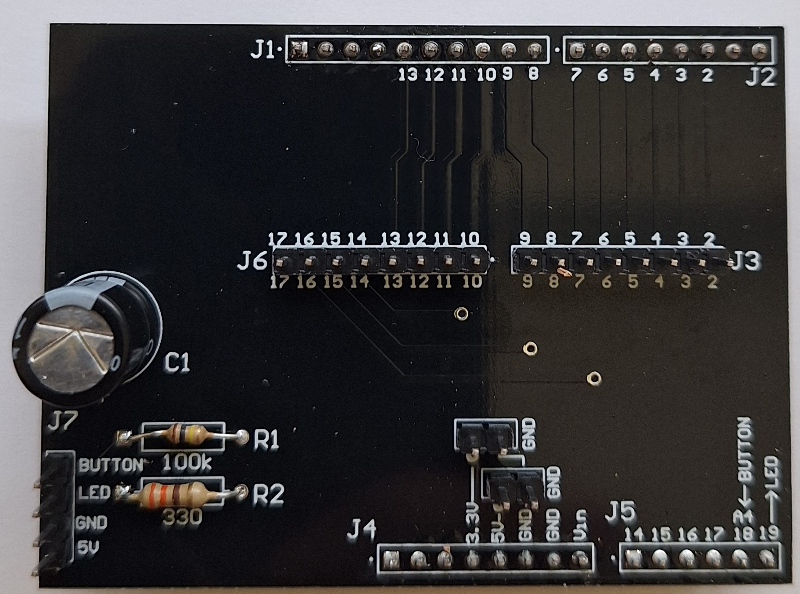
Assembly
MEMSDuino

Slide 6
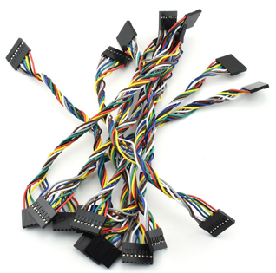
0.1” Header Cables: 8 pin, 6” long to connect to DB25 Relay Circuit Board
https://www.amazon.com/ZYAMY-Dupont-Connector-Multicolor-Breadboard/dp/B0789F2Y1T/
2x
MEMSDuino

Slide 7
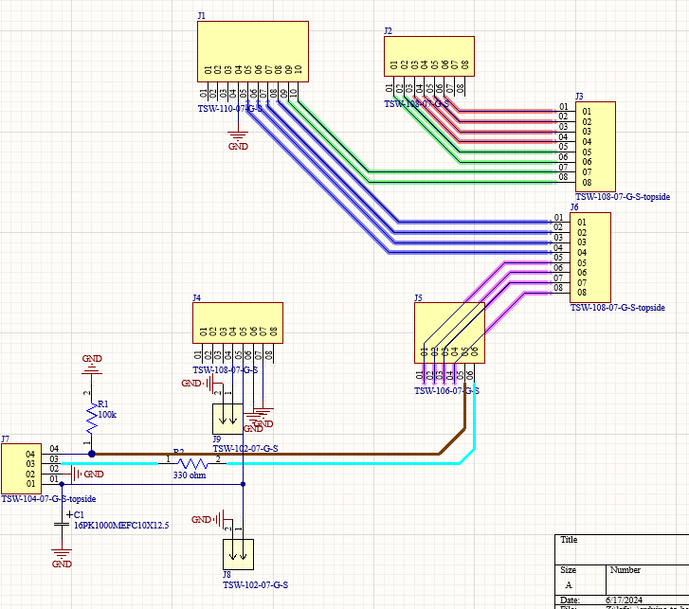

Slide 8
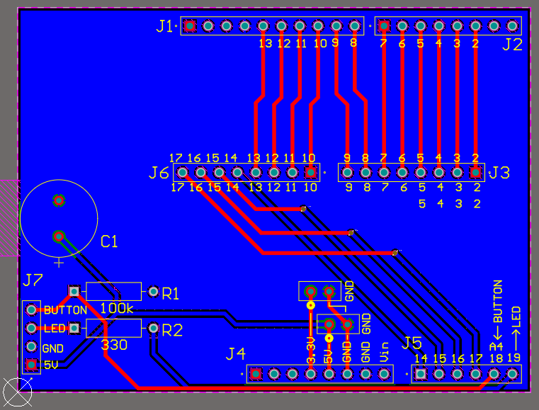

Slide 9
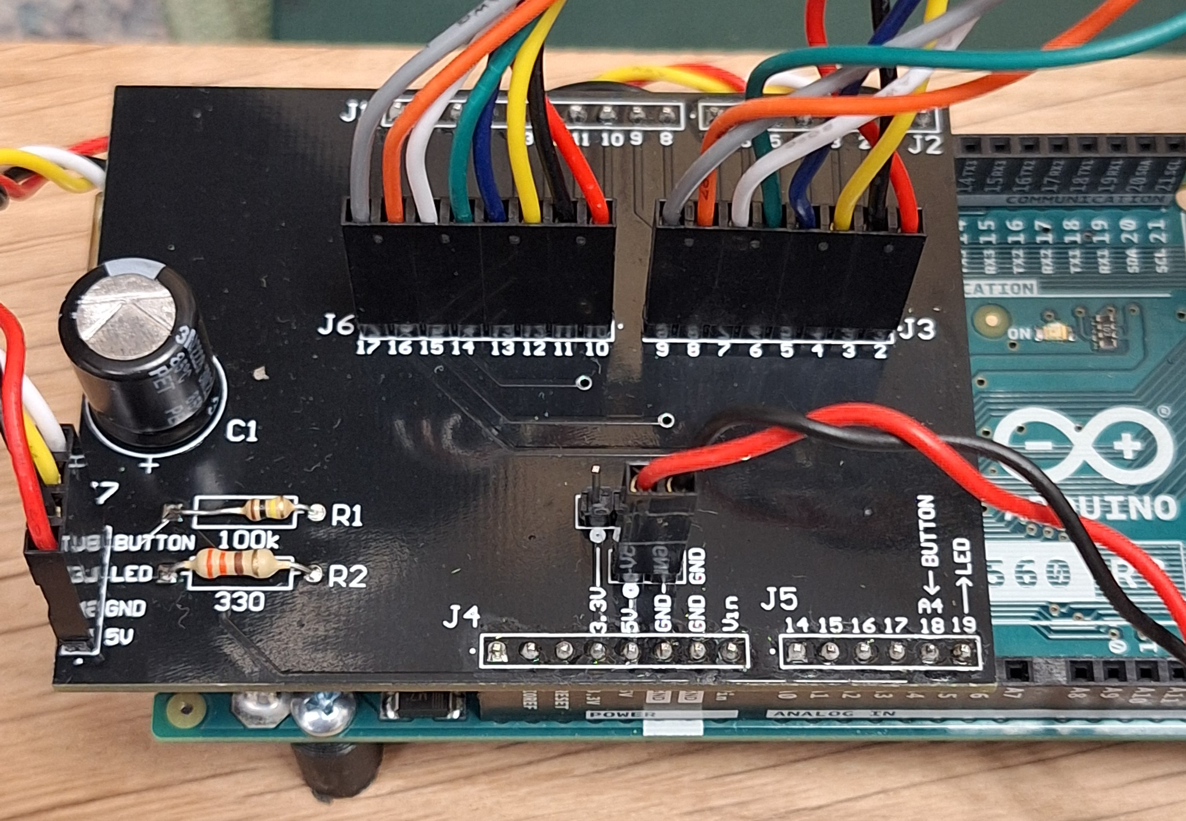
Assembly with cables
MEMSDuino

