Slide 1



5V to 90V Boost Build
MEMSDuino
Lafe Spietz
NIST
2024

Slide 2
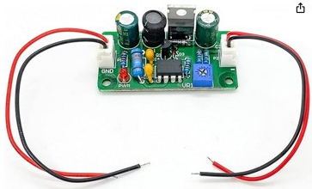
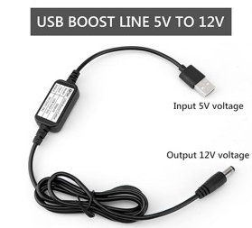
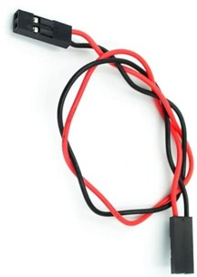
Bill of Materials
https://www.amazon.com/Voltage-Converter-Vintage-Indicator-80V-380V/dp/B09D93QNYK
https://www.amazon.com/DROK-Boost-Converter-Regulator-Length/dp/B09M3LMSS3/
https://www.amazon.com/ZYAMY-Dupont-Connector-Multicolor-Breadboard/dp/B0B8Z23NWX/

Slide 3
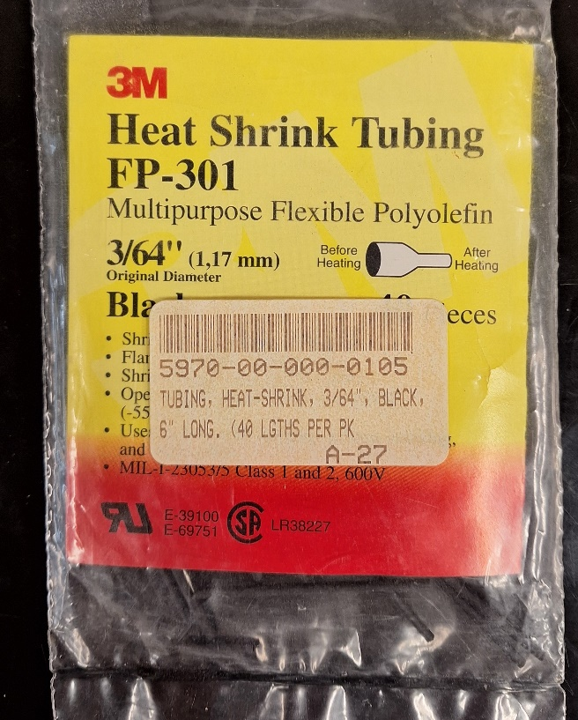
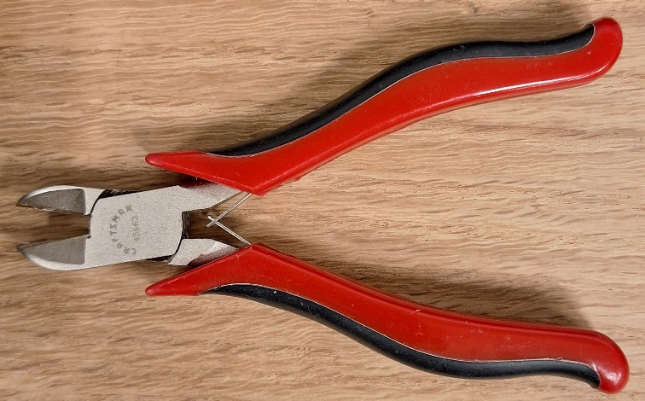
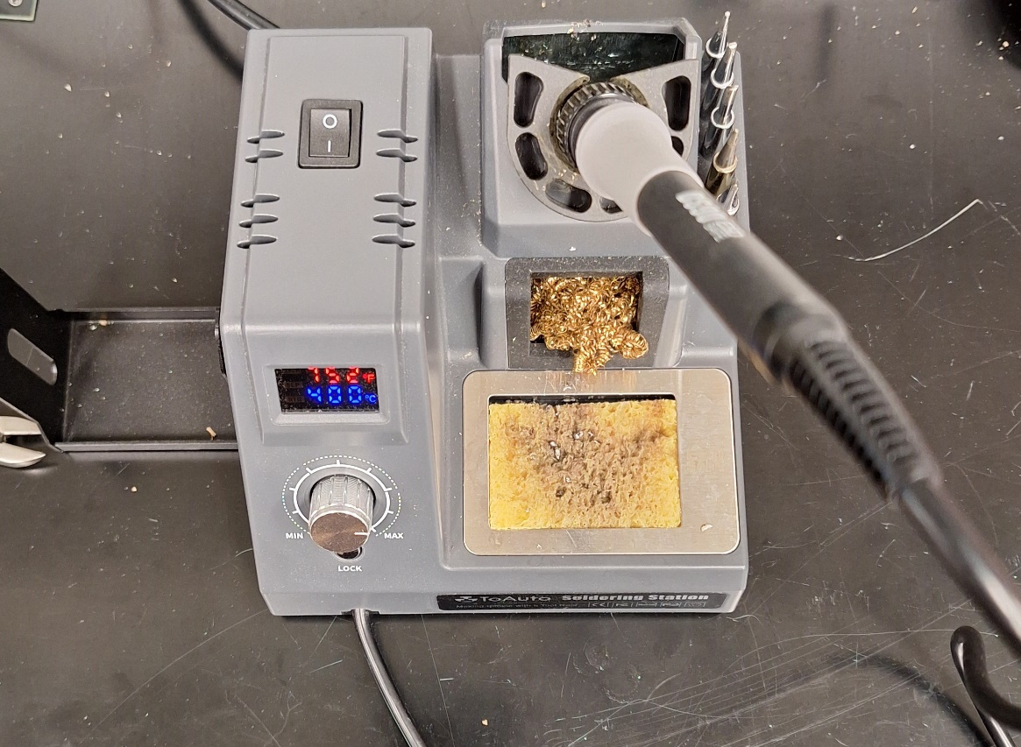
Tools and Consumables

Slide 4
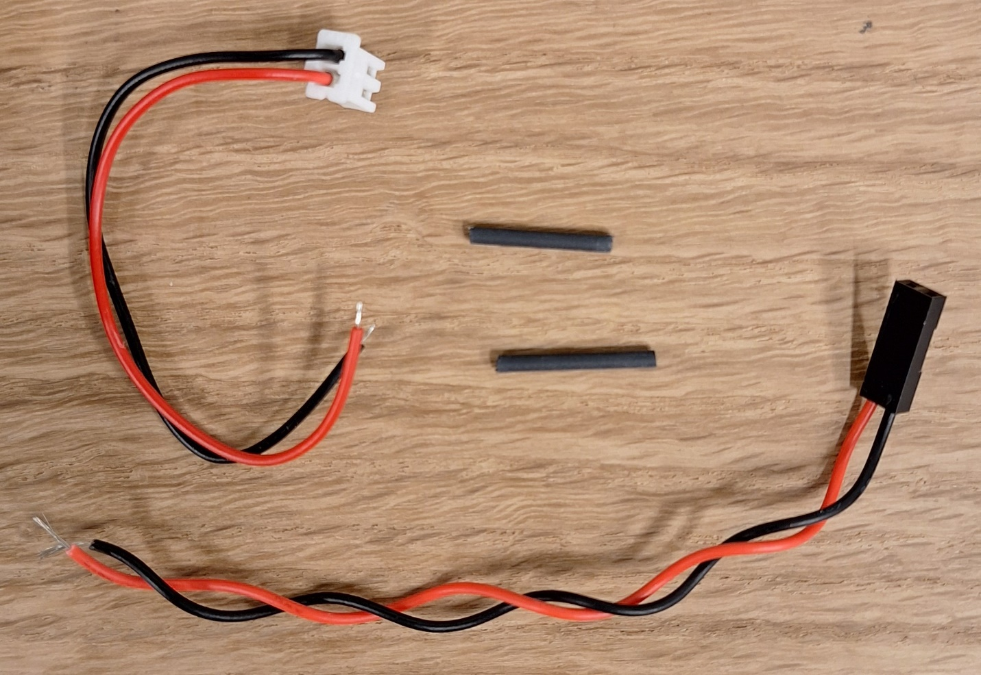
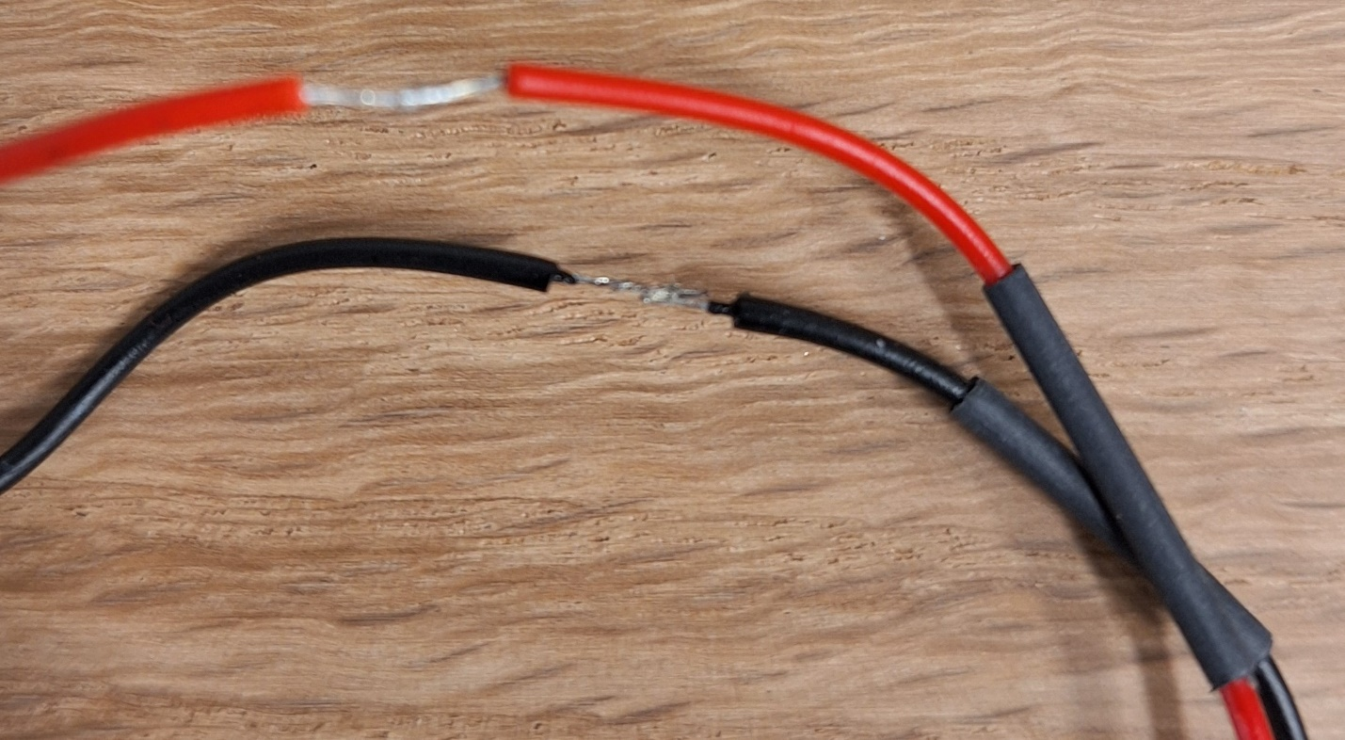
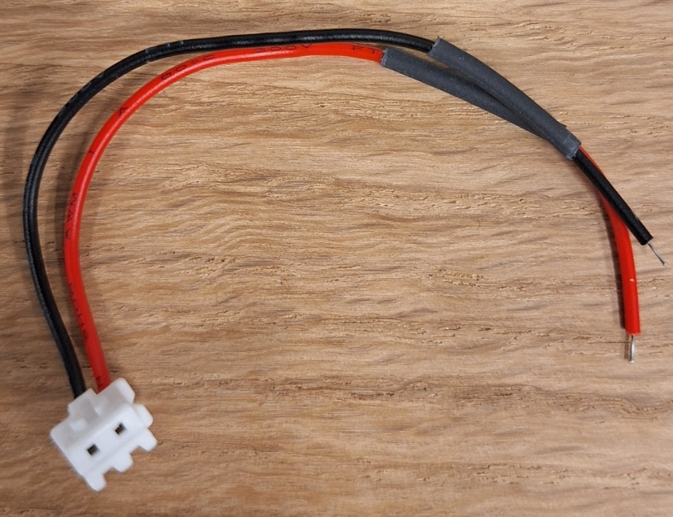
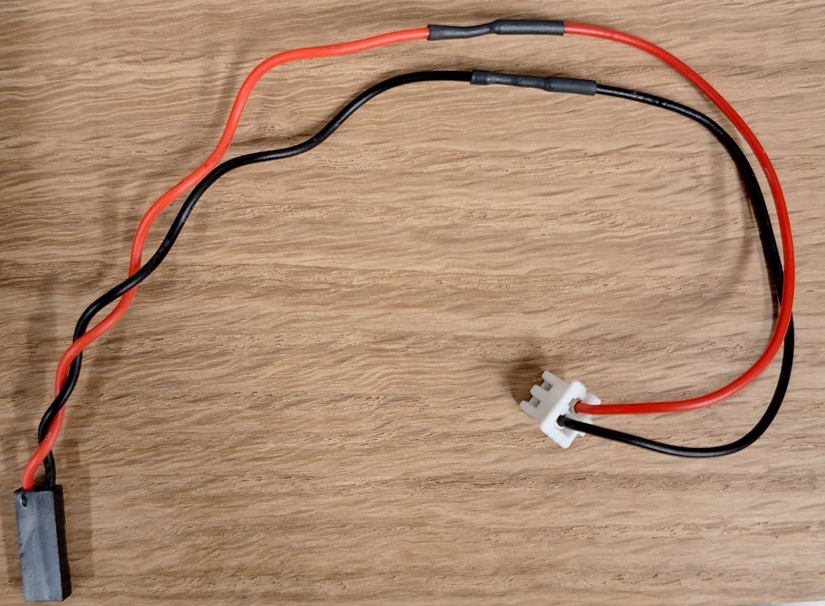
90 Volt to DB25 Relay Board Cable Assembly

Slide 5
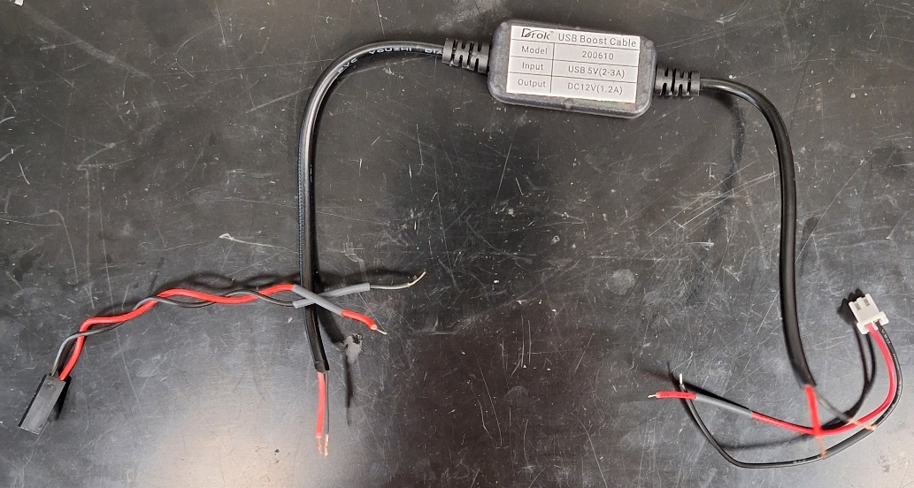
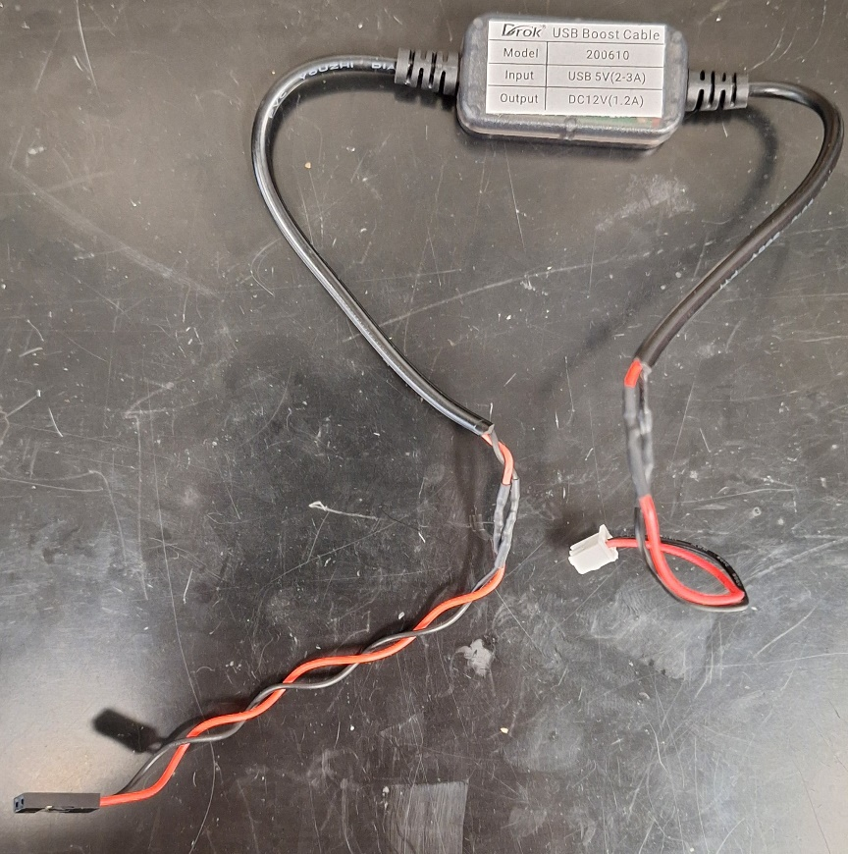
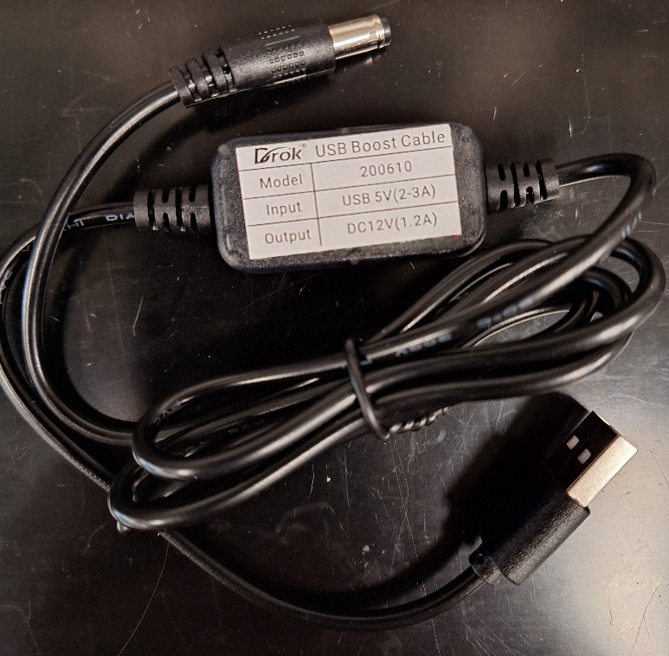
5V to 12 V Cable Assembly

Slide 6
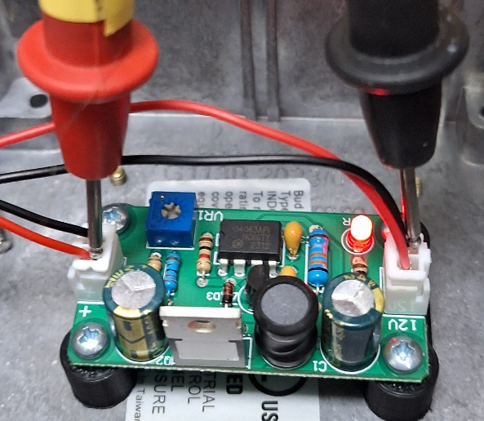
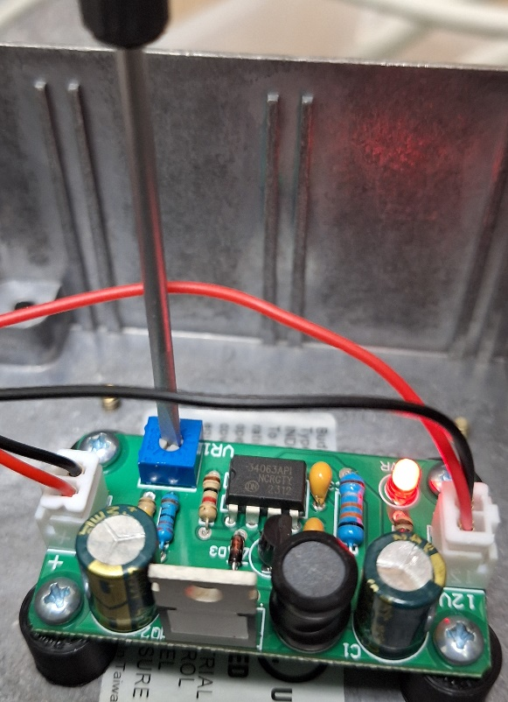
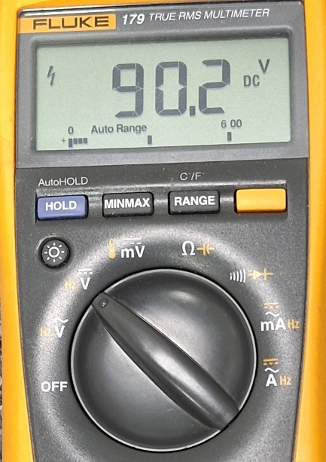
Setting the voltage output to 90V
4-40 ¼” screws
HV-DCDC-bracket

Slide 7
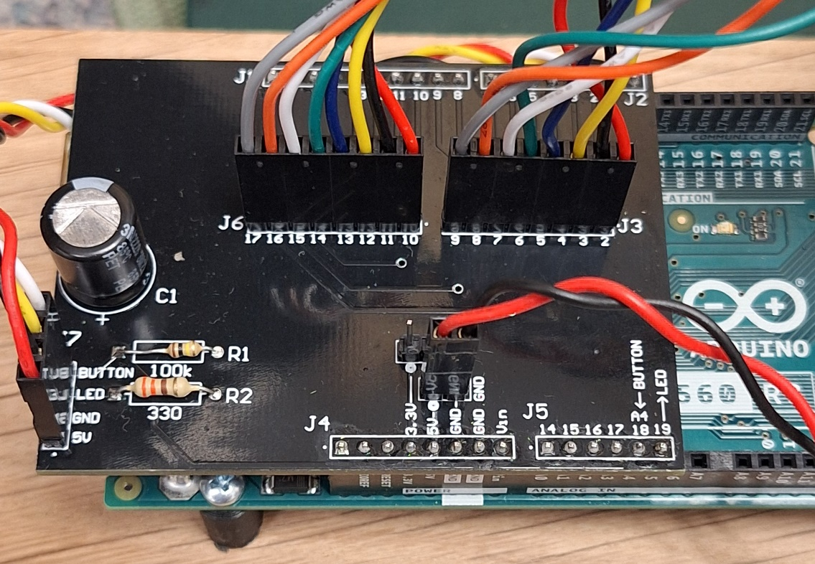
Arduino UNO Shield Connection
5V to Boost

