Slide 1



Arduino Shield Circuit Board
MEMSDuino
Lafe Spietz
NIST
2024

Slide 2
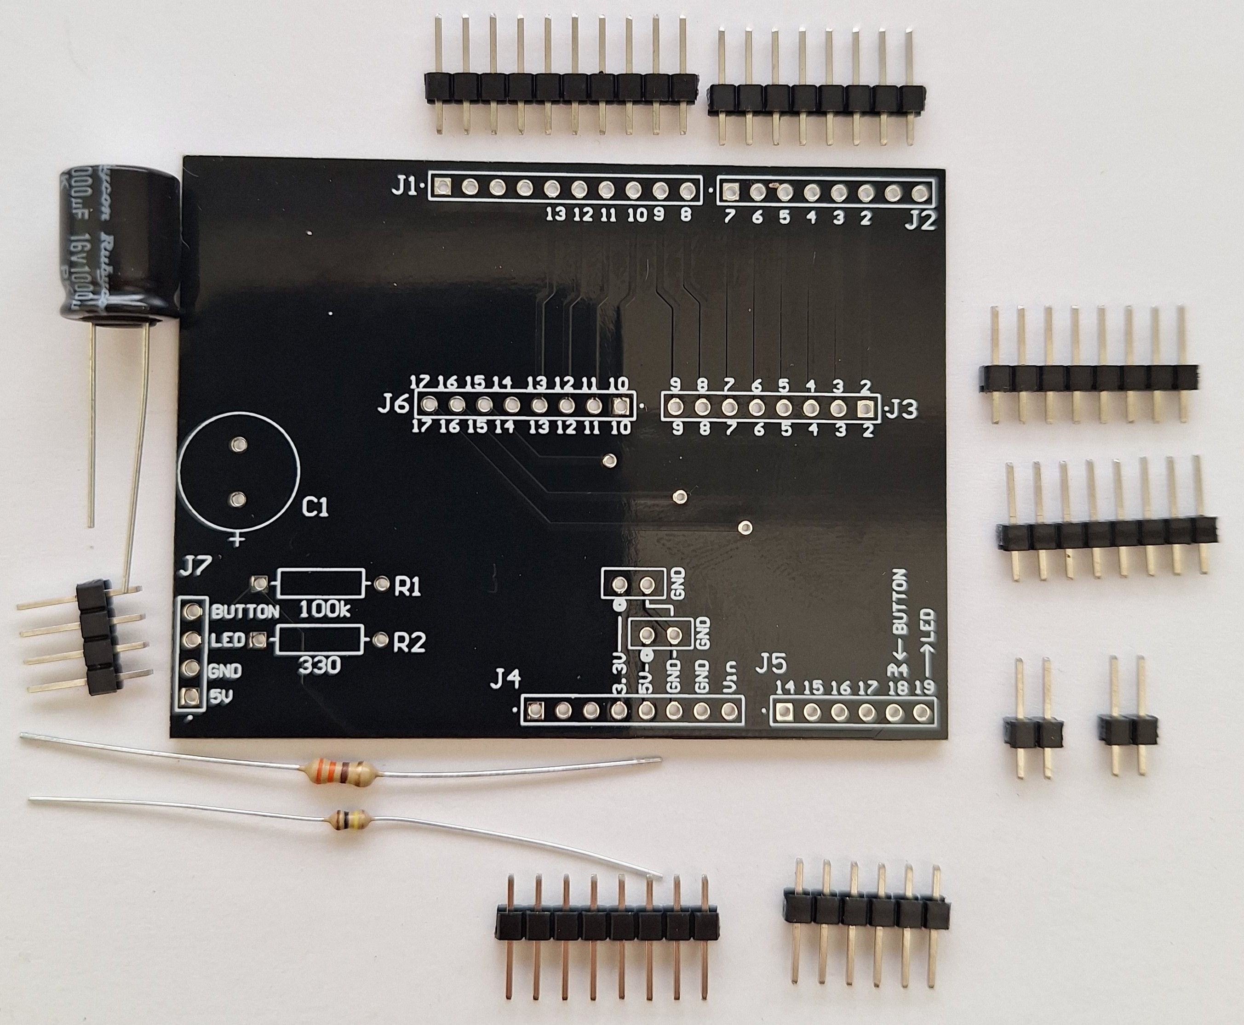
Kit

Slide 3
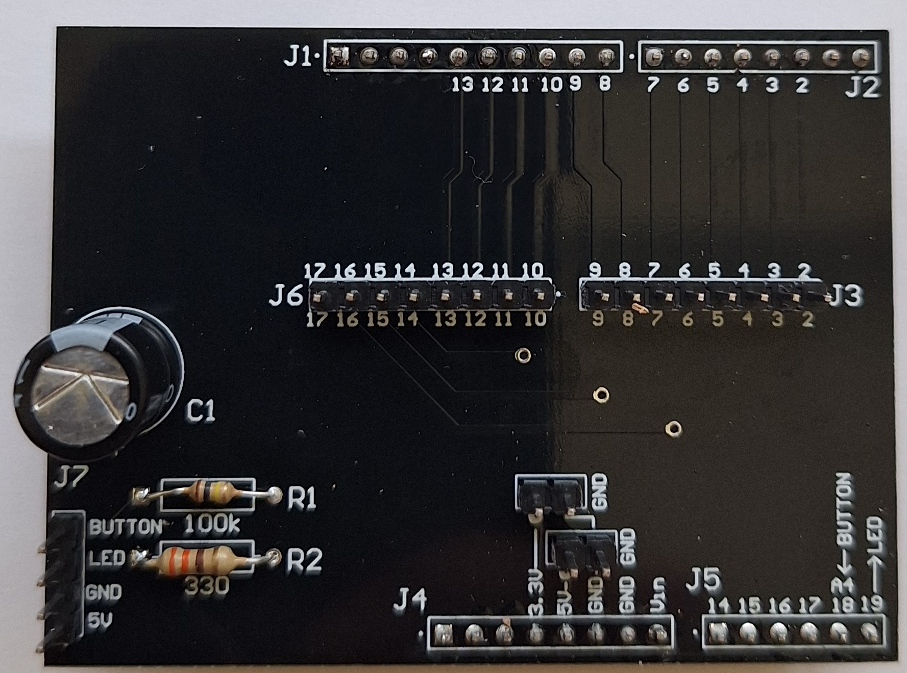
Assembly

Slide 4
Bill of Materials
PCB Arduino-to-headers-shield
0.1” Header strips
100 kOhm axial resistor
330 ohm axial resistor
1000 uF electrolytic capacitor with greater than 6 V max
2, 4 and 8 pin 0.1 inch female to female header cables, 6” long
Soldering iron and solder
An Arduino UNO is useful in assembly for holding pins in place during soldering

Slide 5
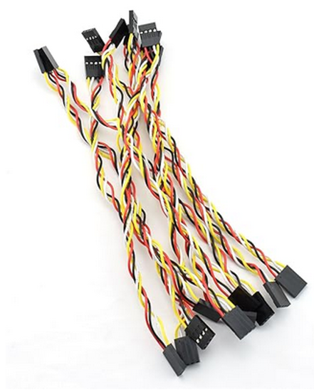
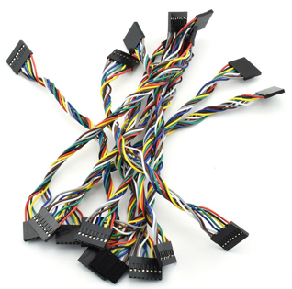
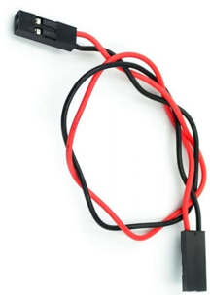
0.1” Header Cables: 2,4 and 8 pin, 6” long
1x
1x
2x

Slide 6
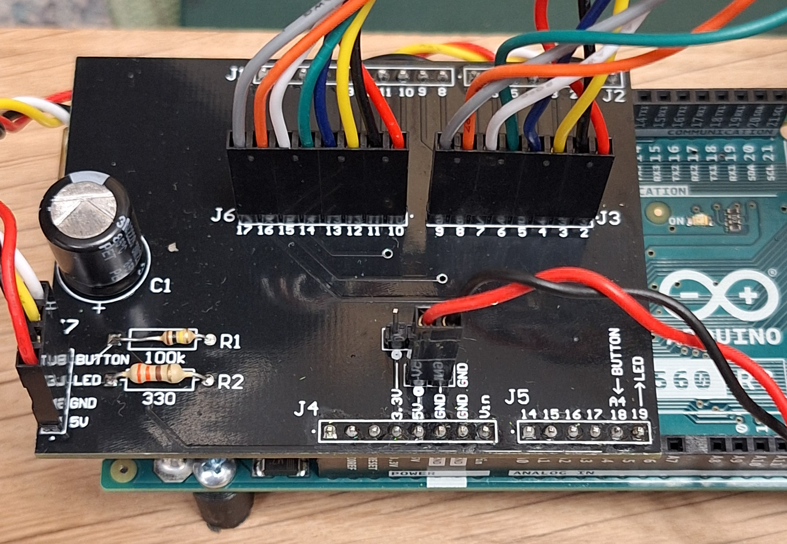
Assembly with cables

