Slide 1
Cold board mount brackets
Lafe Spietz
NIST
Summer 2024

Slide 2
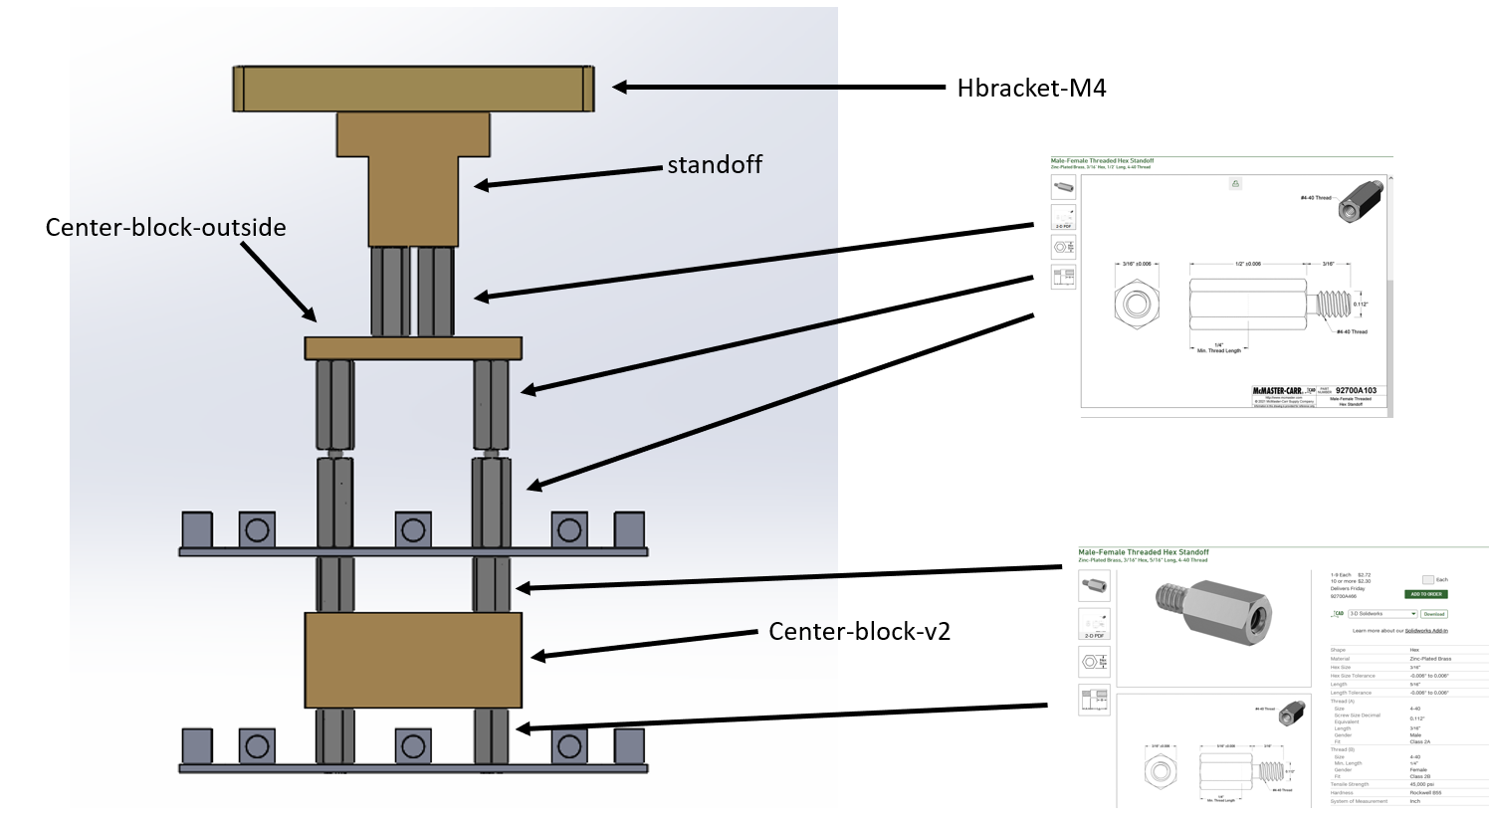
Assembly

Slide 3
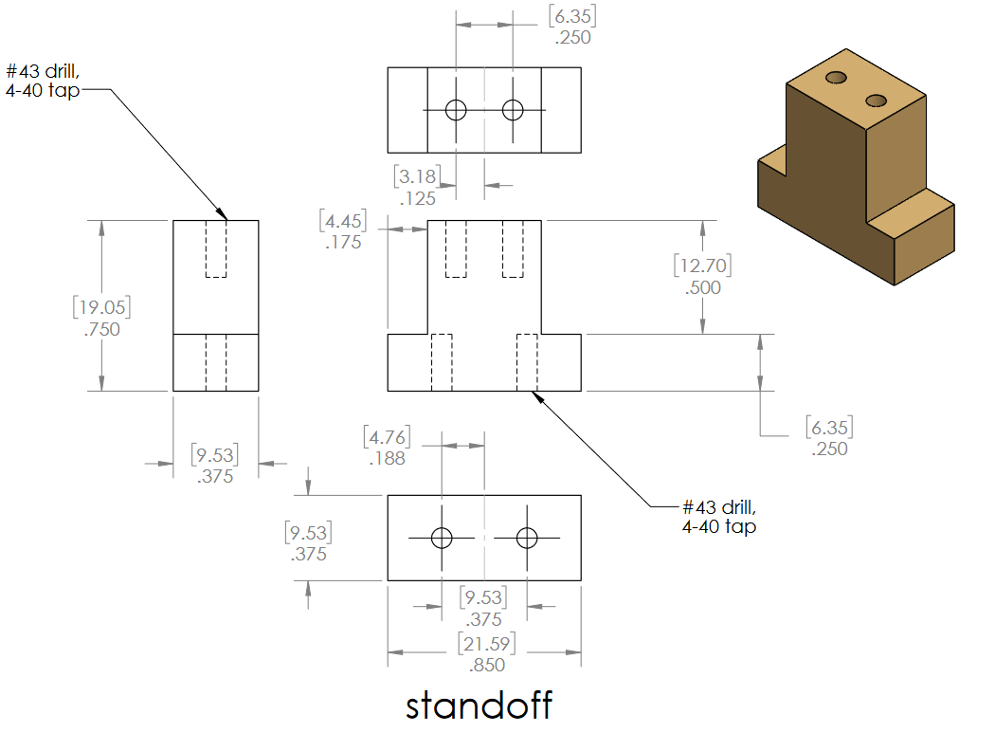

Slide 4
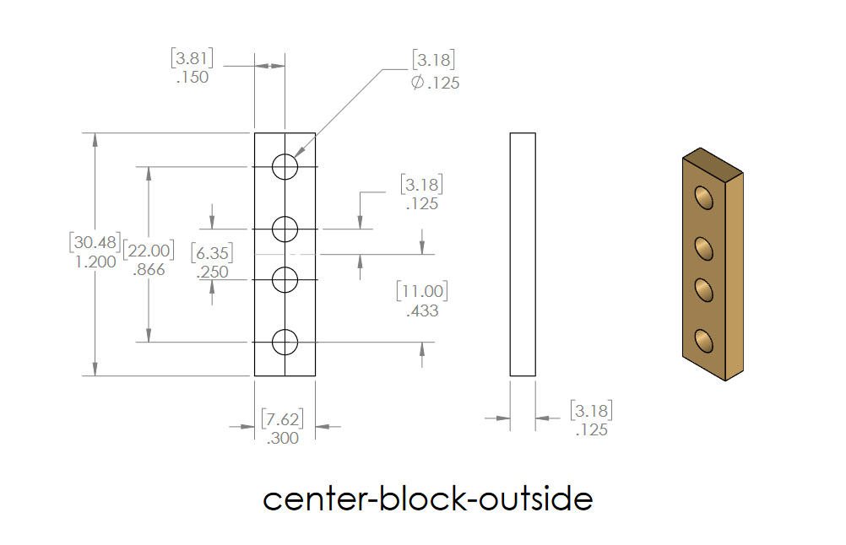

Slide 5
