Slide 1
3D Printed Parts Build
Lafe Spietz
NIST
Summer 2024

Slide 2
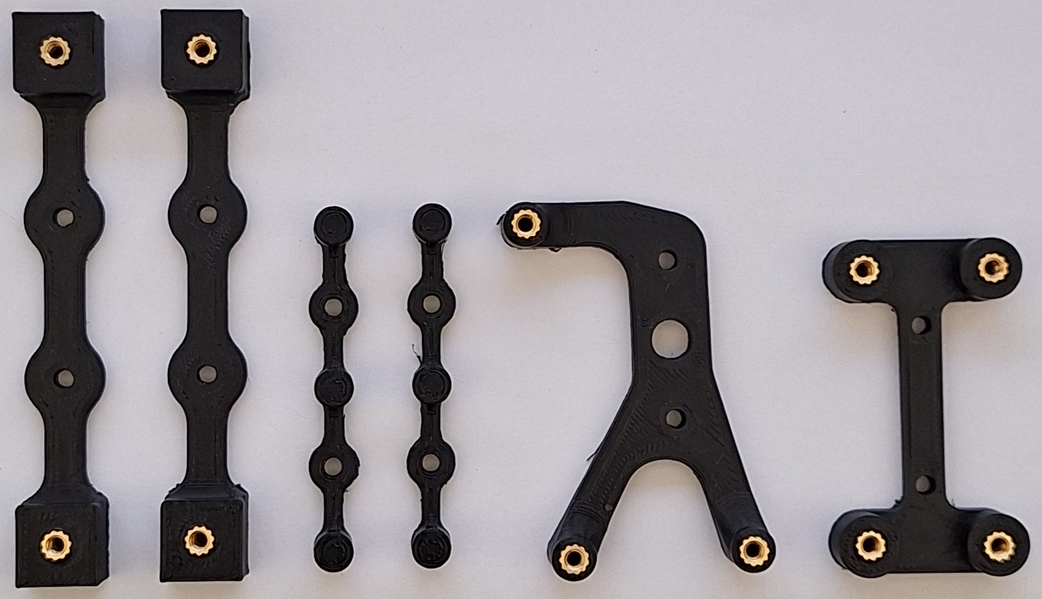
Full Set of Parts
arduino-bracket.STL
HV-DCDC-bracket.STL
front-panel-edge-bracket.STL
front-panel-center-bracket.STL

Slide 3
Print times and filament masses
arduino-bracket.STL: 4 grams, 18 minutes, print 1
HV-DCDC-bracket.STL: 4 grams, 14 minutes, print 1
front-panel-center-bracket.STL: 1 gram/each, 7 minutes/each, print 2
front-panel-edge-bracket.STL: 4 grams/each 14 minutes/each, print 2
Total filament mass: 18 g
Total print time: 77 minutes

Slide 4

4-40 Thread Inserts
Insert with soldering iron, in a press if available

