Slide 1
Front Panel Boards
Lafe Spietz
NIST
Summer 2024

Slide 2
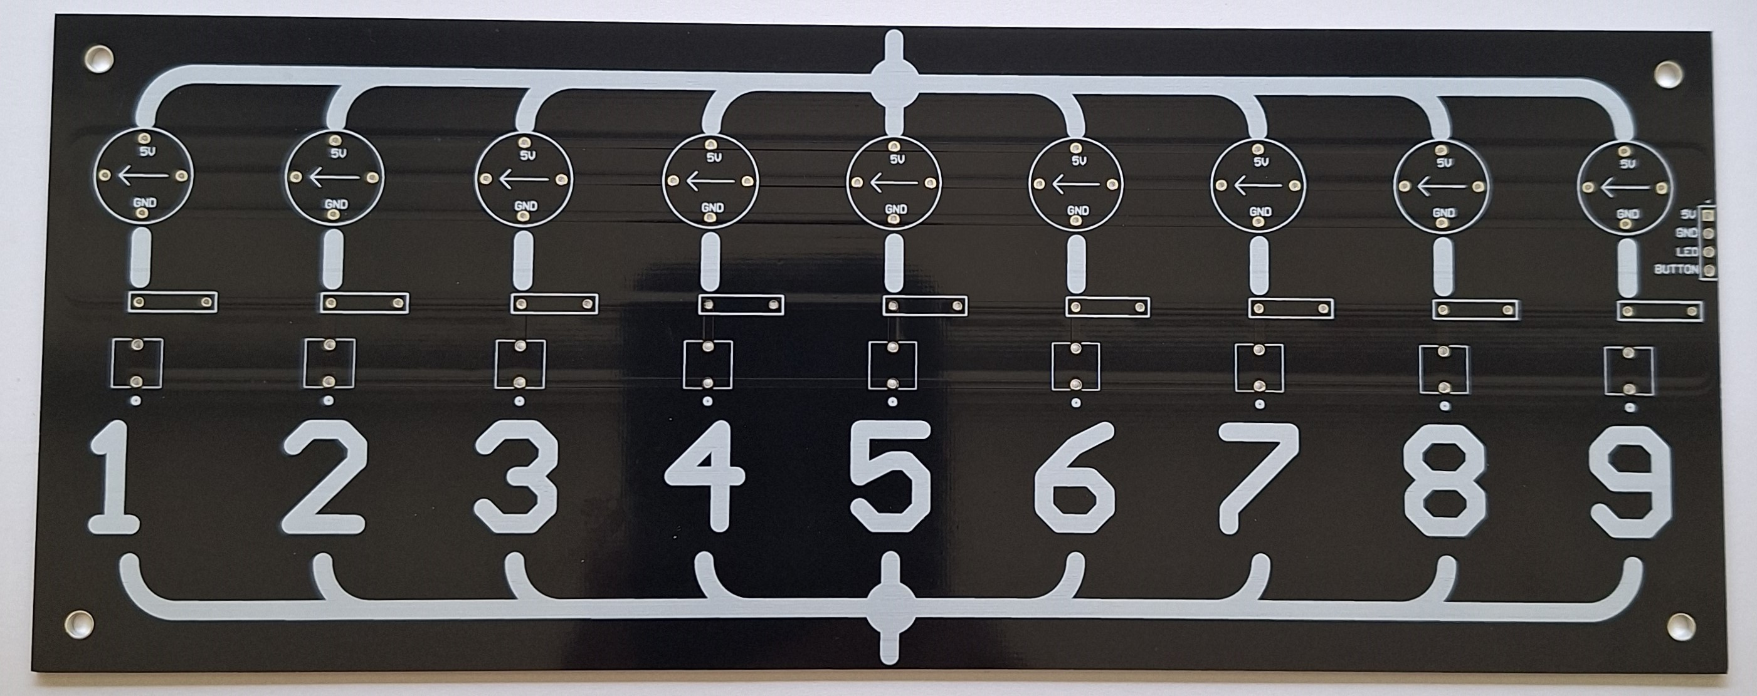
SP9T Board

Slide 3
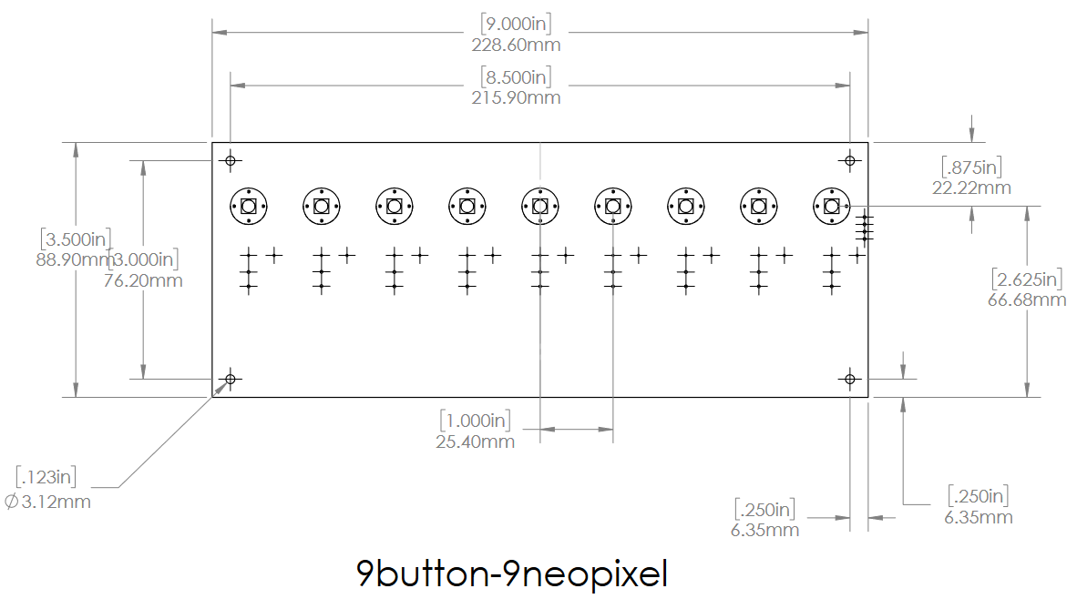

Slide 4
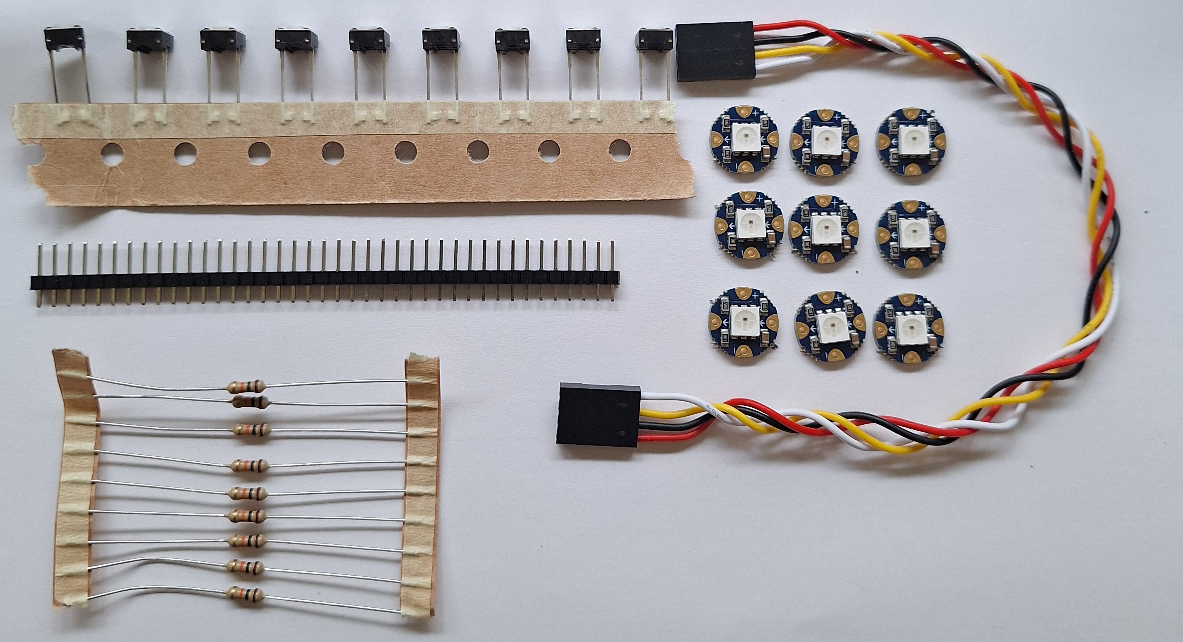
Kit

Slide 5
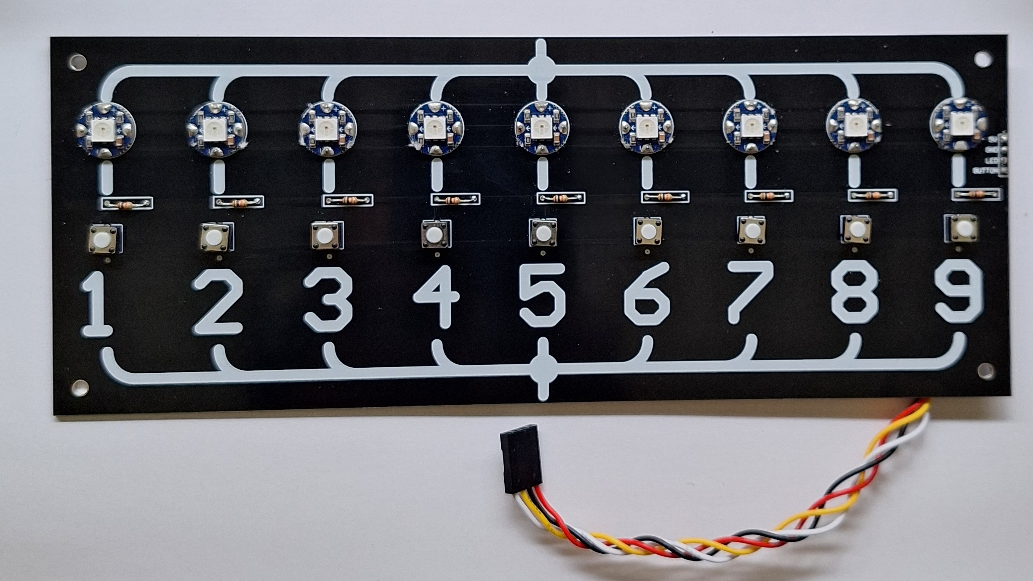
Assembly

Slide 6
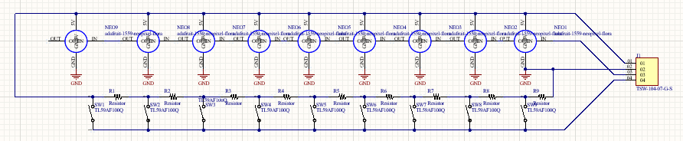
Schematic

