Slide 1
Micro D to Header Adapter Board Build
Lafe Spietz
NIST
Summer 2024

Slide 2
Bill of Materials
Microd-header-adapter-board-rev2
Headers
MicroD

Slide 3
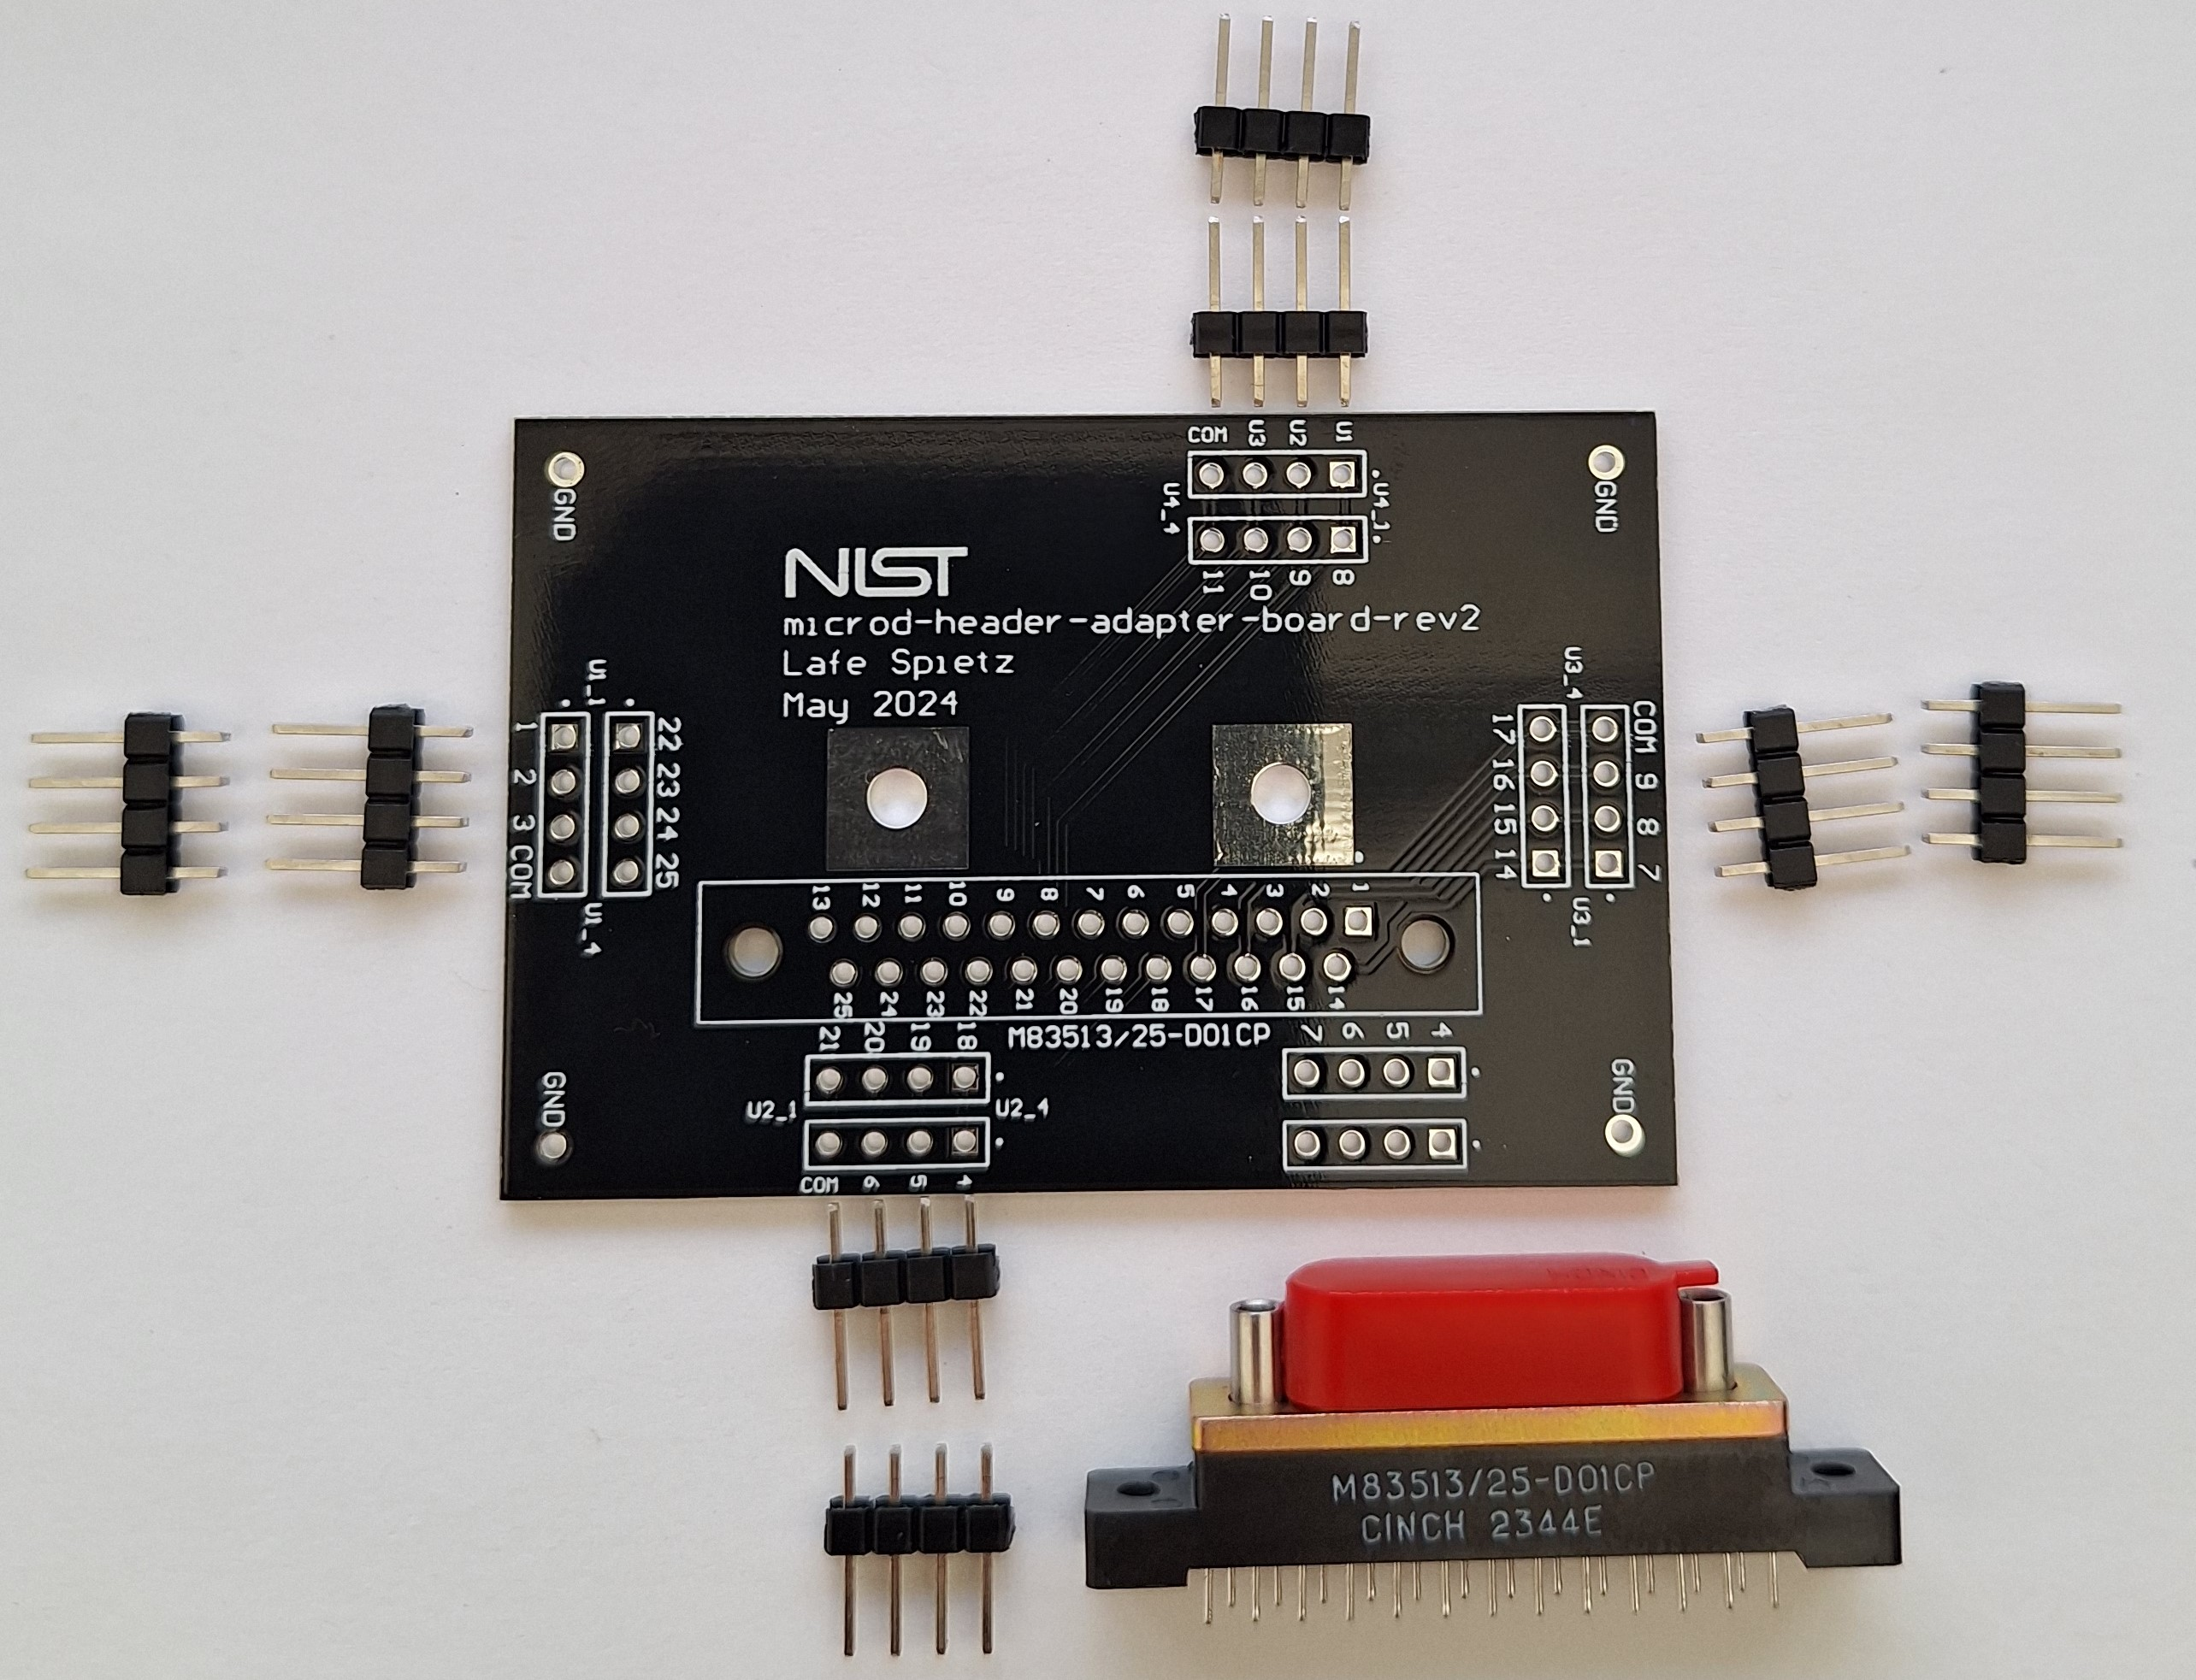
Kit

Slide 4
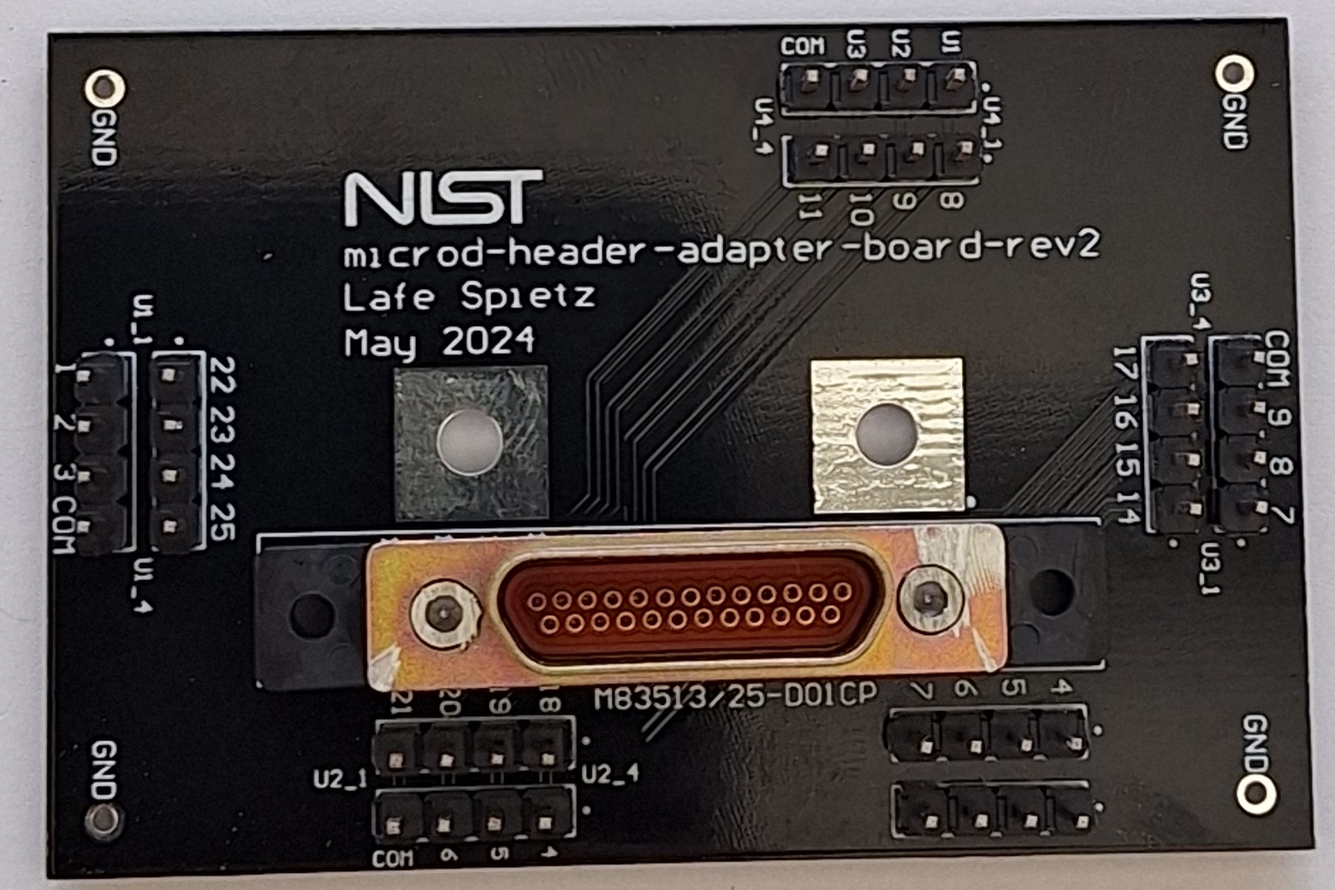
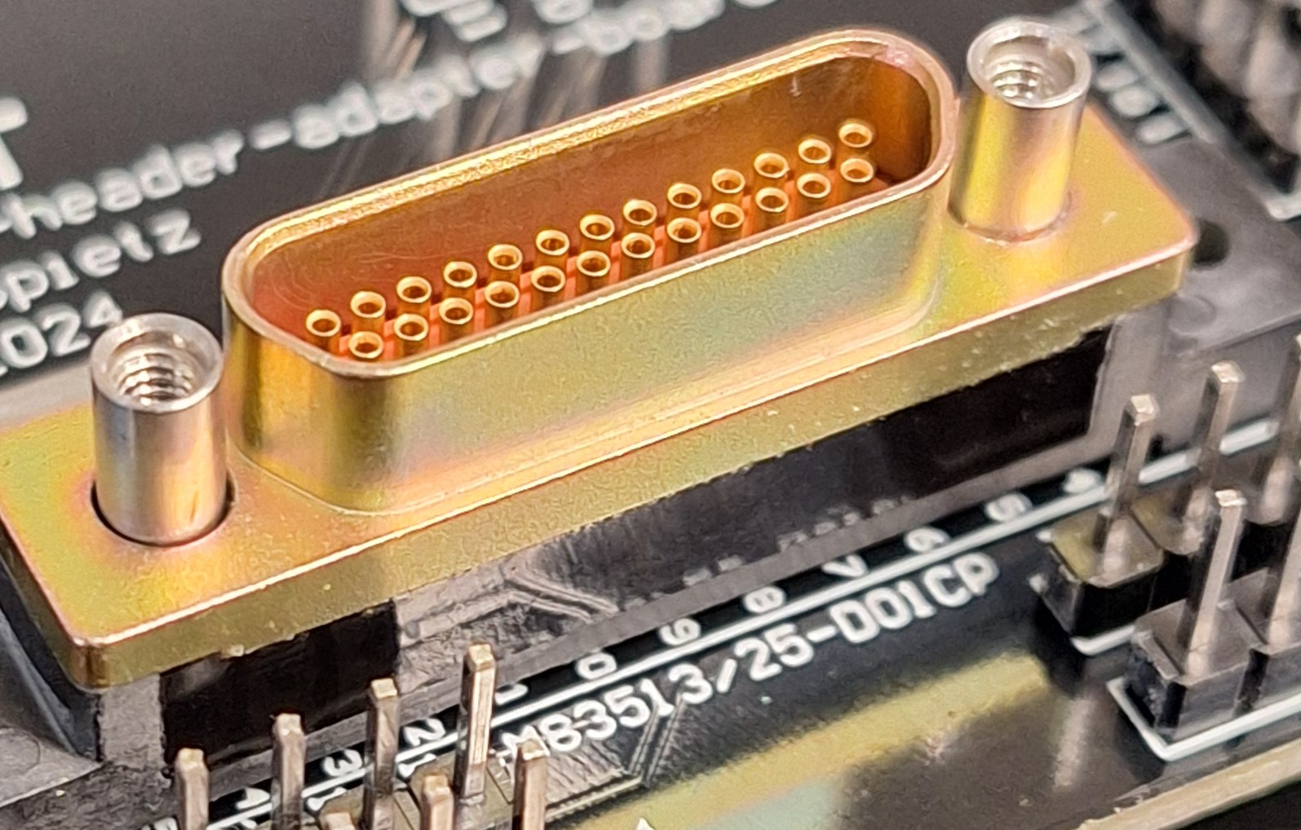
Cut off the screws with a cutting wheel:

