Slide 1



Calibration Circuit Boards
MEMSDuino
Lafe Spietz
NIST
2024

Slide 2
Abstract
These circuit boards connect between the two SP9T switch boards.
MEMSDuino

Slide 3
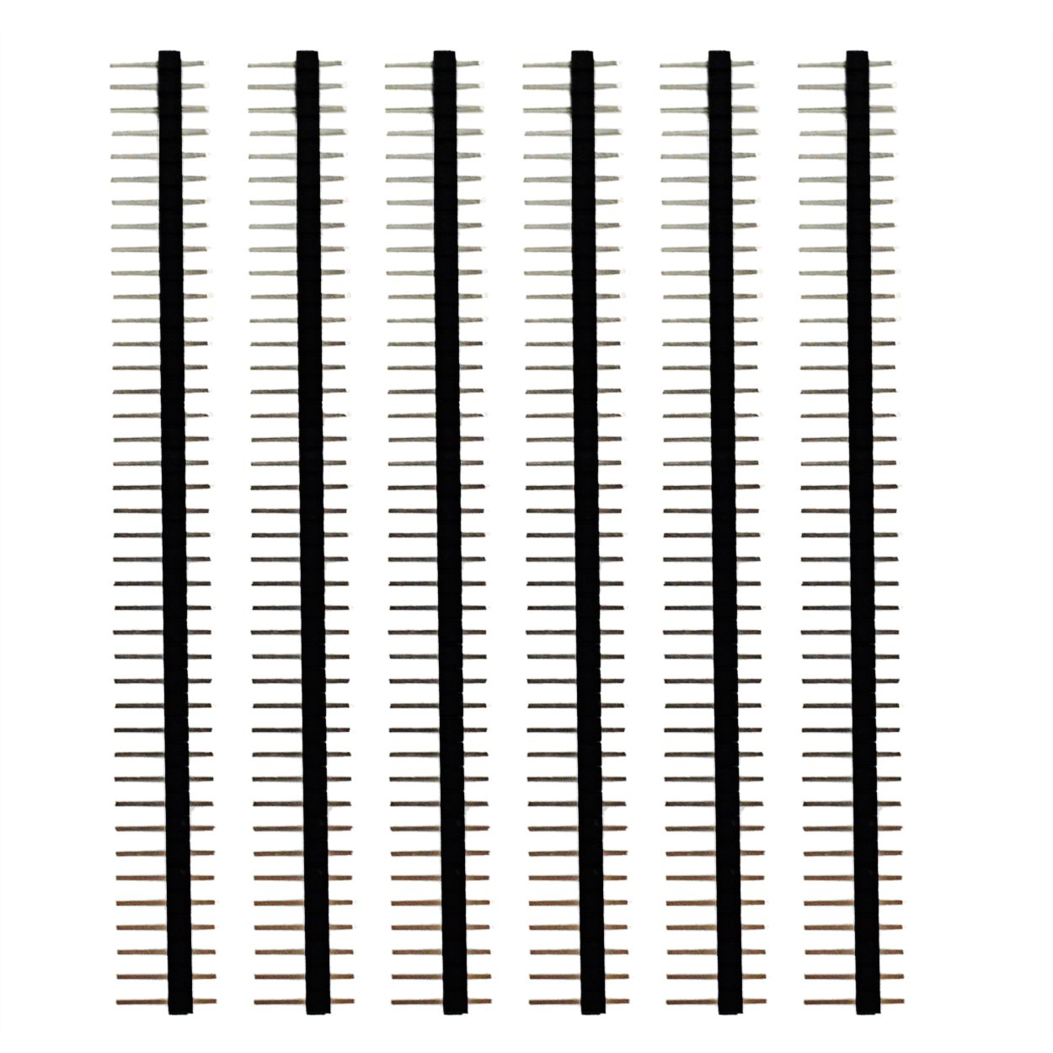
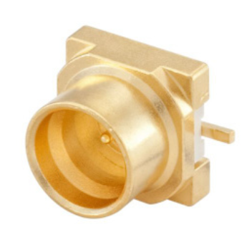
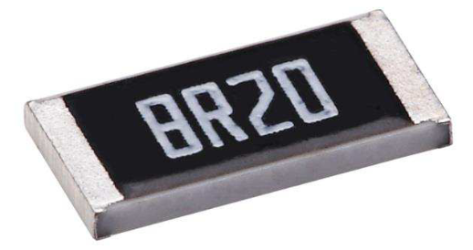
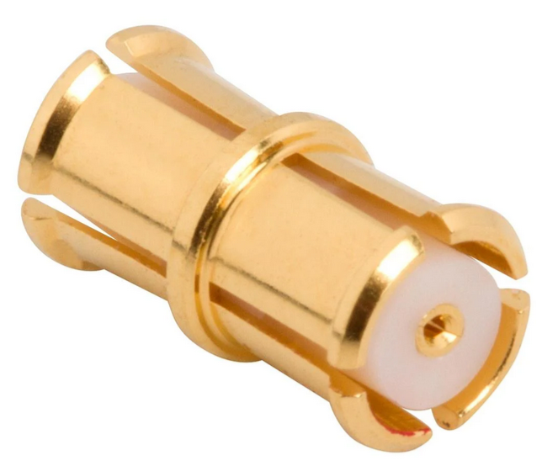
Parts
Rosenberger Smooth Bore SMP 19S141-40ML5
0.1” headers, 40 pin strips x1
https://www.amazon.com/Header-Lystaii-Pin-Connector-Electronic/dp/B06ZZN8L9S/
https://www.digikey.com/en/products/detail/rosenberger/19S141-40ML5/7926829
TE Connectivity
49.9 Ohm 0201 NiCr Resistor CPF0201B49R9E1
Amphenol SMP-FS2A-645
F-F SMP Bullet
https://www.digikey.com/en/products/detail/te-connectivity-passive-product/CPF0201B49R9E1/14007284
https://www.mouser.com/ProductDetail/Amphenol-RF/SMP-FS2A-645?qs=u16ybLDytRZu9pNzWfGeSw%3D%3D
MEMSDuino

Slide 4
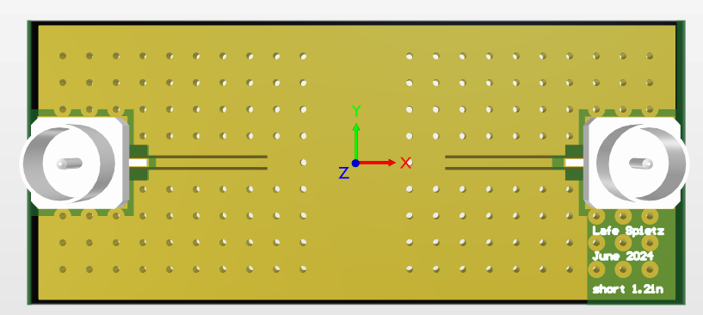
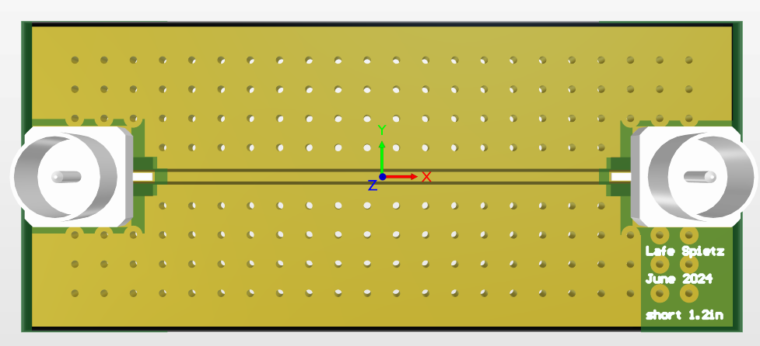
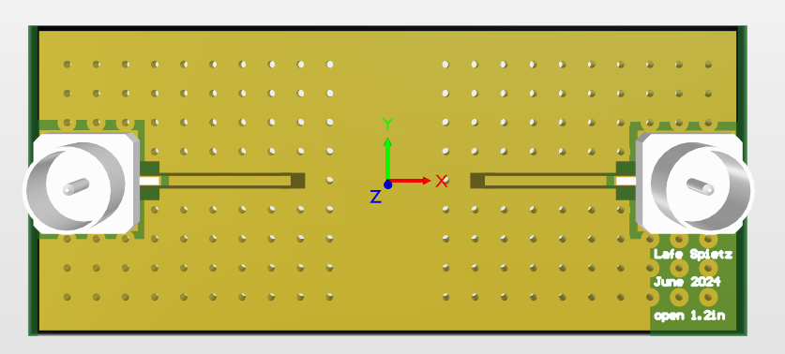
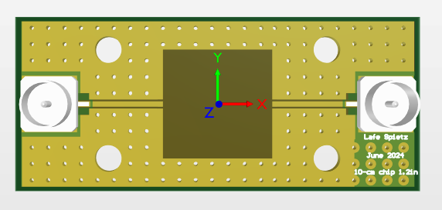
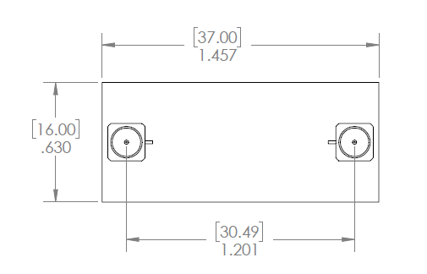
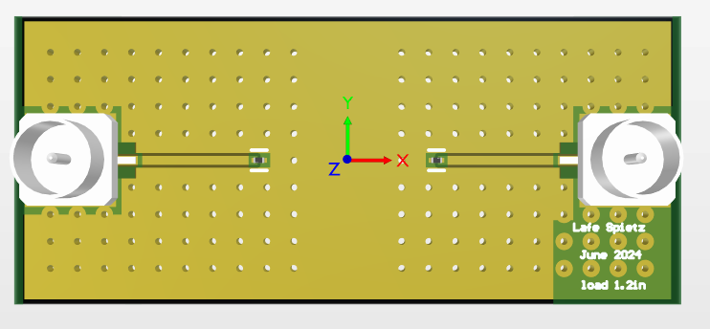
Short
Through
Open
10 mm Chip
Load
MEMSDuino

Slide 5
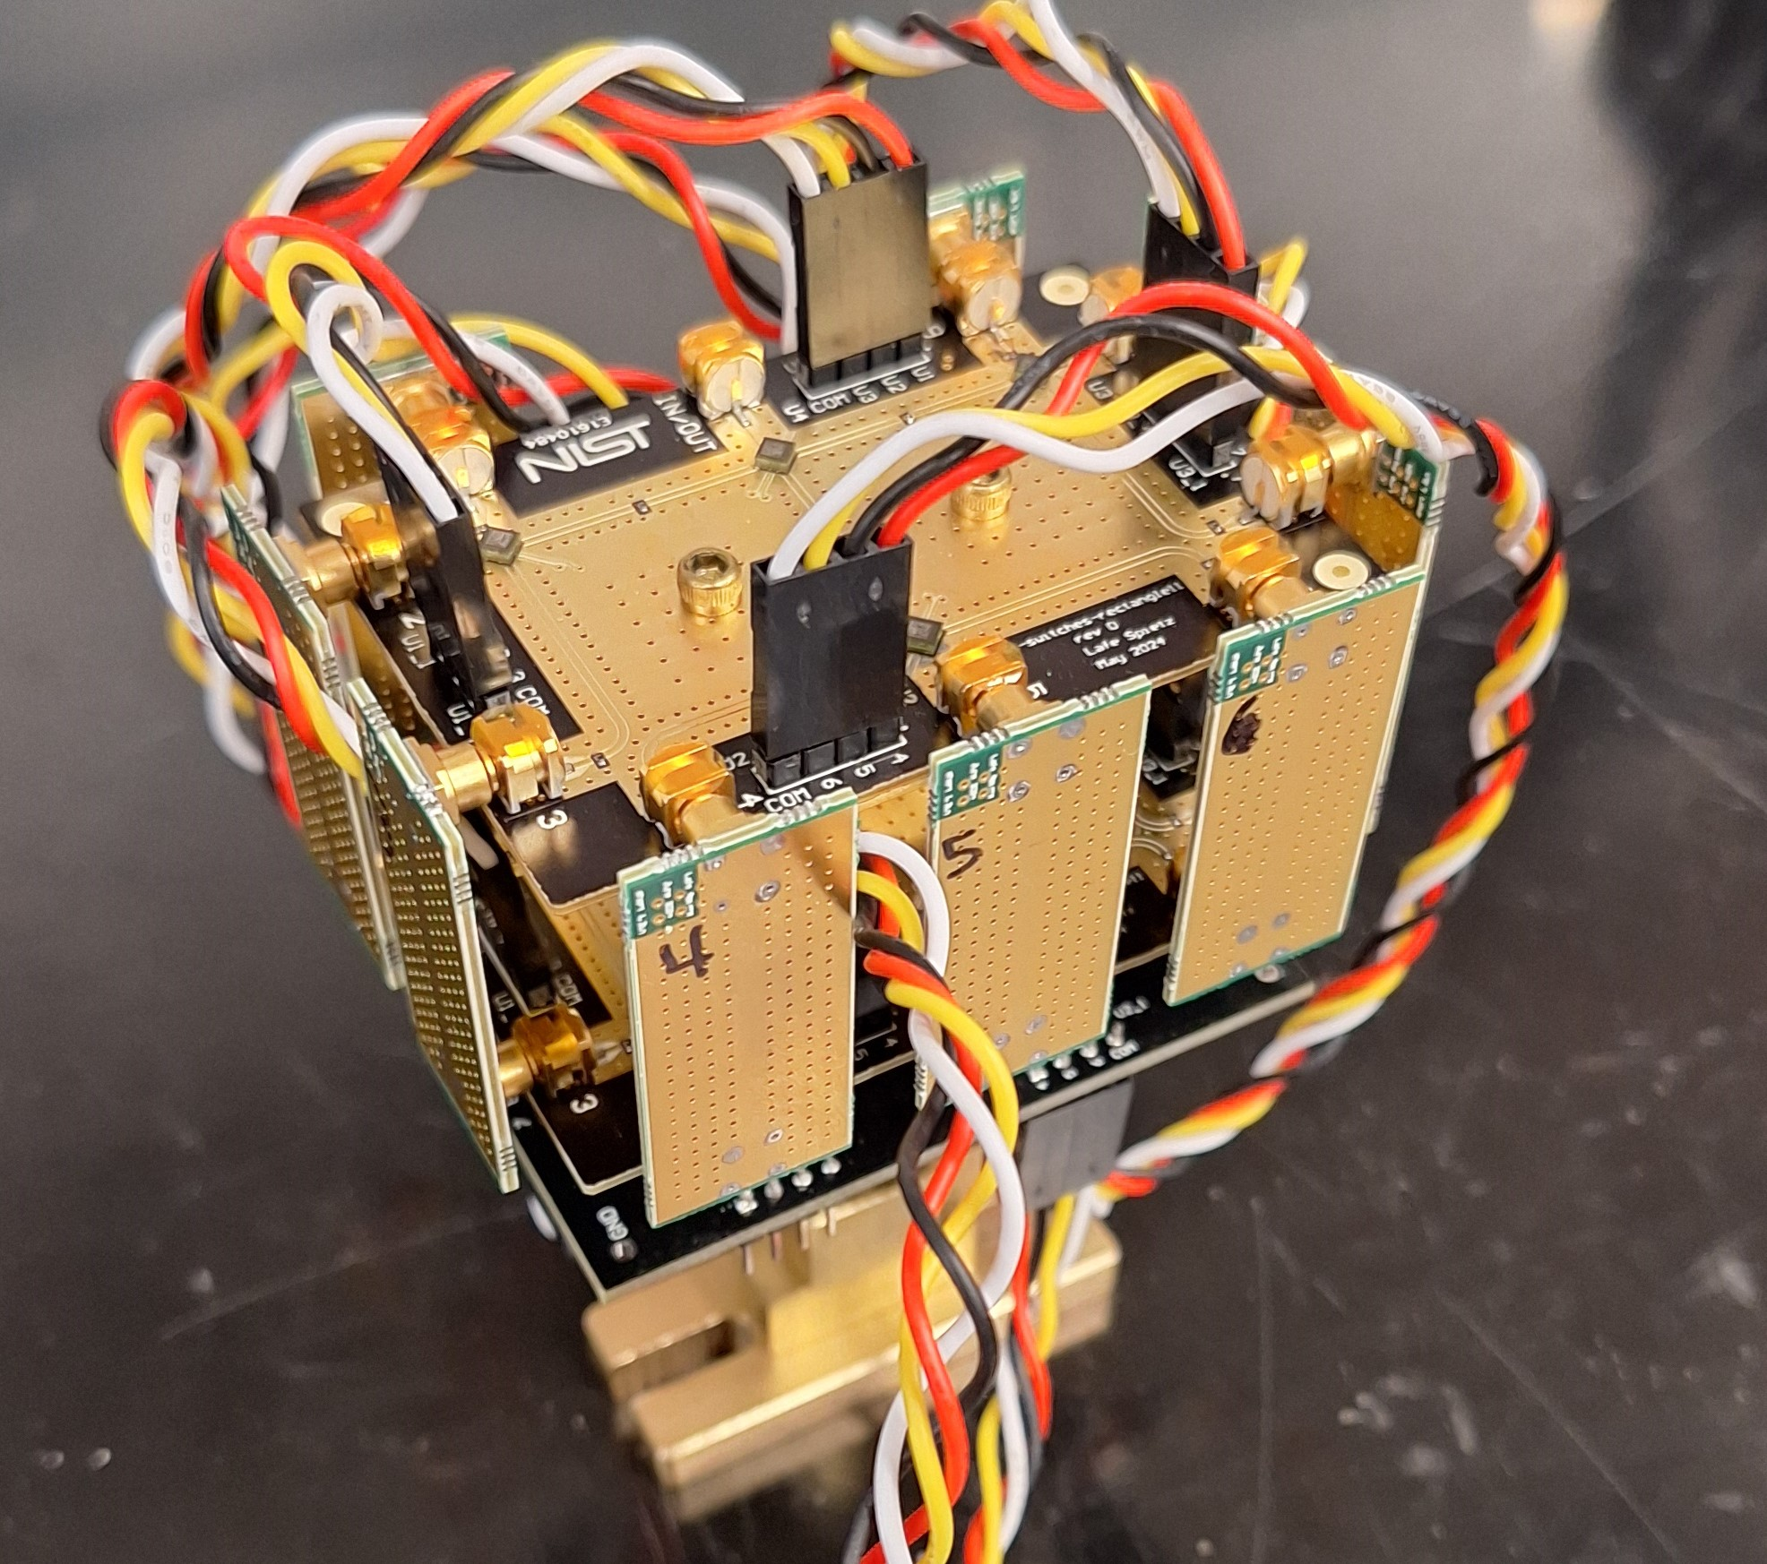
MEMSDuino

Slide 6
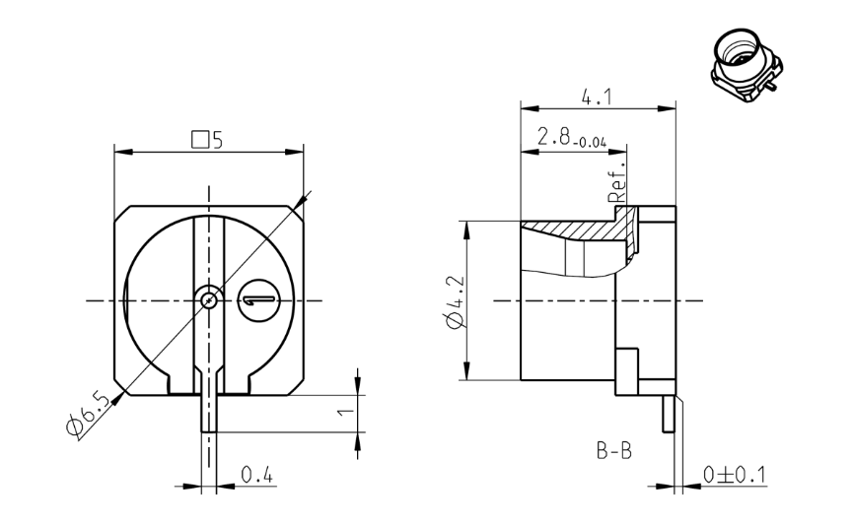
Rosenberger Smooth Bore SMP 19S141-40ML5
https://www.digikey.com/en/products/detail/rosenberger/19S141-40ML5/7926829

Slide 7
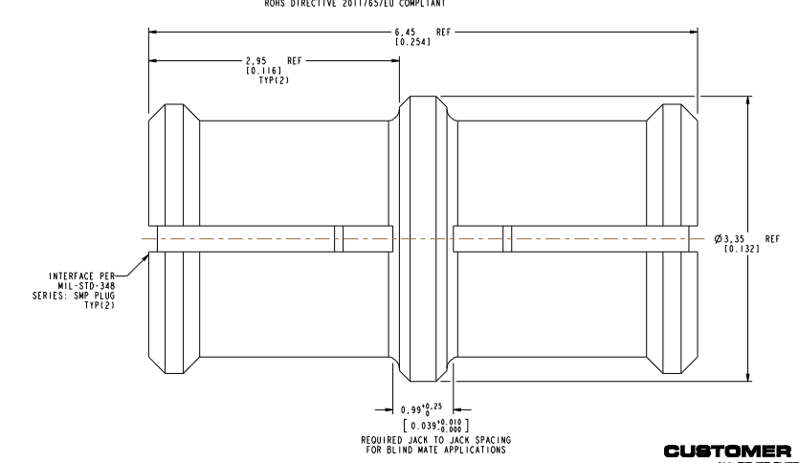
Amphenol SMP-FS2A-645
F-F SMP Bullet
https://www.mouser.com/ProductDetail/Amphenol-RF/SMP-FS2A-645?qs=u16ybLDytRZu9pNzWfGeSw%3D%3D

Slide 8
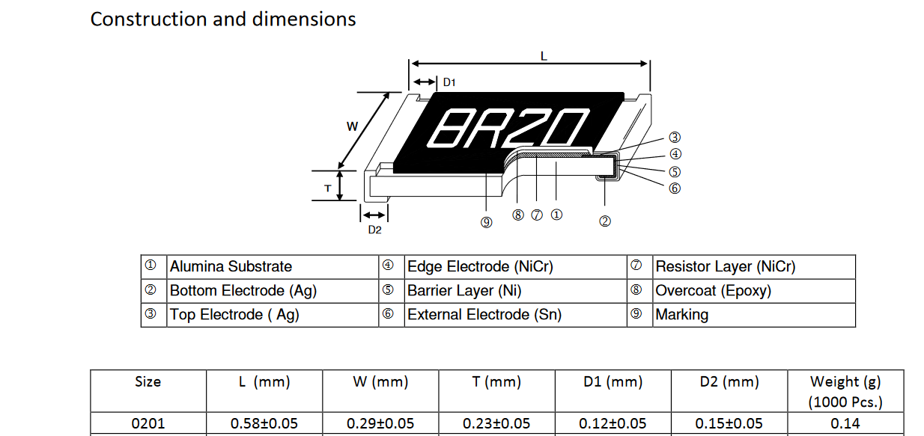
TE Connectivity
49.9 Ohm 0201 NiCr Resistor CPF0201B49R9E1
https://www.digikey.com/en/products/detail/te-connectivity-passive-product/CPF0201B49R9E1/14007284
MEMSDuino

Slide 9
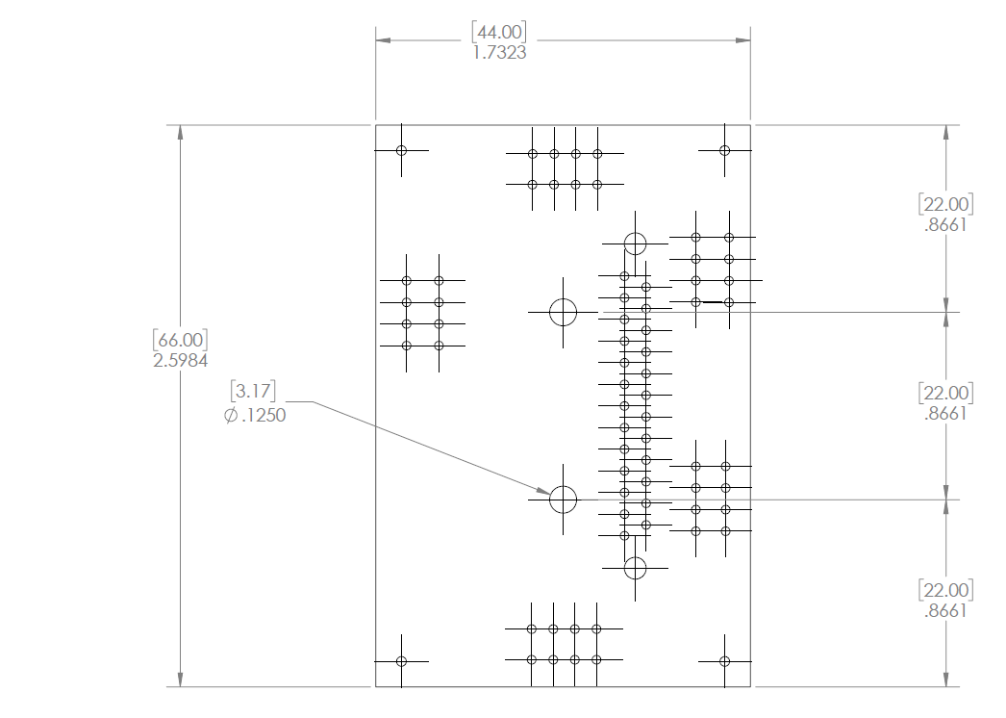
Mechanical Drawing
MEMSDuino

Slide 10
Conclusions:
Note that pins 13 and 12 connect to ground. This might not be ideal in certain circumstances. We have broken ground at room temperature and use the metal in the dilution refrigerator for the ground now. This board will almost certainly be different from what other users will want. This example drives all 4 control lines of 4 MEMS switches.
MEMSDuino

