Slide 1



Micro D to Header Adapter Board Build
MEMSDuino
Lafe Spietz
NIST
2024

Slide 2
Abstract
This circuit board breaks out the MicroD found at the base of many dilution refrigerators into a set of up to 20 lines, each broken out in a pair of identical 4 pin header outputs. Labels are specific to our switch matrix at NIST, but can be adapted to any switch with 20 or fewer lines.
MEMSDuino

Slide 3
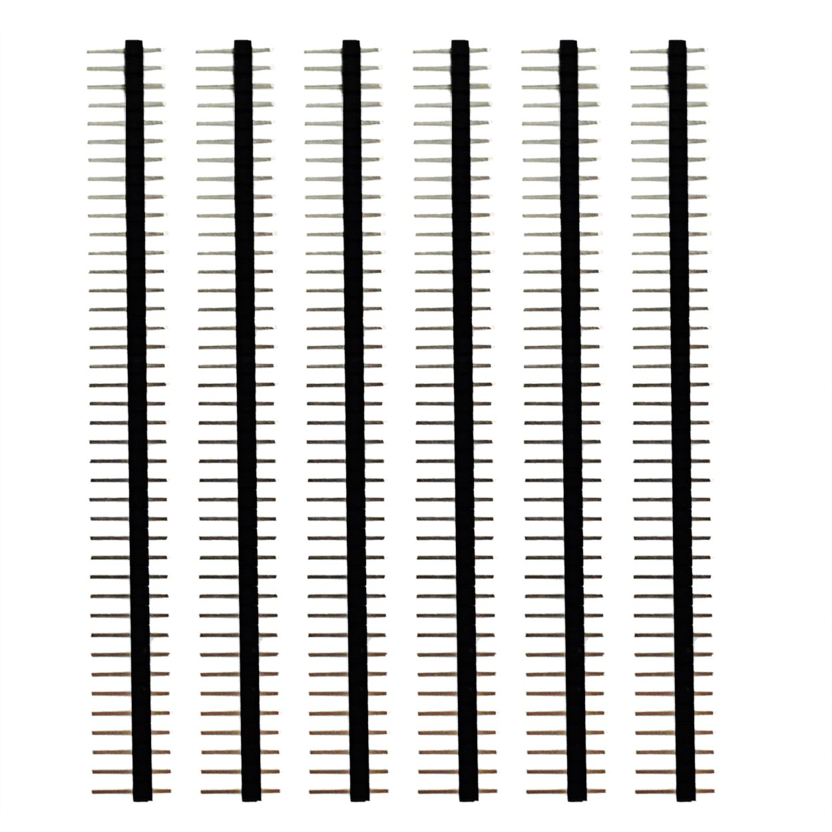
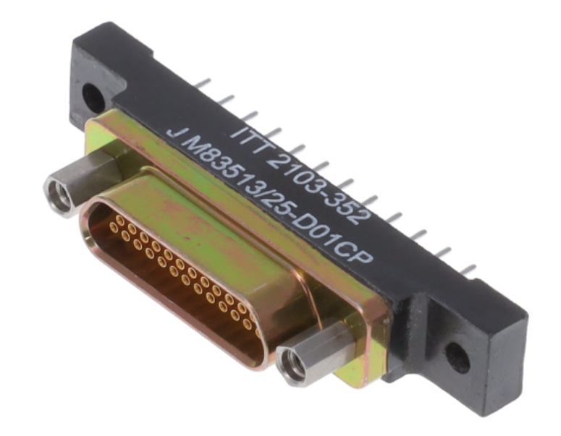
Parts
M83513/25-D01CP x1
0.1” headers, 40 pin strips x1
https://www.amazon.com/Header-Lystaii-Pin-Connector-Electronic/dp/B06ZZN8L9S/
https://www.digikey.com/en/products/detail/itt-cannon,-llc/M83513%2F25-D01CP/4803943
MEMSDuino

Slide 4
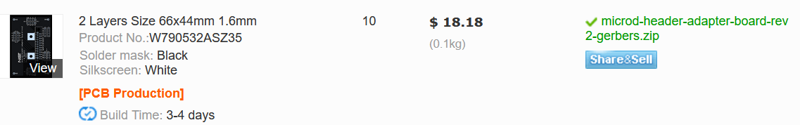
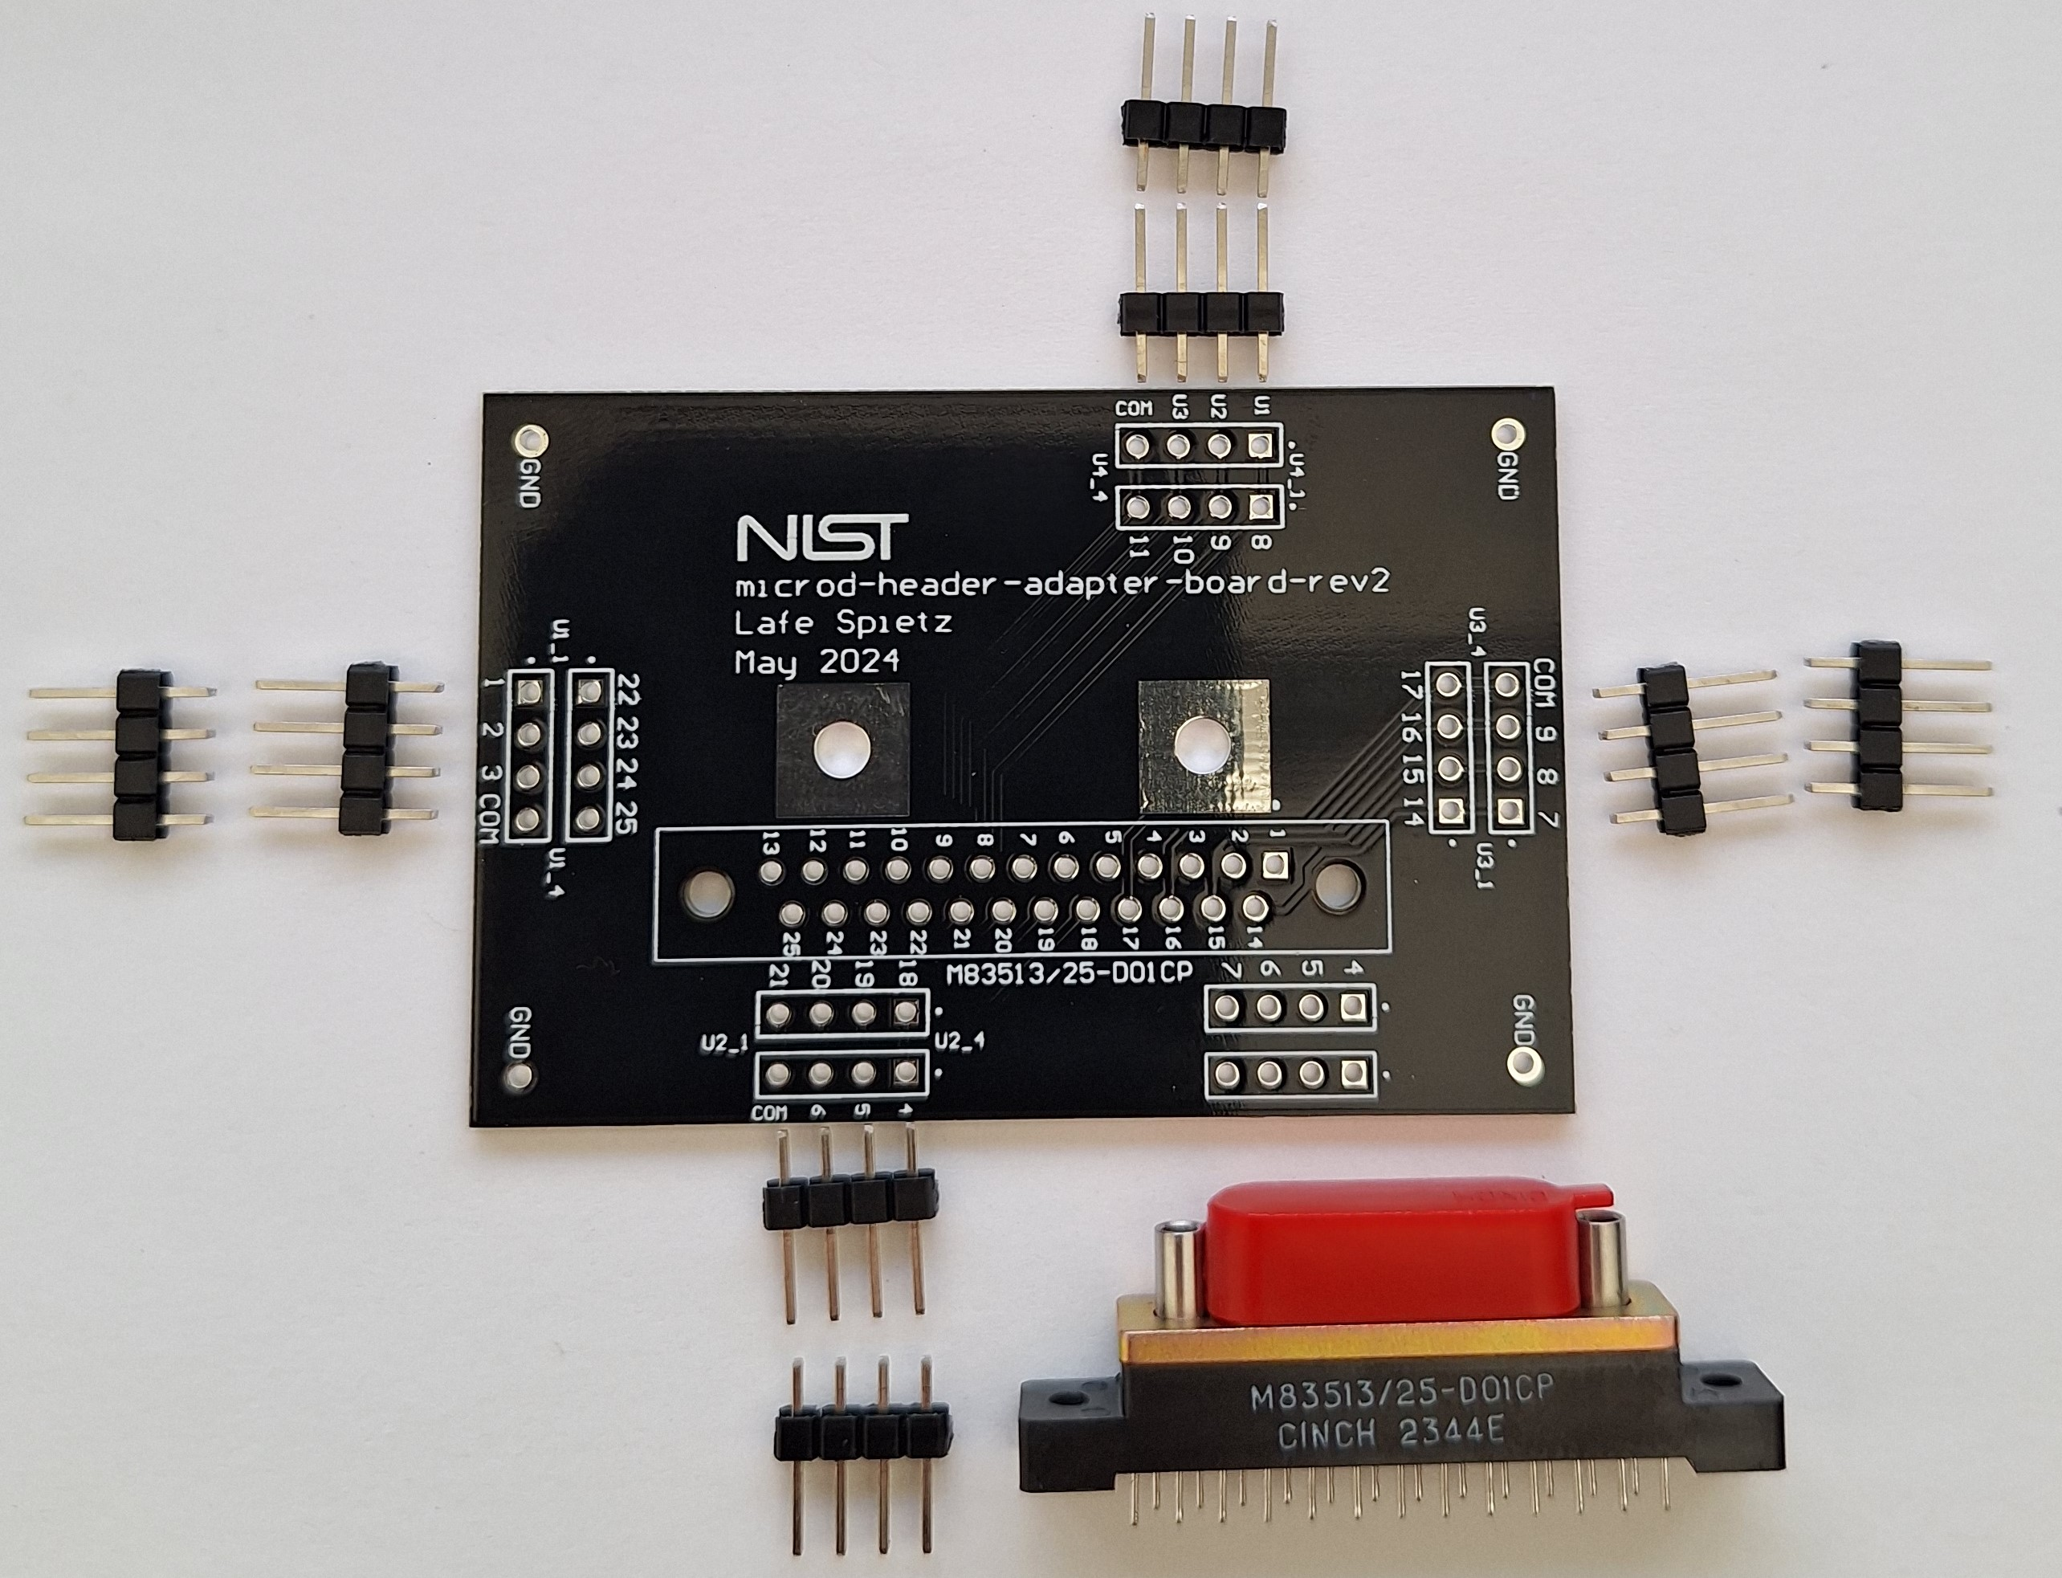
66 x 44 mm size
Black solder mask
White silkscreen
1.6mm FR4
https://github.com/lafefspietz/MEMSduino/raw/main/PCB_files/microd-header-adapter-board-rev2-gerbers.zip
MEMSDuino

Slide 5
Header breakaways: 4 pin x8
MEMSDuino

Slide 6
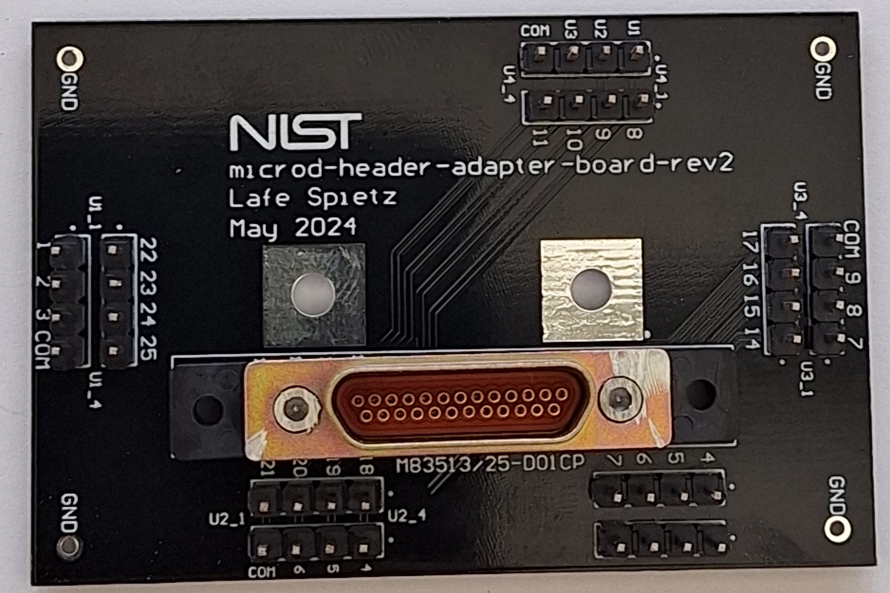
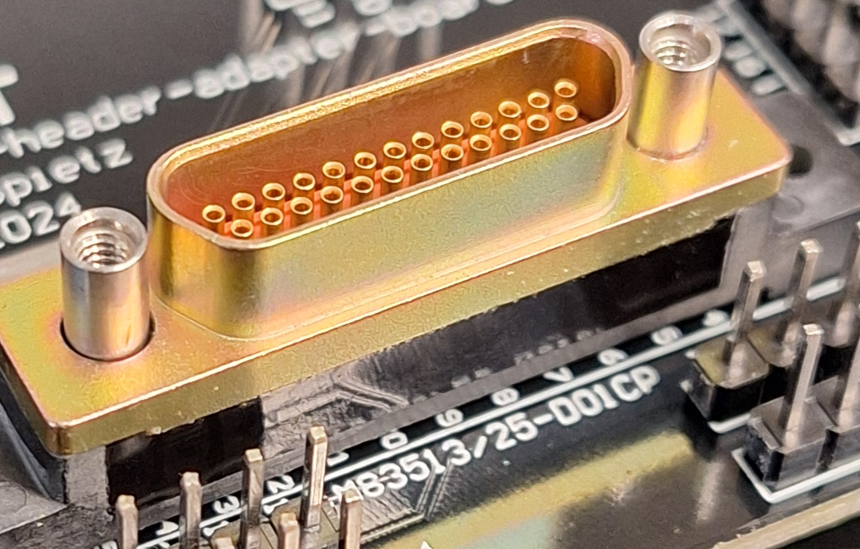
Cut off the screws with a cutting wheel:
MEMSDuino

Slide 7
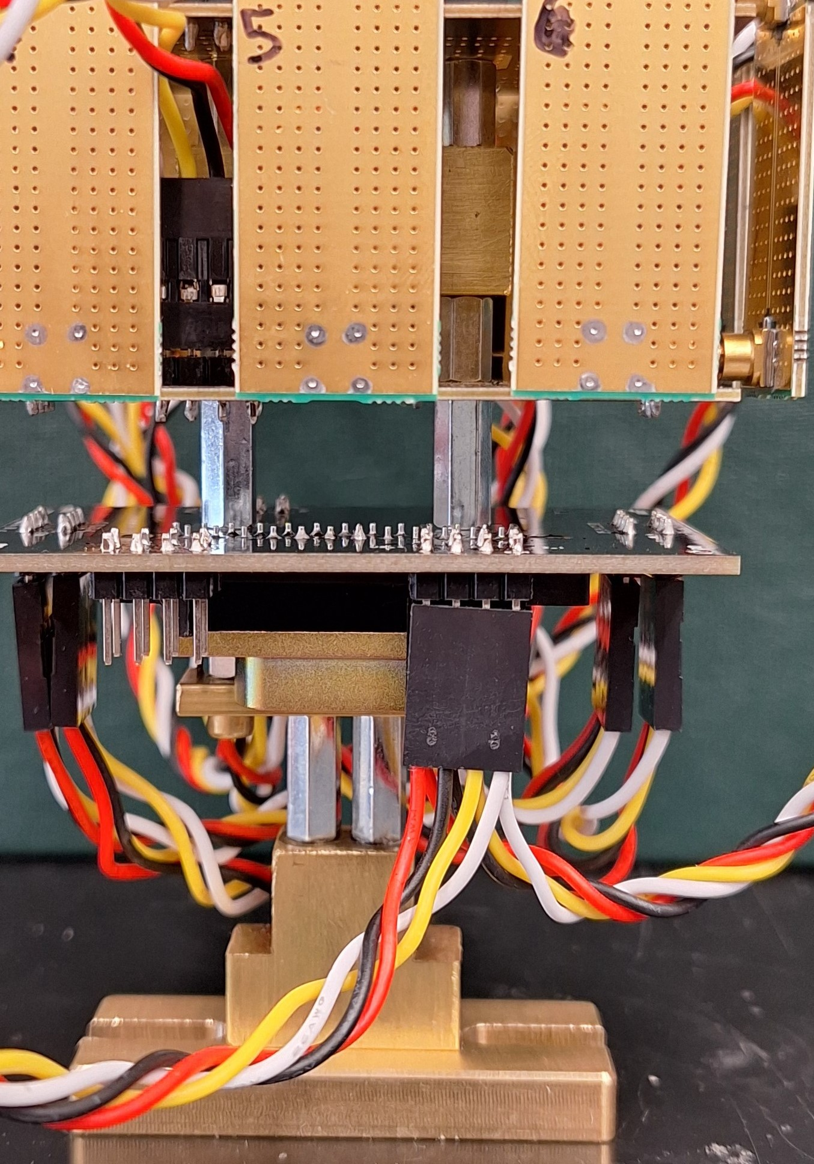
MEMSDuino

Slide 8
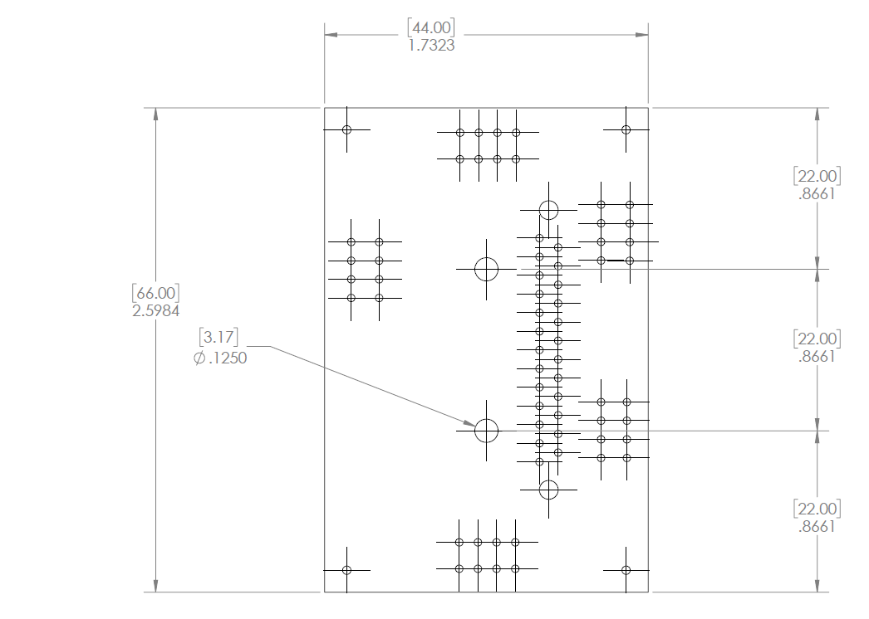
Mechanical Drawing
MEMSDuino

Slide 9
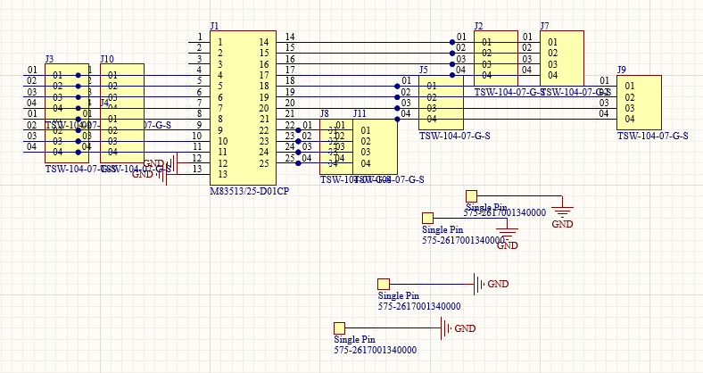
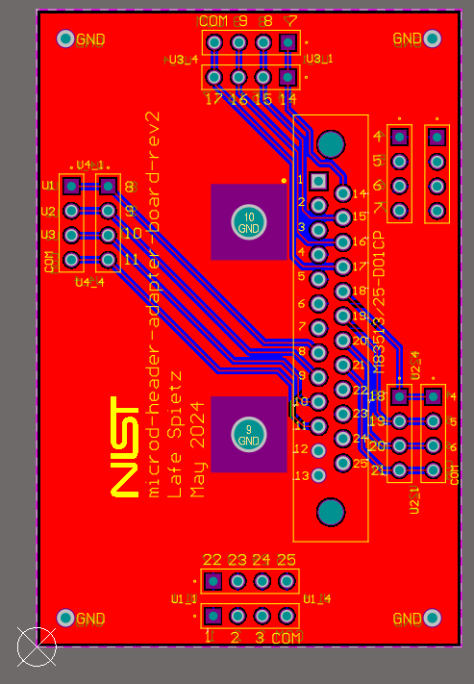
Altium Designer Files
https://github.com/lafefspietz/MEMSduino/raw/main/PCB_files/microd-header-adapter-board-rev2.SchDoc
https://github.com/lafefspietz/MEMSduino/raw/main/PCB_files/microd-header-adapter-board-rev2.PrjPcb
https://github.com/lafefspietz/MEMSduino/raw/main/PCB_files/microd-header-adapter-board-rev2.PcbDoc
MEMSDuino

Slide 10
Conclusions:
Note that pins 13 and 12 connect to ground. This might not be ideal in certain circumstances. We have broken ground at room temperature and use the metal in the dilution refrigerator for the ground now. This board will almost certainly be different from what other users will want. This example drives all 4 control lines of 4 MEMS switches.
MEMSDuino

