Slide 1
Cold board mount brackets
Lafe Spietz
NIST
Summer 2024

Slide 2
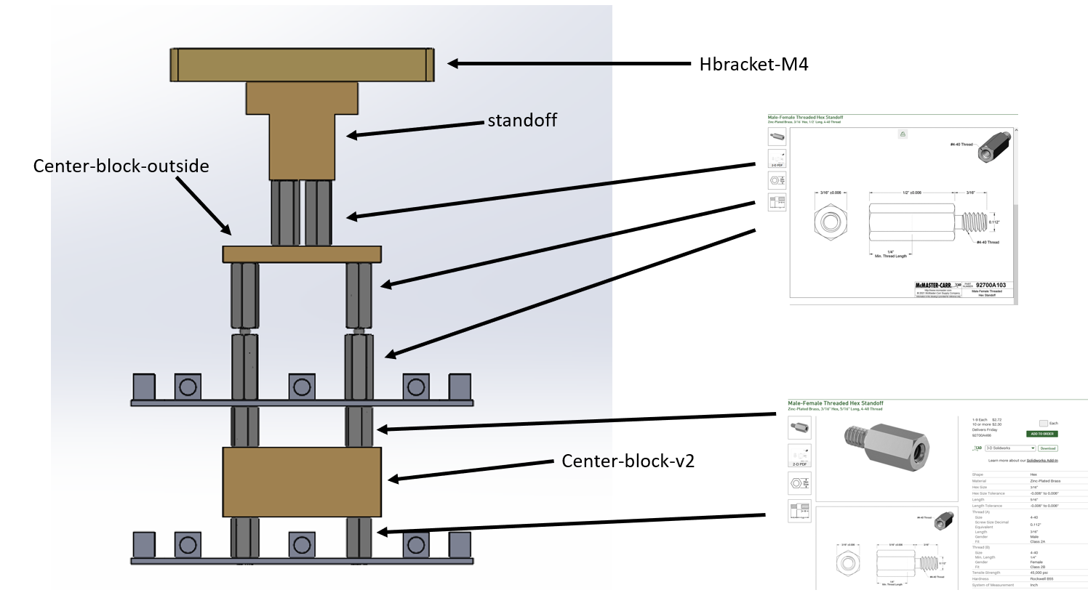
Assembly

Slide 3
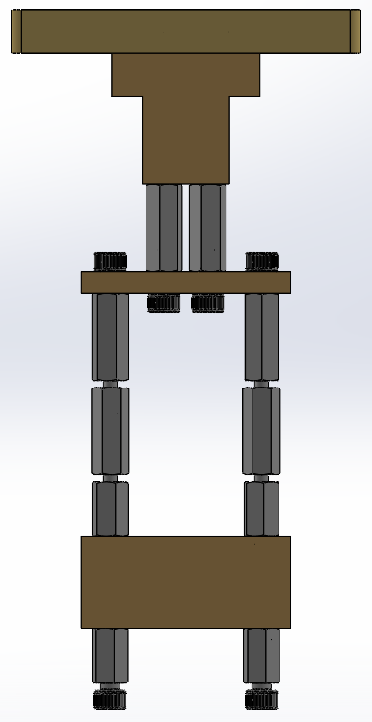
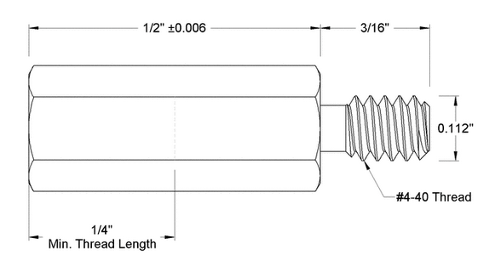
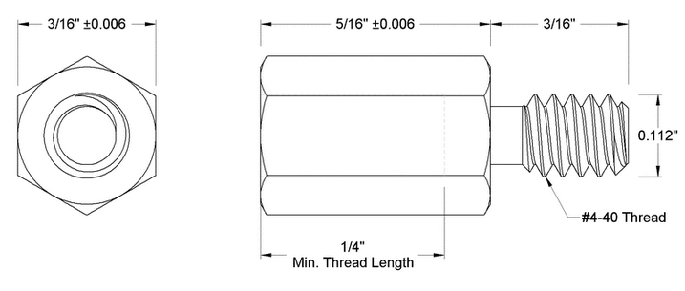
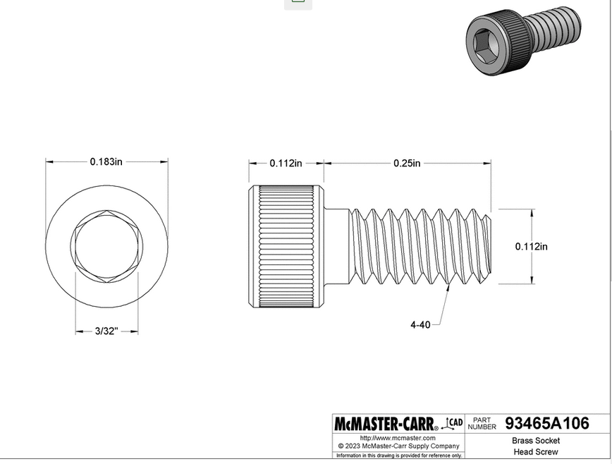
H Bracket
https://www.mcmaster.com/92700A103/
Standoff
Center block outside
https://www.mcmaster.com/92700A103/
Center block v2
https://www.mcmaster.com/92700A466/

Slide 4
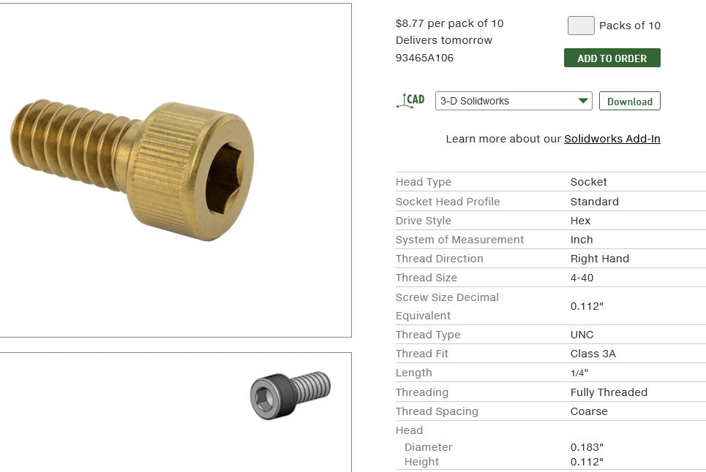
https://www.mcmaster.com/93465A106/

Slide 5
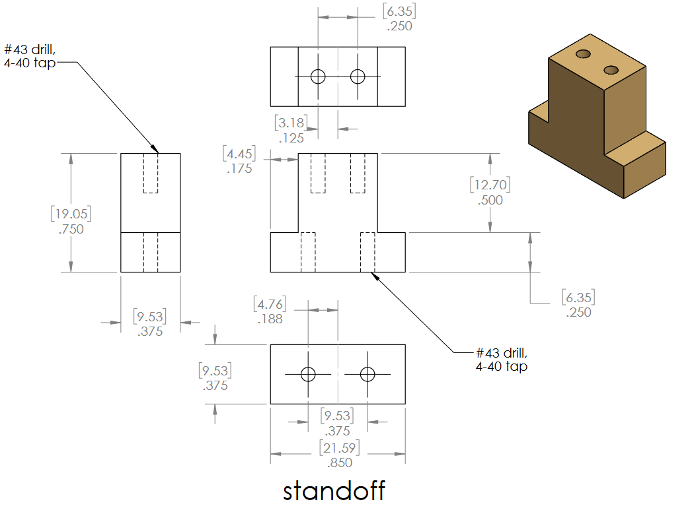

Slide 6
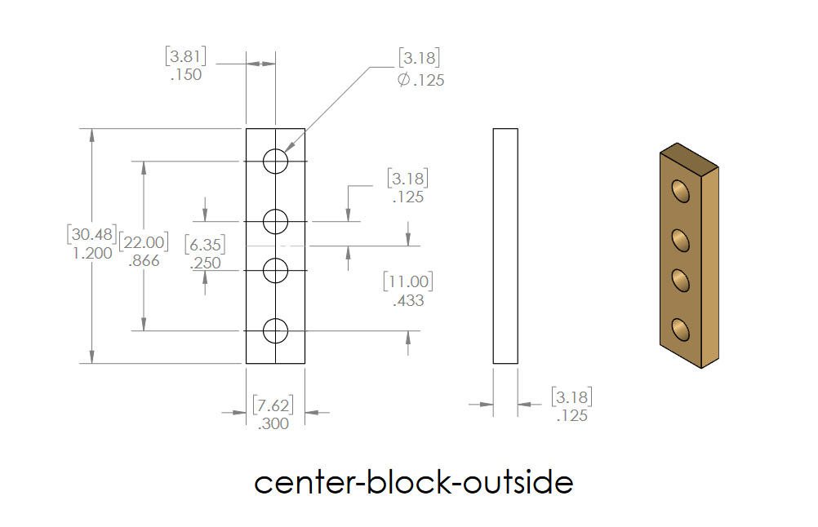

Slide 7
