Slide 1



Cryogenic Mounting Hardware
MEMSDuino
Lafe Spietz
NIST
2024

Slide 2
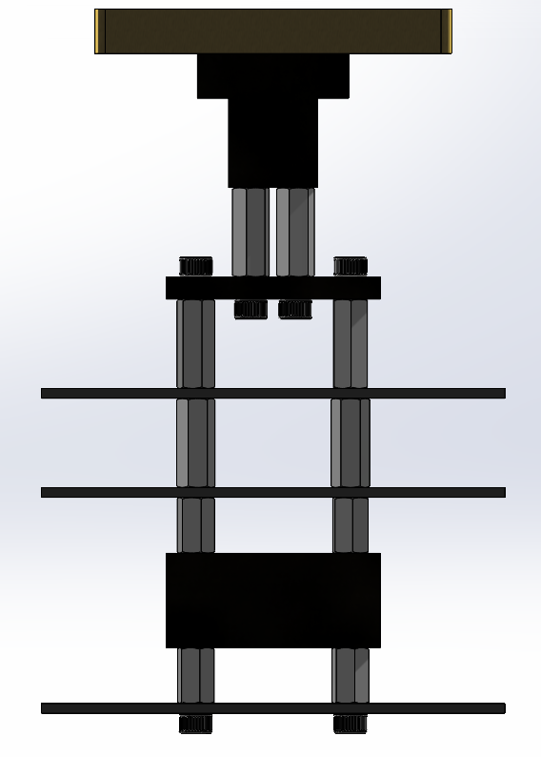
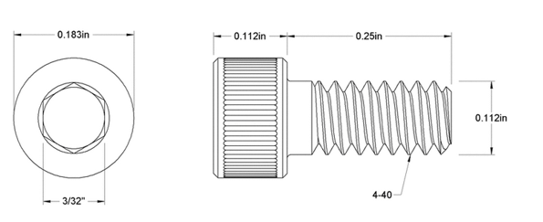
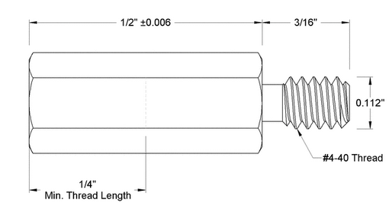
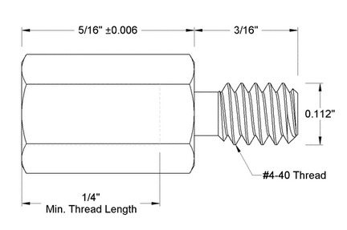
H Bracket
8X
T Stand
https://www.mcmaster.com/93465A106/
Outer Block
6X
MicroD Board
https://www.mcmaster.com/92700A103/
MEMS Switch Board
Center Block
4X
MEMS Switch Board
https://www.mcmaster.com/92700A466/
MEMSDuino

Slide 3
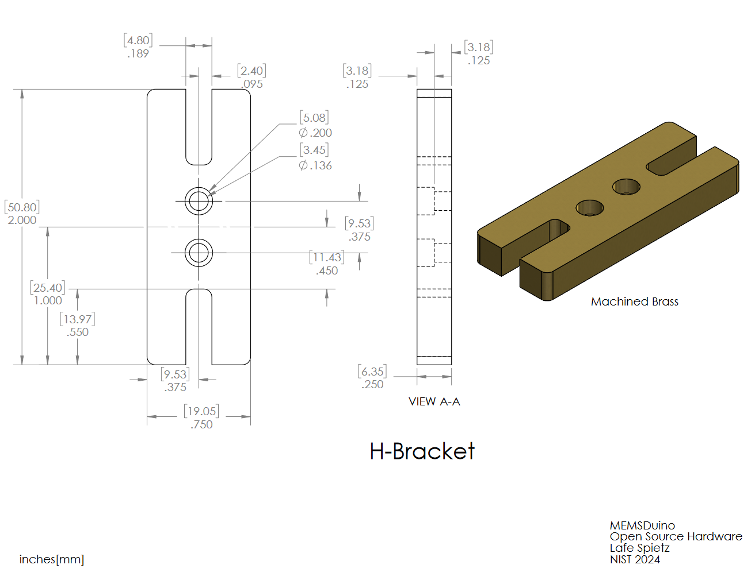
H Bracket
MEMSDuino

Slide 4
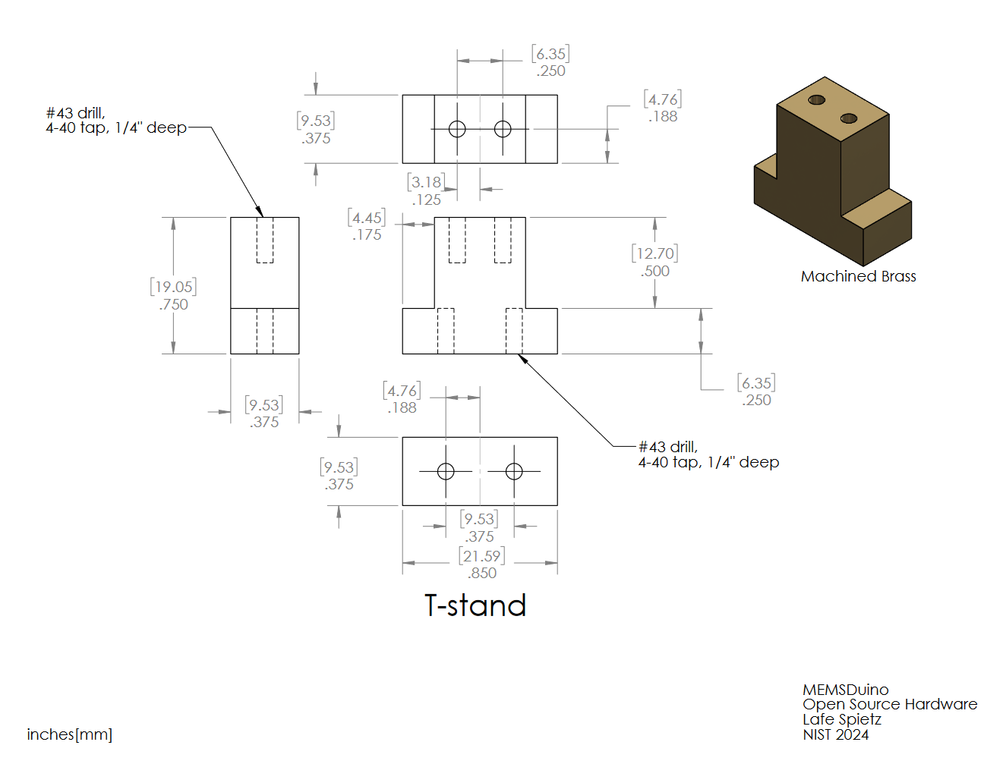
T Stand
MEMSDuino

Slide 5
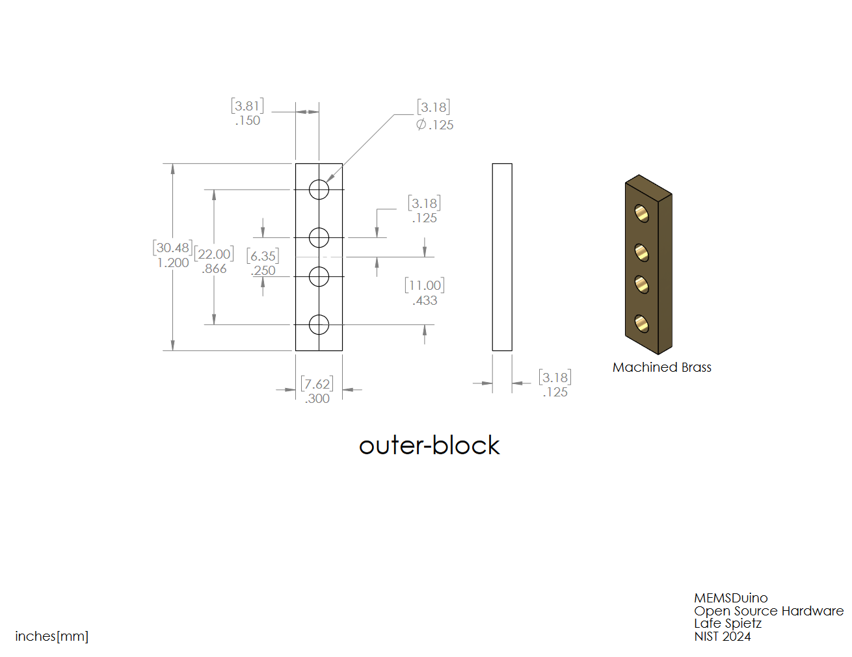
Outer Block
MEMSDuino

Slide 6
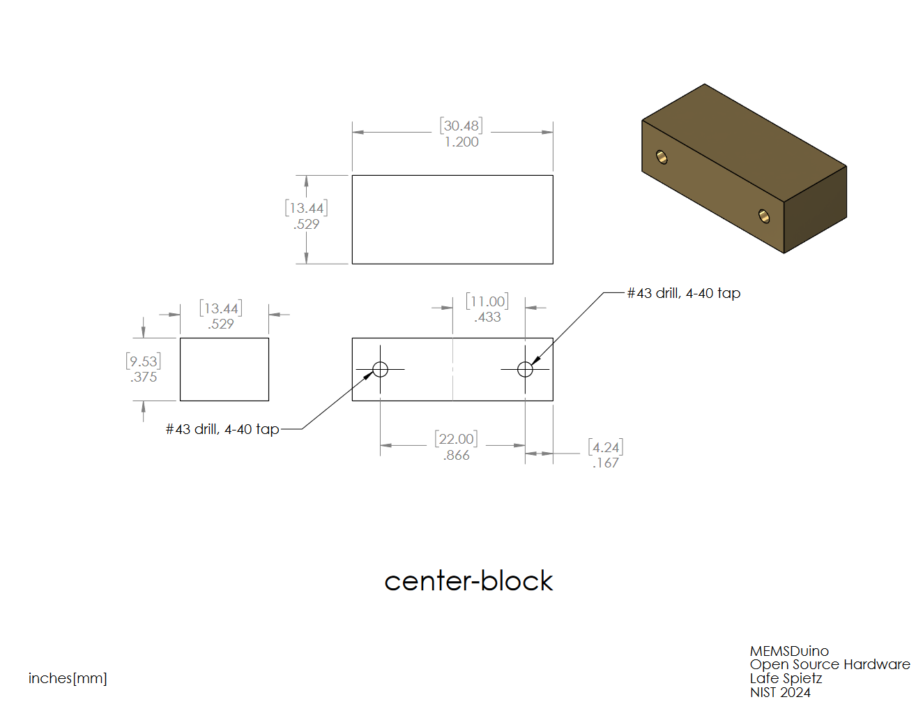
Center Block
MEMSDuino

Slide 7
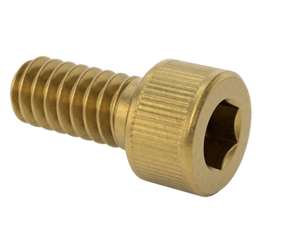
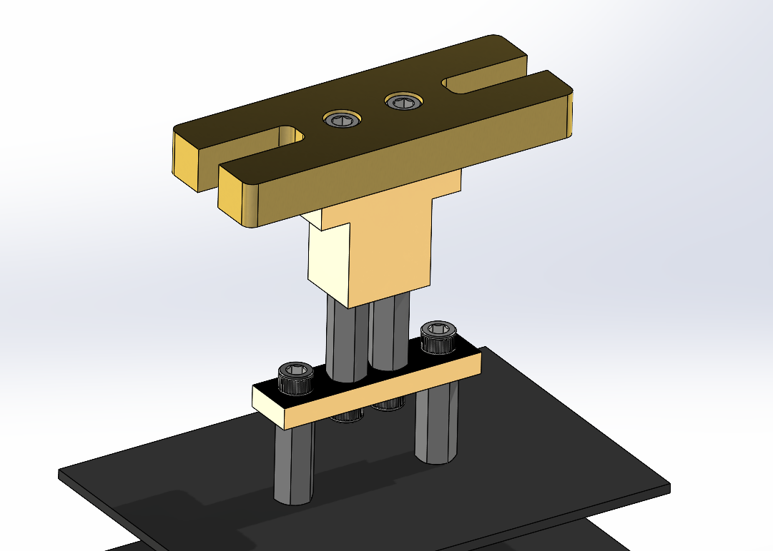
¼” 4-40
Inset Screws
MEMSDuino

