Slide 1
Working on design for cryo-elec mount and redesign of other 3d print parts

Slide 2
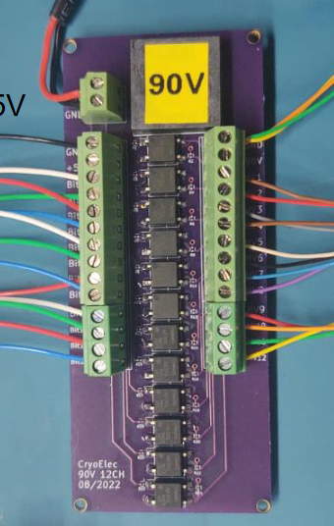
Holes: 0-80 free fit clearance = 1.75 mm = 0.069”
Dimensions of hole rectangle: 29 mm x 73.69 mm (1.142” x 2.901”)
Outer dimensions: 76.36 mm x 31.72 mm

Slide 3
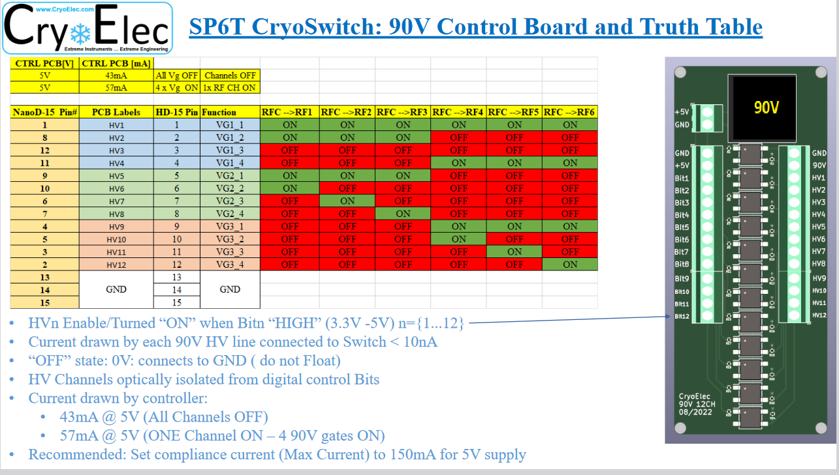

Slide 4
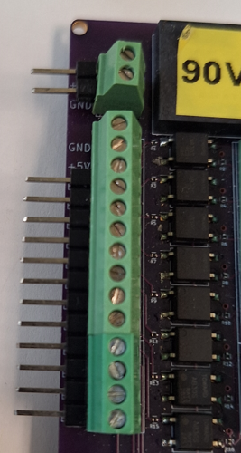
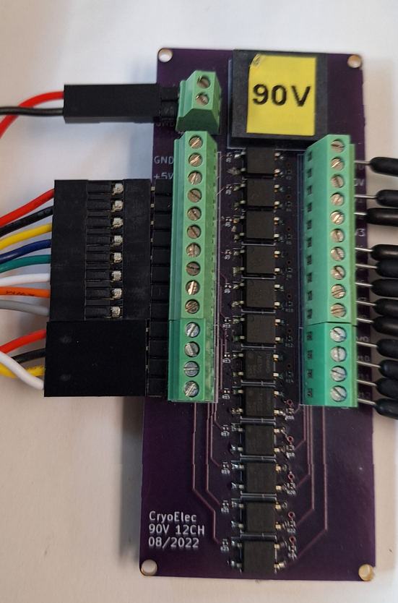
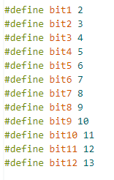
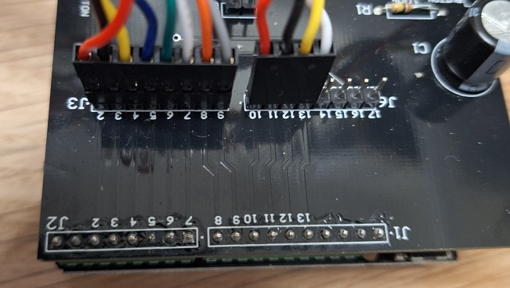
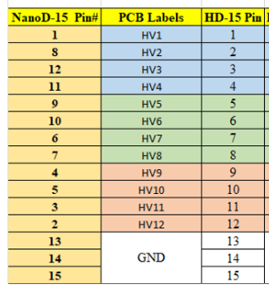

Slide 5
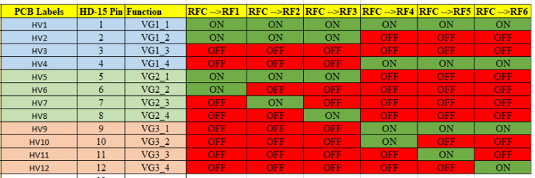

Slide 6
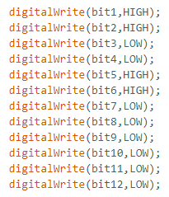
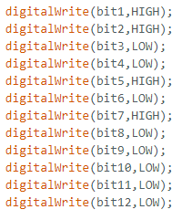
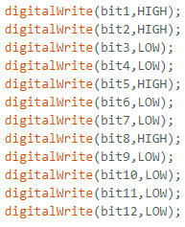
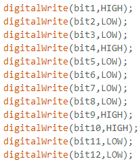
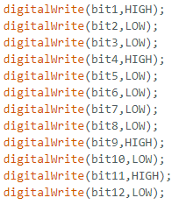
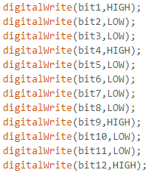
1
2
3
4
5
6

Slide 7
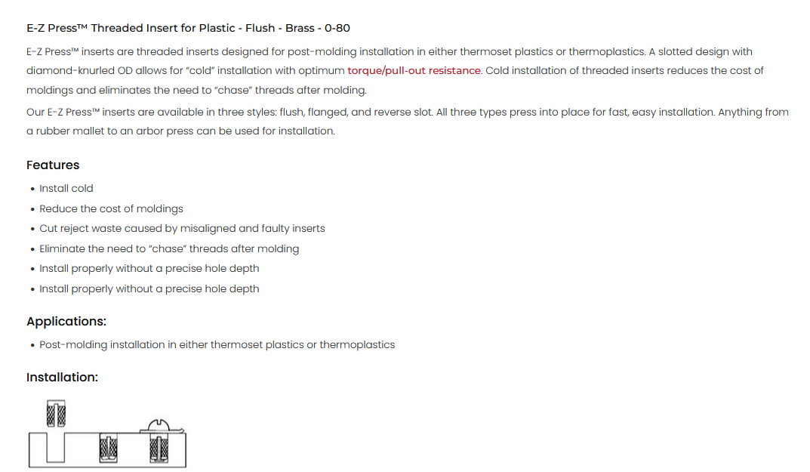
https://www.amazon.com/Z-LOK-Threaded-Insert-Plastic/dp/B08QJJDCW1/
https://www.ezlok.com/ezpress-insert-240-000-BR

Slide 8
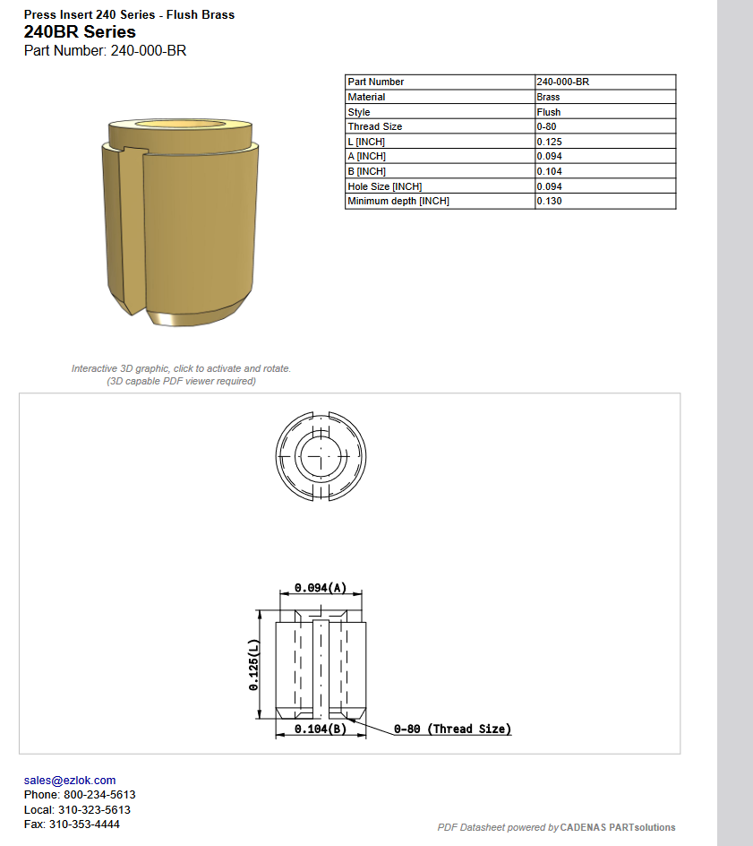

Slide 9
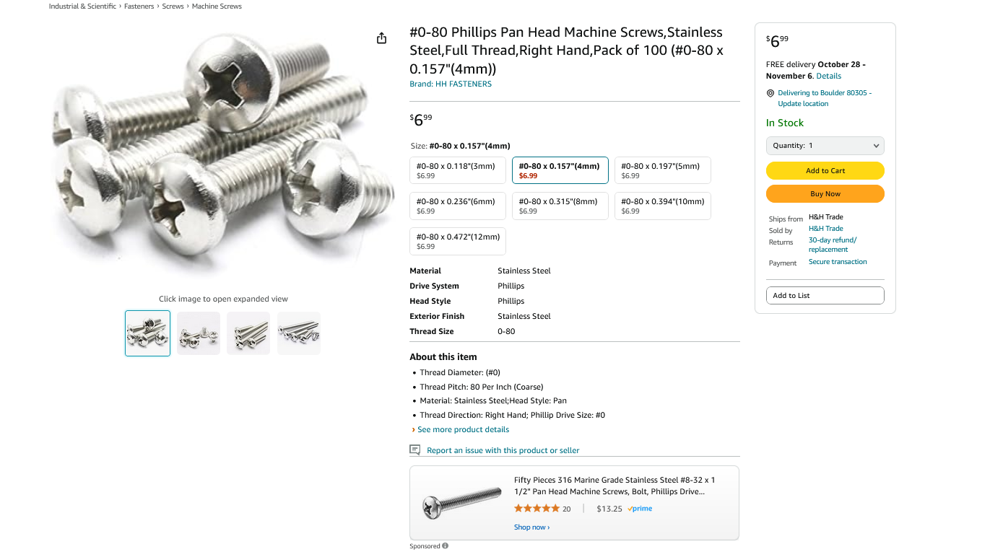
https://www.amazon.com/Phillips-Machine-Screws-Stainless-Thread/dp/B07D6L9M9G/

Slide 10
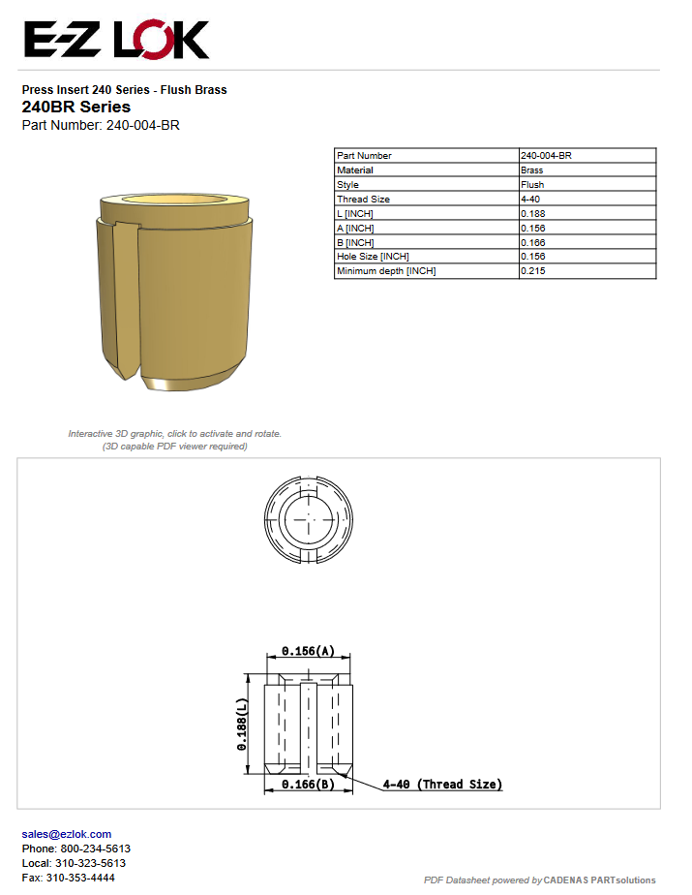
Hole depth: 0.188” = 4.7752 mm
Hole width: 0.156” = 3.9624 mm
https://www.ezlok.com/ezpress-insert-240-004-BR
E-Z Lok ‎240-004-BR
https://www.amazon.com/Z-LOK-Threaded-Insert-Plastic/dp/B08QJHXR7P/

Slide 11
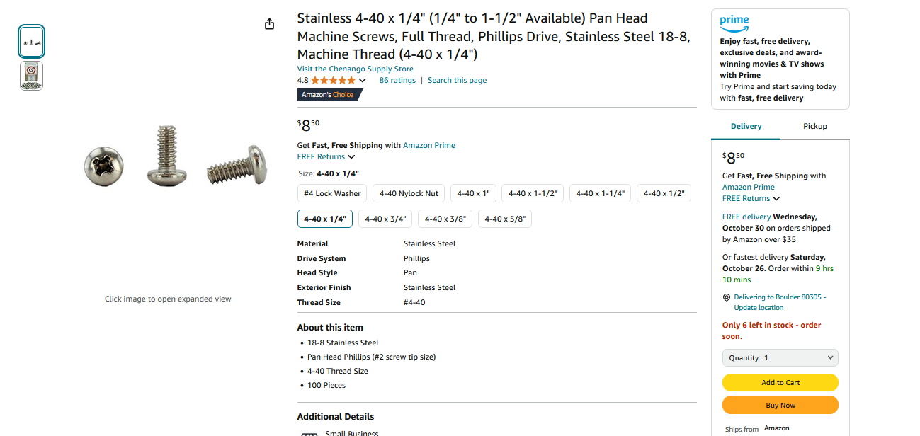
https://www.amazon.com/Stainless-Available-Machine-Screws-Phillips/dp/B07B3XQ5Y2/

Slide 12
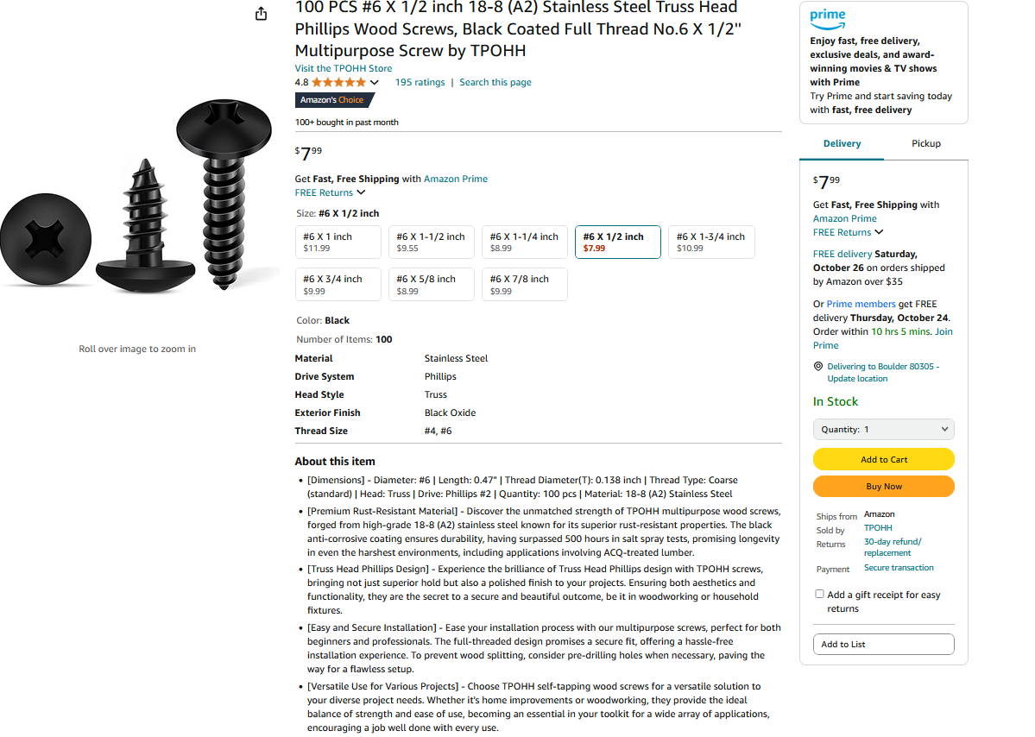
#6 clearance hole: .1495” free fit, round to .150”
https://www.amazon.com/Stainless-Phillips-Screws-Multipurpose-TPOHH/dp/B0CHRWGT8N/

