Slide 1
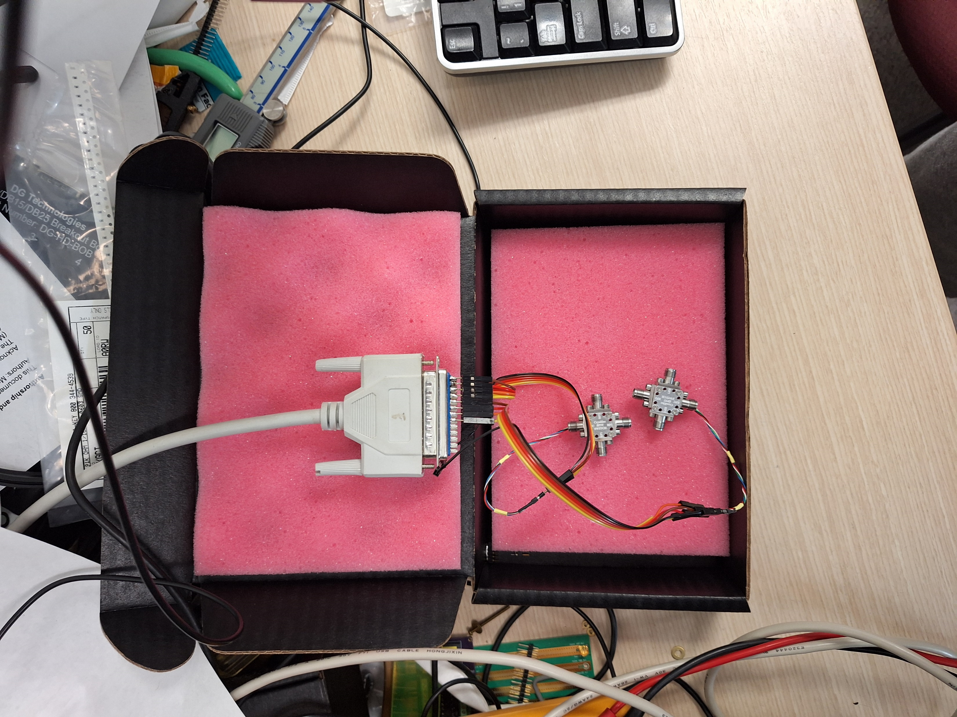
Room temperature test setup, Feb 24, 2025

