Slide 1
Notes on Open Source Quantum Switch version 2

Slide 2
To do
Add connectors for control of four throw switches
Update the launch to the one copied from the launch test board
Make the silk screen make sense, add all relevant information including url
Add teardrop launches to rf lines on switches
Add back the ground plane and vias
Make the copper have a square end at board edges
Go thru and align everything so it has maximal symmetry
Make a version with internal ecal and six DUTs
Move all the dc lines out of the way of the vias
Make the dimensions all make sense, including the mounting holes

Slide 3
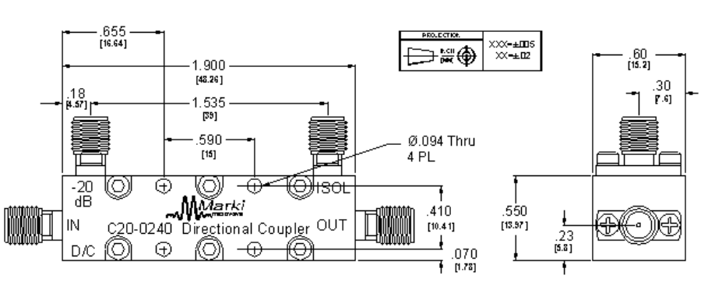
2-56 thru

Slide 4
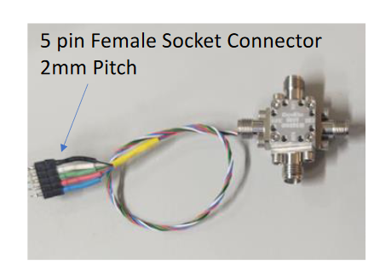
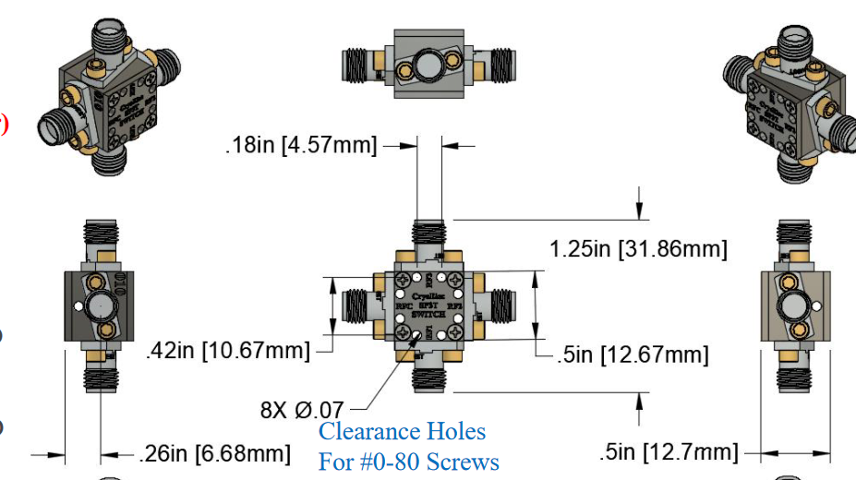

Slide 5
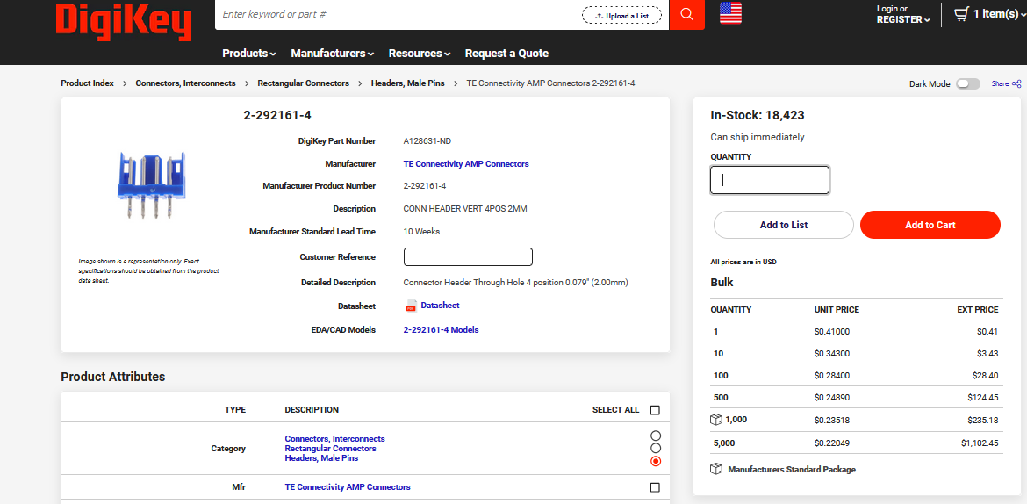
https://www.digikey.com/en/products/detail/te-connectivity-amp-connectors/2-292161-4/5124519

Slide 7
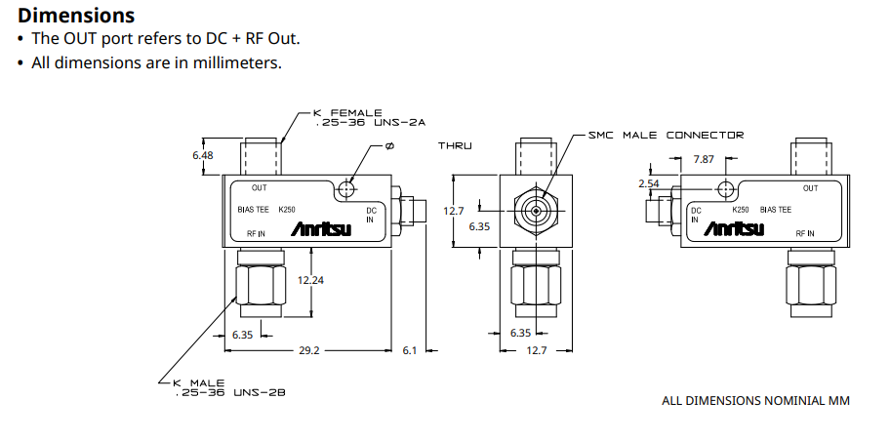
Anritsu K250 Bias tee
https://www.anritsu.com/en-us/components-accessories/products/k250-v250

Slide 8
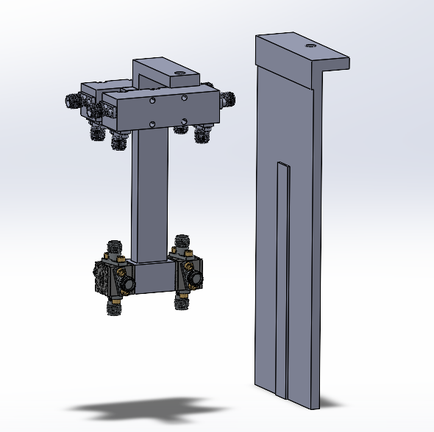
50
50

Slide 9
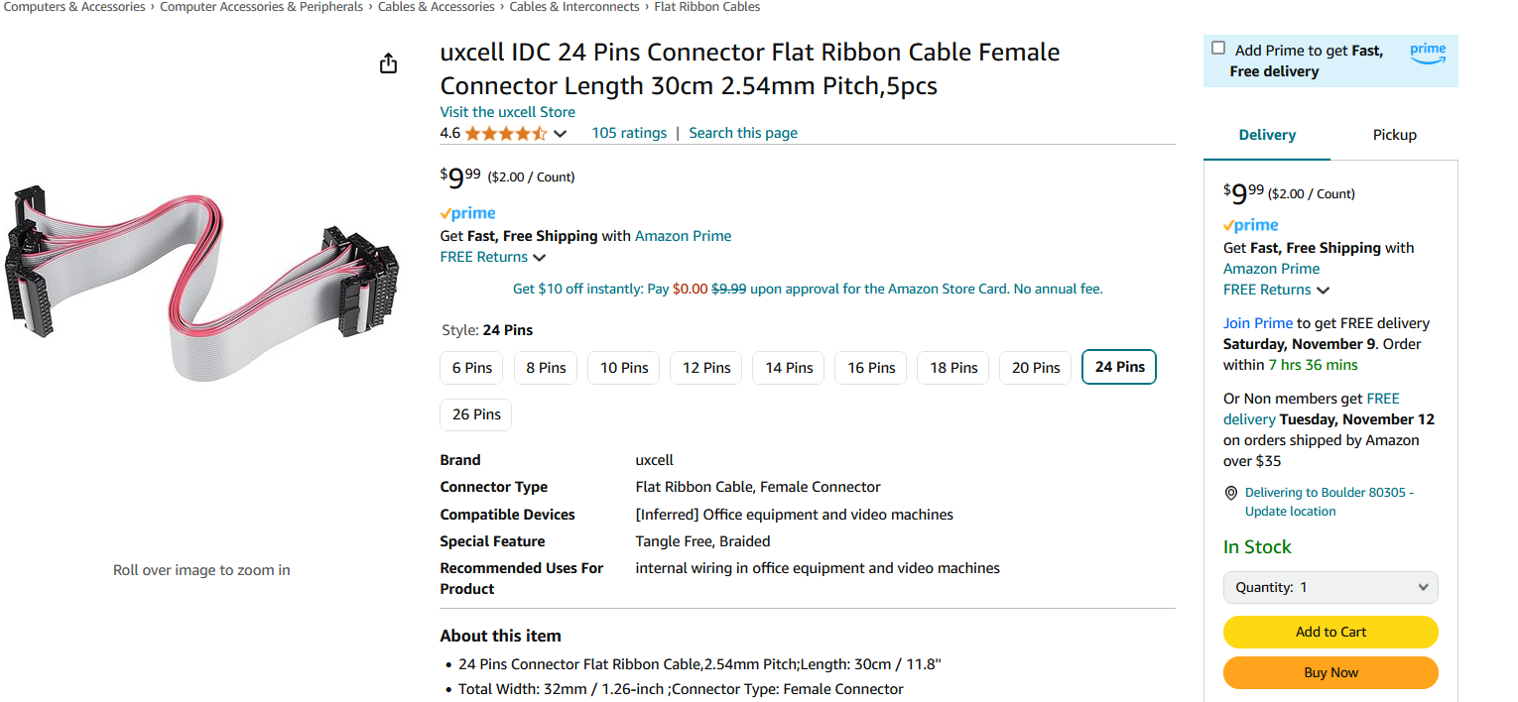
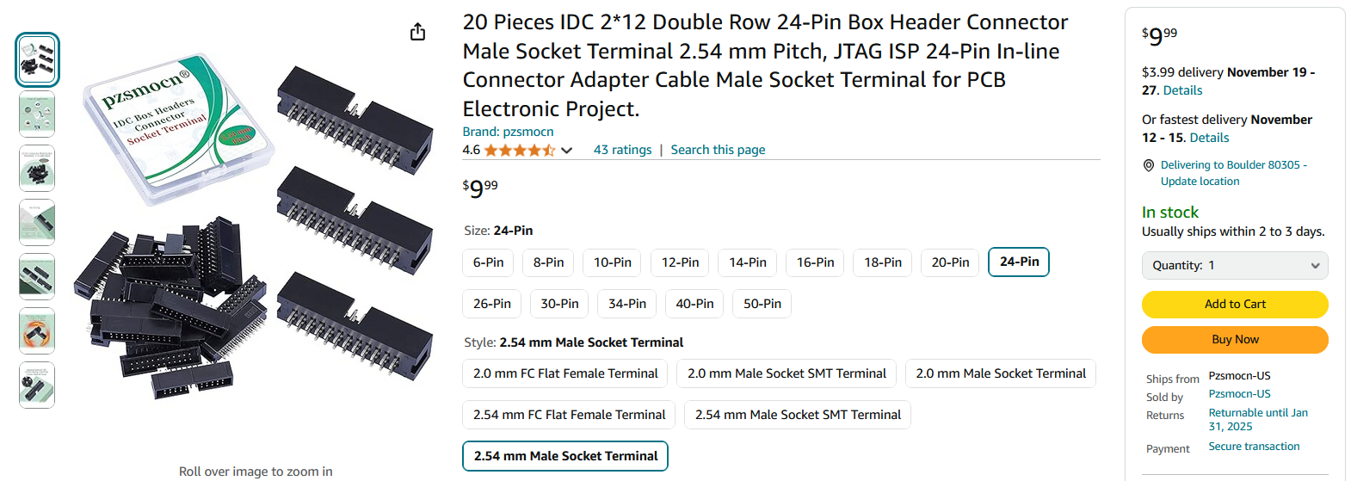
https://www.amazon.com/Pzsmocn-Connector-Terminal-Electronic-Project/dp/B0BY8W5H71/
https://www.amazon.com/uxcell-Connector-Ribbon-Female-Length/dp/B07FLRW1ZL/

Slide 10
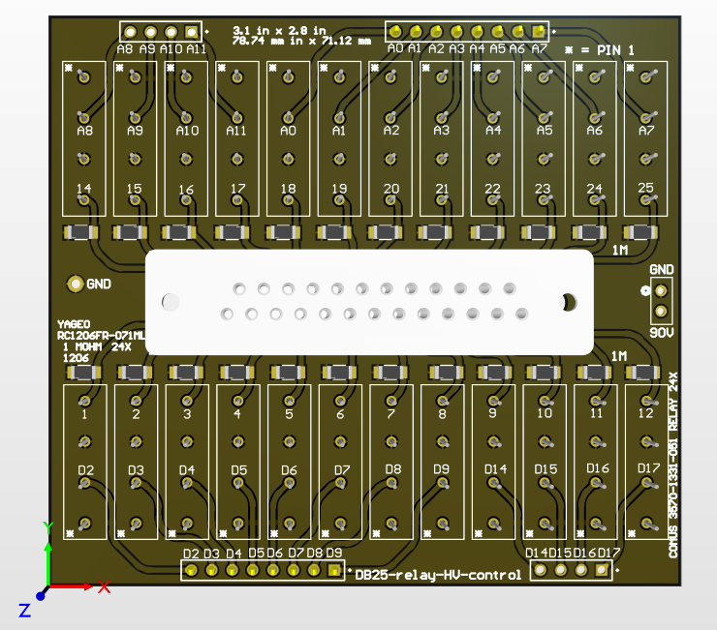
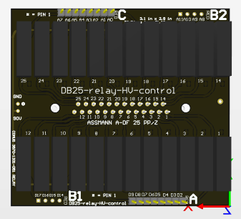
DB25-relay-HV-control

Slide 11
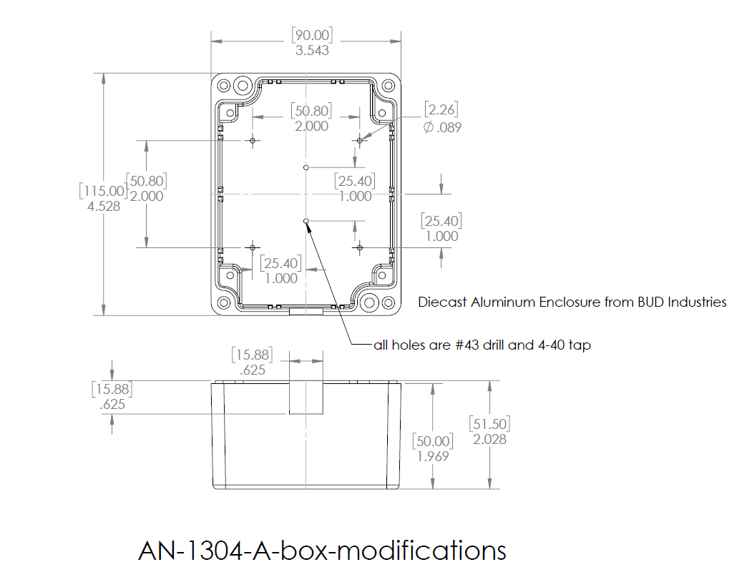

Slide 12
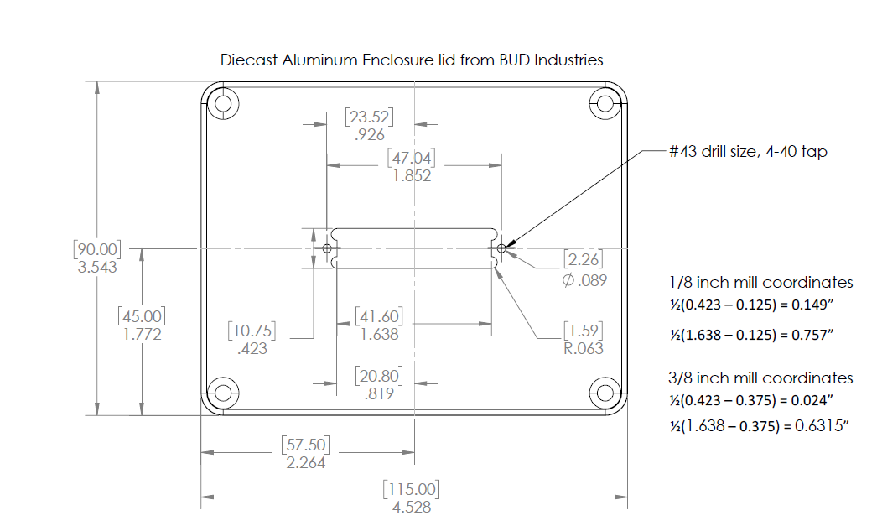

Slide 13
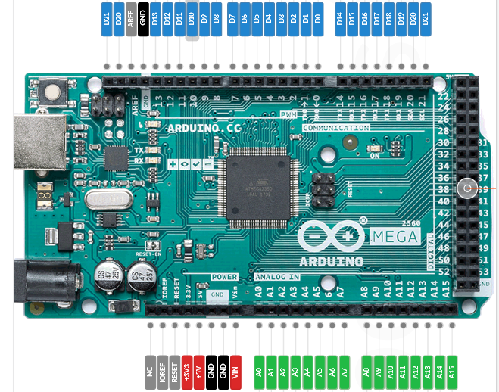
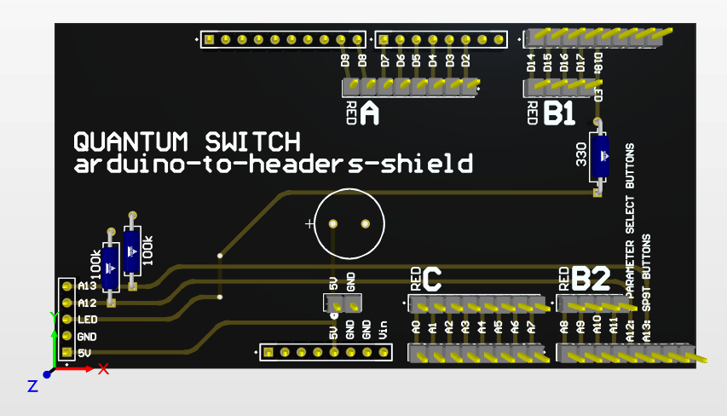

Slide 14
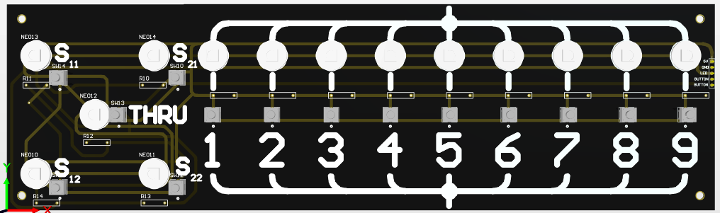

Slide 15
MICRO D: 25,12,24,11 | 23,10,22,9 | 21,8,20,7 | 19,6,18,5
U1 { G1, G4, G3, G2} | U4 {G1, G4, G3, G2} | U2 {G1, G4, G3, G2} U3 {G4, G3, G2, G1}
U8 {G2,G1,G4,G3} | U6 {G3,G2,G1,G4} | U7 {G2,G1,G4,G3} | U5 {G3,G2,G1,G4}
RF3
U3
RF2
RF2
RF1
U5
RF4
RF1
RF3
RF4
RF4
RF3
RF1
RF4
U4
U6
RF1
RF2
RF2
RF3
RF4
RF3
RF1
RF4
U2
U7
RF1
RF2
RF2
RF3
RF4
RF3
RF1
RF4
U1
U8
RF1
RF2
RF2
RF3

Slide 16
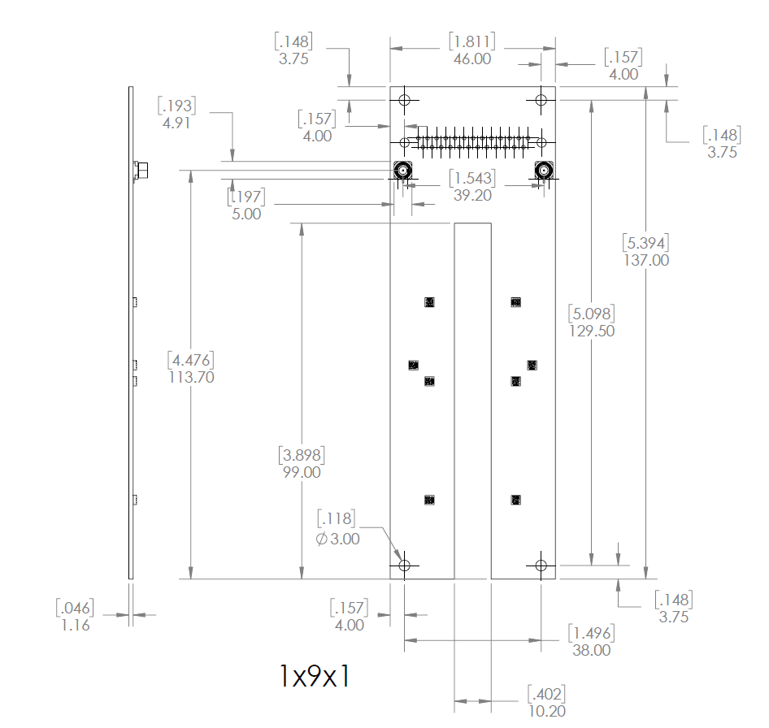
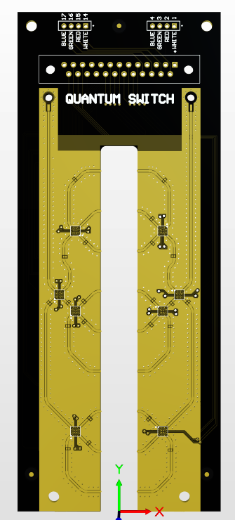

Slide 17
