Slide 1
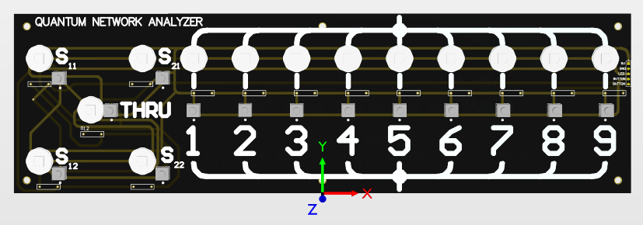

QUANTUM NETWORK ANALYZER

