Slide 1
JPA-CAL
Using the Josephson Parametric Amplifier as a Cal standard

Slide 2
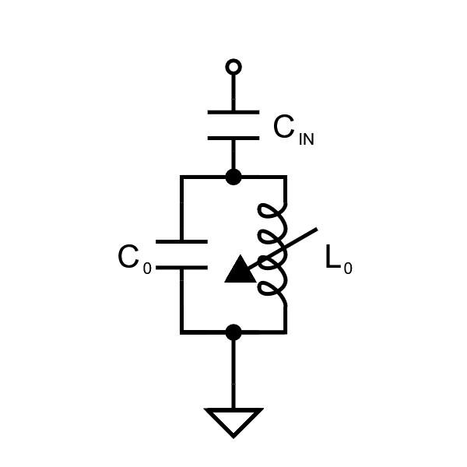
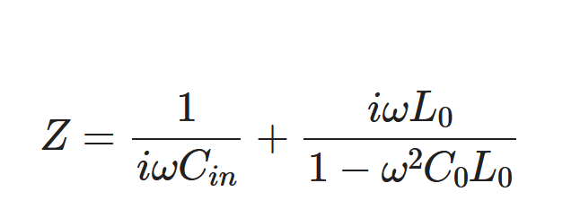
JPA Model

Slide 3
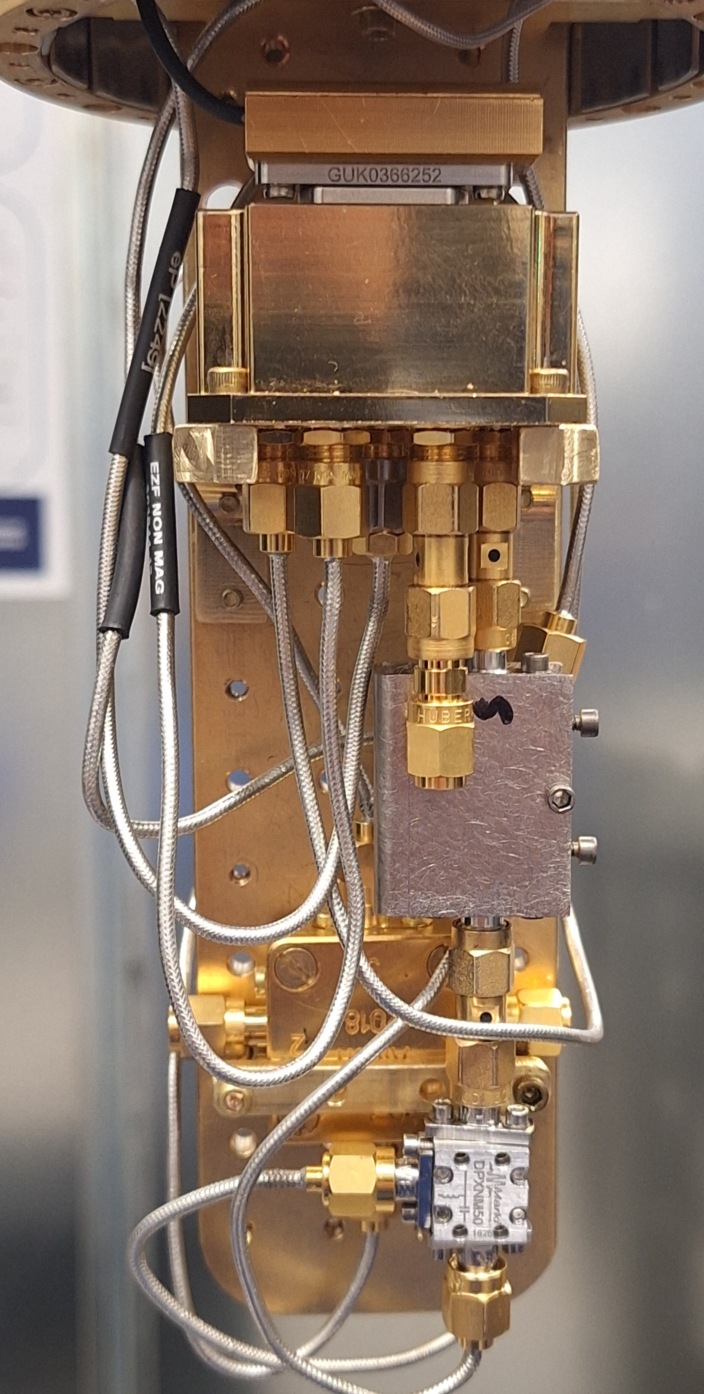
Measurement
MEMS Switch
JPA
Bias Tee
DC Flux Bias
Pump

Slide 4
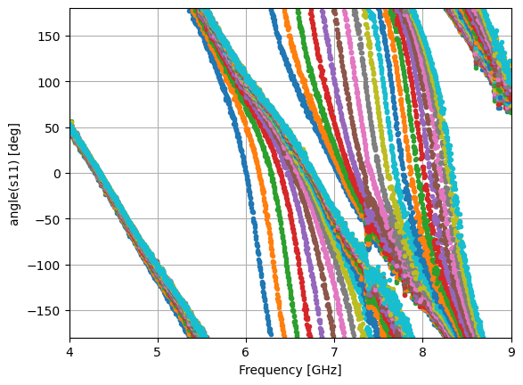
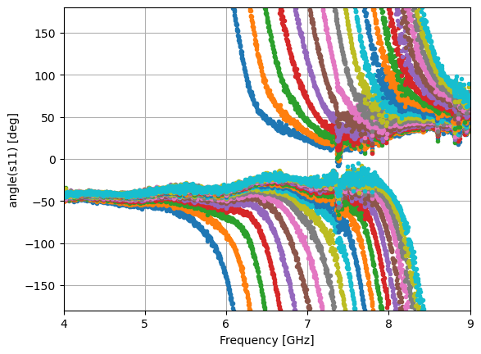


Measurement of S11 Corrected with MEMS E-Cal
Make range from 4- 5 GHz flat
$$τ=0.434 ns$$
$$×e^{2πifτ}$$
Unwind to make fit tractable

Slide 5
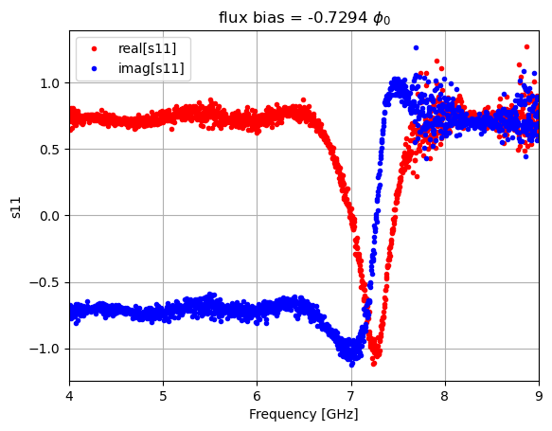
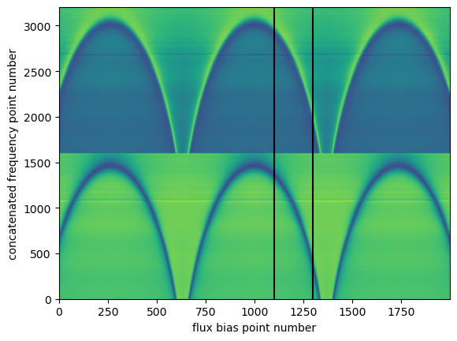
Unwrapped data, concatenated
IMAGINARY
1300
REAL
1100
Concatenate imaginary on top of real to make a function that can be fit with both real and imaginary

Slide 6
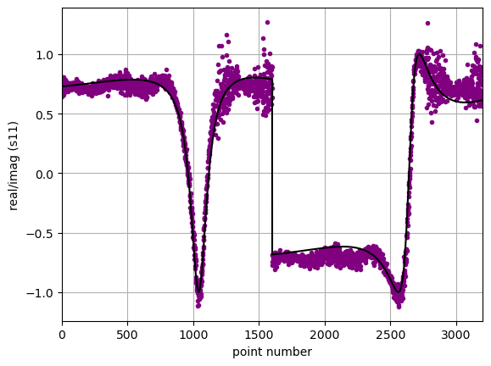
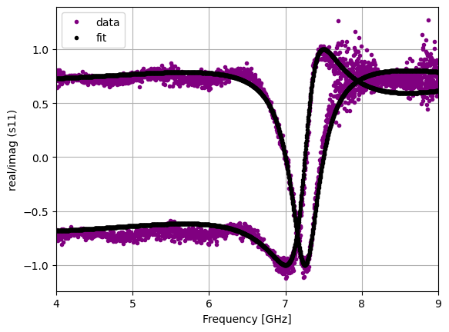
Fit Using concatenated data and function

Slide 7
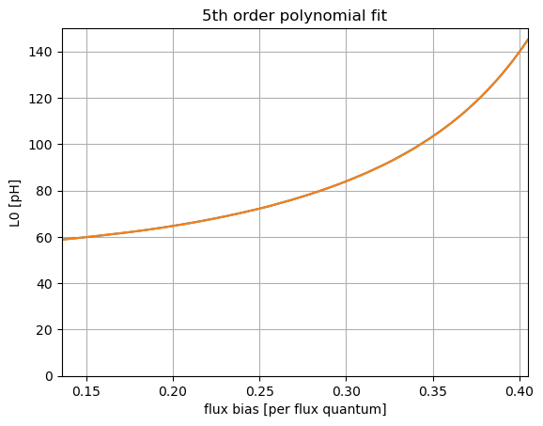
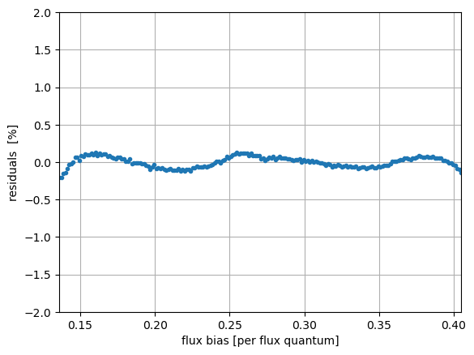
Fits as Function of Flux Bias

Slide 8
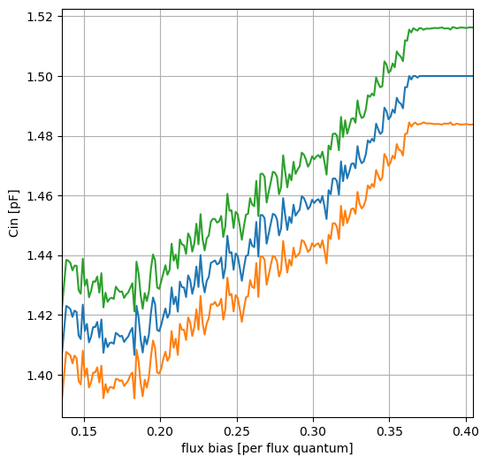
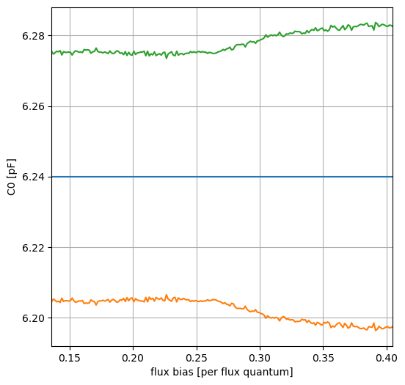
Fit Values for Capacitances

Slide 9
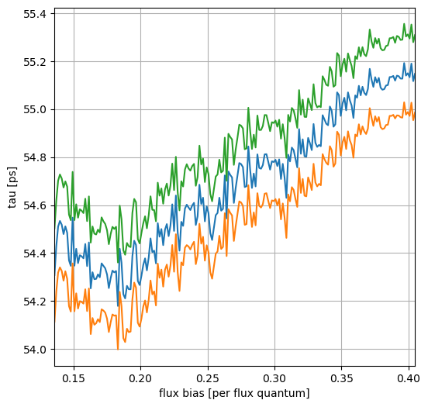
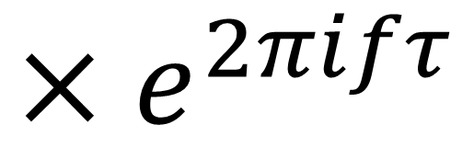
Time Delay Fit
$$×e^{2πifτ}$$

Slide 10
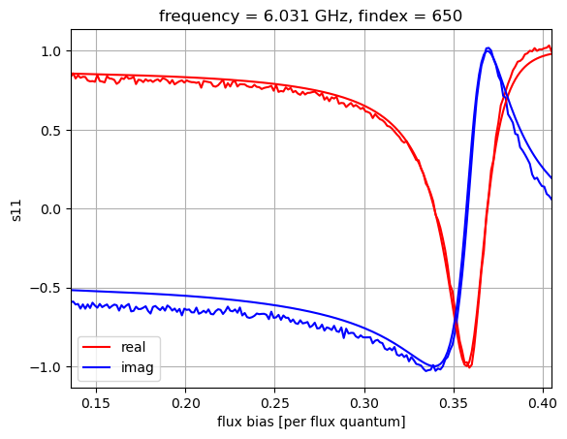
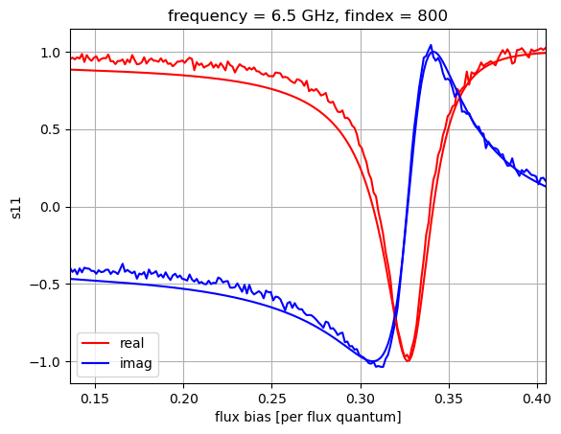
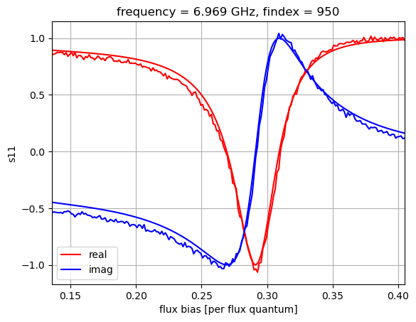
Compare Theory to Data for fixed values of parameters

Slide 11
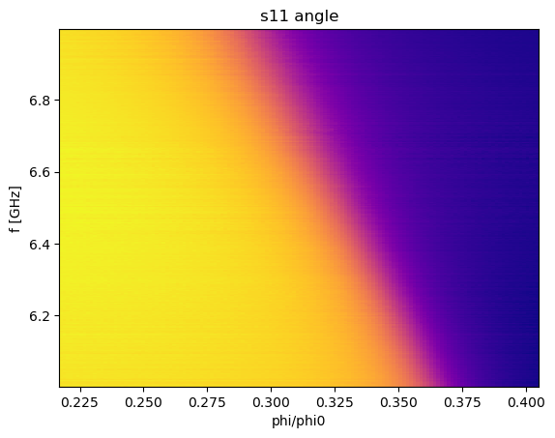
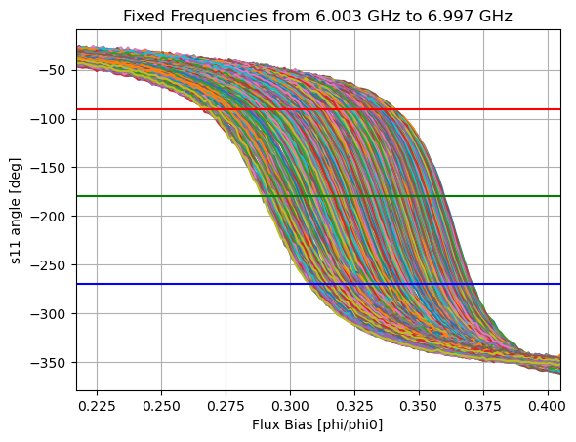
Zoom In on Flux Bias and Frequency

Slide 12
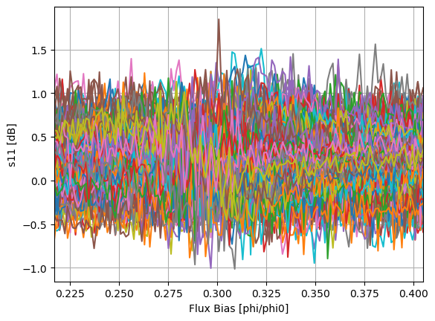
Amplitude

Slide 13
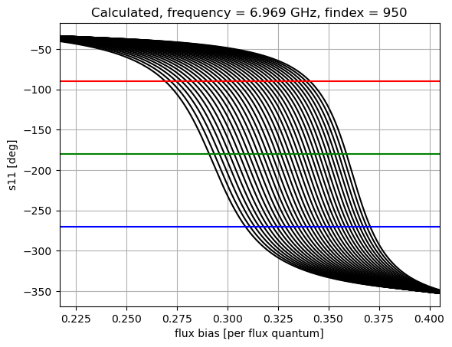
Calculated standards curves

Slide 14
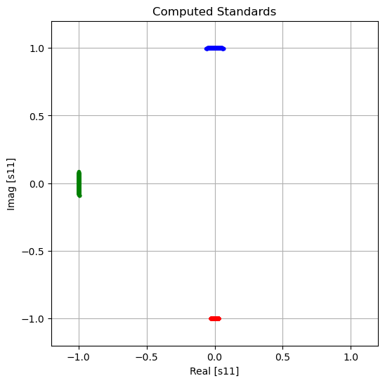
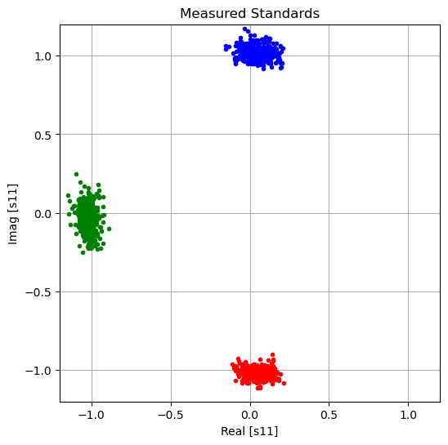
South-West-And-North Calibration
NORTH
NORTH
WEST
WEST
SOUTH
SOUTH

Slide 15
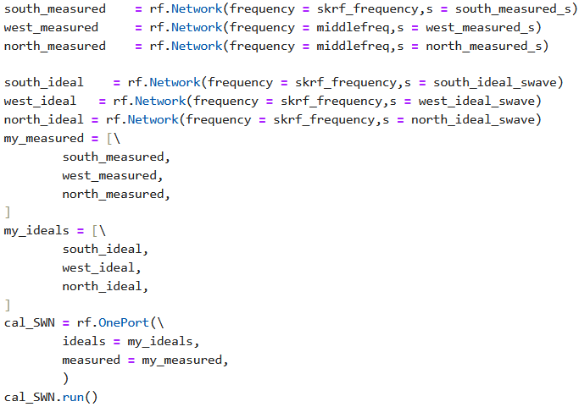
SWaN Cal In Scikit-RF

Slide 16
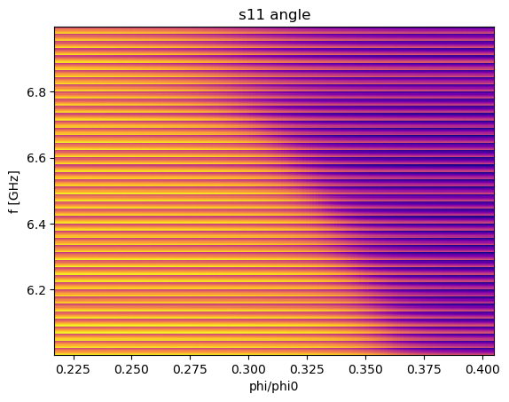
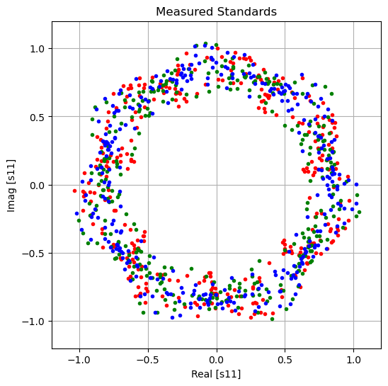
Attempt to apply cal to raw data

Slide 17
