Slide 1
Micro D
Open Source Hardware for Quantum Technology
Lafe Spietz
NIST Boulder

Slide 2
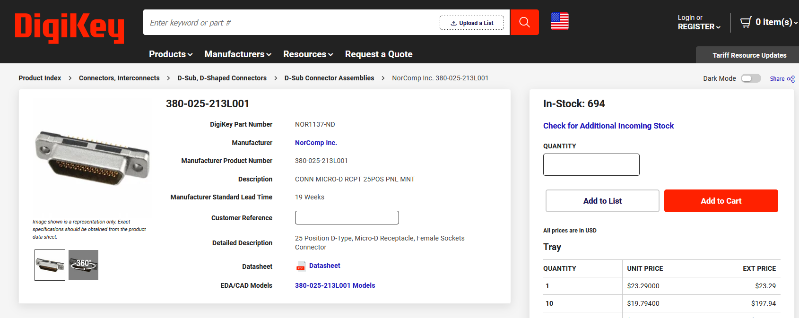
Female PCB connector
https://www.digikey.com/en/products/detail/norcomp-inc/380-025-213L001/2798600

