Slide 1
Notes on Open Source Quantum Switch version 2
Lafe Spietz
NIST
2024

Slide 2
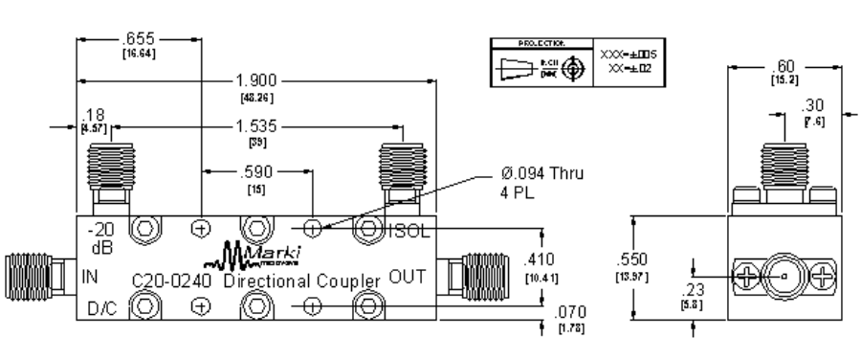
2-56 thru

Slide 3
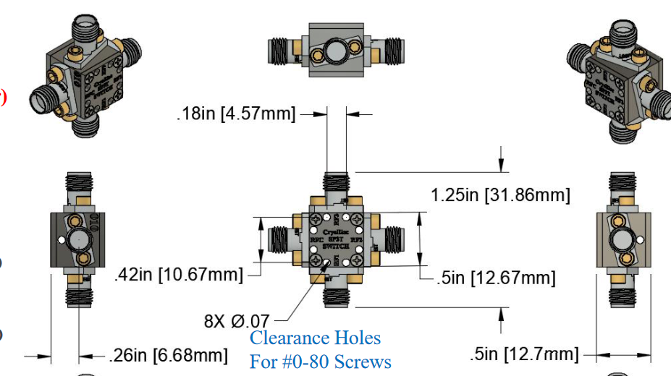

Slide 4
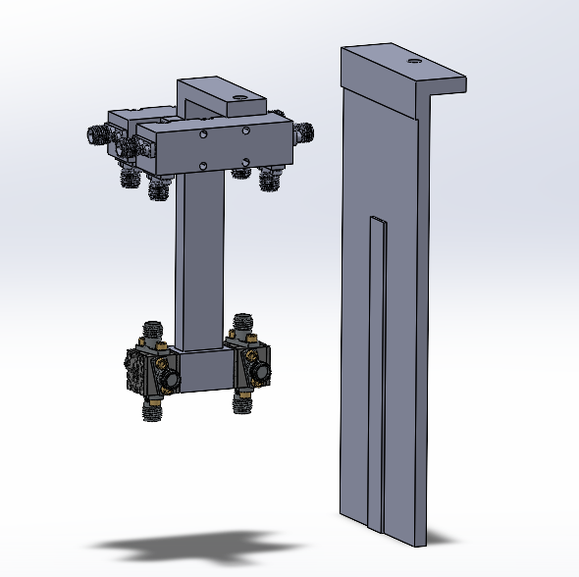
50
50

