Slide 1
Notes on Open Source Quantum Switch version 2
Lafe Spietz
NIST
2024

Slide 2
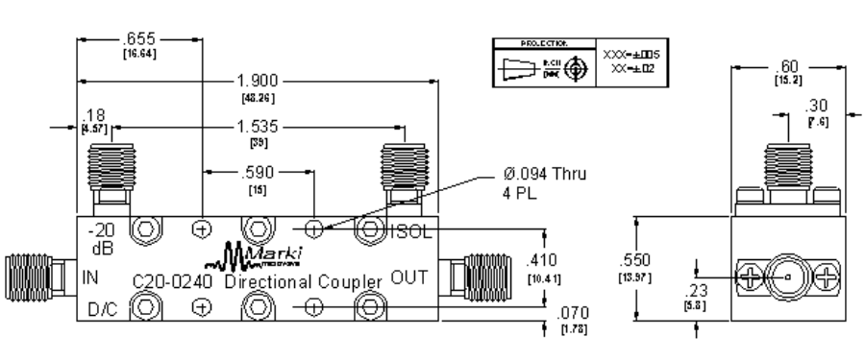
2-56 thru

Slide 3
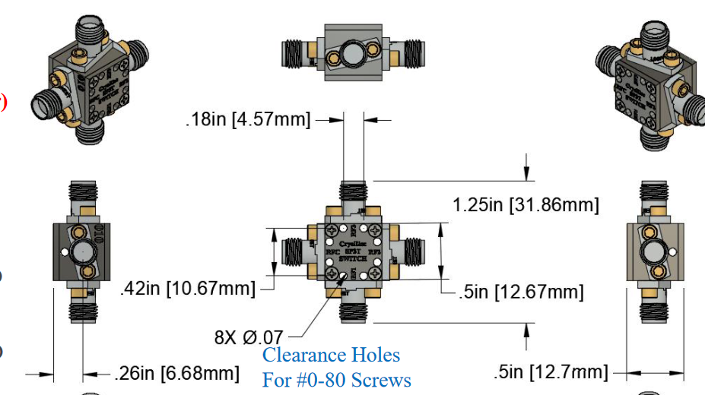

Slide 4
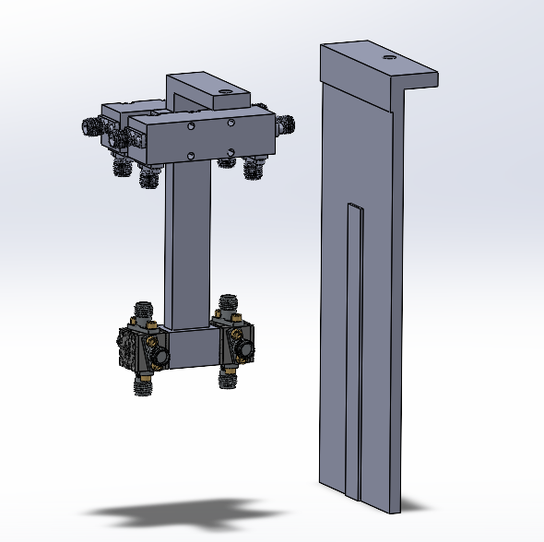
50
50

Slide 5
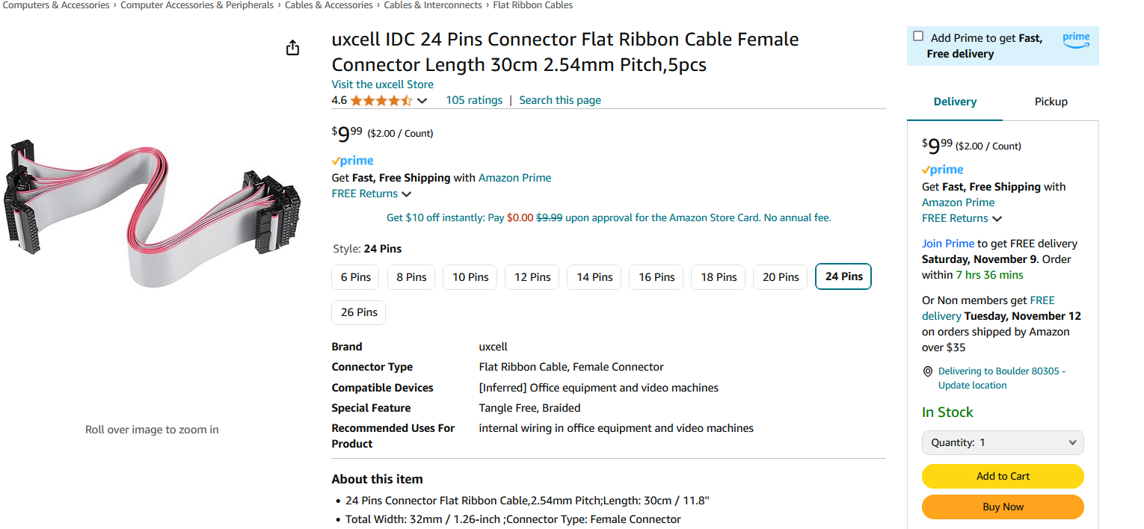
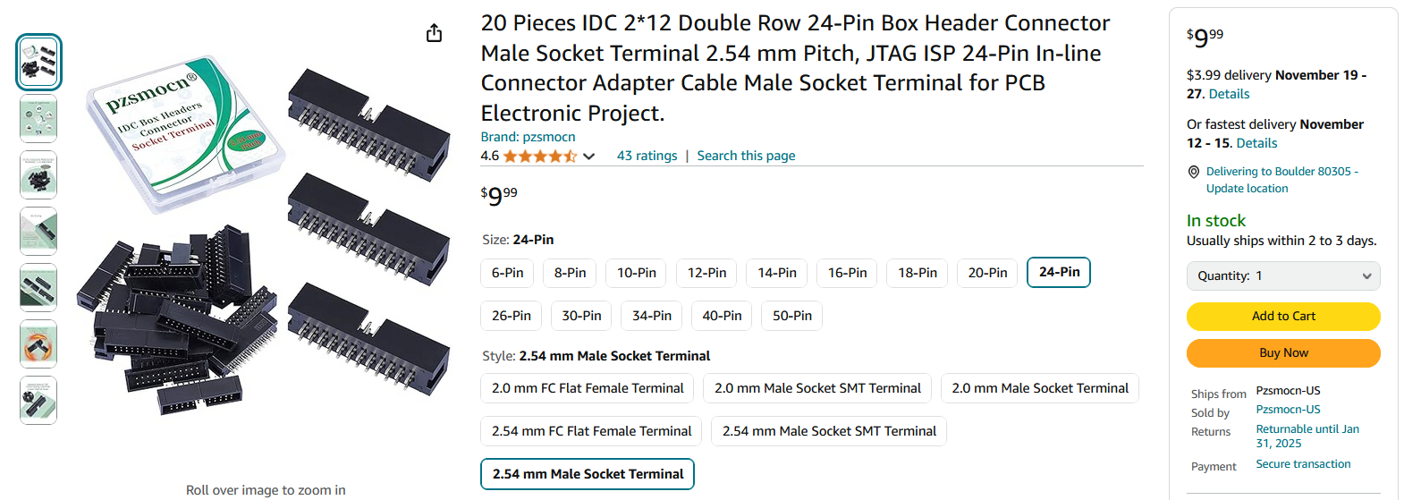
https://www.amazon.com/Pzsmocn-Connector-Terminal-Electronic-Project/dp/B0BY8W5H71/
https://www.amazon.com/uxcell-Connector-Ribbon-Female-Length/dp/B07FLRW1ZL/

Slide 6
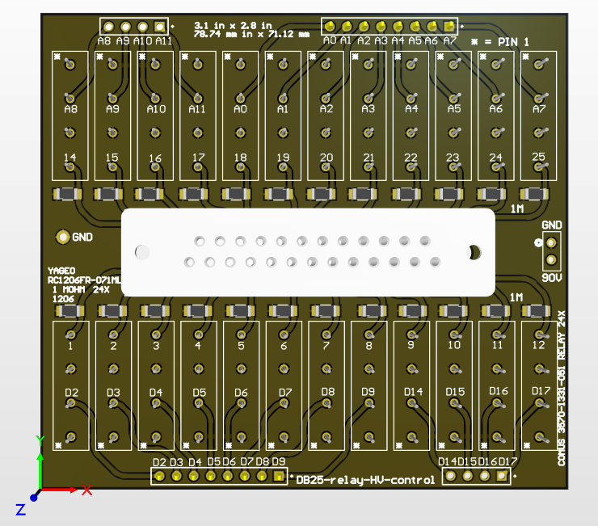
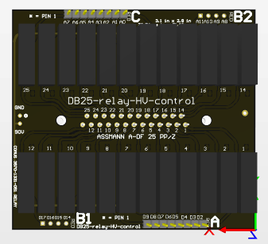
DB25-relay-HV-control

Slide 7
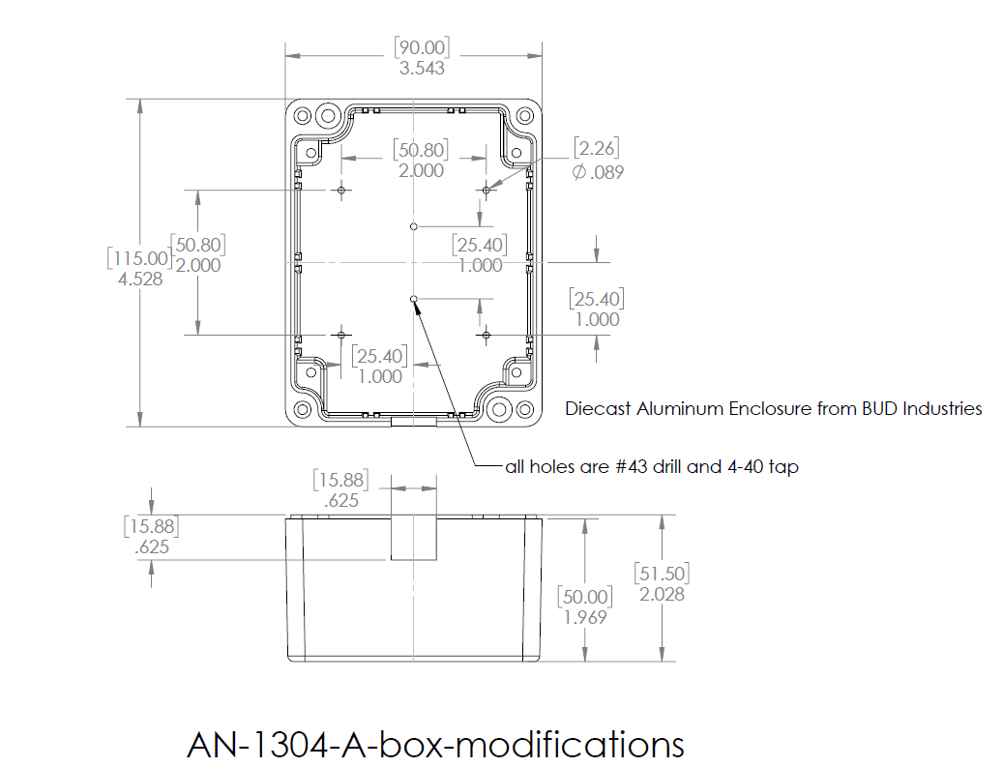

Slide 8
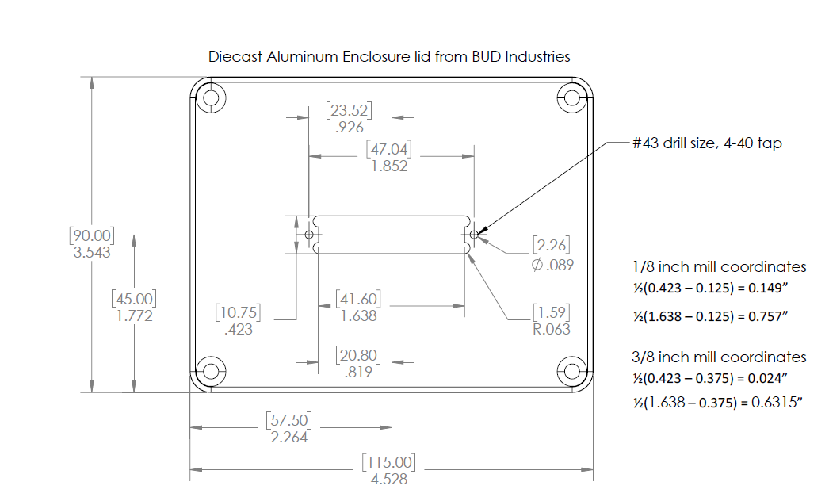

Slide 9
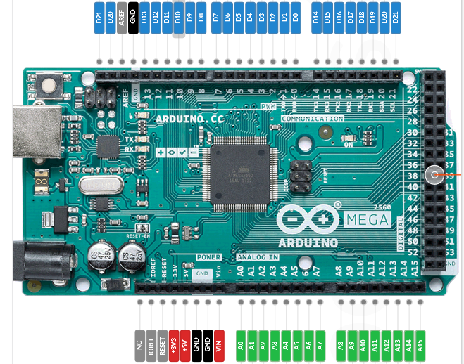
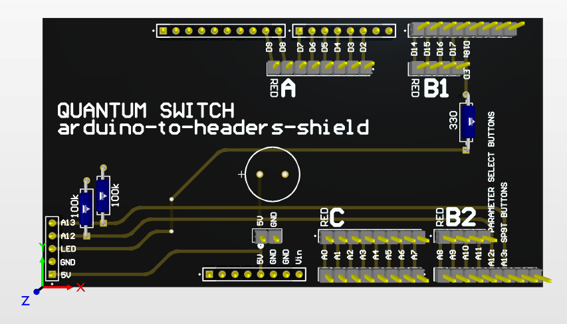

Slide 10
