Slide 1
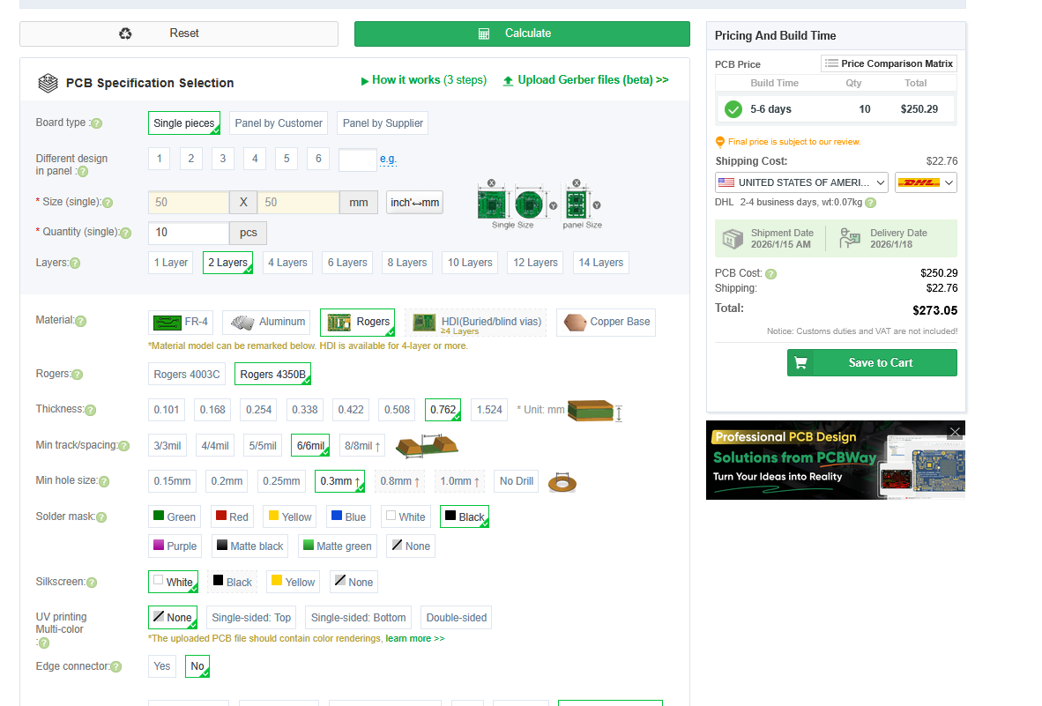
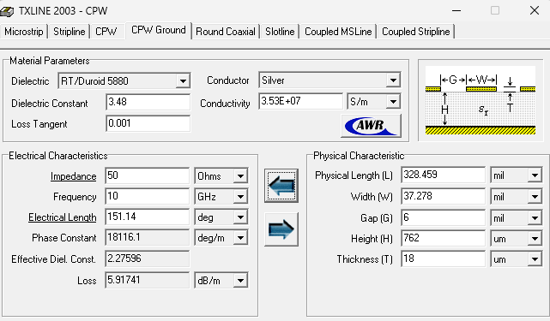
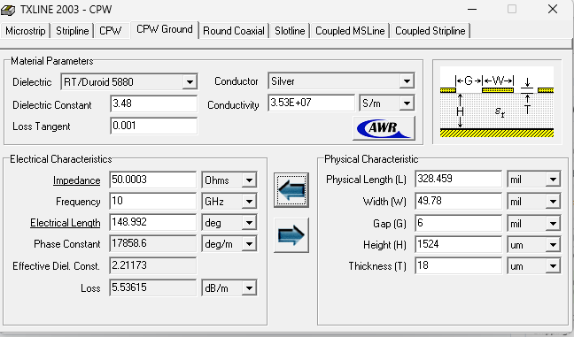

Slide 2
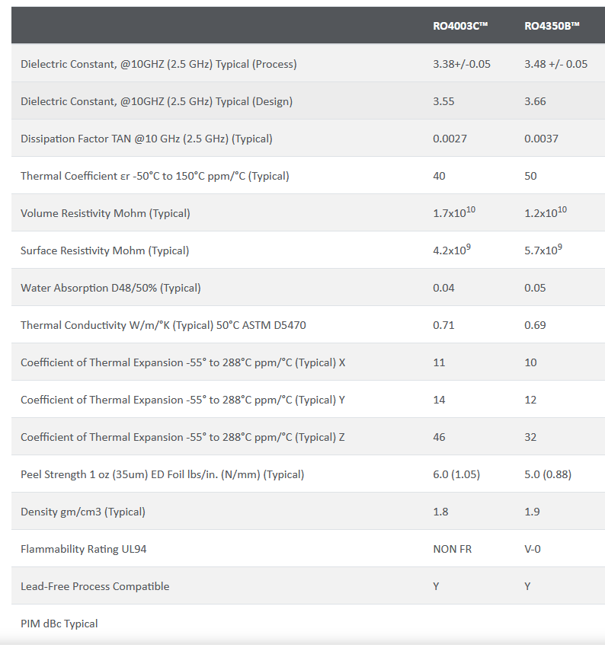
https://rogerscorp.com/advanced-electronics-solutions/ro4000-series-laminates/ro4350b-laminates

Slide 3
