Slide 1
Test Board Molex And Bias Tee
October 2024
Lafe Spietz et al

Slide 2
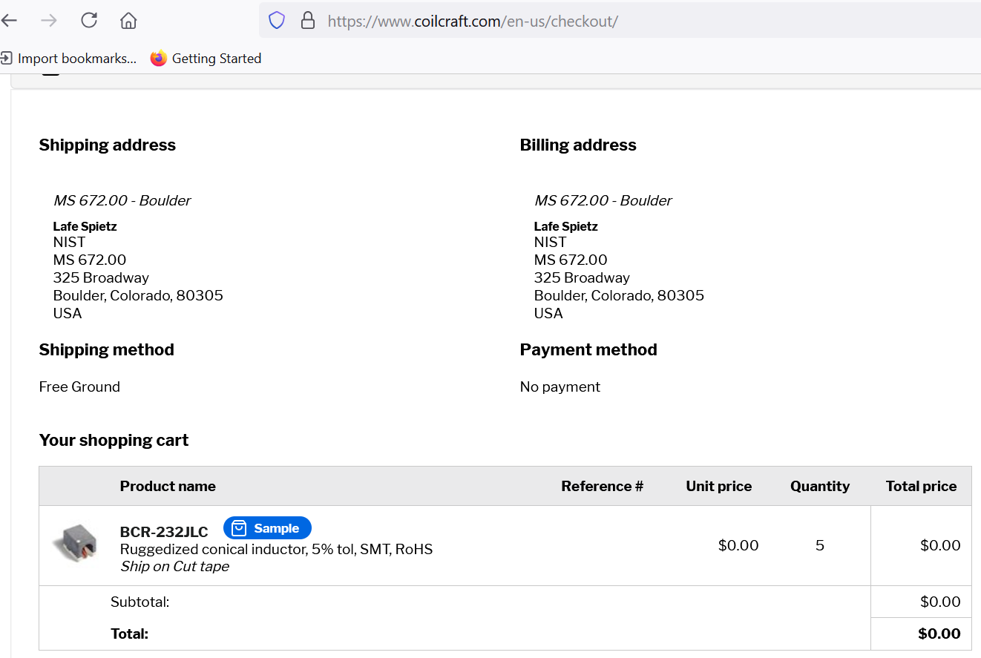
10/23/24

Slide 3
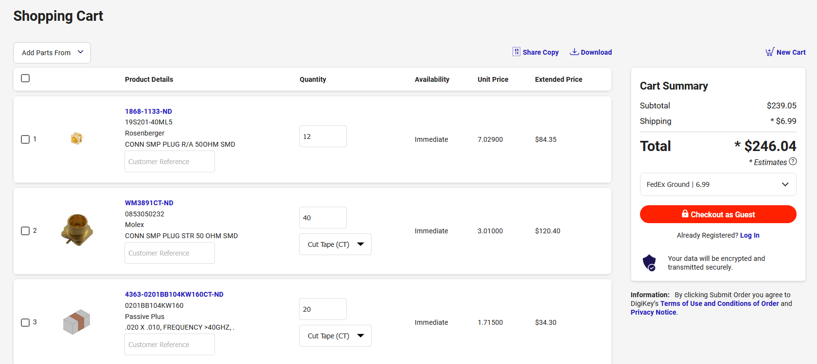
https://www.digikey.com/short/t1bt58f8
Put into purchasing 10/23/24

Slide 4
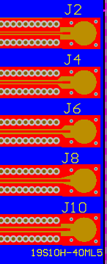
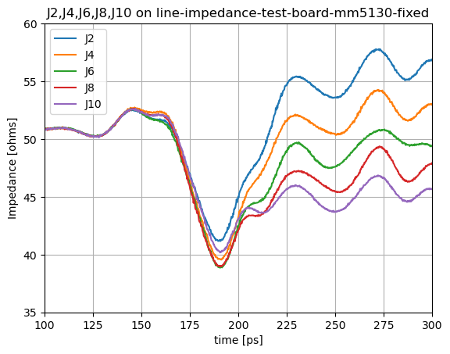
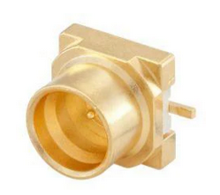
14 mil center line
16 mil center line
18 mil center line
20 mil center line
22 mil center line

Slide 5
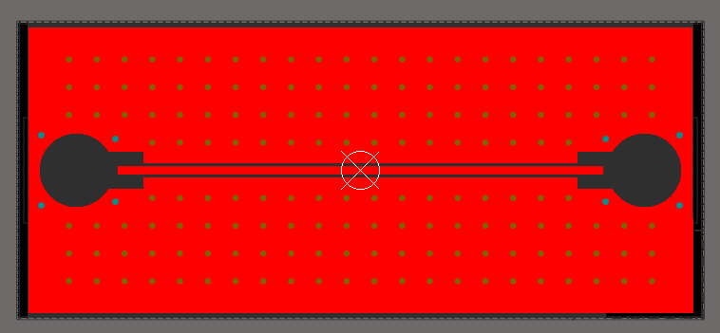
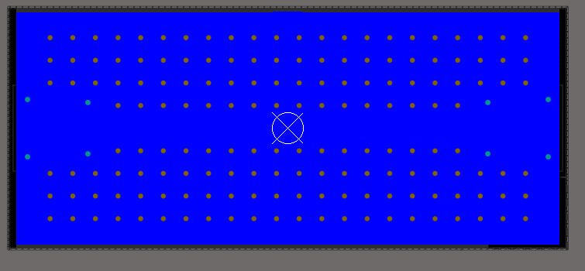
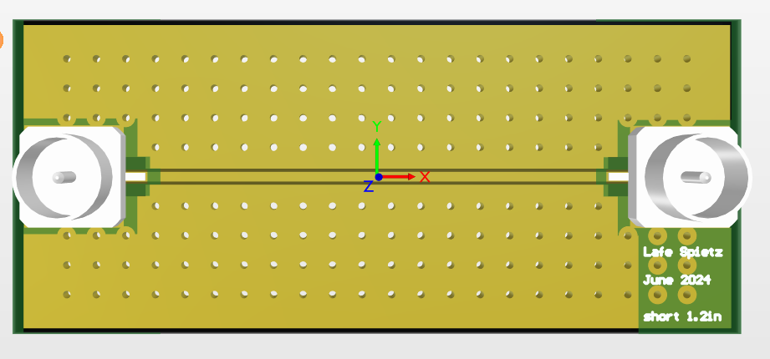
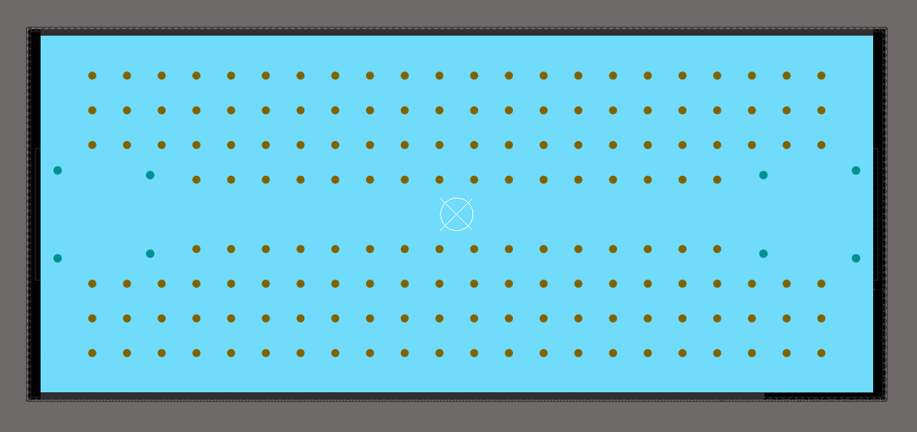
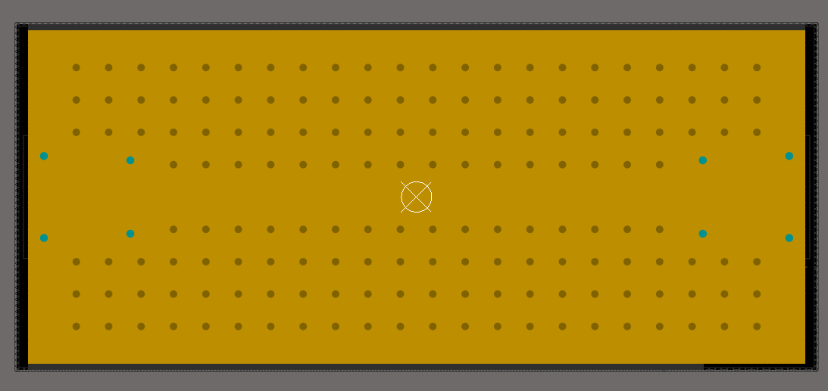
From thru cal boards:

Slide 6
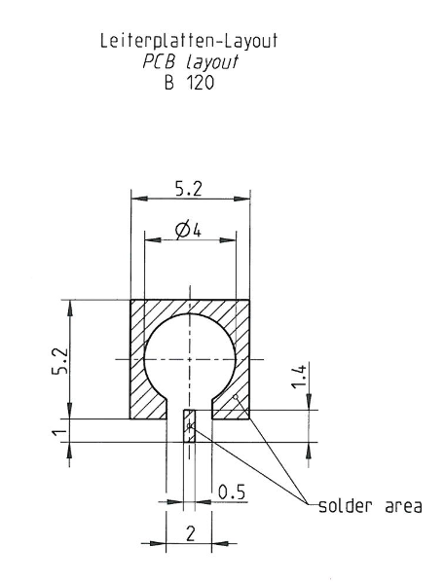
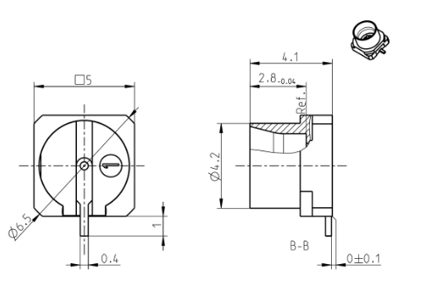
What we used in cal boards
Rosenberger 19S141-40ML5
Terse data sheet, didn’t specify the lower layers of copper or any kind of hole

Slide 7
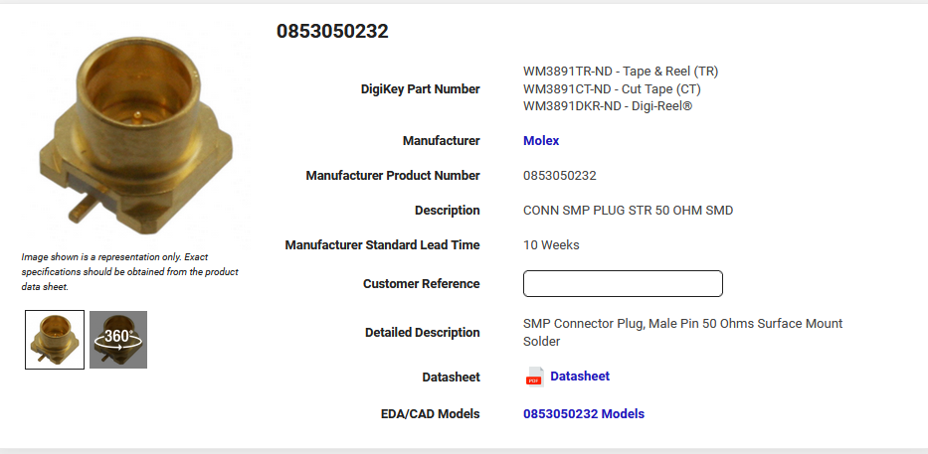
https://www.digikey.com/en/products/detail/molex/0853050232/2421464
Molex connector chosen by Anna for use on the JAWS project has MUCH more verbose data sheet!

Slide 8
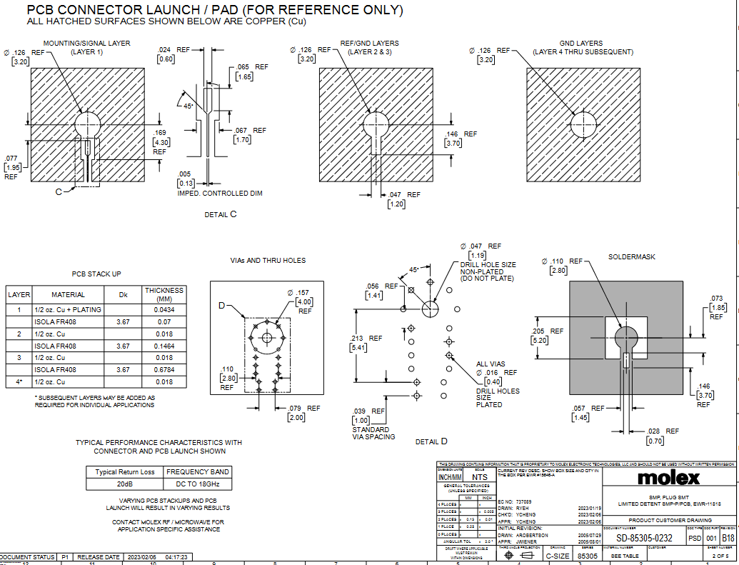

Slide 9
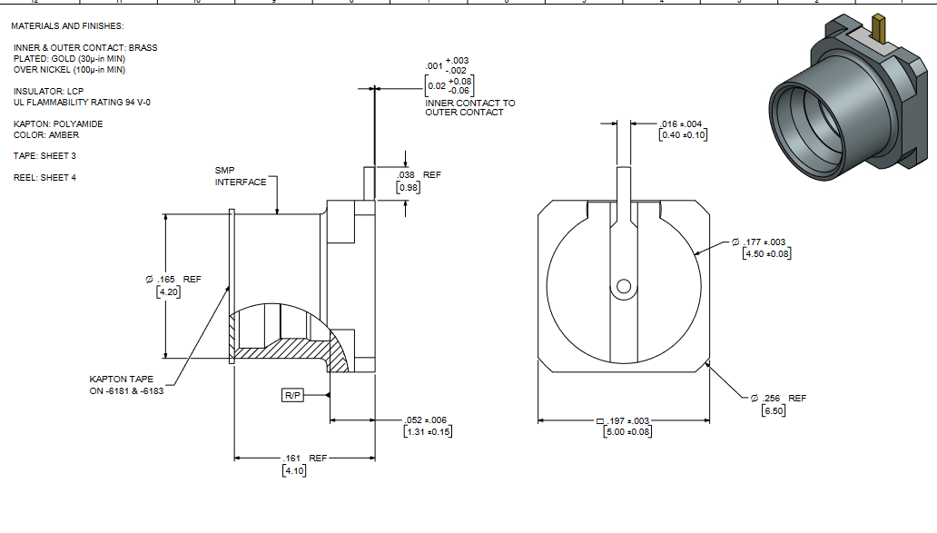

Slide 10
Diameters From data sheet:
Connector metal outer ring: 177 mils, 4.5 mm
Soldermask hole: 110 mils, 2.8 mm
Hole in metal, all 4 layers of metal: 126 mils, 3.2 mm
Hole in dielectric: 47 mils, 1.19 mm

Slide 11
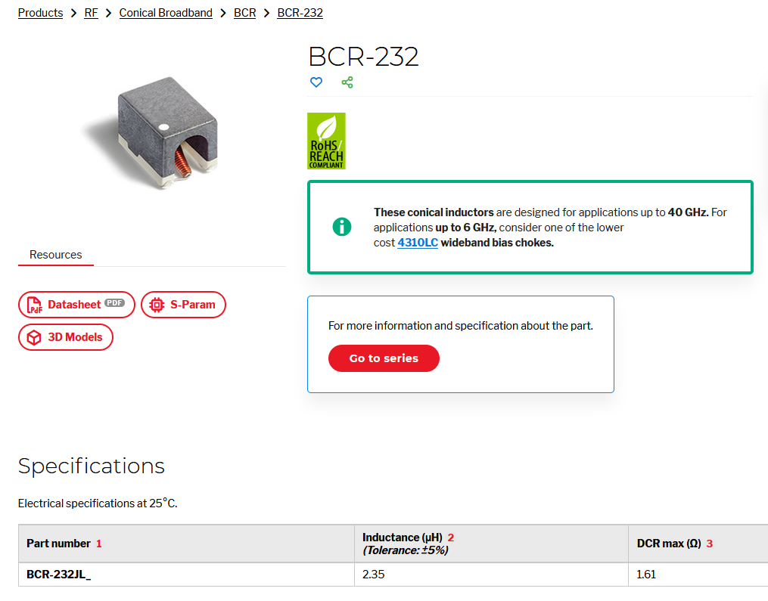
https://www.coilcraft.com/en-us/products/rf/conical-broadband/0-40-ghz/bcr/bcr-232/

Slide 12
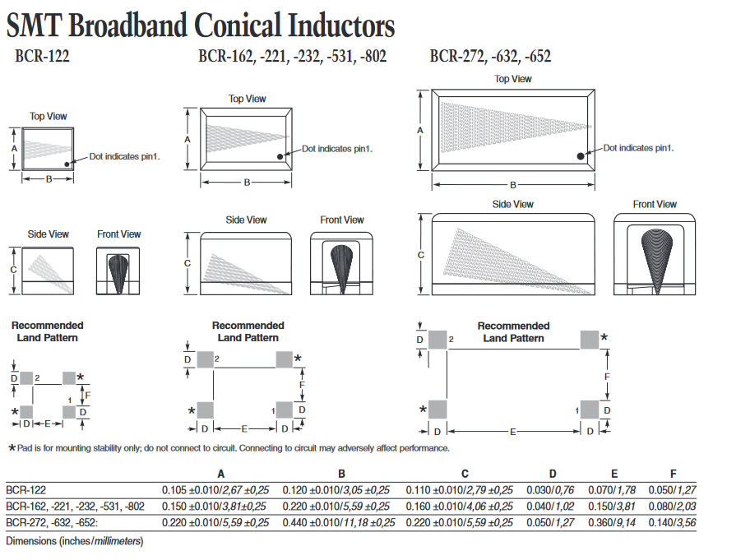

Slide 13
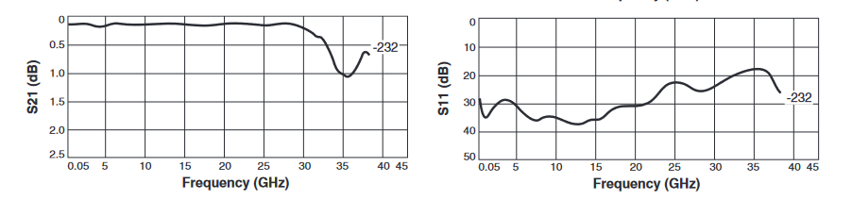
S parameters BCR-232

Slide 14
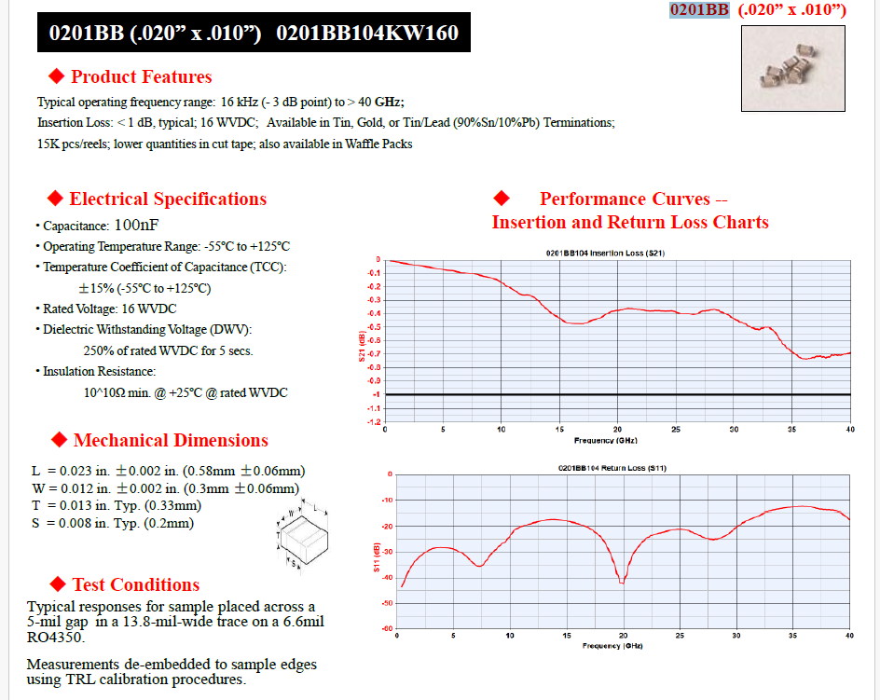
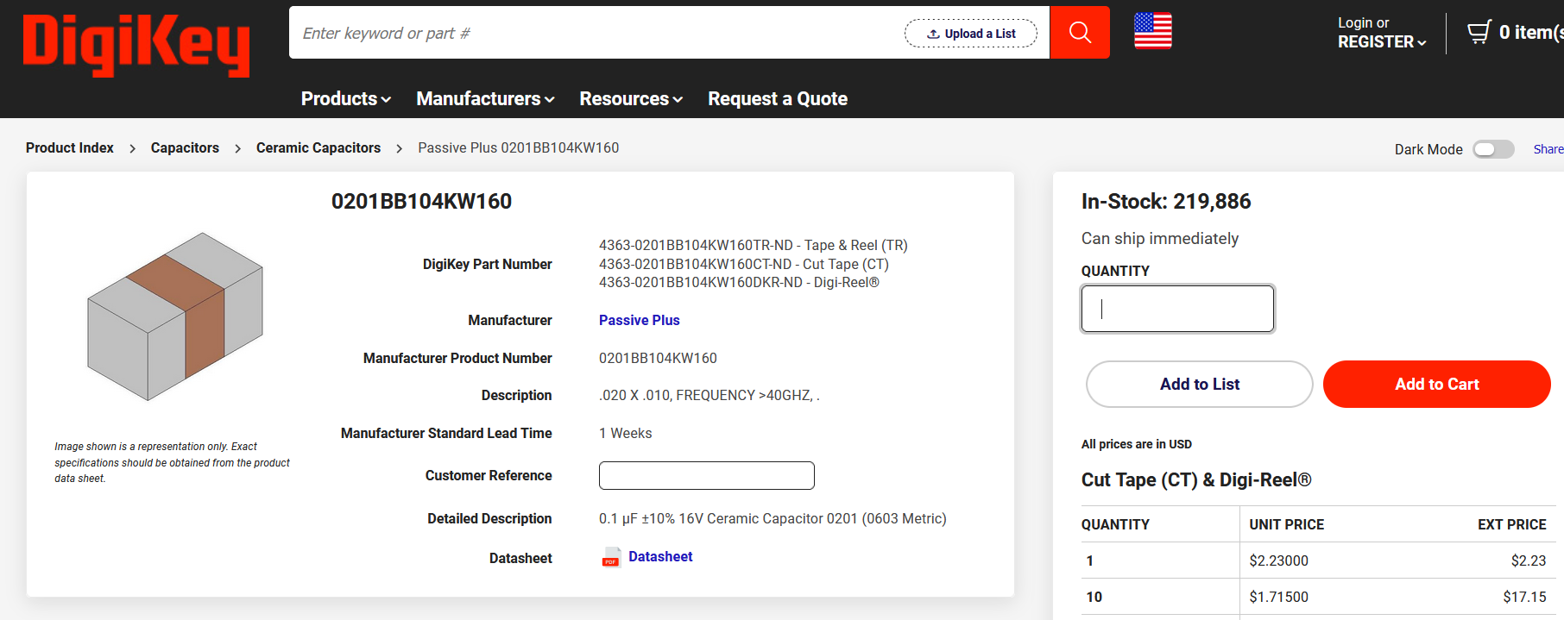
Passive Plus 0201BB104KW160
100 nF
https://www.digikey.com/en/products/detail/passive-plus/0201BB104KW160/19186628

Slide 15
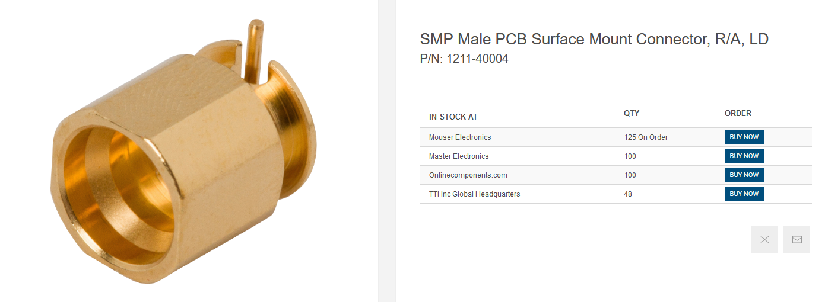
There is a rumor going around that SV microwave is willing to help customers with printed circuit board layout for launch from various connectors. Is this true? We need to launch from a SMP like the 1211-40004 to a grounded coplanar waveguide transmission line on the Eurocircuits RF Pool stackup, with a 6 mil gap, one 10 mil thick layer of RO4350B on each side of the board, and about 19 mils of prepreg in between the inner ground layers, for a total of 4 metal layers. Thanks!
Supposedly SVMicrowave is willing to do design for customers for the launch to various PCB transmission lines.
https://www.svmicrowave.com/smp-male-pcb-surface-mount-connector-ra-ld

Slide 16
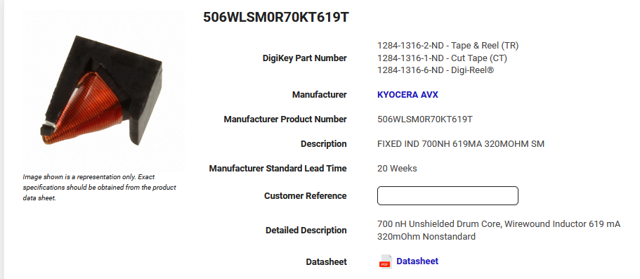
Might be better than coilcraft for availability
https://www.digikey.com/en/products/detail/kyocera-avx/506WLSM0R70KT619T/4789861

Slide 17
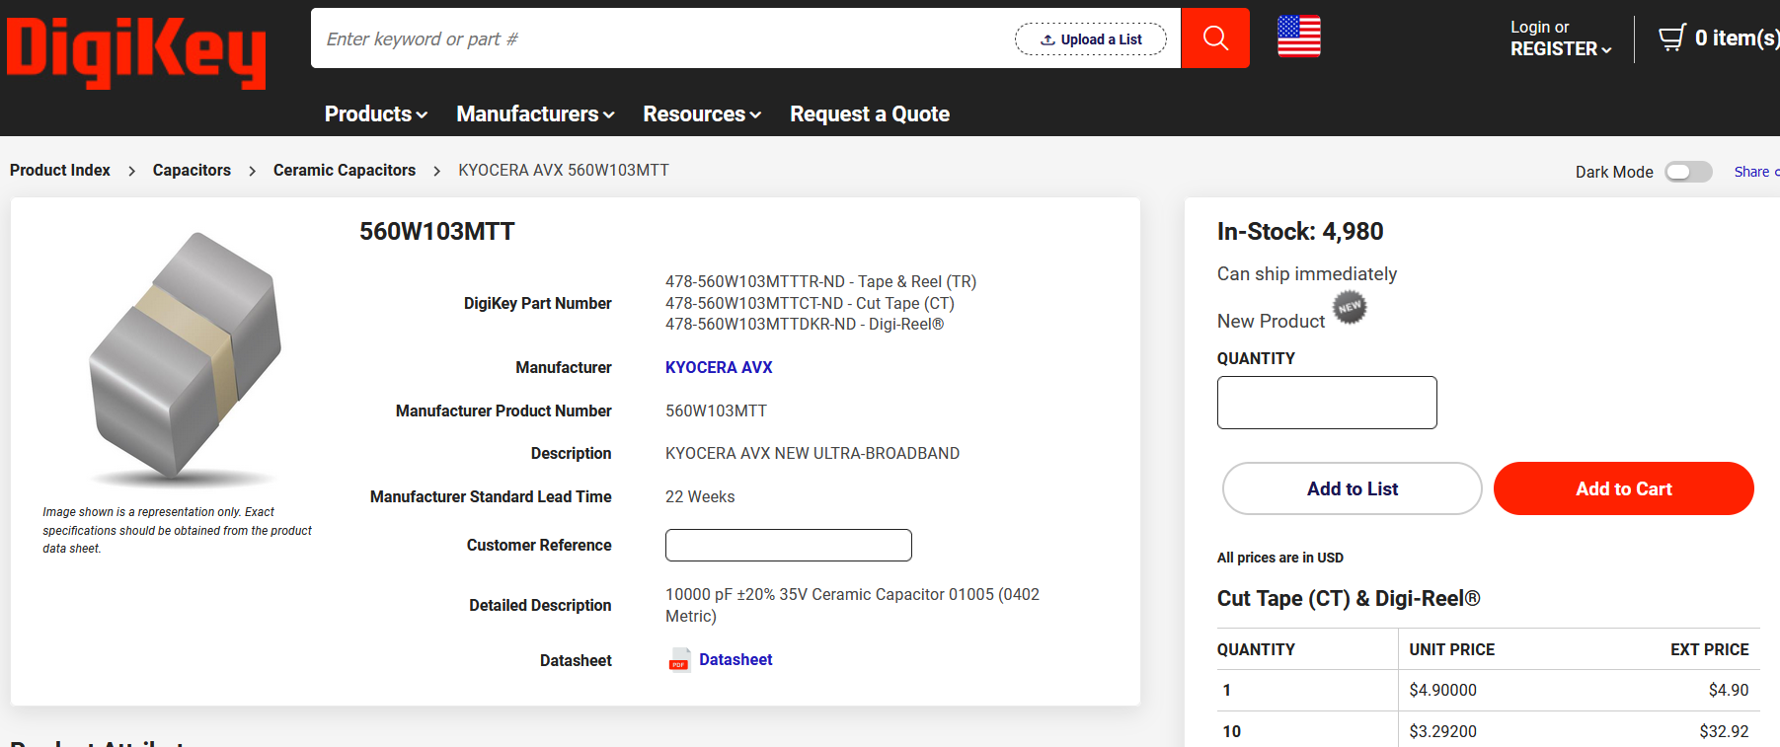
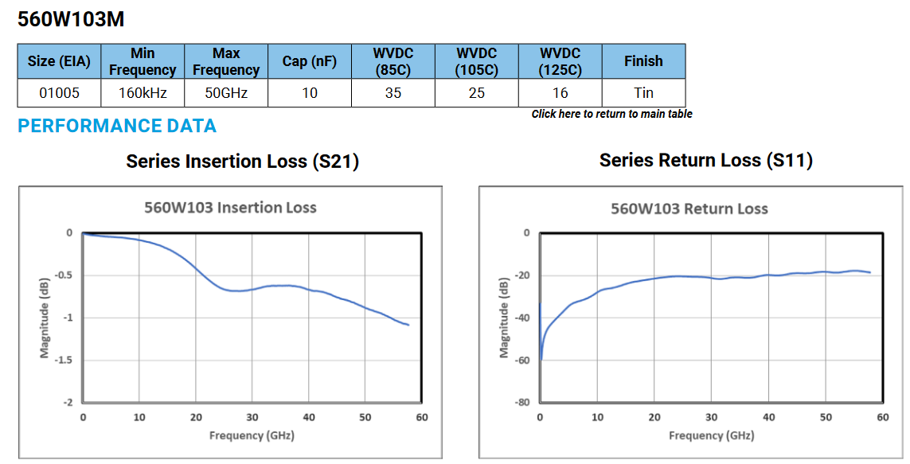
https://www.digikey.com/en/products/detail/kyocera-avx/560W103MTT/22205406

Slide 18
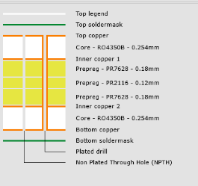
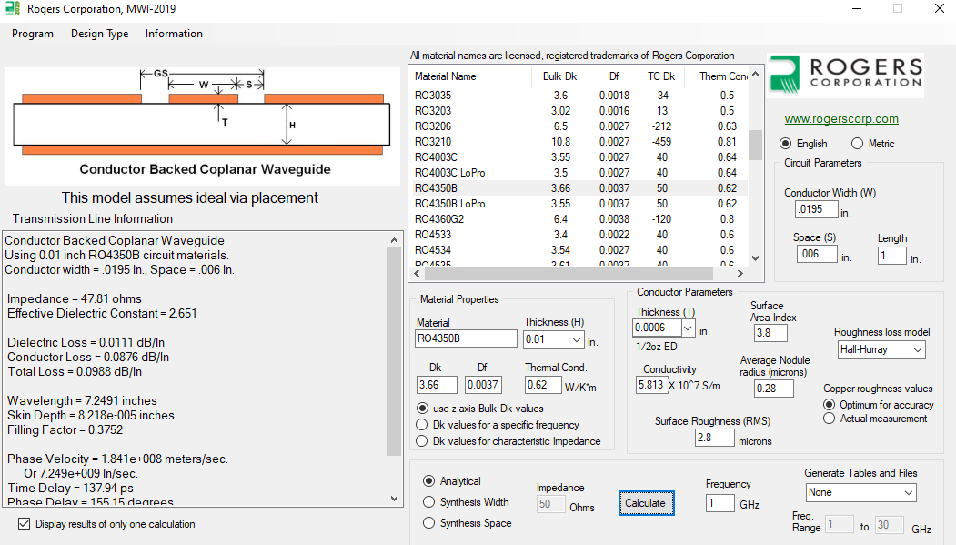

Slide 19
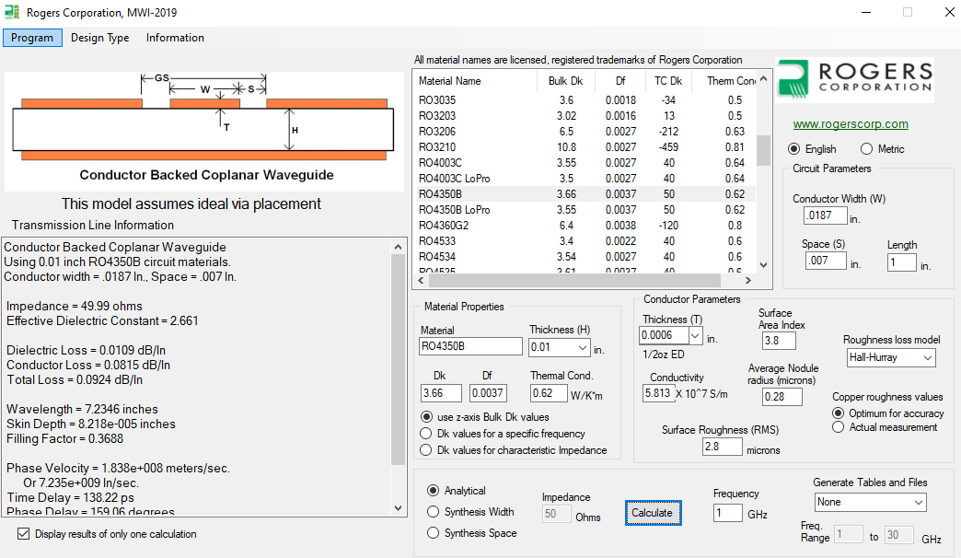

Slide 20
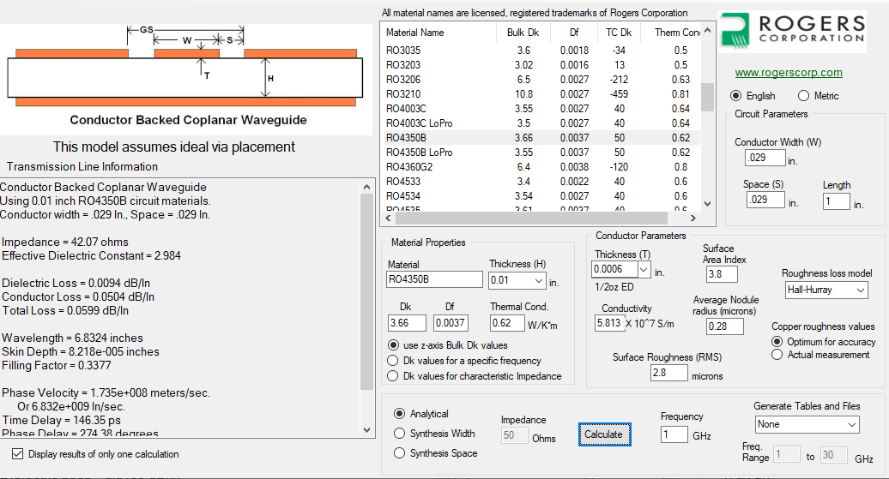

Slide 21


