Slide 1
MM4250 Cal PCBs and Dual SP3T Ecal
Lafe Spietz
NIST
Boulder, CO

Slide 2
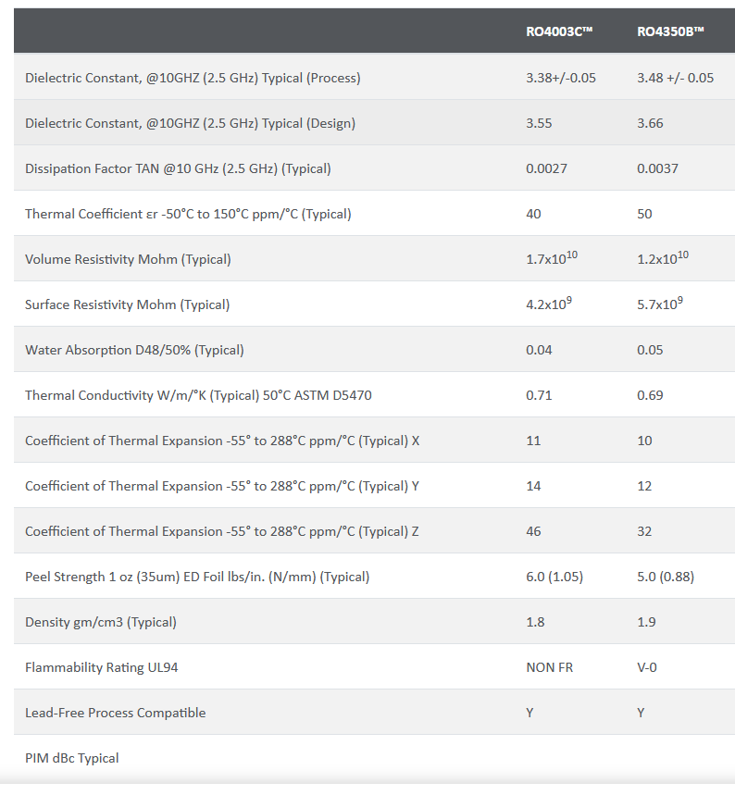
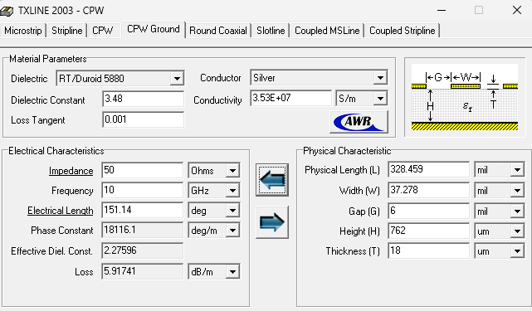
CPW-G Rogers 4350 B 0.762 mm (30 mils)
https://rogerscorp.com/advanced-electronics-solutions/ro4000-series-laminates/ro4350b-laminates

Slide 3
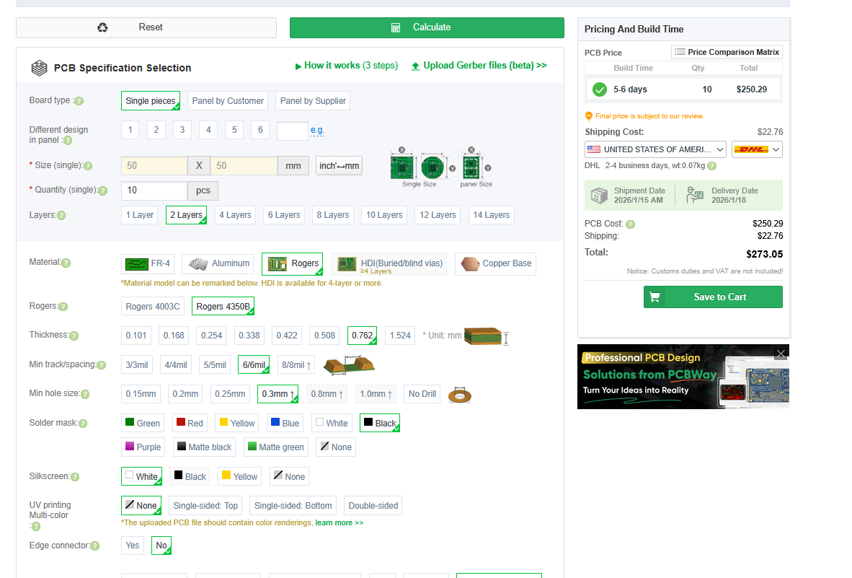
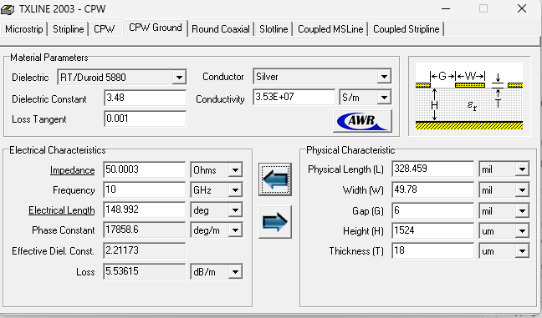
60 mil thick board

Slide 4
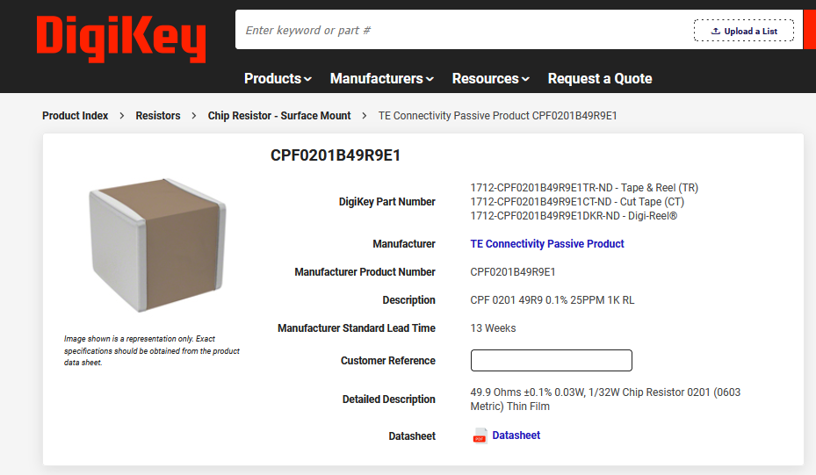
Load resistors
https://www.digikey.com/en/products/detail/te-connectivity-passive-product/CPF0201B49R9E1/14007284

Slide 5
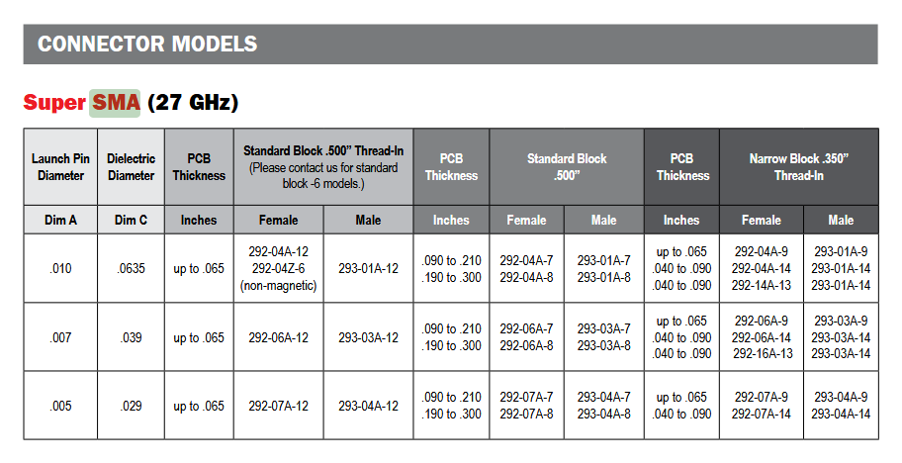

Slide 6
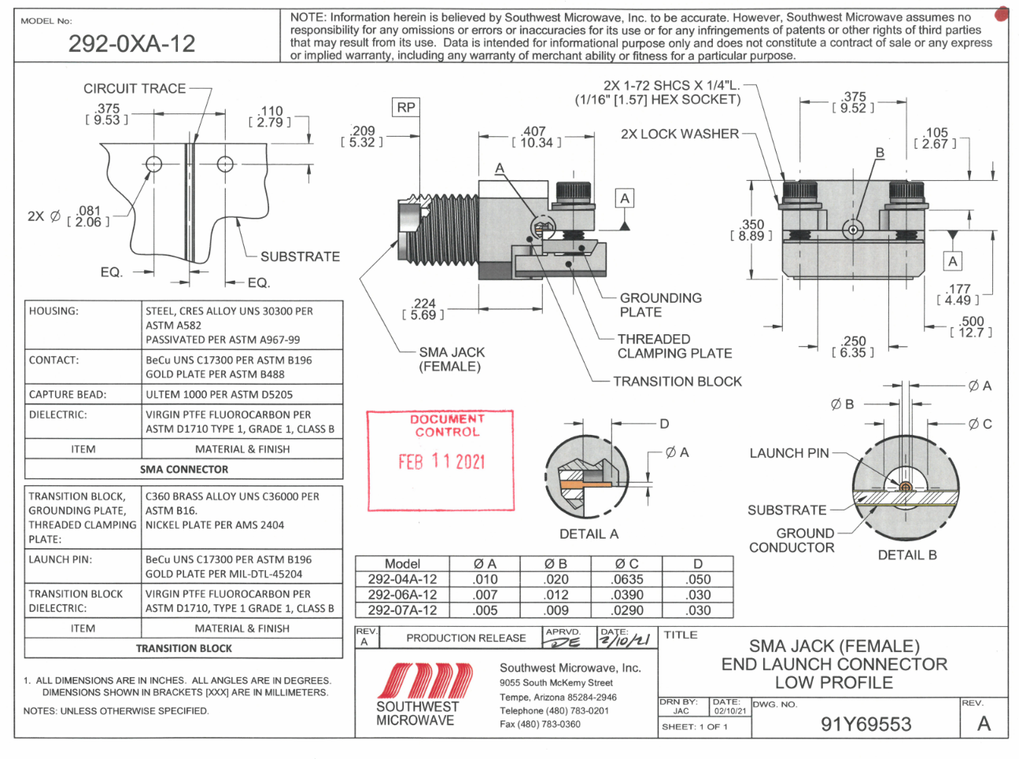
https://mpd.southwestmicrowave.com/product/292-04a-12-end-launch-supersma-27-ghz-jack-female-standard-block-500-thread-in/

Slide 7
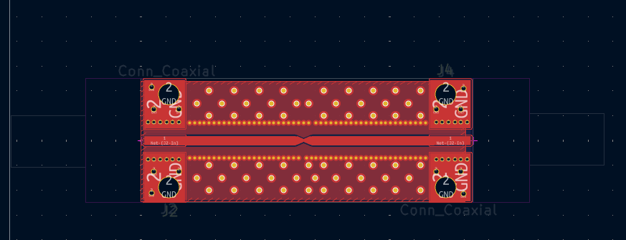
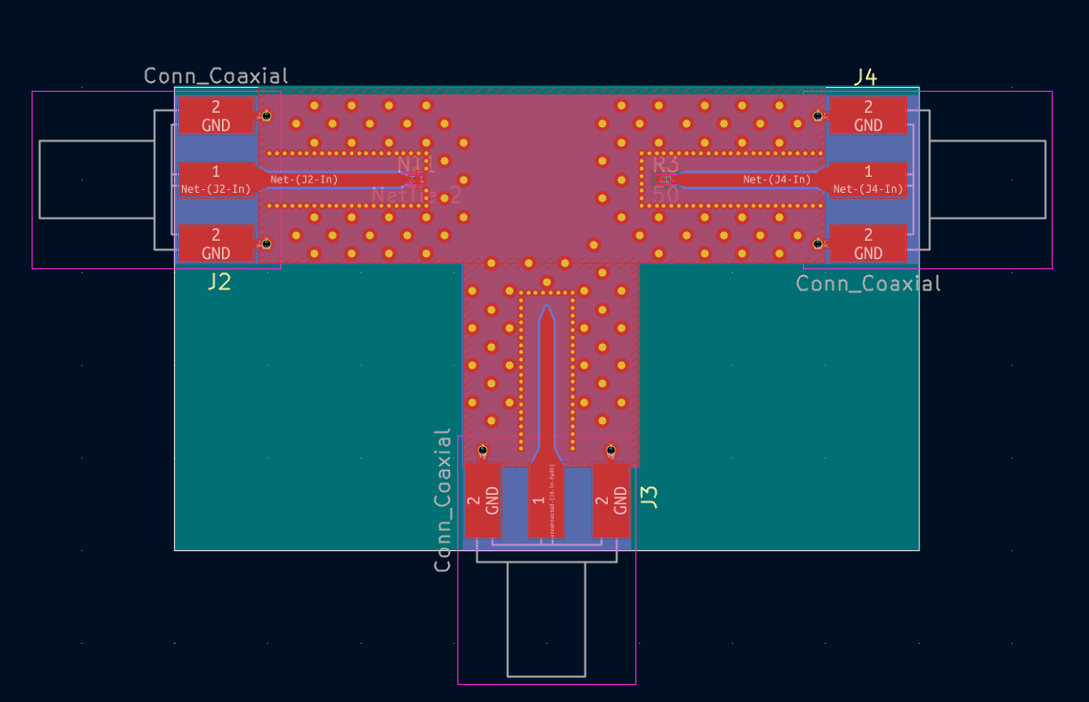
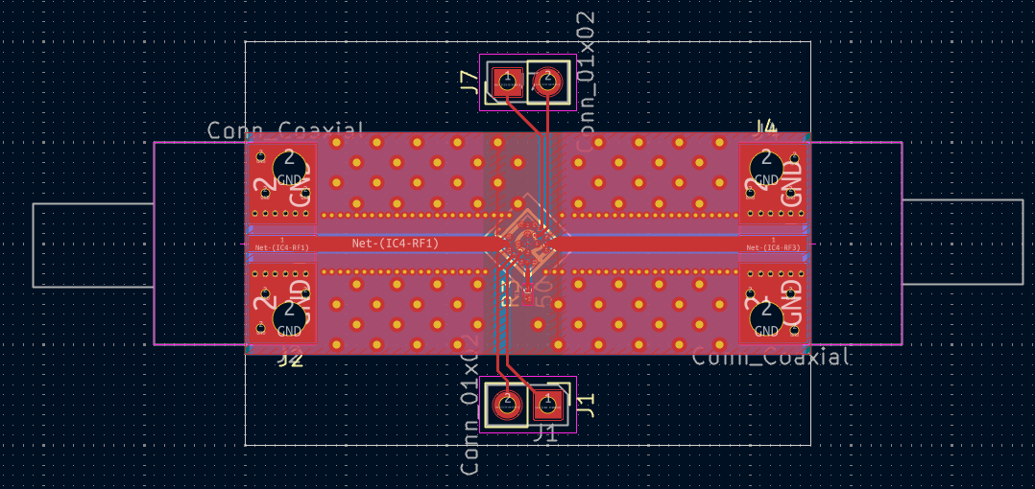
SOLT Standards
THRU
SHORT
LOAD
SWITCH
OPEN

Slide 8
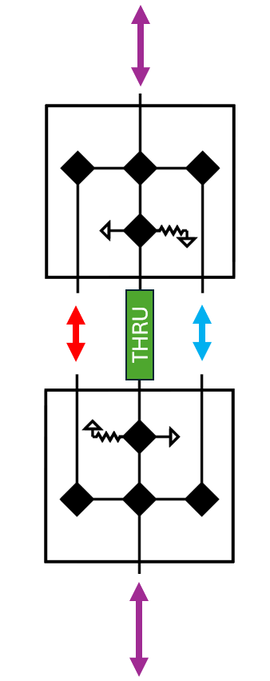
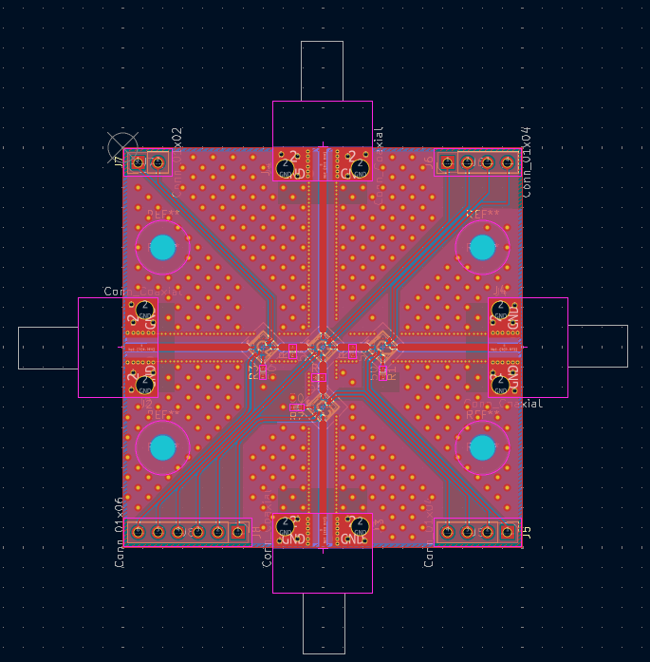
Dual SP3T Ecal

Slide 9
Questions
Do we want to make an attempted impedance transformer to also test?
Do we want to switch to the full Eurocircuits stackup for the SP3T board?
Do we want 30 mil or 60 mil boards for the test boards?
Who orders the boards?
What else to make?
What about trying to measure TWPA in existing switch setup? Have they tried it? Should we try it?
Where to publish results on measurements?

Slide 10
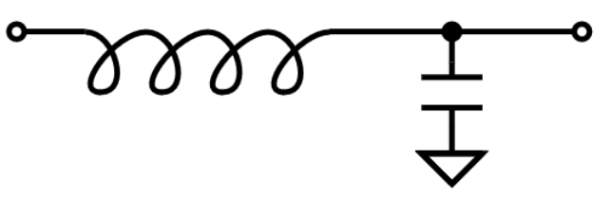
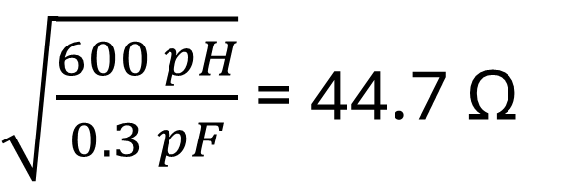
Impedance matching network, version 1
Input
Switch
0.3 pF
600 pH
$\sqrt{\frac{600 pH}{0.3 pF}}$ = 44.7 Ω

Slide 11
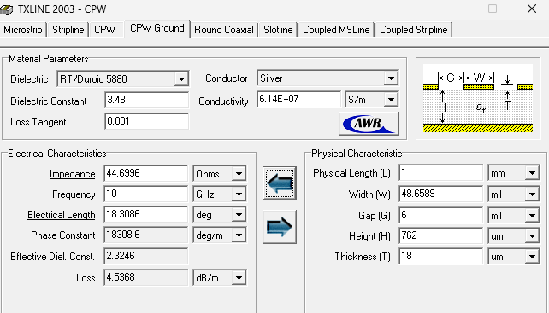
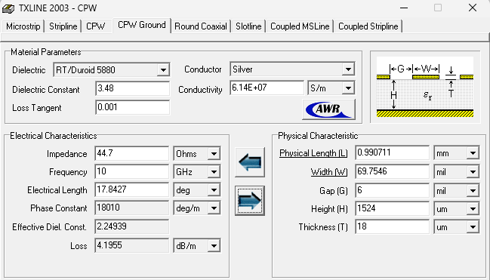
44.7 Ohm impedance

Slide 12
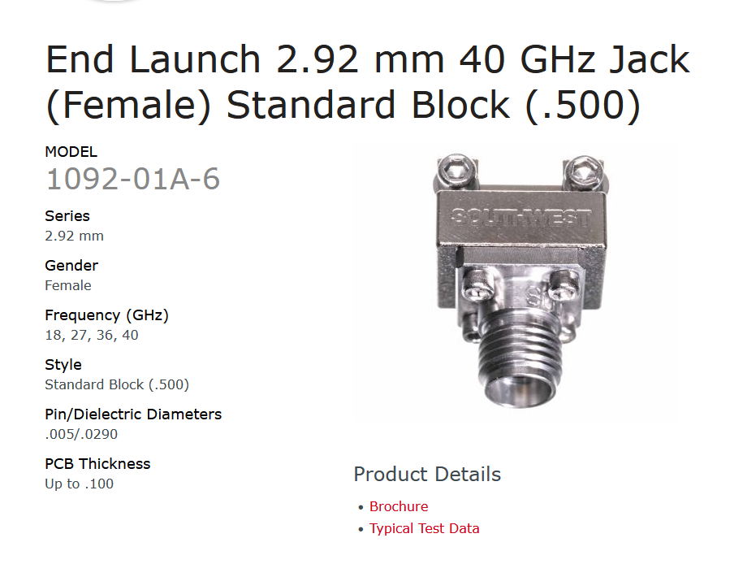
We have 4 of these:

Slide 13
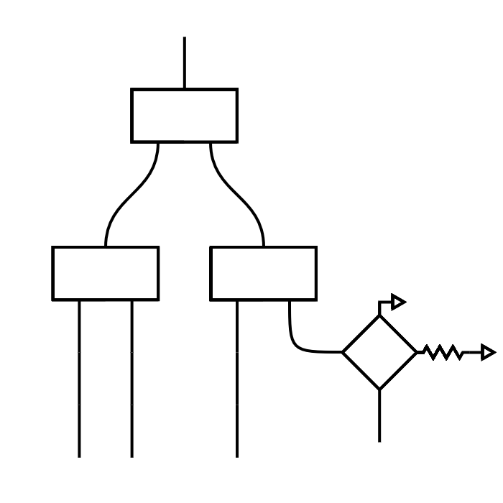
TWPA-TRON
SPDT
SPDT
DUT1
SPDT
DUT2
SPDT
SPDT
SPDT
DUT3
SP3T
SOLR
SP3T

Slide 14
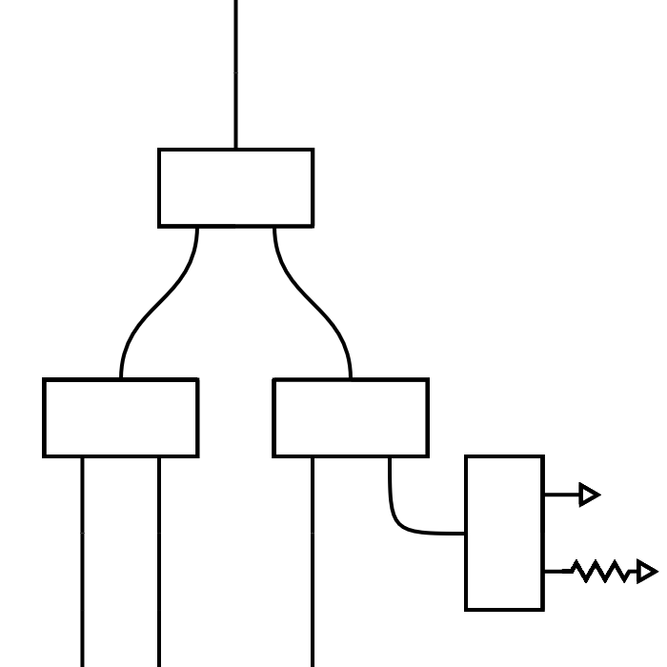
TWPA-TRON
SPDT
SPDT
DUT1
SPDT
DUT2
SPDT
SPDT
SPDT
DUT3
SPDT
SPDT
SOL
SOL

Slide 15
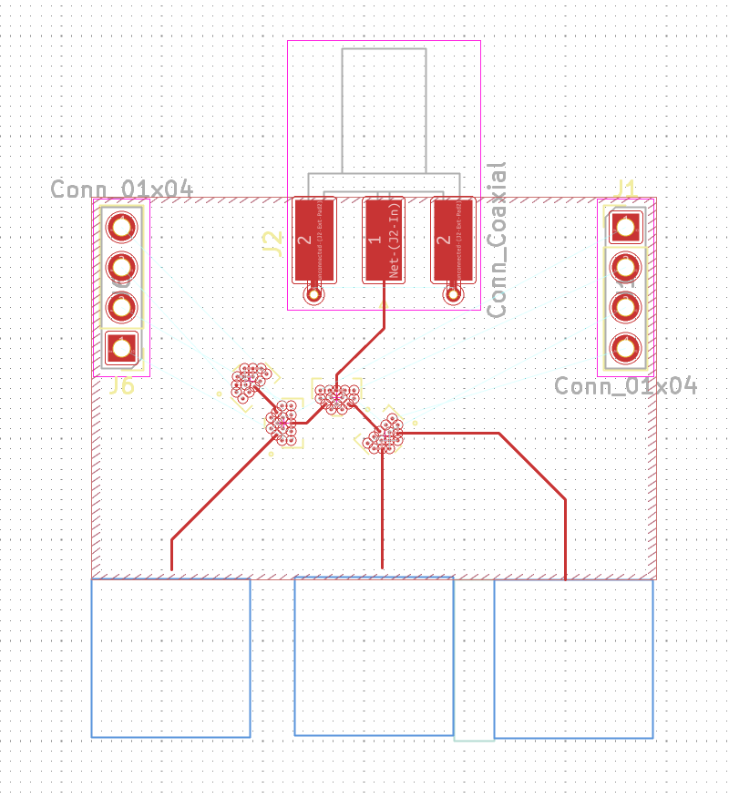
Rough draft of layout topology

Slide 16
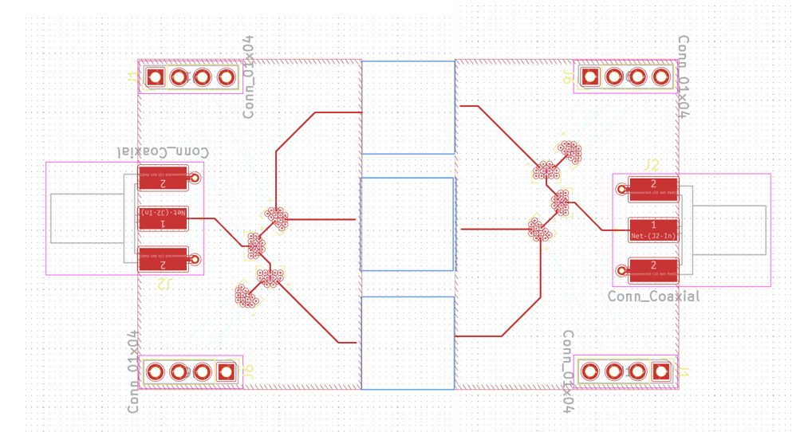
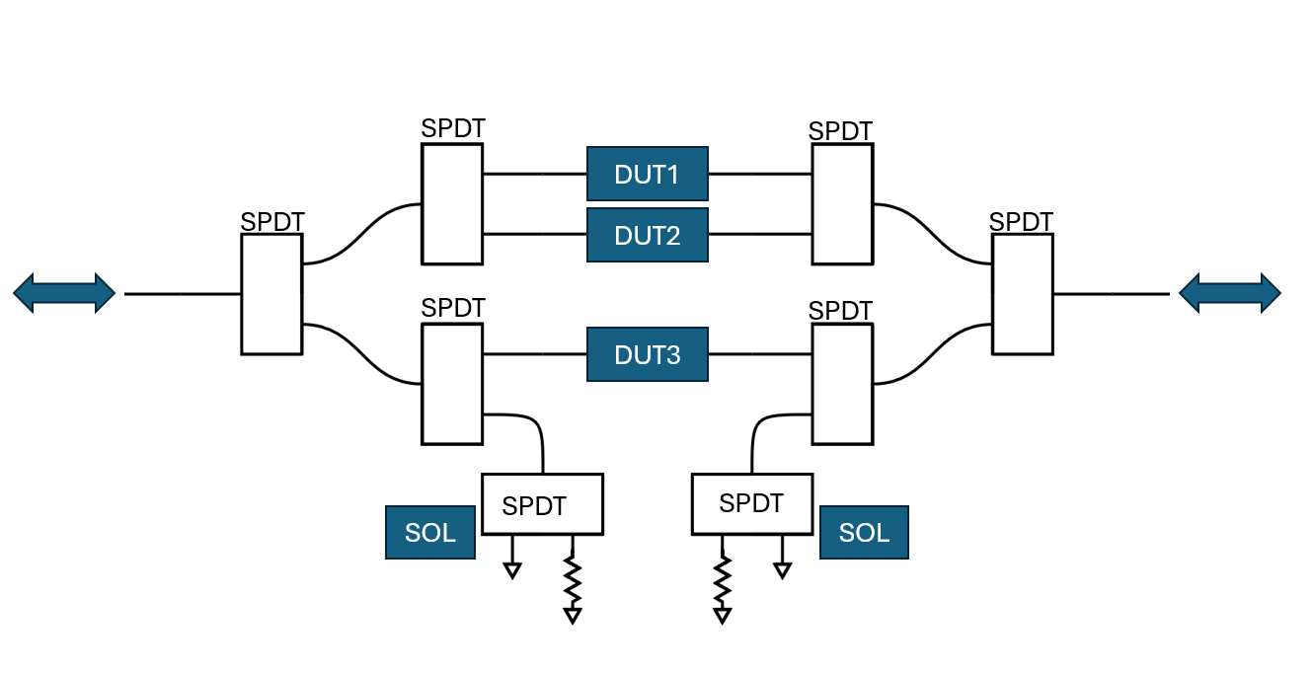
TWPAtron rough layout topology

Slide 17
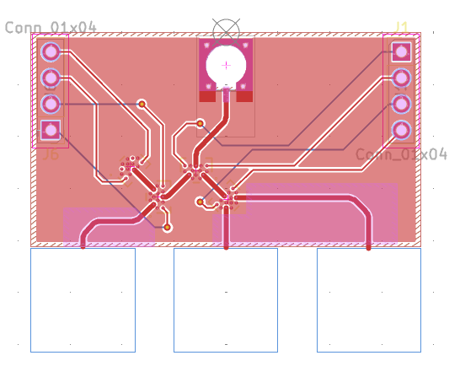
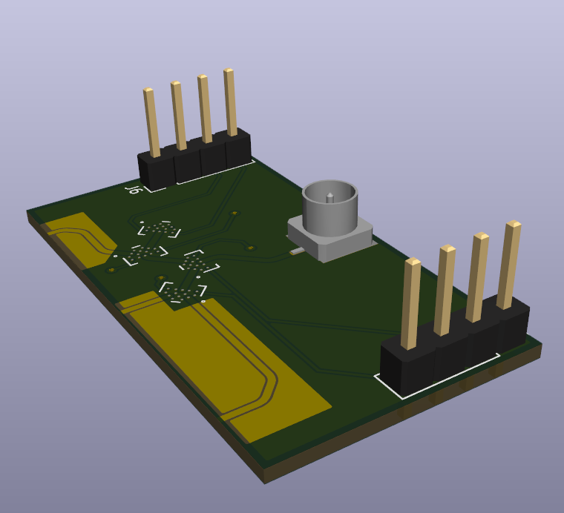
TWPAtron Draft
10x10 mm

Slide 18
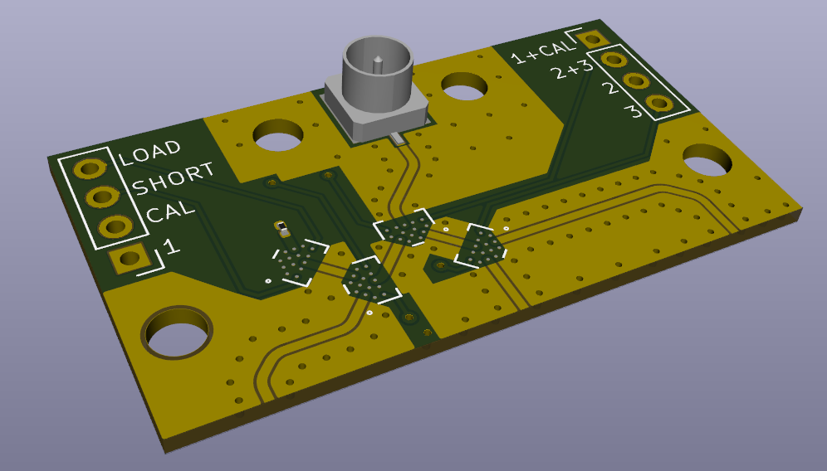
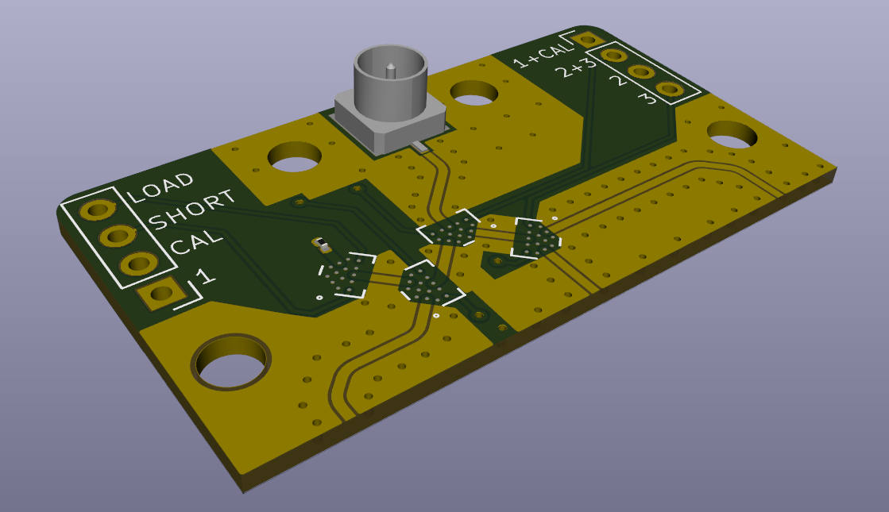
3d render of latest draft

Slide 19
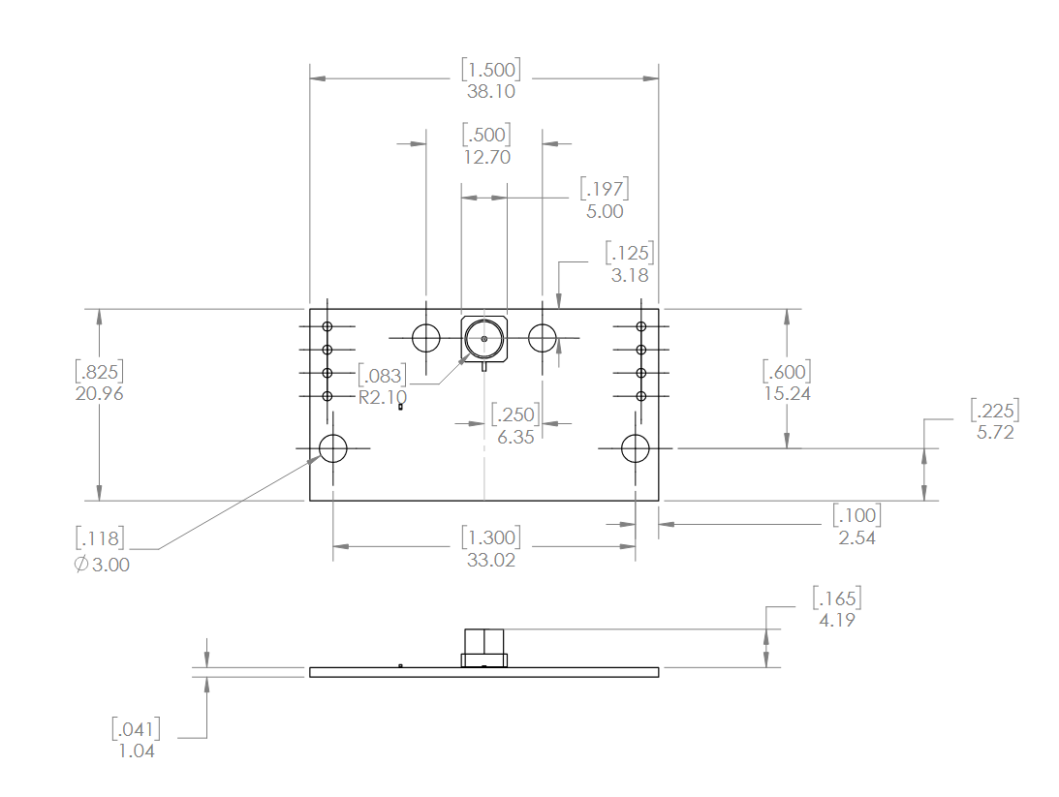

Slide 20
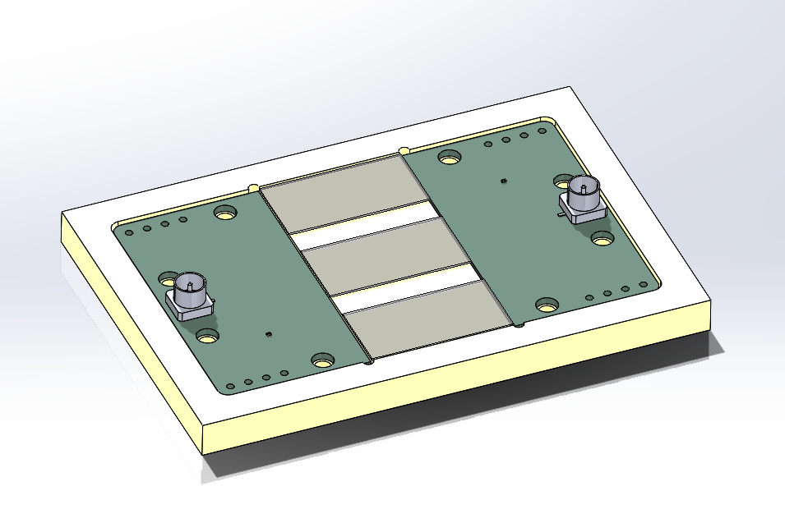

Slide 22
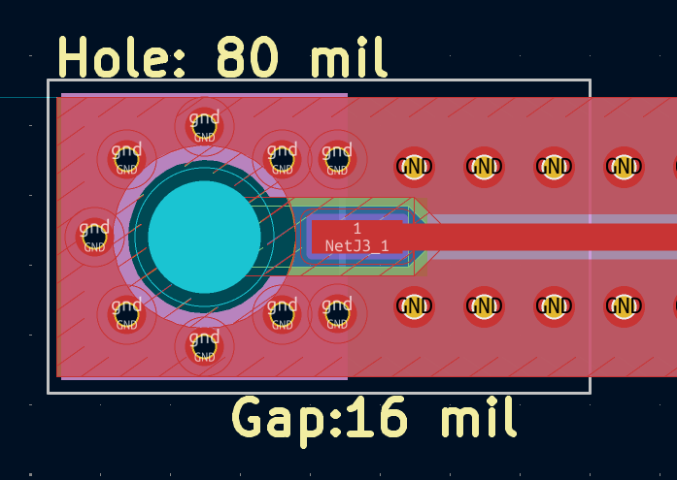
24X65 mil
Diameter 0.131”
Diameter 0.08”
0.085”
0.016”

Slide 23
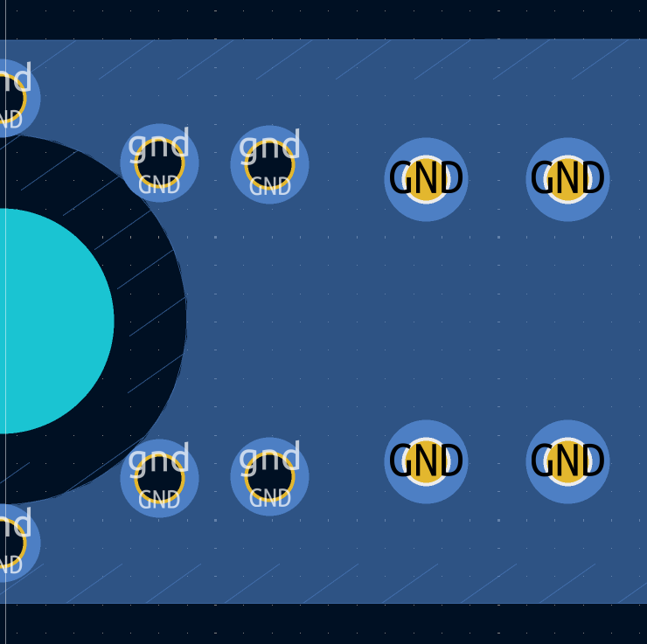
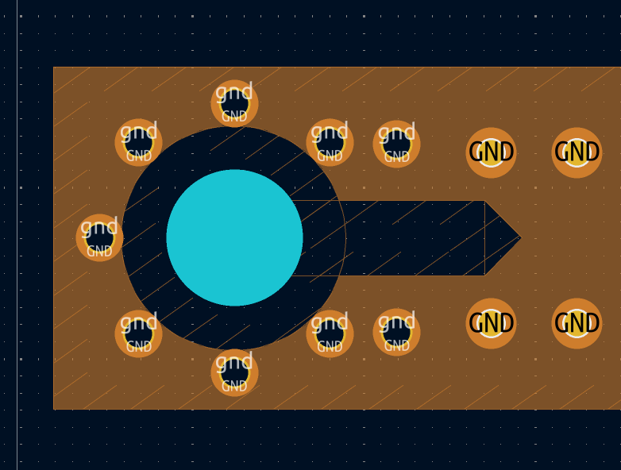

0.103”
0.044”

Slide 24
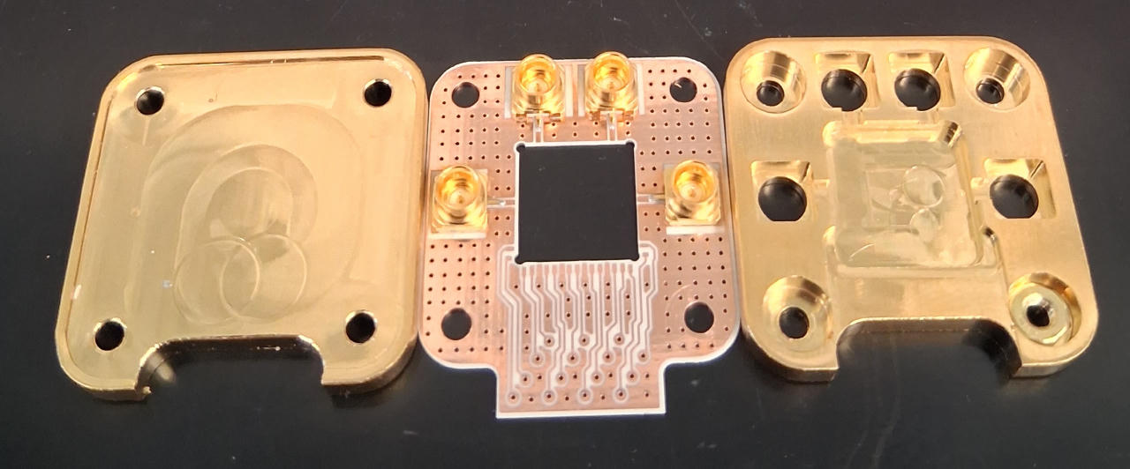
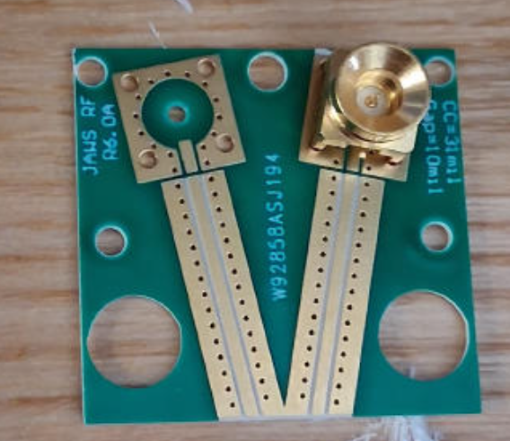
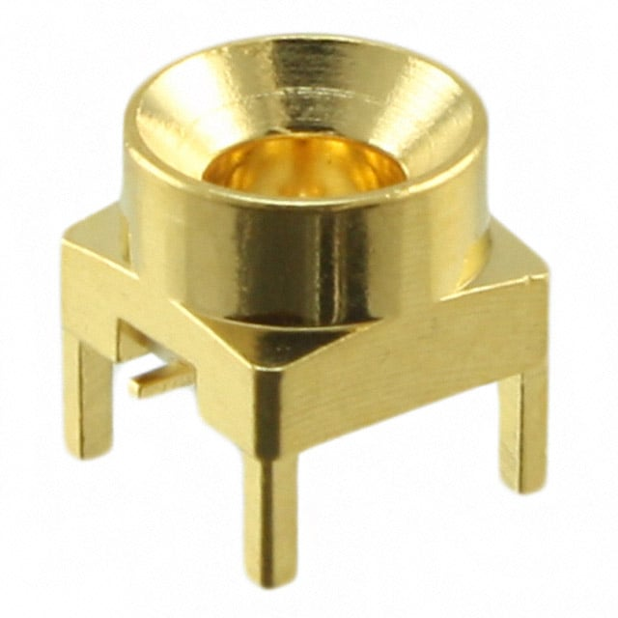
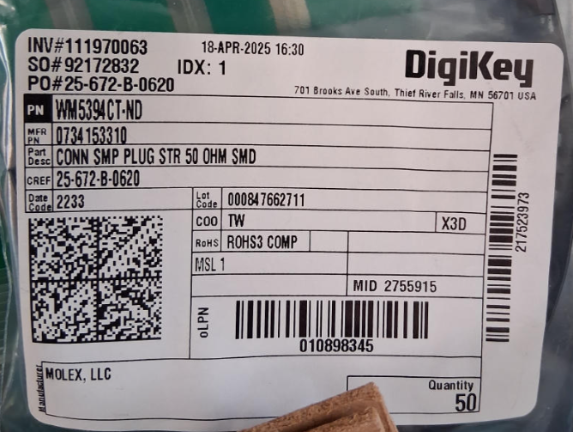
Looking at JAWS designs and Aivon designs
Move to 20 mil PCB
With one insulating layer and 2 copper layers
https://www.digikey.com/en/products/detail/molex/0734153310/2755910
WM5394CT-ND

Slide 25
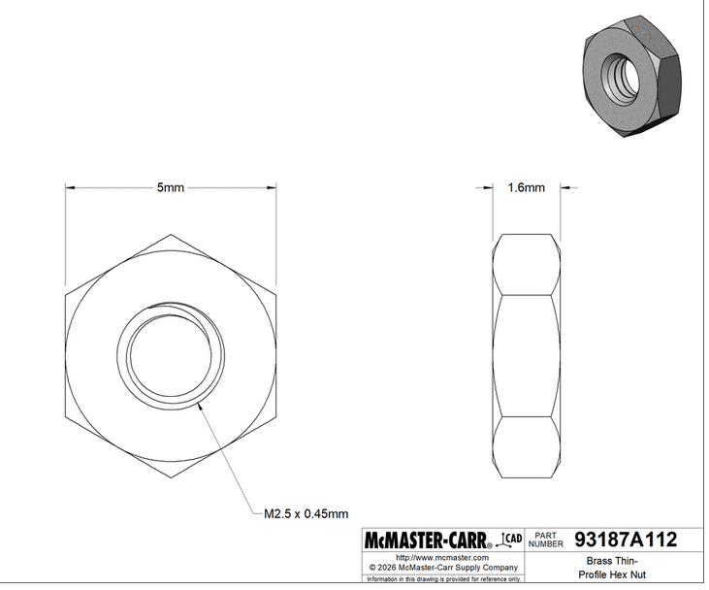
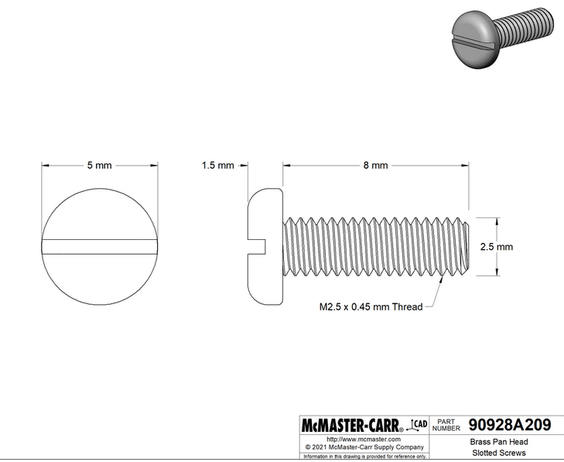
M2.5 Screw and Nut
Clearance 2.75 mm = 108 mils
https://www.mcmaster.com/90928A209/
https://www.mcmaster.com/93187A112/

Slide 26
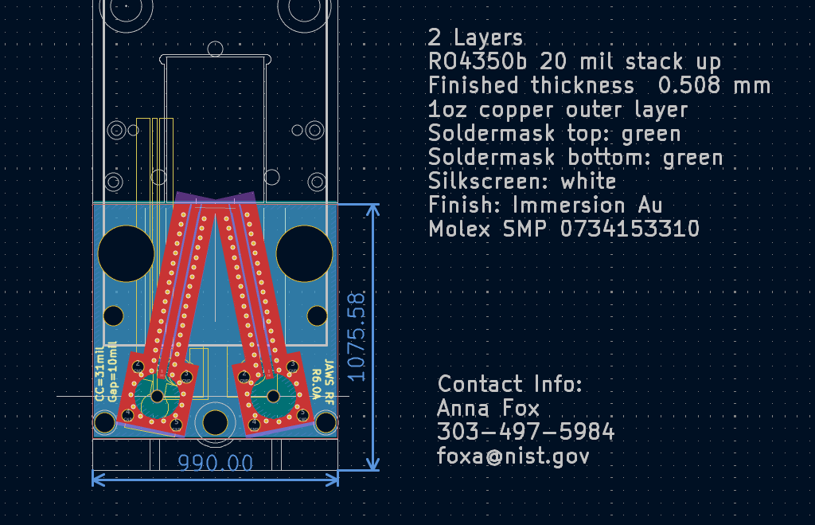
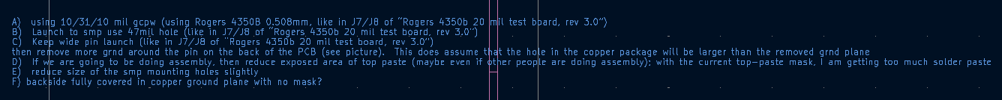
JAWS Import from Alium

