Slide 1
Memes
wood2pcb

Slide 2
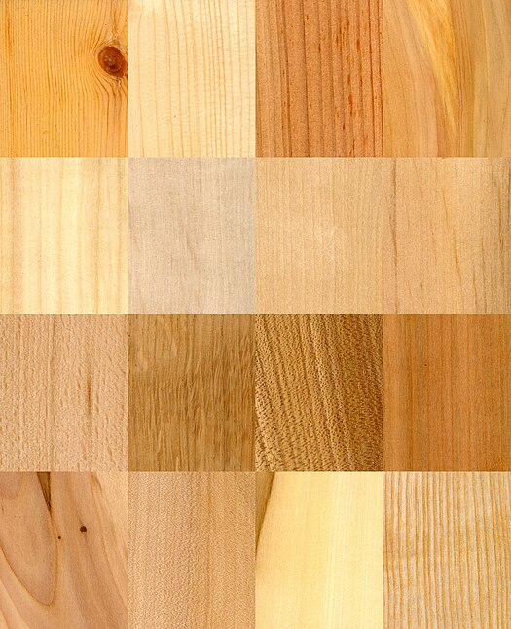
Wood

Slide 3
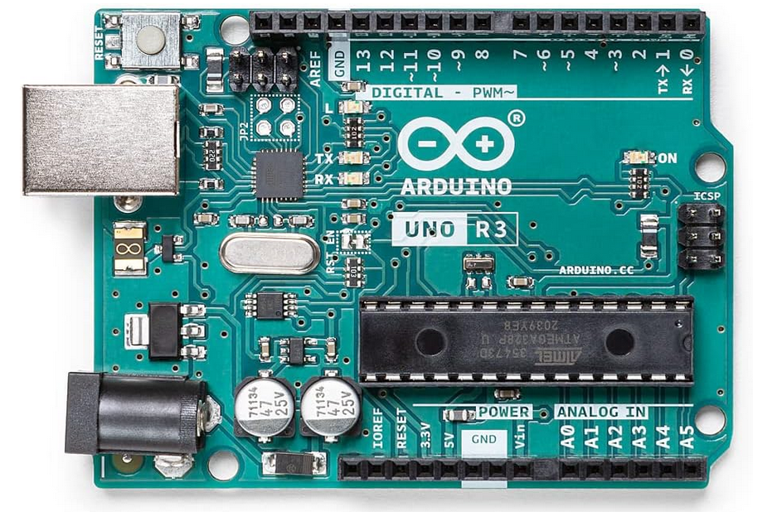

Slide 4
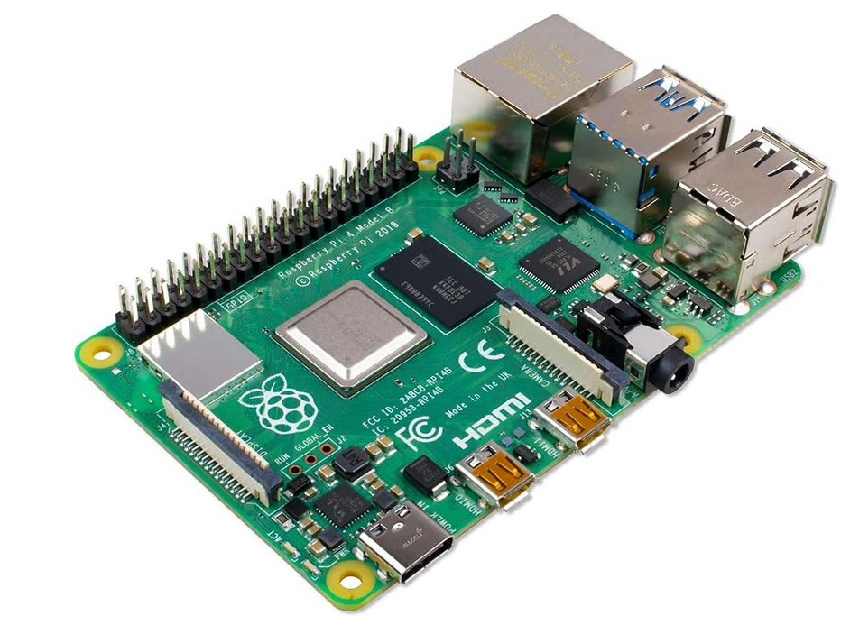

Raspberry Pi

Slide 5
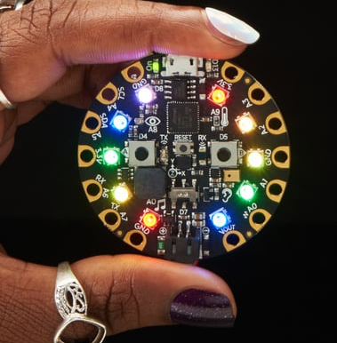
Circuit Playground Express

Slide 6
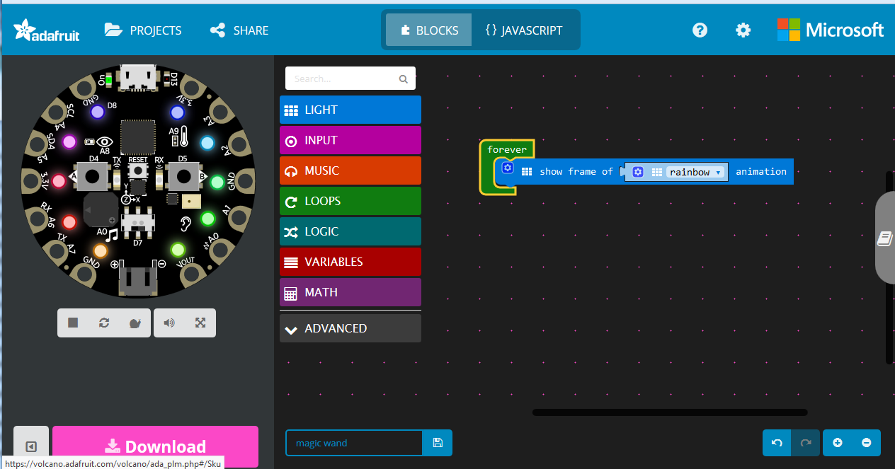
Microsoft MakeCode

Slide 7


Slide 8
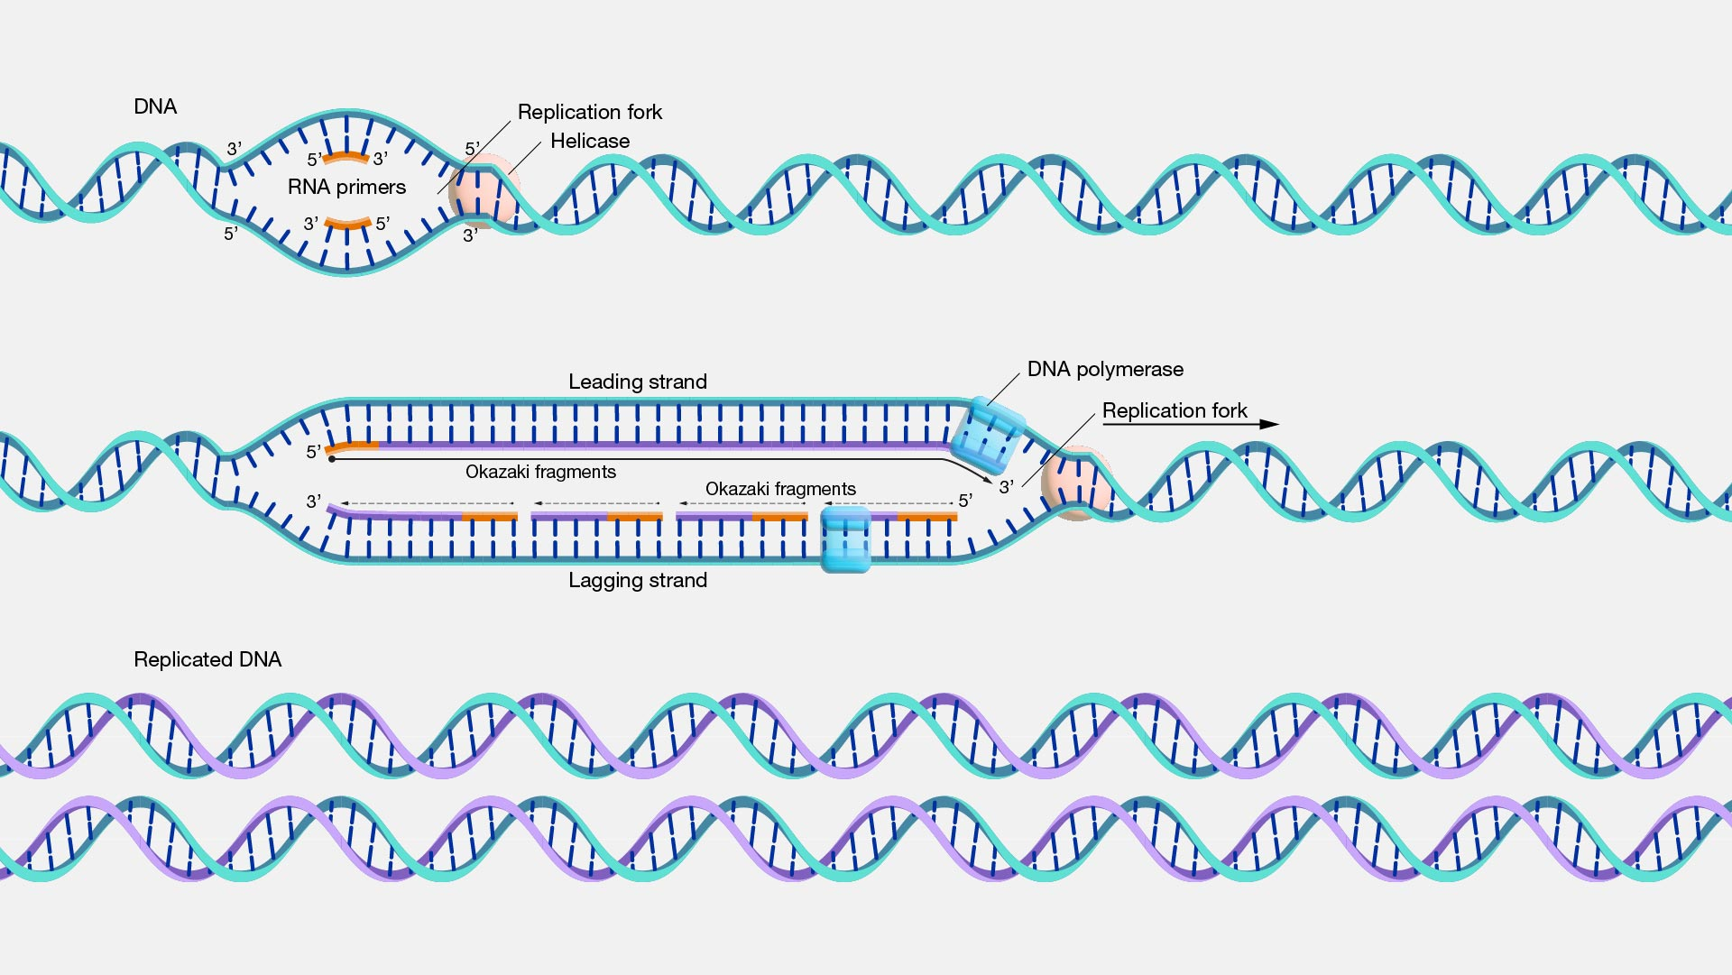
Self-replicating Media

Slide 9
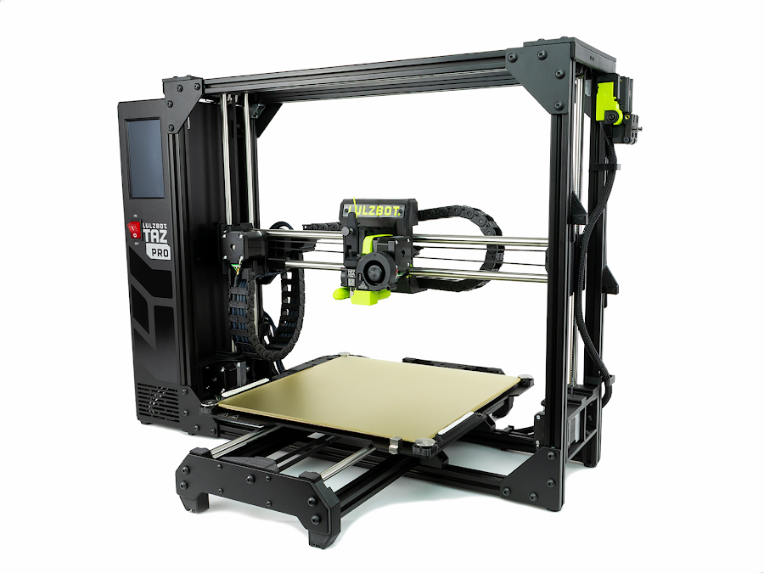
3d Printing

Slide 10
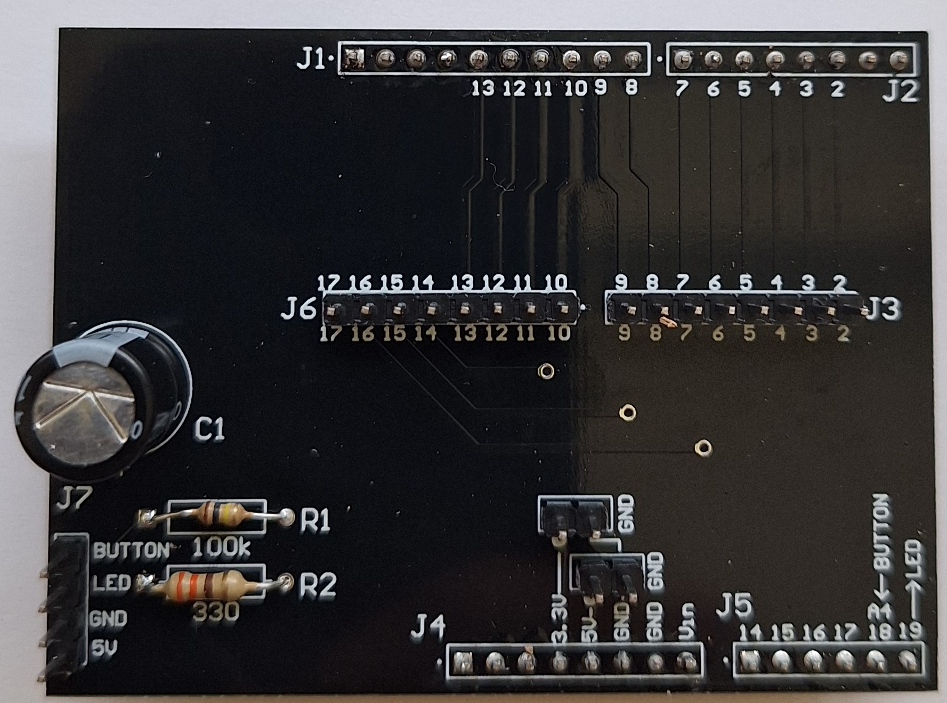
Low Cost Printed Circuit Board Manufacturing

