Slide 1
Memes
wood2pcb

Slide 2
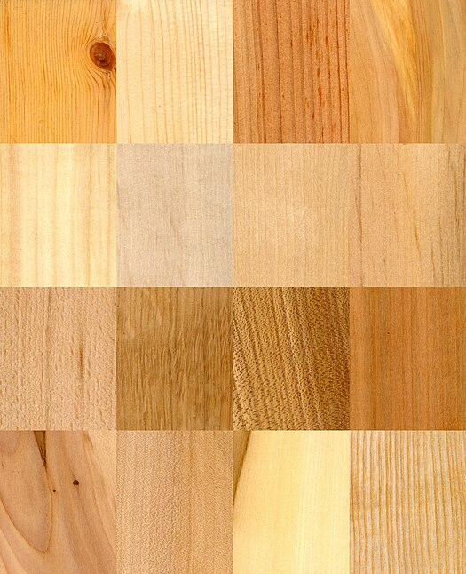
Wood

Slide 3
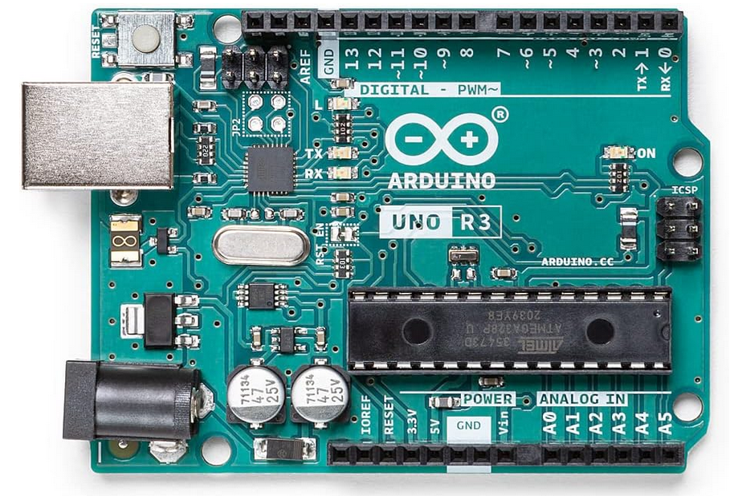

Slide 4
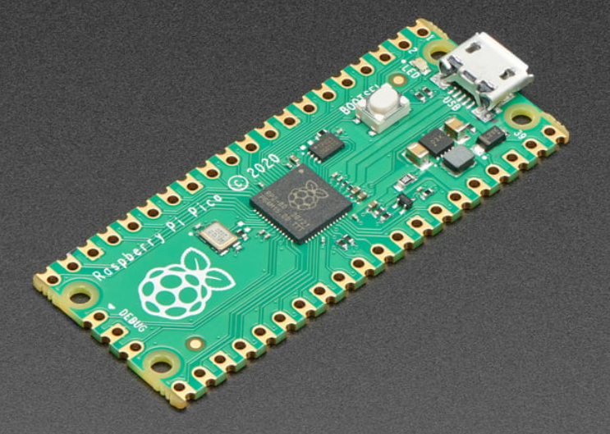

Slide 5
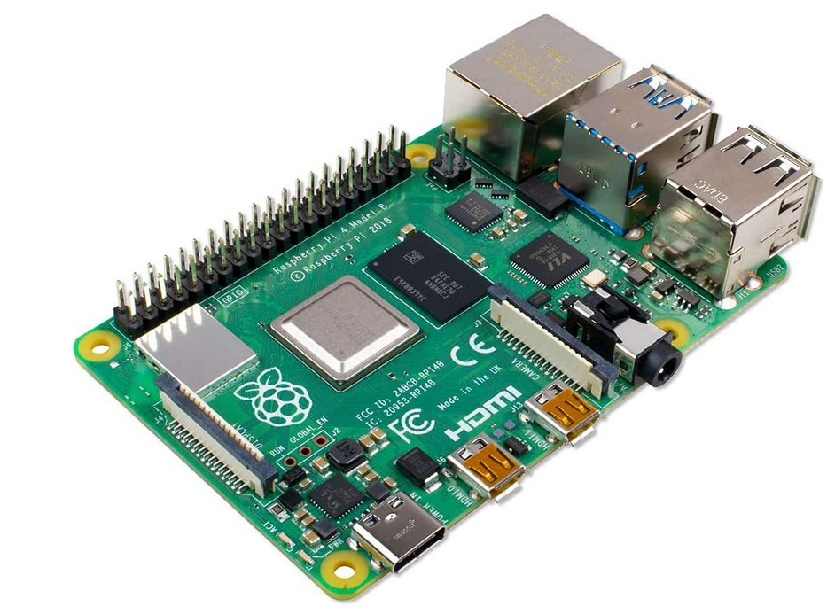

Raspberry Pi

Slide 6
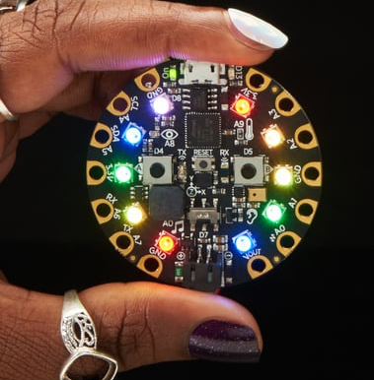
Circuit Playground Express

Slide 7
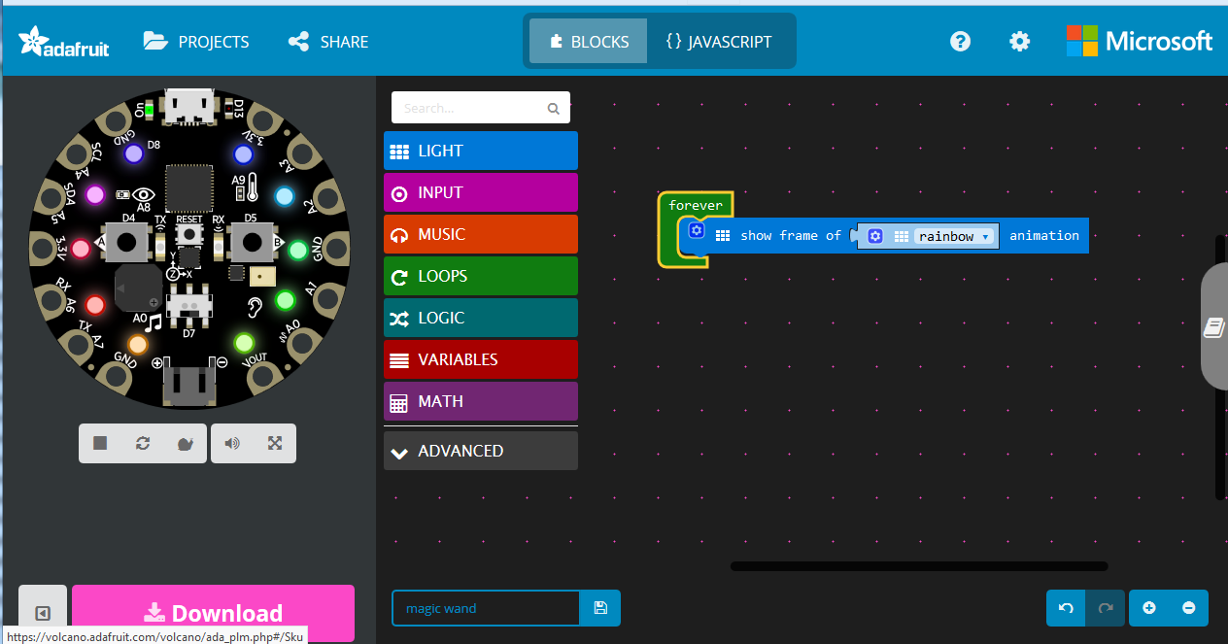
Microsoft MakeCode

Slide 8


Slide 9
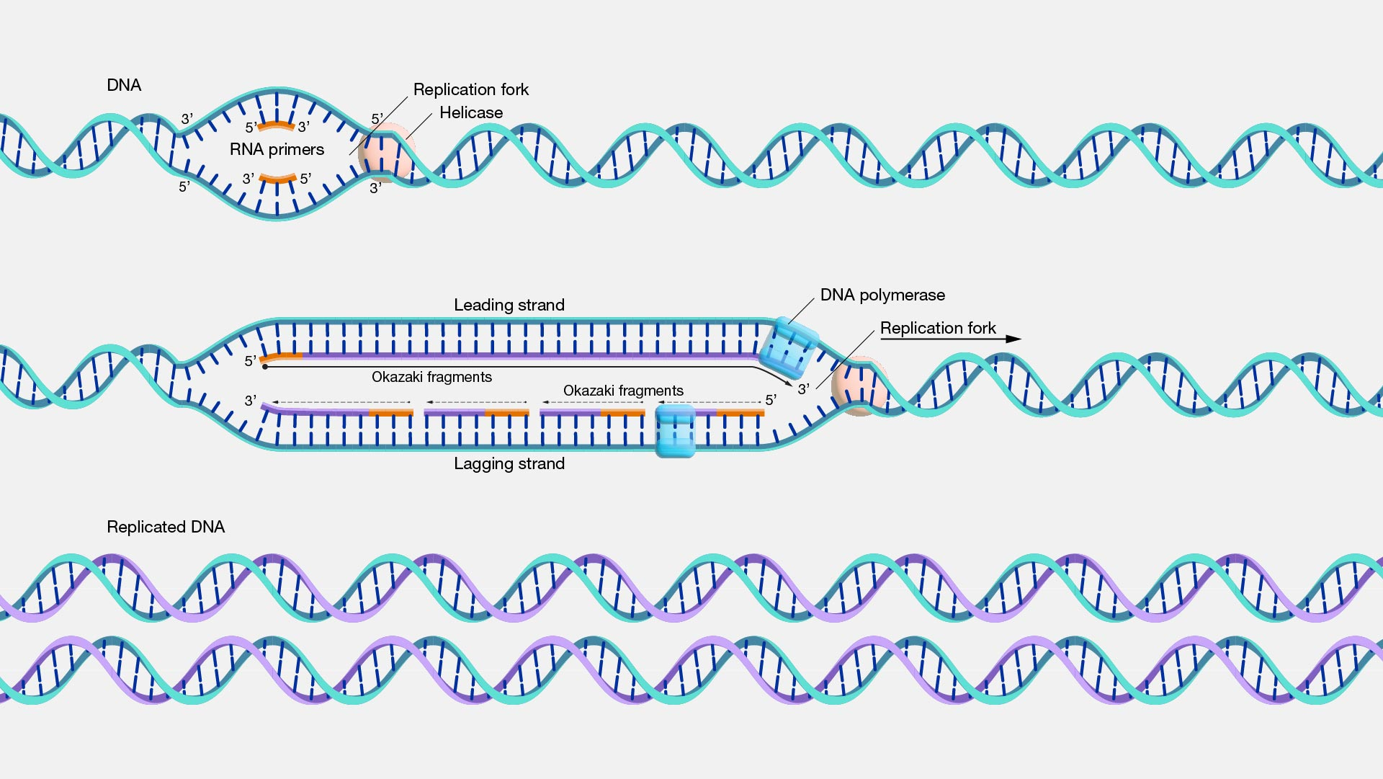
Self-replicating Media

Slide 10
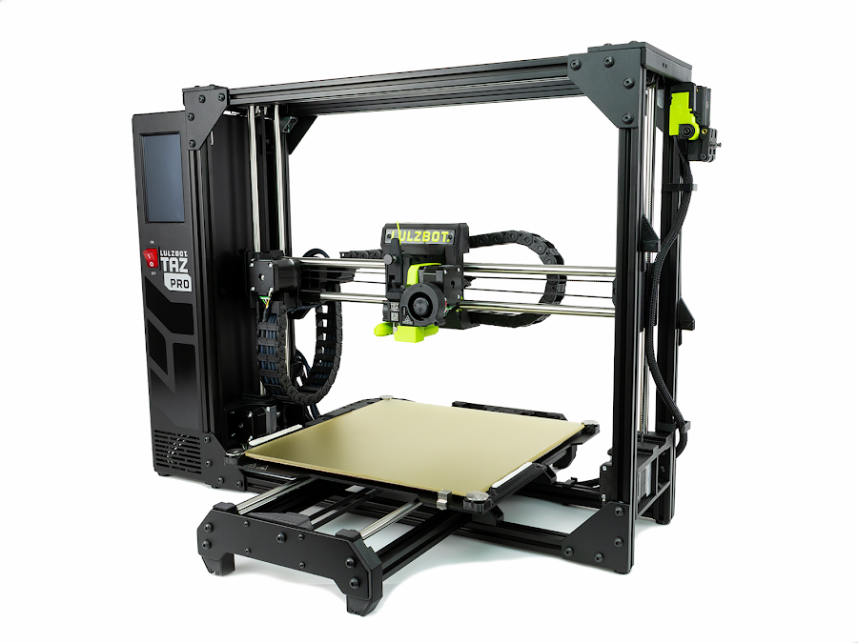
3d Printing

Slide 11
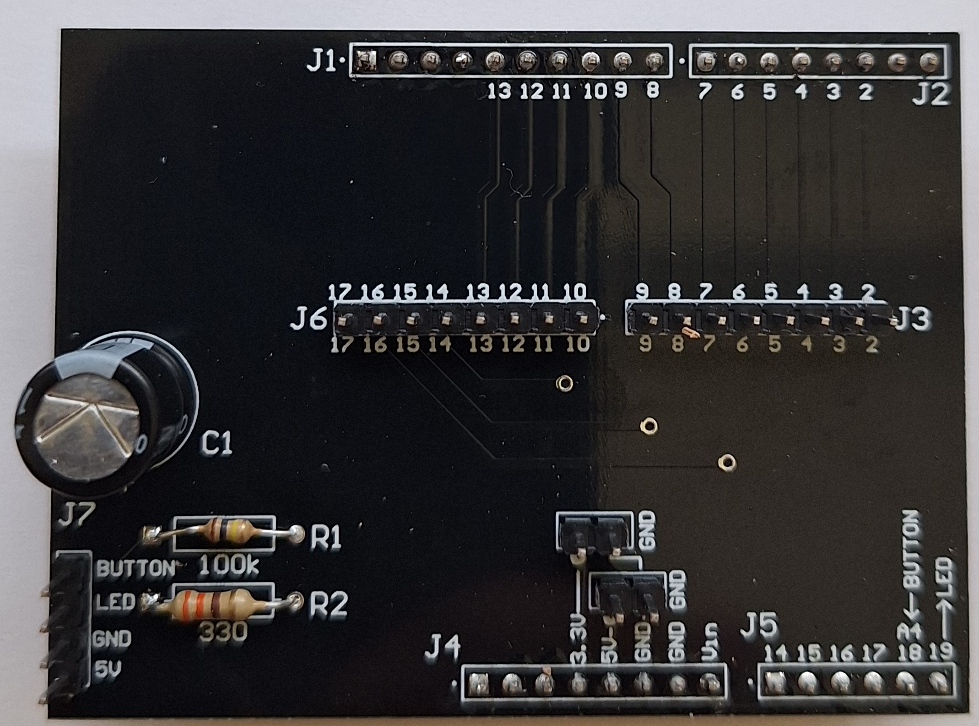
Low Cost Printed Circuit Board Manufacturing

