Slide 1
Welcome to ist 263
Intro to Front End Web Development

Slide 2
Agenda
About the Instructor?
Key Syllabus Info
History of the Internet
Introduce Yourself

Slide 3
About the Instructor

Slide 4
Who am I?
Professor Ferger
Web Application Developer
I’ve been programming the front and backend of the web since 1999.

Slide 5

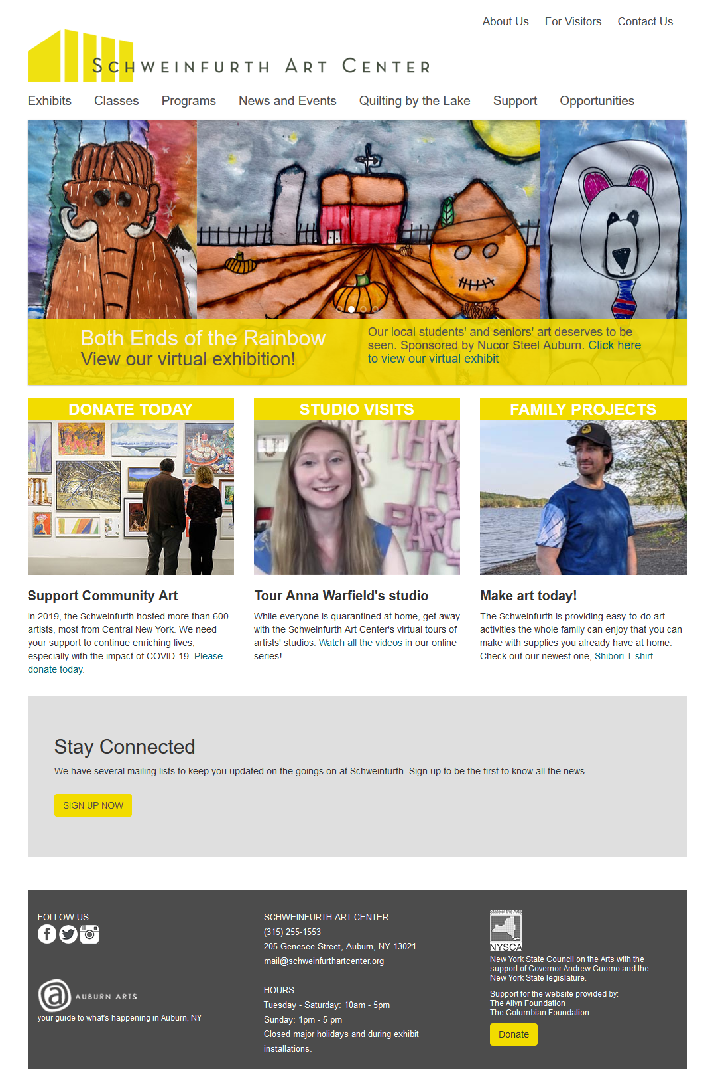

Slide 6
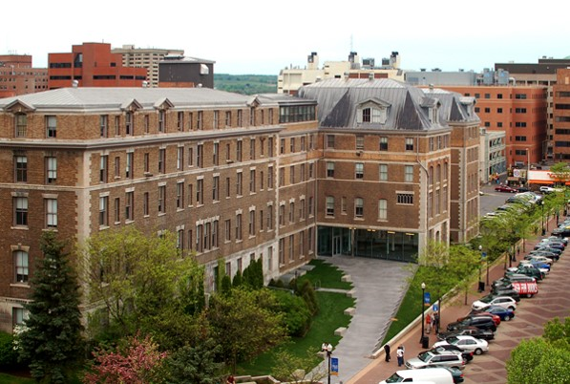
Where am I?
Huntington Hall 030 / School of Education Office Hours: 10-11am Wednesdays

Slide 7
Key Syllabus Info

Slide 8
What will you learn in this class?
HTML, CSS and JavaScript
Web development language and concepts
How to craft & design a functional website

Slide 9

Class Requirements
Bring your laptop to class every day.
Textbook: Learning Web Design: A Beginner's Guide to HTML, CSS, JavaScript, and Web Graphics

Slide 10
Attendance and Participation
Attendance will be taken promptly at the beginning of class. If you are not in class at this time you are absent. Absences are recorded in blackboard.
Participation will be part of your grade. This includes:
Activities we will be doing in class
Volunteering to answer questions in class
Working diligently on in class activities
Helping classmates
Your attendance in class.

Slide 11
Blackboard and Class Website
Class Website
Weekly Schedule
Class Notes
Labs and Projects
Blackboard
Grades

Slide 12
General Policies
No late work accepted.
No makeup exams or exams at alternate times.
No mobile phone use in class unless it’s needed for lesson.
All due dates are posted in the syllabus today. Plan accordingly.

Slide 13
Weekly Labs
Due Sunday at 11:59pm submitted to blackboard.syr.edu

Slide 14
Class Flow
Monday: Discussions and Notes
Wednesday: Labs

Slide 15
Class Schedule
Please check the syllabus and mark the important dates on your calendar.

Slide 16
Grades
Assessment | Quantity | Points Each | Total Points | Part of Grade
Labs | 12 | 10 | 120 | 20%
Exams | 3 | 100 | 300 | 50%
Project | 1 | 120 | 120 | 20%
Participation/Attendance | 12 | 5 | 60 | 10%

Slide 17
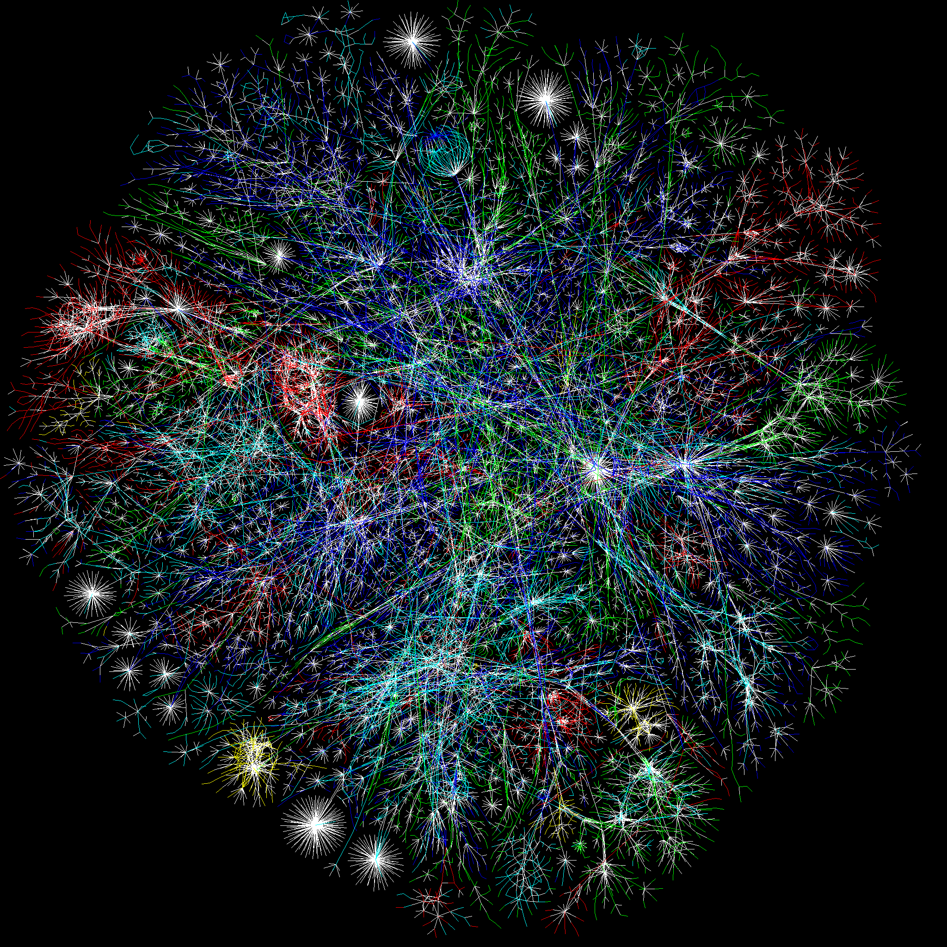
History of the Internet

Slide 18
From you laptop or
mobile phone go to:
http://kahoot.it

Slide 19
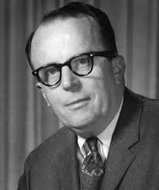
When was the idea of the internet conceived?
1962 Licklider of MIT
The first recorded description of the social interactions that could be enabled through networking was a series of memos written by J.C.R. Licklider of MIT in August 1962 discussing his "Galactic Network" concept. He envisioned a globally interconnected set of computers through which everyone could quickly access data and programs from any site.

Slide 20
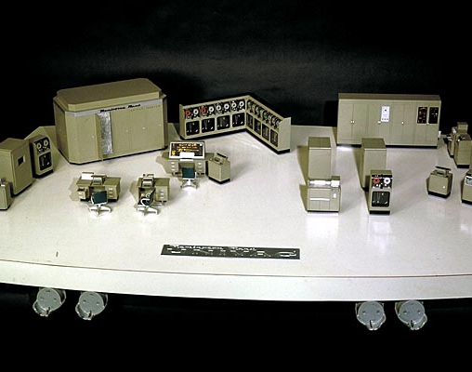
The internet was conceived:
For Gov’t Researchers to Share Info
The Soviet Union's launch of the Sputnik satellite spurred the U.S. Defense Department to consider ways information could still be disseminated even after a nuclear attack.
Computers in the '60s were large and immobile and in order to make use of information stored in any one computer, one had to either travel to the site of the computer or have magnetic computer tapes sent through the conventional postal system.
UNIVAC I :1000 calculations per second
Modern computer: 33,860 trillion calculations per second

Slide 21
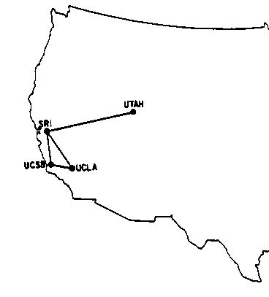
What was the first message sent on the ARPAnet?
In 1969, ARPAnet delivered its first message: a “node-to-node” communication from one computer to another. (The first computer was located in a research lab at UCLA and the second was at Stanford; each one was the size of a small house.) The message—“LOGIN”—was short and simple, but it crashed the fledgling ARPA network anyway: The Stanford computer only received the note’s first two letters.
There were 4 computers on the network in 1969.
By early 1970’s several networks like ARPAnet had been developed.

Slide 22
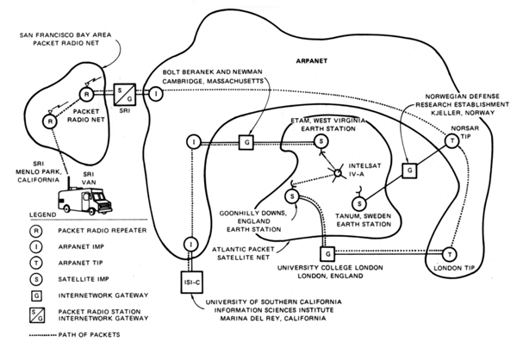
Modern technology that united all computers on early networks: TCP/IP
With so many different network methods, something was needed to unify them.
By the end of the 1970s, a computer scientist named Vinton Cerf had begun to solve this problem by developing a way for all of the computers on all of the world’s mini-networks to communicate with one another. He called his invention “Transmission Control Protocol,” or TCP. (Later, he added an additional protocol, known as “Internet Protocol.” The acronym we use to refer to these today is TCP/IP.)
Diagram of the first internetworked connection

Slide 23
Who used the internet in the 1980’s
Throughout the 1980s, researchers and scientists used it to send files and data from one computer to another.

Slide 24
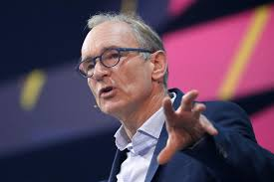
Which of these was NOT a way to surf the internet in the 1980's?
World Wide Web
In 1991 Tim Berners-Lee (working at CERN) introduced the World Wide Web.
helped solve the difficulties scientists were having sharing information.
created HTML
created URLs
developed HTTP the protocol
director of the World Wide Web Consortium (W3C), which oversees the continued development of the Web.
In a list of 80 cultural moments that shaped the world, chosen by a panel of 25 eminent scientists, academics, writers and world leaders, the invention of the World Wide Web was ranked number one.

Slide 25
The first web browser was called:
Mosaic
allowed users to see words and pictures on the same page for the first time
to navigate using scrollbars and clickable links
1993
That same year, Congress decided that the Web could be used for commercial purposes.
Companies hurried to set up websites of their own, and e-commerce entrepreneurs began to use the Internet to sell goods directly to customers.

Slide 26
Introduce Yourself

Slide 27
Who are you?
Hi, my name is _______? (Let me know what I should call you)
I’m from _____________?
I’m currently a _______? (Year in school)
My major is __________?
Best part of your summer?

Slide 28
Questions?

