Slide 1
Landslide Classification

Slide 2
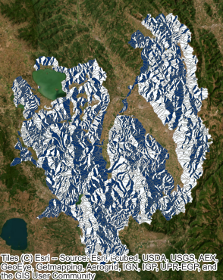
Use Cases
Hazard Assessment
Emergency Response
Environmental Monitoring
Infrastructure Management

Slide 3
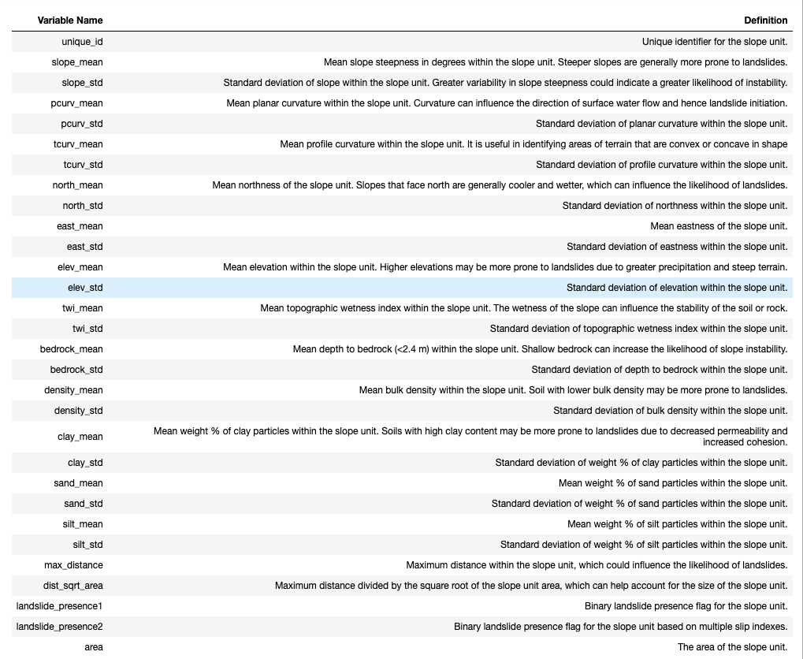
About the Data
This dataset is a subset of a much larger dataset from eartharxiv.org
Proposed a benchmark dataset in Italy
Contains:
Size of the slope
Different slope profiles
Mean and standard deviations of soil / rock content
Presence of a landslide

Slide 4
Modeling Landslides
1
EDA

Slide 5
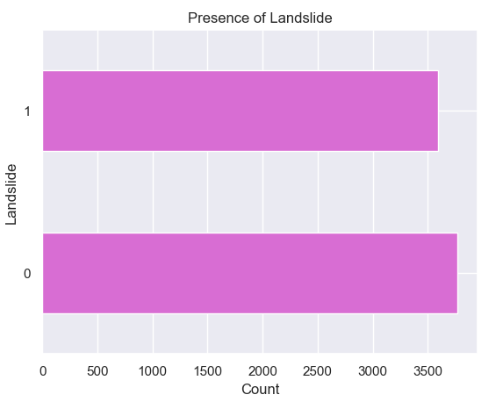
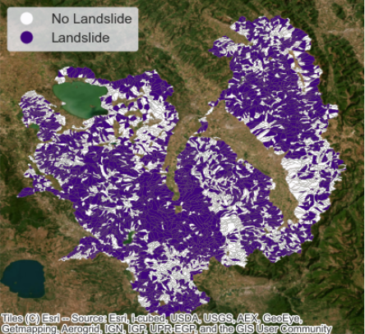
Presence of Landslide
What are the determining factors?

Slide 6
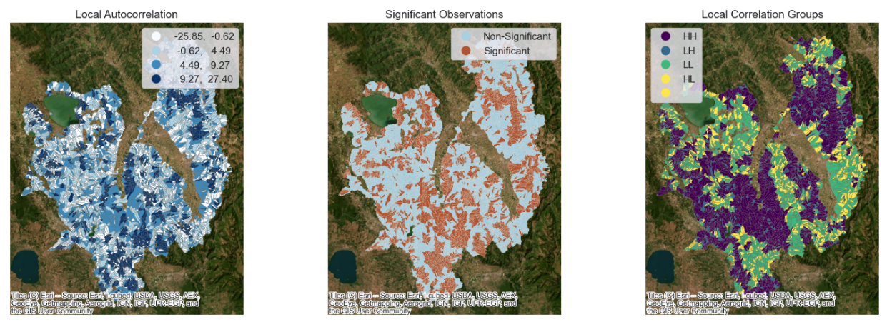
Spatial Relation
Moran’s I: 26%

Slide 7
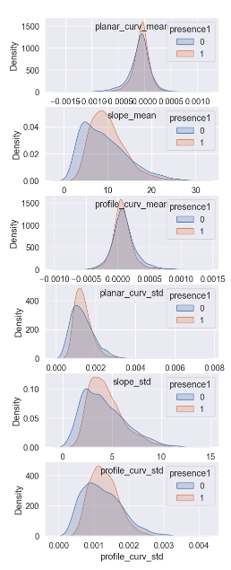
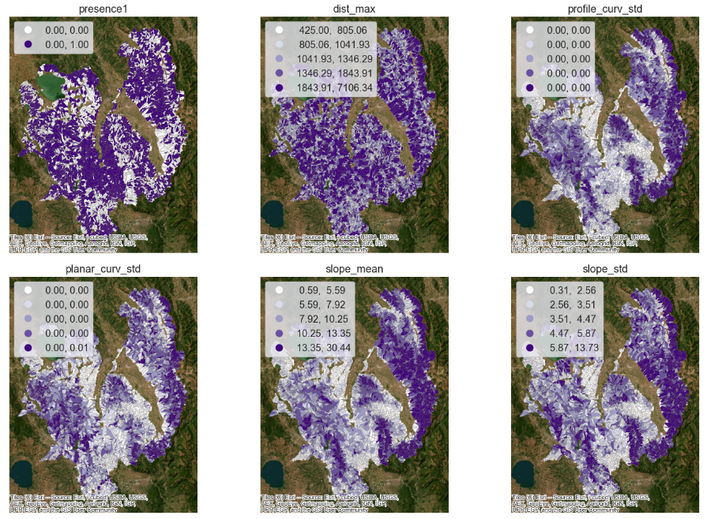
SLOPE

Slide 8
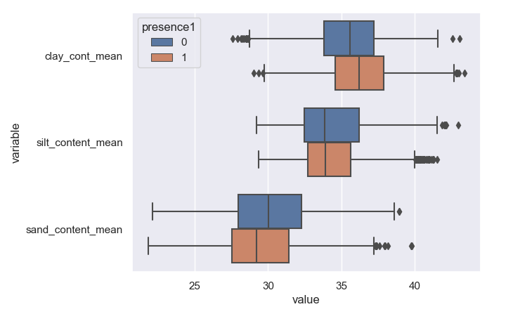
Soil Material
Ground Content vs Landslides
T-Test Results:
Clay Content P-value: 4.28e-38
Silt Content P-value: 0.09
Sand Content P-value 8.61e-20

Slide 9
Modeling Landslides
2
Feature Engineering

Slide 10
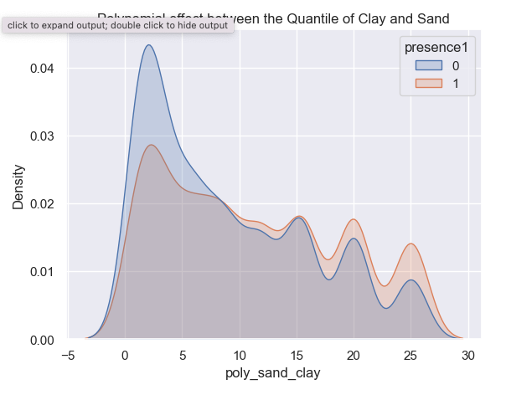
Additional Features
Gaussian Kernel Weight
Polynomial Effects:
Clay vs Sand Quantile
Slope and Curves
Area and Sand Content
Area and Clay Content
Slope and Soil Content

Slide 11
Modeling Landslides
3
Models

Slide 12
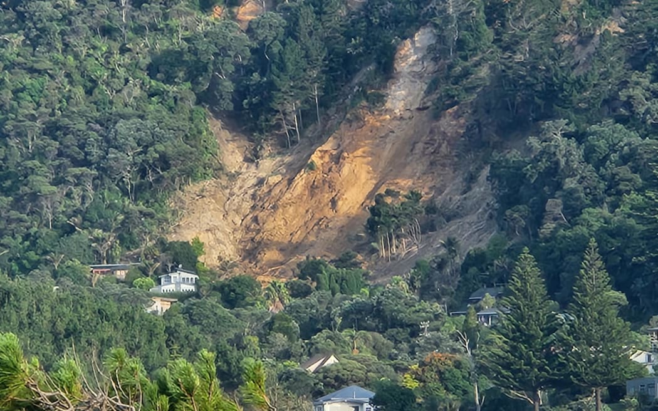
Models
Logistic Regression
Random Forest
Extreme Gradient Boost
Landslip in Muriwai caused by Cyclone Gabrielle.
Photo: RNZ / Finn Blackwell

Slide 13
Modeling Landslides
4
Model Evaluation

Slide 14
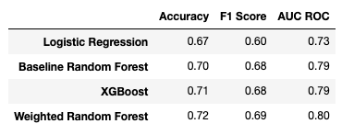
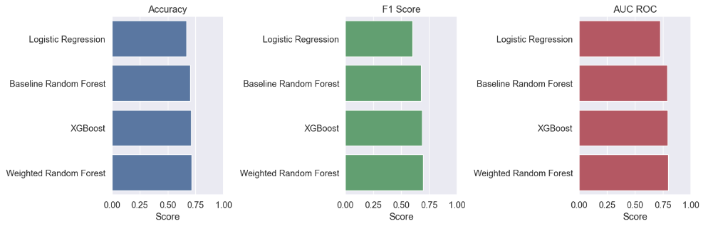
Model Evaluation
Logistic Regression performs poorly compared to other models
Limited improvement in feature engineered models
Most likely due to an effect outside the scope of study.

Slide 15
Conclusion
Predicting landslides is a challenging problem due to the complex interaction of various factors such as geology, slope angle, precipitation, and human activity.
Our results show that the weighted random forest model outperforms other models such as logistic regression and XG Boost in terms of accuracy, F1 score, and AUC ROC.
Due to model simplicity the baseline Random Forest is Recommended for use.
The feature importance analysis suggests that slope area, slope mean, slope deviation, and elevation are the most important features in predicting landslides.
In conclusion, there is more work to be done in classifying landslide. Other approaches and features may yield more significant results.

