Slide 1
Bitcoin Price Prediction:
Application of machine learning techniques to time series data

Slide 2
What is bitcoin?
Unregulated cryptocurrency that is traded on a number of different exchanges
Useful for anonymous transactions, payment for illegal goods and services
Tool for speculation due to ease of trading
You can ‘mine’ bitcoin by solving complex math problems
Buy bitcoins => sell dollars
Sell bitcoins => buy dollars

Slide 3
The dATA:
Price in dollars a trade was settled at on the Coinbase Exchange
Resolution is a tick by tick basis from 2014 until present
The data was obtained from a 3rd party aggregator, www.bitcoincharts.com
This data reflects the instantaneous exchange rate of X dollars/ 1 bitcoin
The data from 2016 until the present was used to speed computation
The data was originally resampled at ten seconds, and I used the past 360 lags.

Slide 4
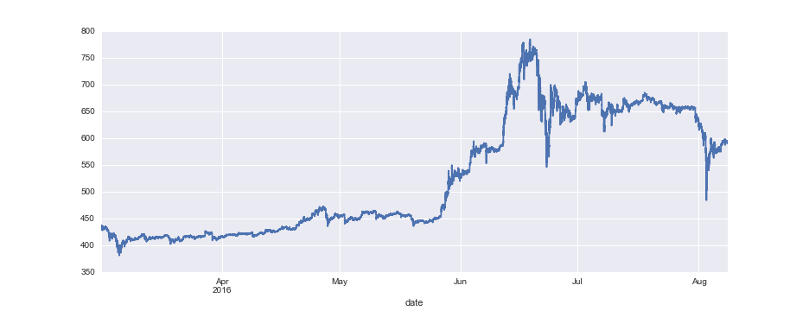
Raw Data:
count 1.386361e+06 mean 5.263377e+02 std 1.101046e+02 min 3.811000e+02 max 7.849206e+02

Slide 5
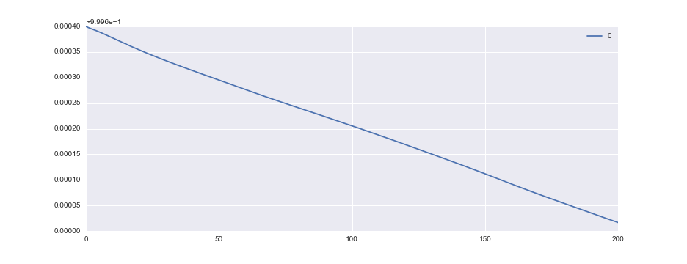
AUTOCORRELATION:

Slide 6
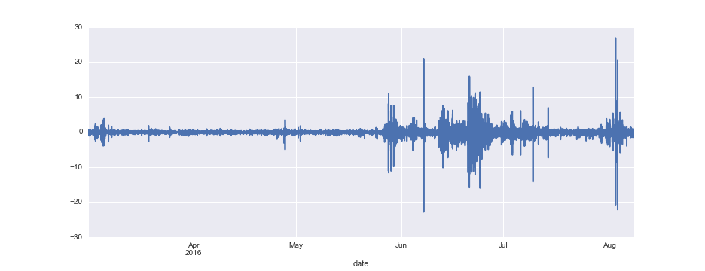
Differenced data:
count 1.386360e+06 mean 1.122869e-04 std 2.235617e-01 min -2.282308e+01 max 2.693486e+01

Slide 7
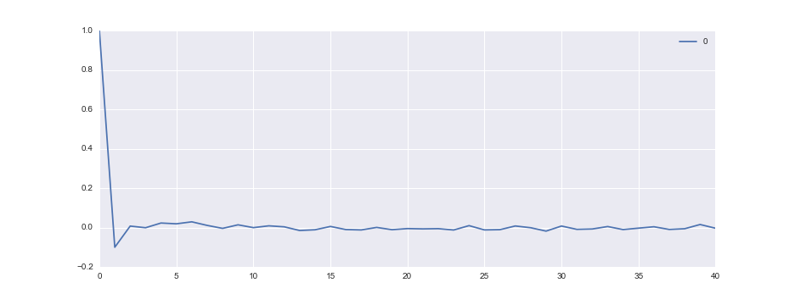
AUTOCORRELATION

Slide 8
Modeling Approach
Began with simple linear regression on lagged data, even though time series data violates some OLS assumptions.
Test R2: 0.999
Test MSE: 0.102
Test RMSE: 0.319
This RMSE is outside 1 standard deviation of the price changes from period to period.

Slide 9
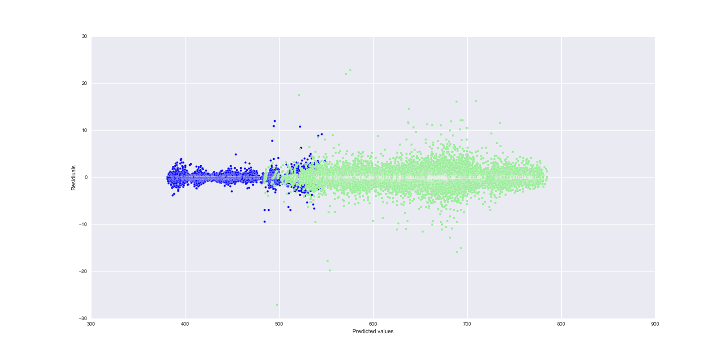
Residual plot

Slide 10
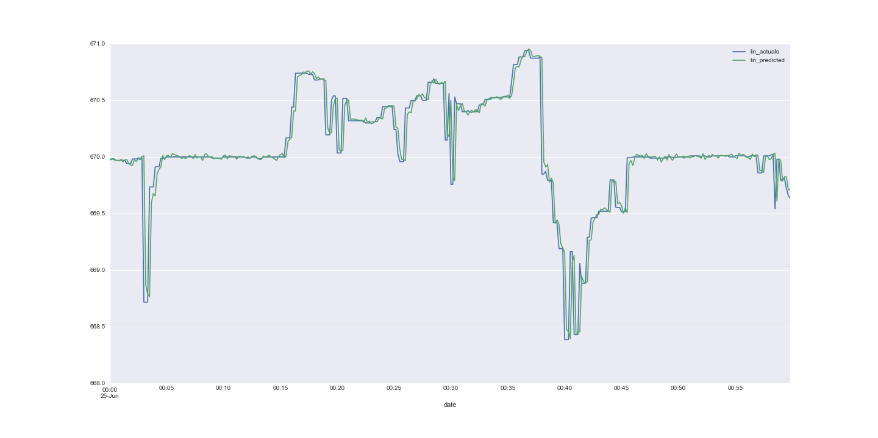
Nice fit?

Slide 11
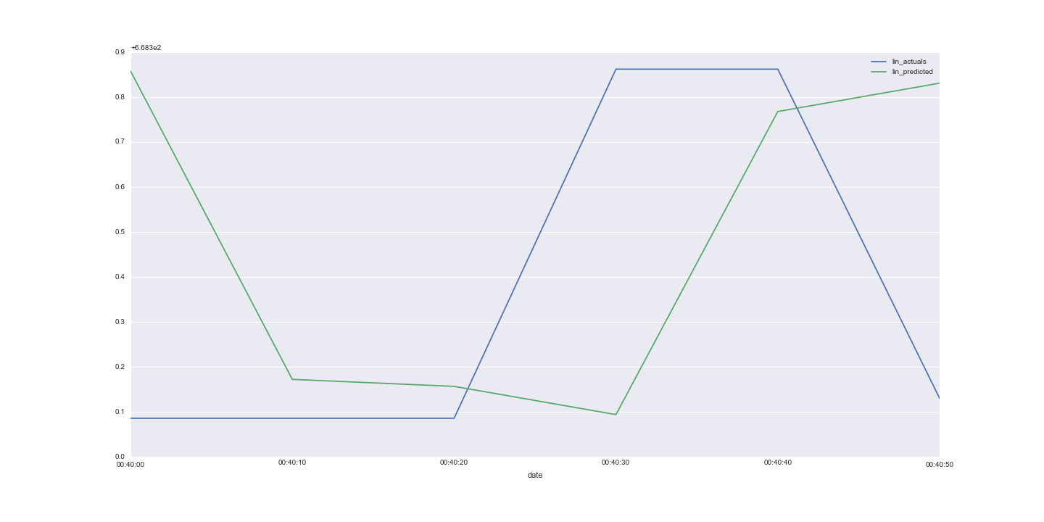
Not so much!

Slide 12
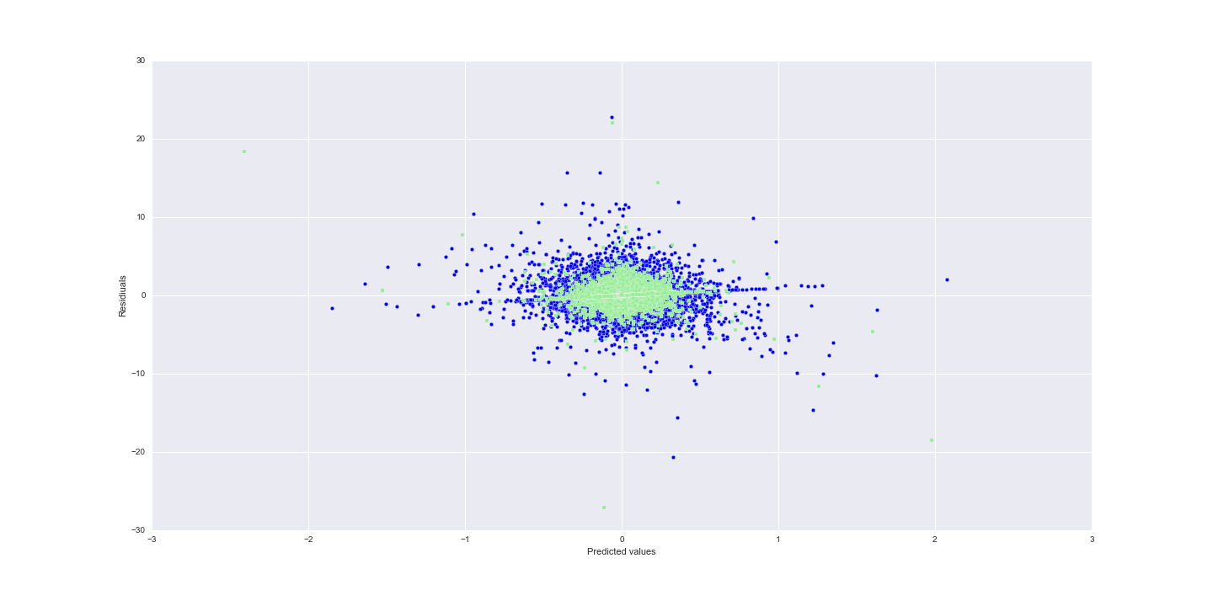
Linear regression on the differenced Data: residuals:

Slide 13
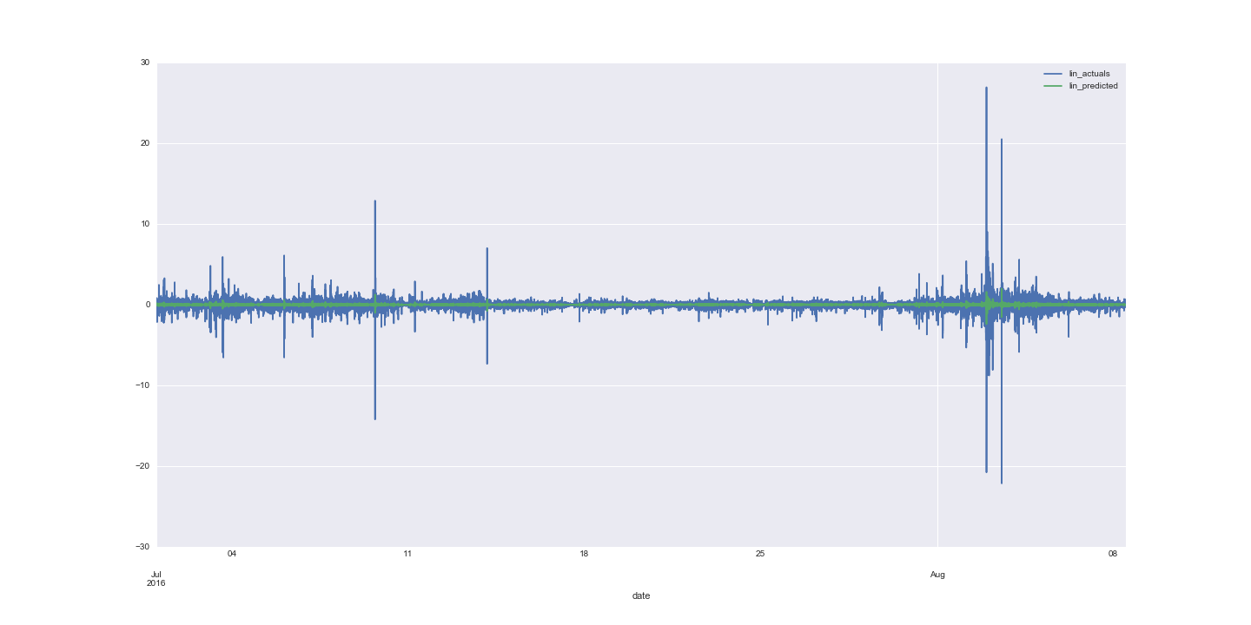
Low R2:

Slide 14
Linear Regression Roundup
Not suitable for time series data
Data should be transformed to fit OLS assumptions
A transformation of the last regression into a classification problem showed worse than chance results
Random forest regression overfit massively on the training set.
Results were slightly better with log transformed data

Slide 15
Classification Methods
Data was assigned target of 1, 0, -1 for an up, unchanged, or down movement.
That is, given a past series of prices, can we predict whether the next will be higher, lower, or the same?
Used a variety of methods.
Used both the raw and differenced data, standardized and not.
Much more successful with the differenced data.

Slide 16
Random Forests
The best results by far came from Random Forests, with a 70% accuracy rate
This is a little misleading because precision and recall were much higher on the 0’s (unchanged periods)
Weighting the classes should remedy this problem.
RF is scale invariant – don’t need to standardize data…
But the training data is still much less volatile than the test set.

Slide 17
XGBOOST
Extreme Gradient Boosting (Tree based method)
Performed well on standardized data, but less accurate than RF
Much, much faster however

Slide 18
Neural Network
Implemented a simple NN using Keras with Theano backend
Performance was terrible – much more research needed

Slide 19
Time Frames
Resampled the data at the second, 10 second, minute, and day intervals.
Used a variety of lags, from 10 to 240
Smaller time frame and more lags generally performed better for all models

Slide 20
More Questions than answers
Does resampling the data cause a loss of information?
Would it be better to use the smallest time frame possible, and predict the future by dropping lags, as opposed to predicting the next lag?
How to deal with low train volatility but high test volatility?
Fitting a standardizer to the train and using on the test will not work as well.
Much more domain knowledge needed
Traditional econometric models vs machine learning?

Slide 21
So you can predict the price…
What does that mean?
Can’t assume you will be able to trade at that price
Or that your whole order will be filled at that price
Transaction costs and market structure
An accurate prediction of direction is much more useful
How to transform a predictive model into an actual trading strategy?

Slide 22
Future work
Add in more variables
Amount Traded
Price on other exchanges, especially in China
Other financial instruments
Interaction terms
More rigorous workflow
Integrate into exchange sandbox and test strategies.
Wrote a toy program, lost about 14 cents in an hour

Slide 23
Conclusion
You can predict price movements in bitcoin using just the historical price
And you will have results that are better than chance.

