Slide 1
Tidy Data and Code Overview
Using R to tidy data and code

Slide 2

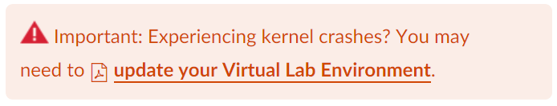
Sincere Apologies for Lab Issues
New modules will have downloadable notebooks
Labs/Assignments
Deadlines – end of class, but don’t wait until the last minute
To discuss in class we need 80%+ submissions
Keep local copies:
*.ipynb – best if you have a local Jupiter engine, e.g. Anaconda
*.html – good if you are OK with cut/paste to a tool, includes explanations
*.R – if you have R Studio – this is text-only file
Kernel crashes

Slide 3
Course Outline
Lesson | Date | Topics
1 | 10/2 | The overall process of making decisions using data
2 | 10/9 | Getting started with data analysis
3 | 10/16 | Data acquisition and preparation
4 | 10/23 | Data Transformation
5 | 10/30 | Grouping and Transforming Data
6 | 11/6 | Probability and Descriptive Statistics
7 | 11/13 | Hypothesis Testing
8 | 11/20 | Introduction to machine learning and data mining
9 | 11/27 | Unsupervised learning
10 | 12/4 | Final Project
Today

Slide 4
Final Project.
See “Project Tips” announcement
Goal: execute end-to-end analytics process
Ask Question[s]
Wrangle Data
Explore Data
Draw Conclusion
Communicate Findings
You decide:
Question
Dataset
Team / self
3-7 page PPT

Slide 5
Teaming
Who formed a team already?
if you are working on a team
Need team lead volunteers
Responsibilities (extra 5 credit points):
Setup team group
Help the team to successfully compete a final project

Slide 6
Datasets – Pick the Topic You Love
Work – most preferred
https://www.kdnuggets.com/datasets
https://opendata.socrata.com
https://www.kaggle.com/datasets
https://archive.ics.uci.edu/ml
https://www.quora.com/Where-can-I-find-large-datasets-open-to-the-public

Slide 7
Project Template

Slide 8
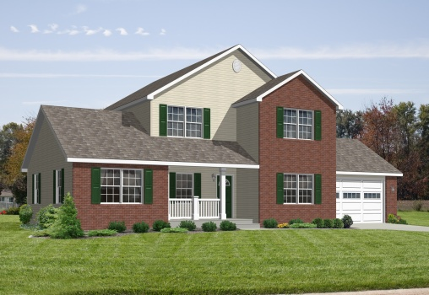
Ames Housing Analysis
Student / Group

Slide 9

Iterative Data Analysis Process Elements
#1 Ask Questions
Wrangle Data
Explore Data
Draw Conclusion
Communicate Findings

Slide 10

Question
What house should I buy?
Evaluation criteria:
4+ bed, 3+ bath
> 4,000 sq/ft living, > 10,000 lot
Good (>6) & newer (<10 y/o) construction
Undervalued or price growth opportunity
Identify ~5 potential houses
Assumptions:
All houses listed are for sale

Slide 11
Data Wrangling
Removed columns: …. What?/Why?
Converted columns: … What?/Why?
Transform data: … What?/Why?
gather()
summarize()
distinct()
sort()
…

Slide 12
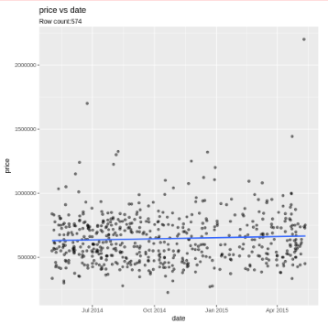
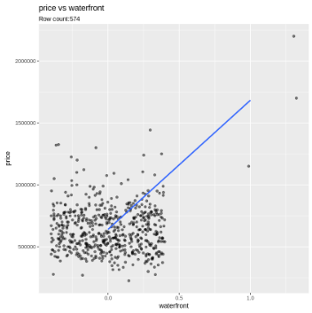
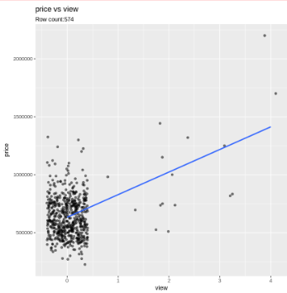
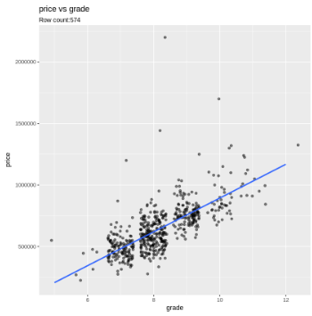
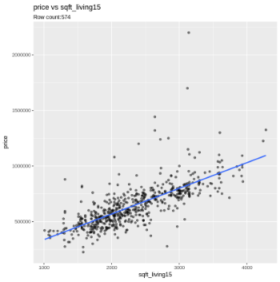
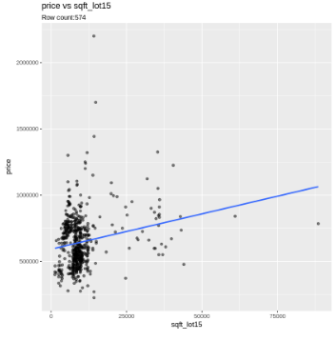
Data Exploration / Visuals

Slide 13
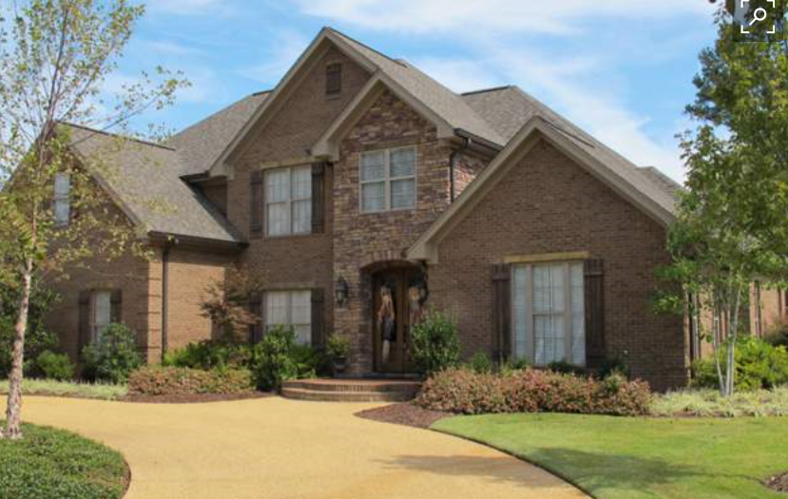
Conclusions
 | House 1 | House 2
Sq. Ft.
Lot
Beds
Bath
…
Price
Why? | Meets all criteria, undervalued

Slide 14
Challenges
Challenge 1:
Only 2 houses returned by the initial criteria
Solution: relax selection criteria
…

Slide 15
Appendix

Slide 16
R Code
Attachments:
Highlights:
#read data
….
#hone on what I need
…
#visualize
ggplot2(…)

Slide 17
Your Questions About THE Final Project

Slide 18
Agenda
Tidy Data
Grouping and Summ. Data
User Defined Functions
For Loop Iteration
Map/Vectorized Iteration
Managing Graphics
Labs:
Tidy
Grouping
Functions
Graphic Functions
Assignment:
Graphic Functions
3 most price correlated columns

Slide 19
Tidy Data
Understanding the principles of tidy data

Slide 20
Introduction to Tidy Data
Cleaning up the dataset
Data organized into rows, columns, and tables
Tidy data, Hadley Wickham, The Journal of Statistical Software, vol. 59. 2014.

Slide 21
Introduction to Tidy Data
Structuring datasets to facilitate analysis
Standard way to organize data values within dataset
Designed to facilitate data exploration and analysis
Consistent interface from output of one tool to input of another
Similar to SQL relational algebra

Slide 22
Defining Tidy Data
 | Var1 | Var2 | …
Obs1
Obs2
Obs3
….
Tidy data =
Data structure
+ Data semantics
Each variable forms a column
Each observation forms a row
Each type of observational unit forms a table
Data dictionary (ex: what is sqft_lot15?)
“Normal Form” for statistics

Slide 23
Tidying Messy Data
 | Plaza Research (14 locations)
 | $175/pp
Per recruit | $55
Incentive | $75
Facility/day not included | $1500 (can negotiate)
Recruitment Numbers | 612 to recruit for 500
Column headers are values, not variable names
Multiple variables stored in one column
Variables stored in both rows and columns
Multiple types in one table
Multiple grains (aggregate/detail) are stored in the same table
One type in multiple tables
A single observational unit is stored in multiple tables (user/country)
Messy Data Example

Slide 24
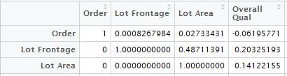
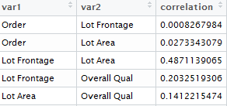
Tidy Tools
Tidyverse
Tidyr package
gather() - unpivot
spread() - pivot
Dplyr package
group_by()
summarize()
gather(X, var1, correlation)

Slide 25
Grouping and Summarizing Data
Using R to group and summarize data

Slide 26
Data Aggregation
Dplyr tidyverse package
group_by()
summarize()
ungroup()
mtcars %>%
group_by(cyl) %>%
summarise(count = n())
https://www.r-bloggers.com/the-tidyverse-curse/

Slide 27
Convenience Wrapper Functions
mtcars %>%
group_by(cyl) %>%
tally()
tally()
distinct()
min_rank()
dense_rank()
top_n()
Value | min_rank | dense_rank
Albert | 1 | 1
Albert | 1 | 2
Bridgett | 2 | 3

Slide 28
Conditional Logic
if_else(x < 0, -1, 1)
case_when() – replaces multiple if_else()

Slide 29
User Defined Functions
Organizing code using user defined functions

Slide 30
User Defined Functions
Organize code into functions if copy code more than twice
User defined function vs inline source
Variable scope
rm() for cleanup
Return value is optional
Function robustness
package::function
require() with if()
install.packages(“package”)
parameter validation
my_function <- function(x){ return(x+x)
}
my_function(2)
`%plus%` <- function(x1, x2){
return(x1+x2)
}
2 %plus% 2

Slide 31
Exception Handling
err <- try(
some_function(…)
)
if ('try-error' %in% class(err))
print (“error”)
else
print (“success”)

Slide 32
For Loop Iteration
Using for loops to organize code

Slide 33
For Loop Iteration
Run same code for each row or column
for(i in 1:5) { print(i) }
vector item (counter variable)
sequence vector (number of loop iterations)
code block (code to run)
Sequence vector generation
Colon for integers (1:10)
seq_len() – counts up from 1
seq_along() – counts objects
seq_along(mpg)
1:ncol(mpg)
1:nrow(mpg)
for(colname in colnames(mpg))
{
print(colname)
}

Slide 34
Map/Vectorized Iteration
Using R to iterate over data

Slide 35
Map/Vectorized Iteration
Functionals – code that applies functions to objects
Try converting For loop to [but don’t obsess about it]
user defined function
single map calling code
Tidyverse purrr package
map() – base R equivalent is apply()
#calculate means of each column
map(mtcars, mean)

Slide 36
Base R Vectorized “Loop” Functions
Calculate means of each column
apply(mtcars, 2, mean)
Change string columns to factors (~mutate)
i <- sapply(mpg, is.character)
mpg[i] <- lapply(mpg[i], as.factor)

Slide 37
Map Operation
Runs function for each sequence vector element
Returns result of specified function
Filter objects to same data type
keep()
discard()
is_<datatype>()
is_numeric() – both integer and double
map(mtcars, mean) %>%
keep(~ mean(.x) > 10)

Slide 38
There’s a Graph for that!
Exploring the King County Housing Data

Slide 39
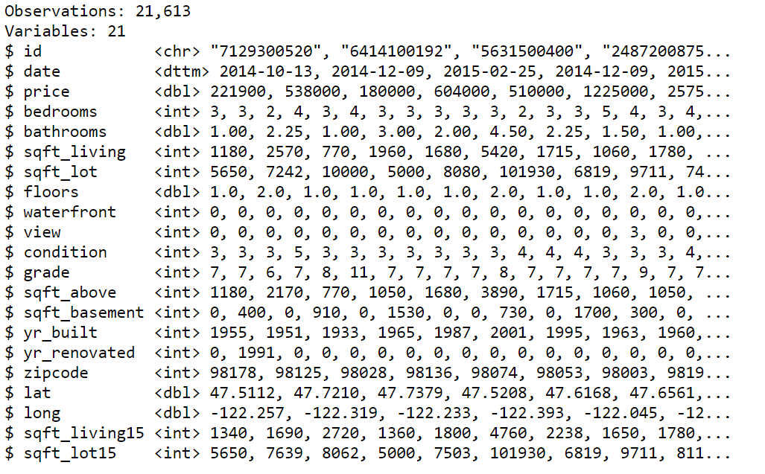
King County Housing Data

Slide 40
A closer look
From May 2014 through May 2015
View = 0 to 4
Condition = 1 to 5
Grade = 1 to 13 building construction & design
1-3 poor, 7 average, 11-13 high quality

Slide 41
More closer look
Sqft_living15 = The square footage of interior housing living space for the nearest 15 neighbors
Sqft_lot15 = The square footage of the land lots of the nearest 15 neighbors

Slide 42
Lesson 5 Assignment
Create new or copy previous notebook
Use Markdown Cells
Use #comments in your code
Save as HTML
Studentname-L05-KingCountyHousing

Slide 43
Assignment #5
Create 2 user-defined functions
gg_scatter(), save_plot()
Run gg_scatter with price and 3 other columns
Write 1 line of code to gg_scatter all numeric variables against price

Slide 44
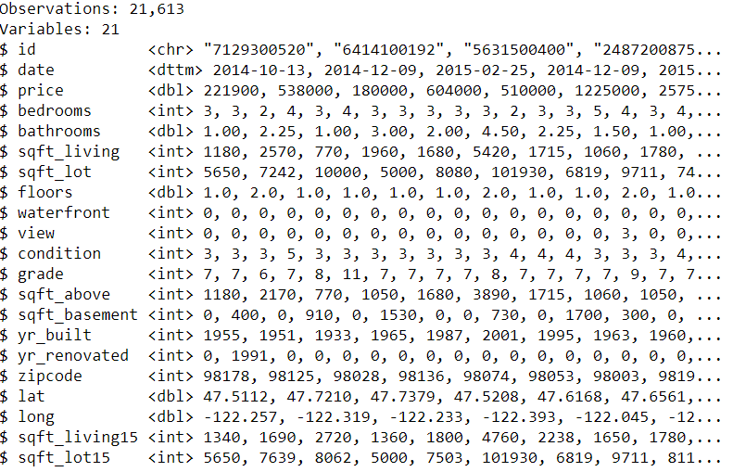
What are the numeric variables?

Slide 45
Create multiple graphs with one line of code
Date Waterfront View
Grade Sqft_living15 Sqft_lot15

Slide 46
What are the 3 most promising columns that correlate well with price?
Do they have a high positive correlation?
Do they have a high negative correlation?

Slide 47
End of HW Explanation
Show off your data wrangling

Slide 48
Organizing Graphics Code
Organizing ggplot graphics code

Slide 49
ggplot Code Duplication
Chart look and feel code duplication
color
background
font
Similar charts for multiple columns
User defined function for graphing
Looping through columns using For or Map

Slide 50
Function Design
Design considerations
Hard coded values vs parameter
Required parameters vs optional parameters
Start specific, generalize as needed
Too generic, create separate function
Create helper functions as required

Slide 51
Saving Images
Save images to disk
ggsave()
Image formats
raster (png)
vector (pdf)
Raster
dpi (300)
file size maxes out
zoom in pixelates
Vector
file size function of data points
Still clear when zooming in
Affects plots with many point (scatterplots)

Slide 52
Benefits of Consistency
Graphics style in one place affects all graphics
Implement your graphics preference for analysis
Common axis range across graphs
expand_limits() – set axis range to include 0, 0
Common lines across graphs
geom_hline() – horizonal line
geom_vline() – vertical line
geom_abline() – diagonal line

Slide 53
Static vs Interactive Graphics
ggplot – static graphics
ggvis – interactive graphics
requires special configuration
works in R Studio, not in our Labs
Both packages by Hadley Wickham
ggvis may eventually surpass ggplot

Slide 54
Lesson Summary
Tidy Data
Grouping and Summarizing Data
User Defined Functions
For Loop Iteration
Map Iteration
Managing Graphics

Slide 55
Tidy Data and Code
Using R to tidy data and code
End of Presentation

