Slide 1
Transfer ladder: where cross-modality prediction breaks down
Modular harness core - 2026-08-25. Every number traces to a promoted artifact with a job id.

Slide 2
The question, and why a single number cannot answer it
A Path B result has no interpretable scale on its own.
L1000 and Tahoe deltas for the SAME (cell line, drug) agree at Spearman 0.041 against a split-half ceiling of 0.572, with sign concordance at chance.
No normalisation recovers it: seven per-gene transforms all land between 0.034 and 0.050, none clearing its own null [job 31661918].
So the ladder supplies the scale: each rung adds exactly one distribution shift.
Rung 0 replicate ceiling - rung 1 held-out line - rung 2 cross-platform - rung 3 GDSC2 viability - rung 4 organoids (frozen holdout).

Slide 3
What makes the rungs comparable
Six invariants, held identical at every rung. Violating any one turns a ratio between rungs into a comparison of two different measurements.
Gene panel: Check 1 on 14,121 genes, Check 2 on 12,368, rung 2 on 8,759 (L1000 constrains it).
CV: 5-fold over cell lines from ONE shared partition, so folds are the same partition and not merely the same count.
Metric, unit, reliability correction, and a null recomputed within each rung.
Reported as a fraction of that rung's own ceiling, never as a raw number.

Slide 4
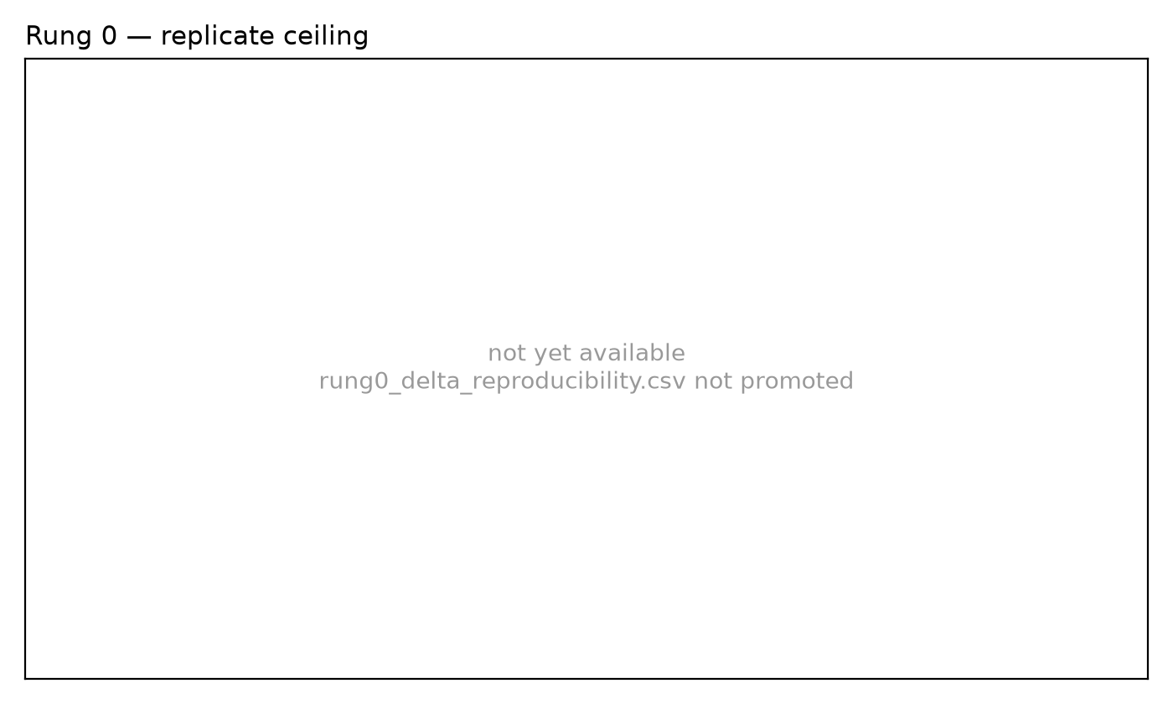
Rung 0 - replicate ceiling
Split-half over plate halves, Spearman-Brown lifted to full data.
The mismatched-pair null is what makes this a ceiling rather than shared gene structure.

Slide 5
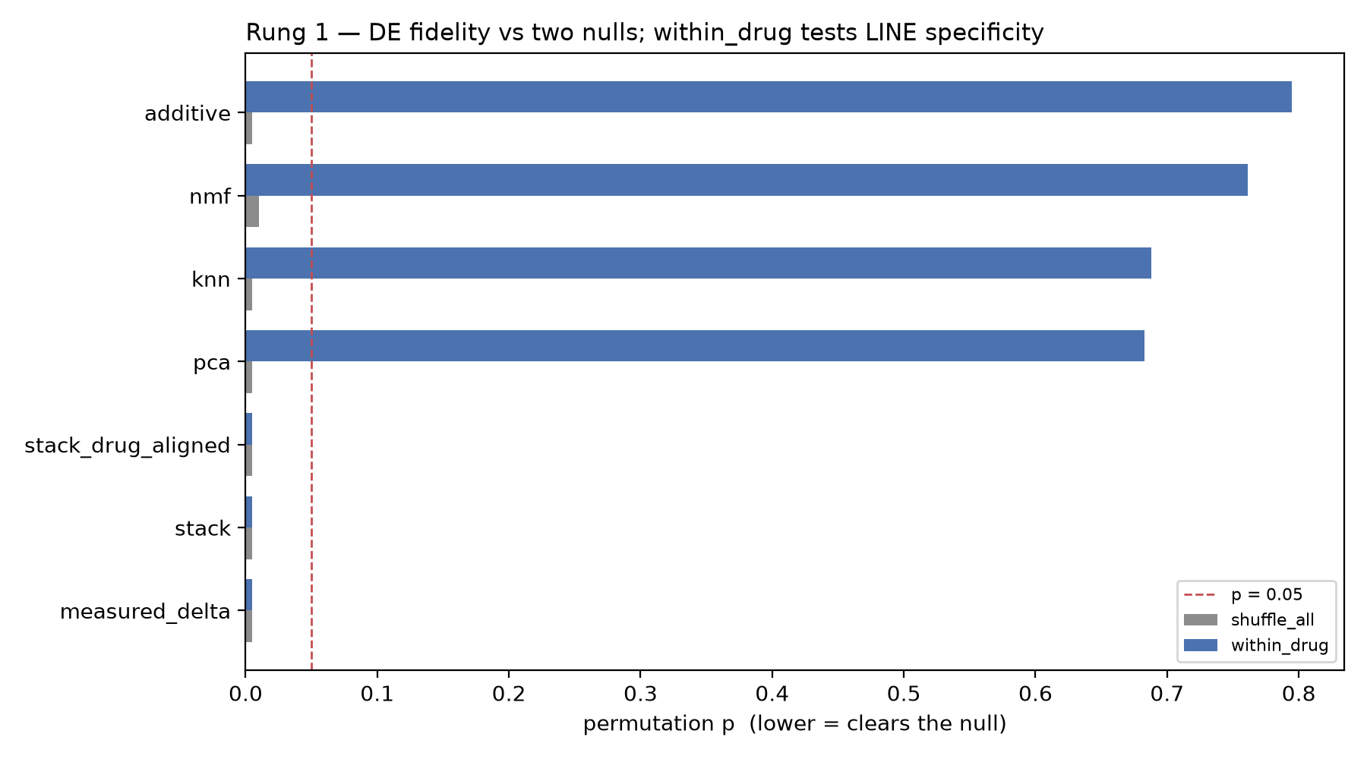
Rung 1 - held-out line, DE fidelity
shuffle_all is cleared by every source including line-independent baselines, so it tests drug specificity, not line specificity.
within_drug holds drug identity fixed and is the test the published claim needs.

Slide 6
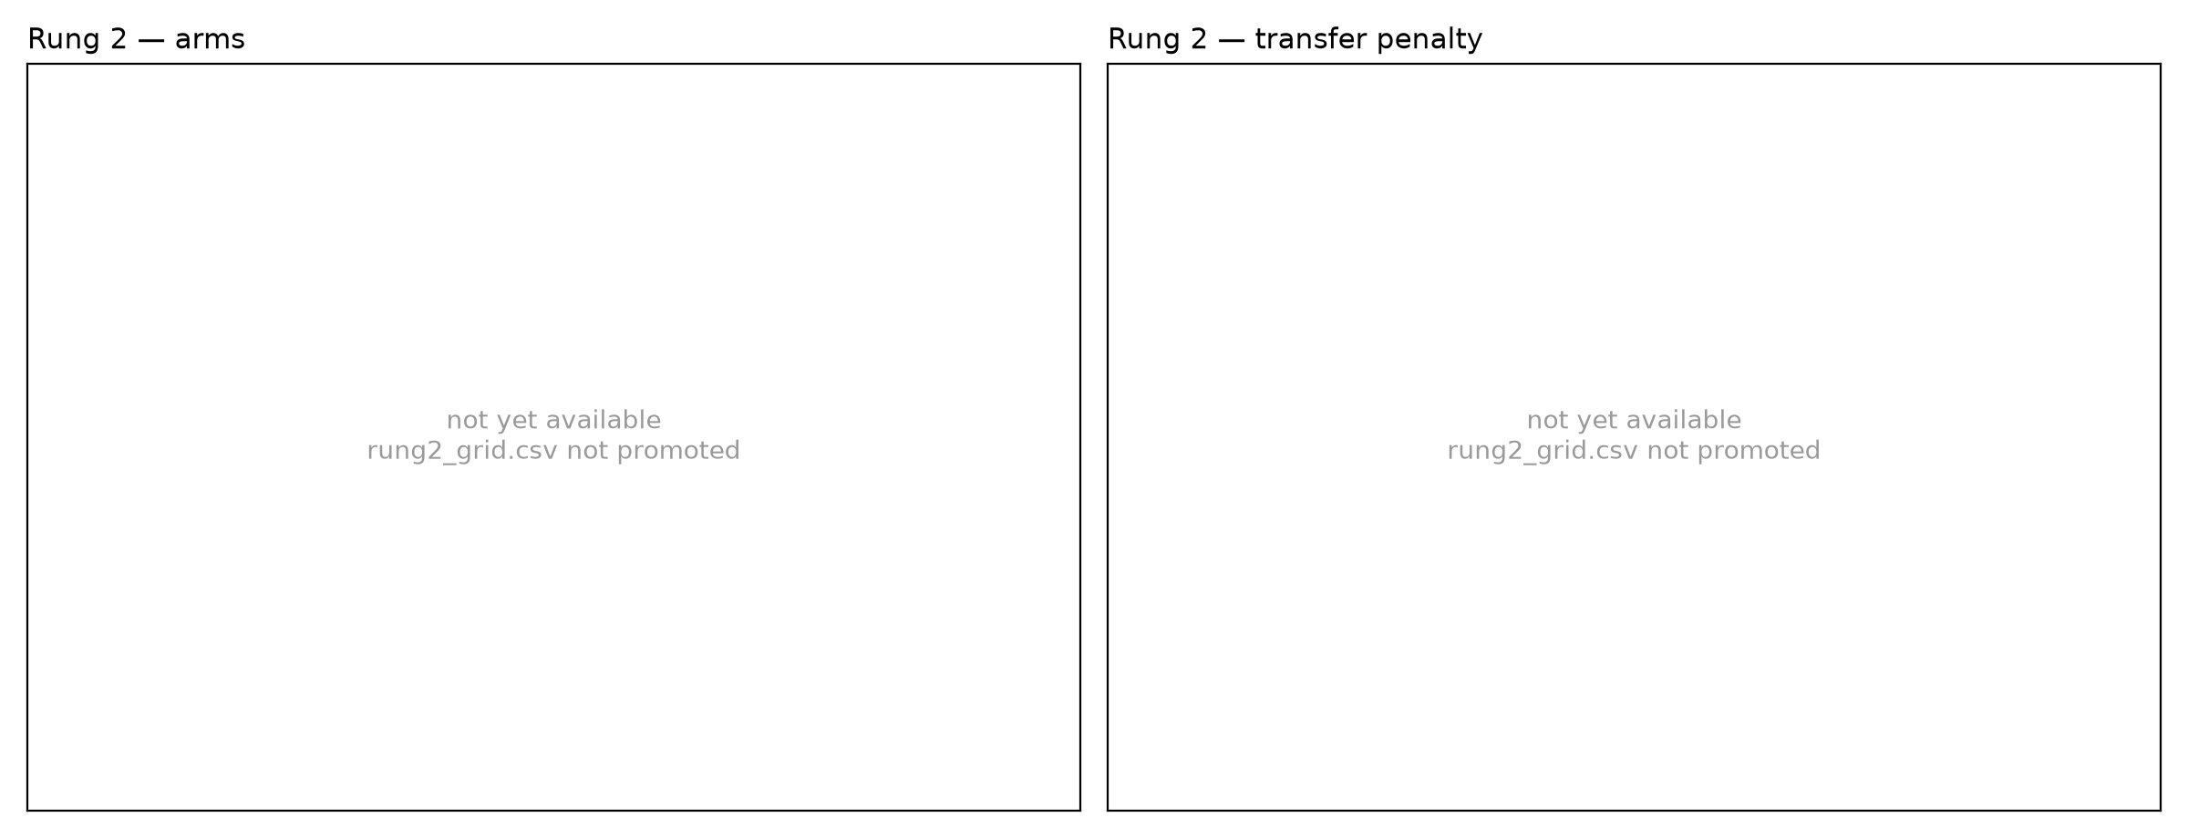
Rung 2 - cross-platform and granularity transfer
Transfer penalty is cross_platform minus in_platform, both arms on one pinned panel.
Stack appears only via its L1000-context arm; it is not fitted here, so an unlabelled constant would read as a win.

Slide 7
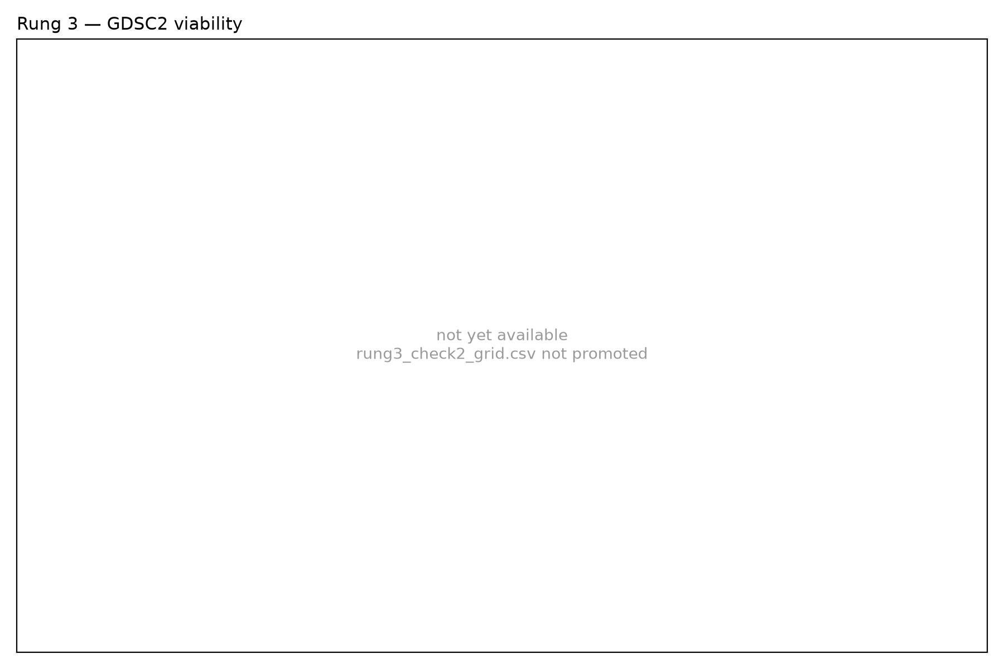
Rung 3 - GDSC2 viability
Grey bars are controls. planted must be recovered; prior is the line-independent floor.
Ceiling is independent-screen agreement, 0.457 GDSC2 vs CTRPv2 [job 31663627].

Slide 8
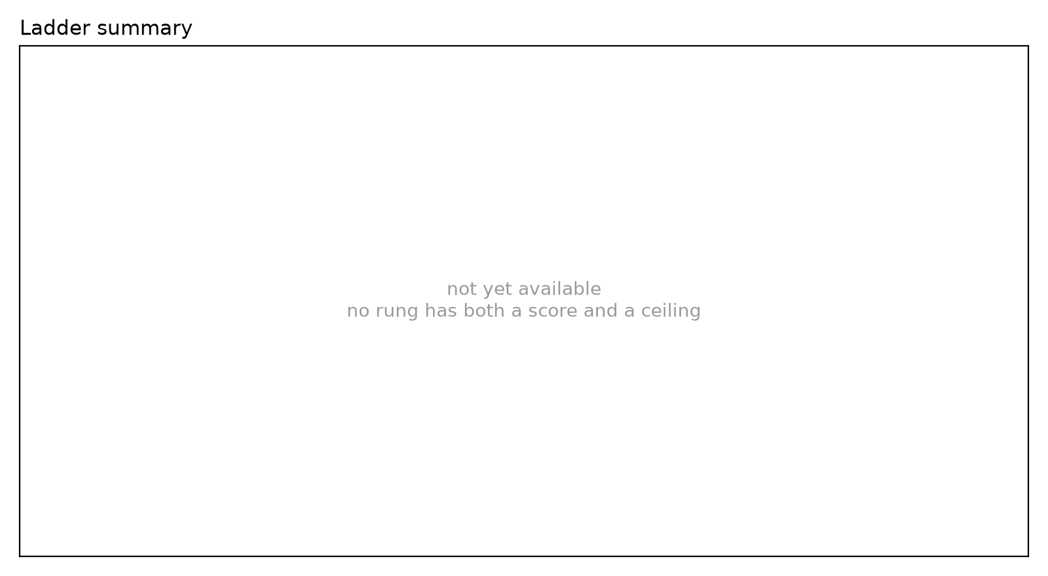
The ladder
Each rung as a fraction of its OWN ceiling. Rung 4 has no ceiling and is omitted.
Rungs without both a score and a ceiling are named rather than silently dropped.

Slide 9
Audit: controls and provenance per rung
Controls and provenance were audited mechanically, not by reading the design.
rung0_ceiling: all axes covered
rung1_check1: all axes covered
rung2_transfer: all axes covered
rung3_check2: all axes covered
rung3_ceiling: all axes covered
rung4_organoid: GAPS - prov_params, prov_panel
Reading the design is how the gaps survived: the panel was imported and never called, and Check 2's positive control vanished in the array conversion.

Slide 10
What a reader should not conclude
Rung 4 has NO ceiling. Verified: no dose or replicate column in any of the seven organoid tables [job 31663218].
So no rung-4 result may be stated as an absolute value. The honest form is always 'X% of what the same method achieves on cell lines'.
Rung 4's usable n is 17 organoids at a median of 17 of 34 drugs, not the 94 screened.
Stack's rung-2 arm covers 14 drugs against the baselines' wider set; the two are not equally powered and are not tabulated as if they were.
The L1000 imputation-fidelity test is NOT ESTABLISHED: the raw gap did not survive variance matching (p = 0.270) [job 31661570].

