Slide 1
Kargo: GitOps Promotion for ArgoCD
Solving the Multi-Environment Deployment Gap
Notes:
Introduction: Audience already familiar with ArgoCD deployment capabilities.
Today's focus: Understanding what Kargo adds to existing ArgoCD setups.
Structure: Problem identification → Solution overview → Core concepts → Implementation patterns.
Duration: 30 minutes with Q&A buffer.
Transition: "You're using ArgoCD successfully. But you've encountered a gap..."

Slide 2
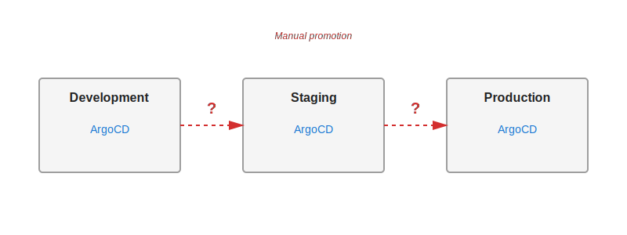
What ArgoCD Doesn't Do
• ArgoCD syncs Git to Kubernetes
• Missing: Promotion workflow orchestration
• No dev → staging → prod concept
• No artifact version coordination
• Manual or scripted promotions required
Notes:
ArgoCD excels at continuous deployment - syncing Git state to Kubernetes clusters.
Critical gap: No built-in concept of progressive promotion between environments.
Current state: Teams use manual processes, custom scripts, or CI/CD orchestration.
Pain points: Version coordination, audit trails, rollback complexity.
This gap is precisely what Kargo addresses. Transition to solution.

Slide 3
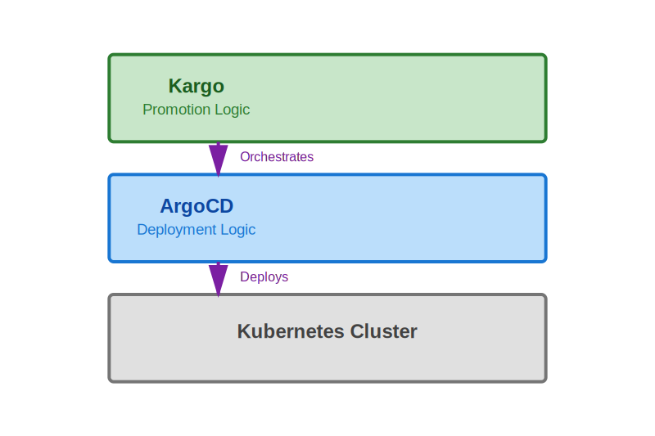
Kargo: Promotion Orchestration Layer
• ArgoCD: Deployment engine (how)
• Kargo: Promotion orchestrator (what, when)
• Declarative promotion workflows
• Multi-stage artifact coordination
• Built by Argo creators
Notes:
Kargo and ArgoCD are complementary, not competitive tools.
Separation of concerns: Kargo decides what to promote and when, ArgoCD handles actual deployment.
Both tools remain independent - can function separately.
Kubernetes-native integration through Custom Resources, not API calls.
Built by same team that created Argo project - design consistency and compatibility.

Slide 4
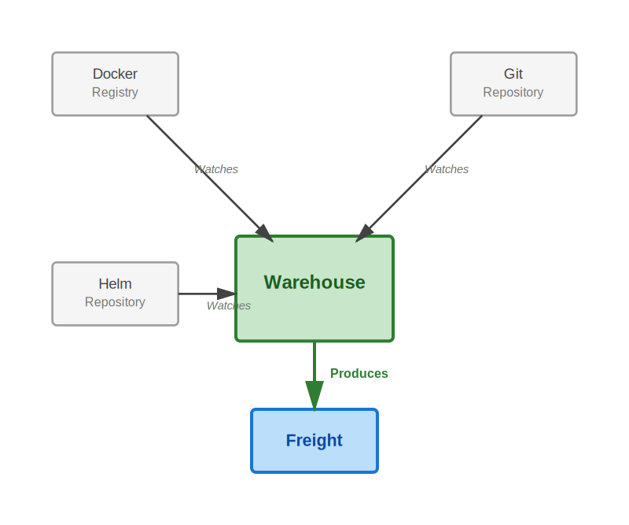
Warehouses: Artifact Discovery
• Monitor repositories for new artifacts
• Images, Git commits, Helm charts
• Apply version constraints (semver)
• Automatic discovery with webhooks
• Produce Freight when versions found
Notes:
Warehouses are the entry point of Kargo workflow - artifact discovery mechanism.
Pull-based monitoring rather than push-based triggers (GitOps principle).
Can subscribe to multiple repository types simultaneously.
Version selection strategies: semver constraints, lexical ordering, newest build.
Warehouses don't deploy - they discover and package into Freight.
Webhook support for immediate discovery vs. polling intervals.

Slide 5
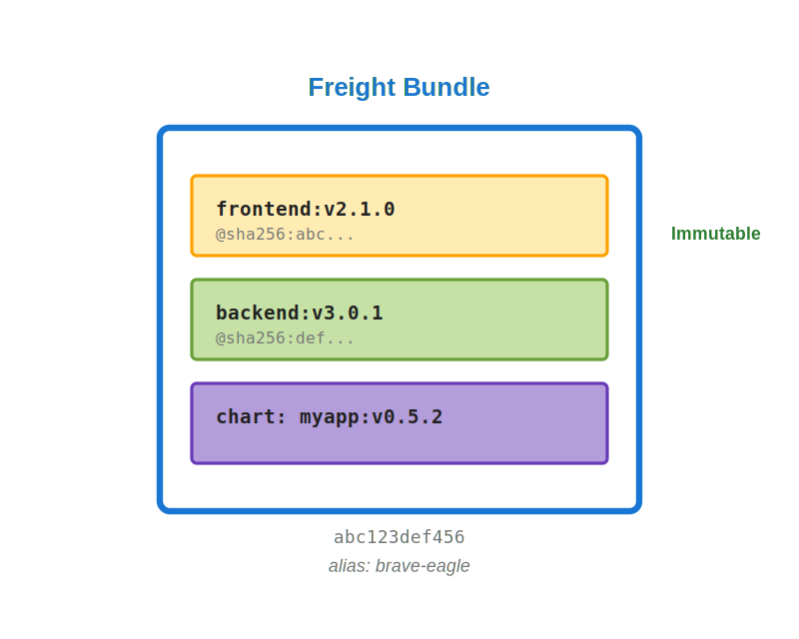
Freight: Immutable Artifact Bundles
• Bundle of specific artifact versions
• NOT a single version number
• Contains: digests, SHAs, versions
• Immutable, cryptographically identified
• Promoted as atomic unit
# Freight bundle structure
apiVersion: kargo.akuity.io/v1alpha1
kind: Freight
metadata:
name: abc123def456 # SHA-1 hash
alias: brave-eagle # Human-friendly
artifacts:
images:
- repoURL: myregistry.io/frontend
tag: v2.1.0
digest: sha256:abc...
- repoURL: myregistry.io/backend
tag: v3.0.1
digest: sha256:def...
charts:
- name: myapp
version: v0.5.2
Notes:
Critical concept: Freight is NOT unified versioning across all components.
Each artifact maintains its own version, bundled together as tested combination.
Immutability ensures reproducibility - Freight never changes after creation.
Cryptographic identification via SHA-1 hash plus human-friendly alias.
This is the "cargo" that moves through promotion pipeline as atomic unit.
Enables independent artifact versioning while maintaining coordinated promotion.

Slide 6
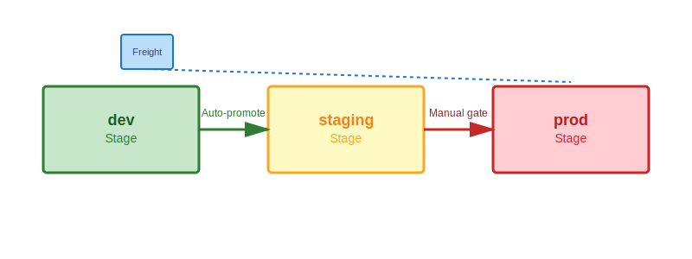
Stages: Promotion Targets
• Represent promotion targets (typically environments)
• Define Freight acceptance rules
• Specify promotion mechanisms
• Track health and verification
• Chain together to form pipelines
Notes:
Stages are promotion targets, though typically map to environments.
Each Stage defines: which Freight it accepts, how promotion executes.
Promotion mechanisms are fully declarative via Kubernetes resources.
Built-in health monitoring and verification support.
Stages form pipelines by subscribing to upstream Stages or Warehouses.
Auto-promotion for lower environments, manual gates for production typical pattern.

Slide 7
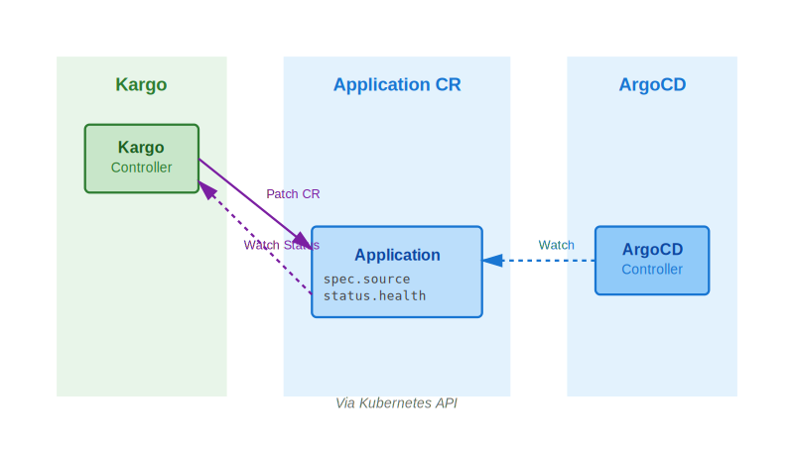
Kubernetes-Native Integration
• Kargo patches Application Custom Resources
• No REST API calls
• Authorization via annotations
• Status monitoring via K8s watch
• Declarative, not imperative
# ArgoCD Application annotation
apiVersion: argoproj.io/v1alpha1
kind: Application
metadata:
annotations:
kargo.akuity.io/authorized-stage: "myproject:production"
Notes:
Key architectural decision: Kubernetes-native integration, not REST API calls.
Kargo modifies ArgoCD Application Custom Resources via Kubernetes API.
Decoupled design - no tight coupling between systems.
Authorization through annotations - explicit permission delegation.
RBAC-based security model using standard Kubernetes mechanisms.
ArgoCD sees standard CR modifications, doesn't need Kargo awareness.
Both tools can operate independently if needed.

Slide 8
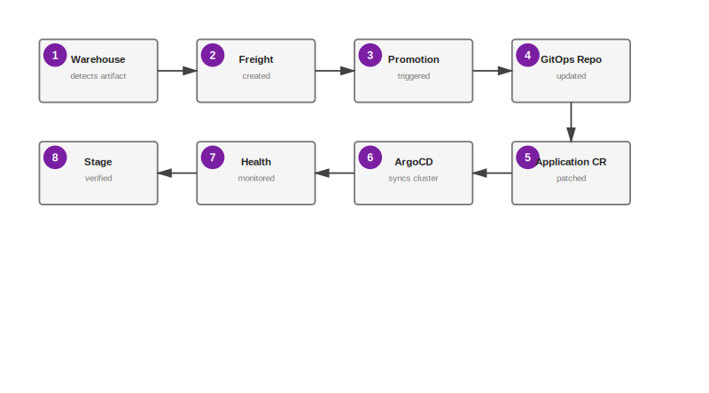
End-to-End Promotion Flow
• 1. Warehouse detects new artifact
• 2. Freight created (immutable bundle)
• 3. Promotion triggered (auto/manual)
• 4. GitOps repo updated
• 5. Application CR patched
• 6. ArgoCD syncs cluster
• 7. Health monitored
• 8. Stage verified for next promotion
Notes:
Complete picture of one promotion cycle from start to verification.
State-driven workflow, not event-driven - continuous reconciliation.
Each step is declarative via Kubernetes resources.
Failure at any step halts progression - safe by default.
Automatic audit trail through Git commits and Kubernetes events.
Health monitoring continues until Stage is marked healthy.
Verification enables progressive promotion to next Stage.
Entire workflow visible through kubectl and Kargo UI.

Slide 9
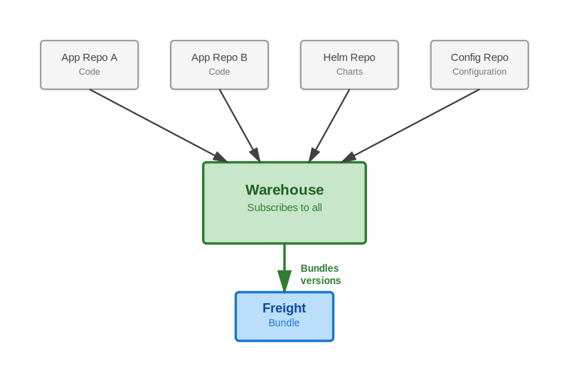
Coordinating Multiple Artifact Sources
• Challenge: Code, charts, config separate
• Single Warehouse subscribes to all
• Freight bundles specific version each
• Promoted together as unit
• Prevents version mismatches
Notes:
Modern reality: polyrepo architectures are common.
Application code, infrastructure code, configuration often separate repositories.
Coordination problem: ensuring compatible versions promoted together.
Kargo solution: Warehouse subscribes to multiple repositories simultaneously.
Freight bundles one specific version from each subscribed repository.
Alternative to unified versioning - independent artifact versions with coordinated promotion.
Each artifact maintains its own lifecycle while promotion stays synchronized.

Slide 10
Preventing Incompatible Combinations
• Problem: Race conditions create bad Freight
• Solution 1: Creation criteria (expressions)
• Solution 2: Manual assembly
• Solution 3: Multiple Warehouses
• Solution 4: Gatekeeper Stage
# Warehouse with Freight creation criteria
apiVersion: kargo.akuity.io/v1alpha1
kind: Warehouse
spec:
freightCreationPolicy: Automatic
freightCreationCriteria:
expression: |
imageFrom('frontend').Tag == imageFrom('backend').Tag
Notes:
Real-world problem: timing issues can create incompatible Freight.
Example: frontend v2.0 discovered before backend v2.0 ready, creates incompatible bundle.
Solution 1 (most powerful): Expression-based creation criteria.
Solution 2: Manual Freight assembly for complex compatibility rules.
Solution 3: Separate Warehouses for fast-moving vs slow-moving artifacts.
Solution 4: Gatekeeper Stage filters bad combinations before important environments.
Choose strategy based on coordination requirements and team workflow.

Slide 11
Working with Freight
• Freight is immutable (by design)
• Cannot merge Freight after creation
• Manual assembly: Select compatible versions
• Freight cloning: Template for hotfixes
• Multiple Warehouses: Parallel pipelines
Notes:
Freight immutability is feature, not limitation - ensures reproducibility.
Cannot merge existing Freight - would break audit trail and create untested combinations.
Manual assembly: Warehouse discovers multiple versions, user selects compatible set.
Freight cloning use case: Production hotfix - clone prod Freight, replace one buggy component.
Multiple Warehouses: Different artifacts can promote at different rates.
Example: Promote images daily, configuration changes weekly.
Design decisions based on organizational requirements and coupling needs.

Slide 12
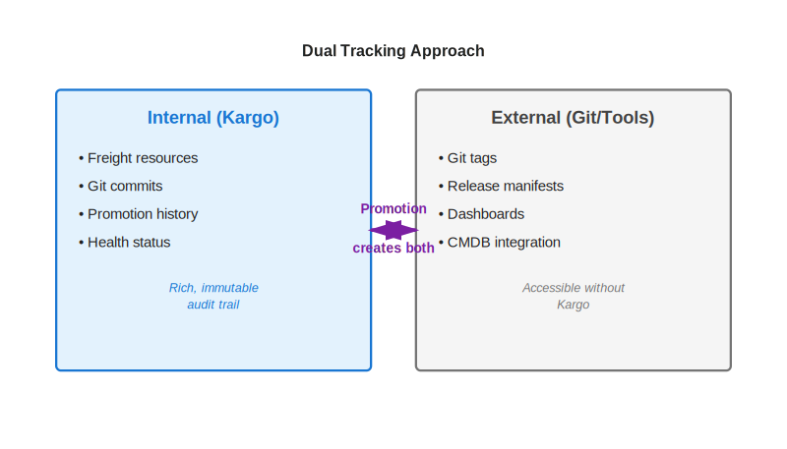
Visibility Beyond Kargo
• Kargo tracks internally (Freight, commits)
• External needs: tags, manifests, dashboards
• Promotion steps can create tags
• Release manifest files for automation
• Hybrid approach recommended
Notes:
Enterprise requirement: tracking releases beyond Kargo system.
Kargo provides excellent internal tracking via Freight and Git commits.
External visibility needs: Git tags for humans, manifests for automation.
Promotion process can create both simultaneously.
Git tags provide external visibility without Kargo access.
Release manifests enable programmatic querying and integration.
Hybrid approach: rich internal tracking plus external accessibility.
Best of both worlds without duplication.

Slide 13
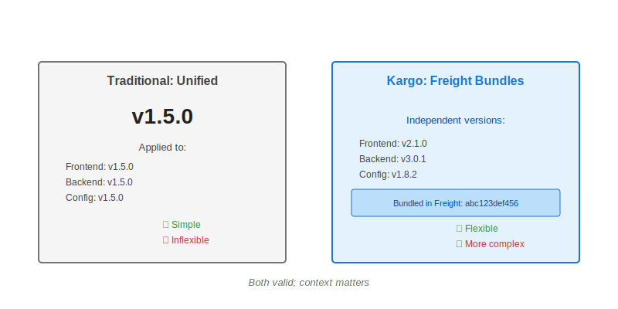
Architectural Trade-offs
• Traditional: Single version across artifacts
• Kargo: Independent versions, bundled promotion
• Unified: Simple, inflexible
• Freight: Flexible, more complex
• Both valid; context matters
Notes:
Both architectural approaches have merit - not one-size-fits-all.
Unified versioning: Single version tag across all components (v1.5.0 everywhere).
Advantages: Simple to communicate, easy mental model.
Disadvantages: Tight coupling, requires rebuilding everything for any change.
Freight approach: Each artifact maintains independent version.
Advantages: Flexible, handles independent lifecycles, selective promotion.
Disadvantages: More complex, requires coordination mechanism.
Hybrid approaches possible: unified major versions, independent minor/patch.
Migration path exists from unified to Freight-based promotion.

Slide 14
Ensuring Safe Promotions
• Stage health ≠ Application health
• Multiple health indicators aggregate
• Argo Rollouts integration
• Custom verification jobs
• Progressive promotion gates
Health checks aggregate:
✓ Application sync status
✓ Application health status
✓ Verification results
✓ Custom checks
→ Stage health decision
Notes:
Stage health encompasses more than just Application health.
Multiple health indicators: Application sync, health, verification, custom checks.
Integration with Argo Rollouts for progressive delivery patterns.
Custom verification via Kubernetes Jobs or external systems.
Verification gates prevent premature promotion to next Stage.
Health monitoring continuous throughout promotion lifecycle.
Failed verification stops progression - safe by default.
Enables canary deployments, blue-green, other advanced patterns.

Slide 15
Deployment Patterns with Kargo
• Common: Image + config together
• Grouped: Multiple images as unit
• Independent: Different cadences
• Gatekeeper: Filter bad combinations
• Choose based on coupling
[Common Case] [Grouped Services]
Single Warehouse Multiple images
↓ ↓
Combined Promoted
Freight together
[Independent] [Gatekeeper]
Multiple Initial filter
Warehouses stage first
Notes:
Not one-size-fits-all - pattern selection based on requirements.
Common case: Single Warehouse for tightly coupled components (image + config).
Grouped services: Microservices with interdependencies promoted together.
Independent pipelines: Different promotion cadences for different artifact types.
Gatekeeper pattern: Initial Stage filters invalid combinations before important environments.
Selection criteria: Component coupling, change frequency, risk tolerance.
Most teams start with common pattern, evolve to more complex as needs arise.

Slide 16
GitOps Repository Structure
• Stage-specific branches (recommended)
• Single branch with paths (alternative)
• Format: stage/dev, stage/staging, stage/prod
• Not Git Flow—independent storage
• Use path filters to prevent loops
Stage-Specific Branches:
main (source)
├── stage/dev (rendered)
├── stage/staging (rendered)
└── stage/prod (rendered)
Single Branch Alternative:
main
├── builds/dev/
├── builds/staging/
└── builds/prod/
Notes:
GitOps repository structure affects promotion workflow.
Recommended: Stage-specific branches for rendered manifests.
Clear separation of environment states, independent histories.
Easy rollback per environment - checkout previous commit on branch.
Not merge-based Git Flow - branches are independent storage.
Alternative: Single branch with path-based separation.
Path filter requirement: Prevent Warehouse from triggering on own promotion outputs.
Feedback loop prevention critical for stability.
Choose based on team Git workflow preferences and tooling.

Slide 17
Production Recommendations
• Separate source from GitOps repos
• Use Freight creation criteria
• Auto-promote lower environments
• Manual gates for production
• Implement verification at each stage
✓ Repository structure: Source ≠ GitOps
✓ Freight creation: Use criteria expressions
✓ Promotion policy: Auto dev, manual prod
✓ Verification: Define for each stage
✓ Access control: RBAC for approvals
Notes:
Production-tested recommendations from real deployments.
Repository separation: Source code repos separate from GitOps manifest repos.
Prevents conflicts, enables different access controls.
Freight creation criteria prevent incompatible combinations proactively.
Automation strategy: Auto-promote dev/test, manual approval for production.
Verification at each Stage before allowing next promotion.
RBAC-based access control for production promotion approvals.
Security principle: Least privilege via Kubernetes RBAC.
Balance automation with control based on risk tolerance.

Slide 18
Issues and Quick Fixes
• Incompatible Freight → Creation criteria
• Feedback loops → Path filters
• Slow discovery → Webhooks
• App not syncing → Check annotation
• Lost context → External tracking
Notes:
Common issues encountered in real deployments with quick fixes.
Incompatible Freight: Use creation criteria expressions to prevent.
Feedback loops: Warehouse triggering on own promotion output - use path filters.
Slow artifact discovery: Add webhooks for immediate notification.
Application not syncing: Verify authorization annotation present and correct.
Lost context externally: Implement Git tagging in promotion process.
Most issues are configuration, not bugs.
Diagnostic approach: Check Warehouse status, Promotion logs, Application events.
Prevention better than cure - use criteria and verification.

Slide 19
Integrating Kargo into Existing Setup
• Prerequisites: K8s, ArgoCD, GitOps repo
• Start small: Single app, dev→staging
• Expand gradually: Add stages, apps
• No disruption to existing ArgoCD
• Incremental adoption possible
Phase 1: Install + Single App
↓
Phase 2: Add Stages
↓
Phase 3: Multiple Apps
↓
Phase 4: Advanced Patterns
Notes:
Low-risk adoption strategy for existing ArgoCD environments.
Prerequisites already in place for most teams: Kubernetes cluster, ArgoCD, GitOps repositories.
Start with single non-critical application, two stages (dev, staging).
ArgoCD continues working as-is - no disruption to existing deployments.
Learn Kargo patterns and concepts with low stakes.
Expand gradually: Add production stage, additional applications.
Advanced patterns come later: Multiple Warehouses, verification, complex criteria.
Team can learn incrementally without big-bang migration.
Parallel operation: Some apps via Kargo, others traditional while transitioning.

Slide 20
Key Takeaways
• Kargo solves ArgoCD promotion gap
• Declarative, Kubernetes-native
• Freight bundles coordinate artifacts
• Progressive, verifiable promotions
• Resources: docs.kargo.io
Key Points:
1. ArgoCD deploys, Kargo promotes
2. Freight = immutable artifact bundles
3. Stages = promotion targets
4. Kubernetes-native integration
5. Production-ready from Argo team
Resources:
• Documentation: docs.kargo.io
• GitHub: github.com/akuity/kargo
• Community: Discord, CNCF Slack
Notes:
Recap core concepts: Kargo addresses promotion gap in ArgoCD.
Complementary relationship - deployment engine plus promotion orchestration.
Freight concept critical: bundled artifacts, not unified versioning.
Declarative workflows via Kubernetes resources - GitOps principles maintained.
Built by Argo creators - production-ready, actively maintained.
Point to backup slides for detailed examples and troubleshooting.
Resources available: comprehensive documentation, active community.
Open for questions - backup slides cover common deep-dive topics.

Slide 21
A1
Example: Multi-Repository Warehouse
Complete Warehouse with image, Git, and Helm subscriptions
apiVersion: kargo.akuity.io/v1alpha1
kind: Warehouse
metadata:
name: my-warehouse
namespace: my-project
spec:
# Automatic Freight creation with criteria
freightCreationPolicy: Automatic
freightCreationCriteria:
expression: |
imageFrom('myapp/frontend').Tag == imageFrom('myapp/backend').Tag
subscriptions:
# Container image subscription
- image:
repoURL: myregistry.io/myapp/frontend
semverConstraint: ^2.0.0
discoveryLimit: 10
- image:
repoURL: myregistry.io/myapp/backend
semverConstraint: ^2.0.0
discoveryLimit: 10
# Git repository subscription
- git:
repoURL: https://github.com/myorg/config.git
commitSelectionStrategy: NewestFromBranch
branch: main
includePaths:
- config/
excludePaths:
- config/README.md
# Helm chart subscription
- chart:
repoURL: https://charts.example.com
name: myapp
semverConstraint: ^1.0.0
Notes:
This Warehouse subscribes to multiple artifact types. Freight creation criteria ensures frontend and backend versions match before creating Freight. Discovery limits prevent excessive version tracking.

Slide 22
A2
Example: Production Stage
Complete Stage with promotion template and manual approval
apiVersion: kargo.akuity.io/v1alpha1
kind: Stage
metadata:
name: production
namespace: my-project
spec:
# Request Freight from upstream staging Stage
requestedFreight:
- origin:
kind: Warehouse
name: my-warehouse
sources:
stages:
- staging
# Promotion template (manual trigger only)
promotionTemplate:
spec:
vars:
- name: gitopsRepo
value: https://github.com/myorg/gitops.git
steps:
- uses: git-clone
config:
repoURL: ${{ vars.gitopsRepo }}
checkout:
- branch: stage/production
create: true
path: ./out
- uses: kustomize-set-image
config:
path: ./out
images:
- image: myapp/frontend
tag: ${{ imageFrom('myapp/frontend').Tag }}
- uses: git-commit
as: commit
config:
path: ./out
message: "Production release"
- uses: git-push
config:
path: ./out
- uses: argocd-update
config:
apps:
- name: myapp-production
namespace: argocd
Notes:
Production Stage accepts Freight verified in staging. Manual promotion required (no auto-promotion). Promotion template updates GitOps repo and triggers ArgoCD sync.

Slide 23
A3
Example: ArgoCD Application Authorization
Application annotated to allow Kargo Stage management
apiVersion: argoproj.io/v1alpha1
kind: Application
metadata:
name: myapp-production
namespace: argocd
annotations:
# Authorize Kargo Stage to manage this Application
kargo.akuity.io/authorized-stage: "my-project:production"
spec:
project: default
source:
repoURL: https://github.com/myorg/gitops.git
targetRevision: stage/production
path: .
destination:
server: https://kubernetes.default.svc
namespace: myapp-production
syncPolicy:
automated:
prune: true
selfHeal: true
syncOptions:
- CreateNamespace=true
# Optional: ignore differences
ignoreDifferences:
- group: apps
kind: Deployment
jsonPointers:
- /spec/replicas
Notes:
Authorization annotation grants production Stage permission to patch this Application. Auto-sync ensures ArgoCD deploys changes immediately. targetRevision points to stage-specific branch updated by Kargo.

Slide 24
A4
Example: Freight Creation Criteria
Expression-based criteria to prevent incompatible combinations
# Tag matching - ensure versions match
freightCreationCriteria:
expression: |
imageFrom('frontend').Tag == imageFrom('backend').Tag
# Version constraints - only create for stable releases
freightCreationCriteria:
expression: |
!(imageFrom('myapp').Tag contains 'alpha') &&
!(imageFrom('myapp').Tag contains 'beta')
# Date-based filtering - only recent commits
freightCreationCriteria:
expression: |
commitFrom('github.com/myorg/repo').CommitterDate
.After(date('2025-01-01'))
# Combined criteria - versions match AND stable
freightCreationCriteria:
expression: |
imageFrom('frontend').Tag == imageFrom('backend').Tag &&
imageFrom('backend').Tag == chartFrom('myapp').Version &&
!(imageFrom('frontend').Tag contains 'rc')
# Specific version pattern - only patch updates
freightCreationCriteria:
expression: |
imageFrom('myapp').Tag matches '^v2\.1\.\d+$'
Notes:
Criteria prevent Warehouse from creating Freight with incompatible artifact versions. Use expressions for tag matching, version filtering, date constraints, or complex combinations.

Slide 25
A5
Example: Complete Promotion Workflow
Full promotion template with all common steps
promotionTemplate:
spec:
vars:
- name: gitopsRepo
value: https://github.com/myorg/gitops.git
steps:
# Clone source and output branches
- uses: git-clone
config:
repoURL: ${{ vars.gitopsRepo }}
checkout:
- branch: main
path: ./src
- branch: stage/dev
create: true
path: ./out
# Clear output directory
- uses: git-clear
config:
path: ./out
# Update image tags
- uses: kustomize-set-image
as: update-image
config:
path: ./src/overlays/dev
images:
- image: myapp/frontend
tag: ${{ imageFrom('myapp/frontend').Tag }}
- image: myapp/backend
tag: ${{ imageFrom('myapp/backend').Tag }}
# Build manifests
- uses: kustomize-build
config:
path: ./src/overlays/dev
outPath: ./out
# Commit changes
- uses: git-commit
as: commit
config:
path: ./out
messageFromSteps:
- update-image
# Push to remote
- uses: git-push
config:
path: ./out
# Update ArgoCD Application
- uses: argocd-update
config:
apps:
- name: myapp-dev
namespace: argocd
sources:
- repoURL: ${{ vars.gitopsRepo }}
desiredRevision: ${{ outputs.commit.commit }}
Notes:
Complete promotion workflow: clone repos, update images, build manifests, commit, push, and trigger ArgoCD. Uses step outputs (commit SHA) to update Application targetRevision.

Slide 26
A6
Example: Git Tag Creation for Releases
Bash step for creating annotated tags and release manifests
# Git tag creation step in promotion template
steps:
# ... standard promotion steps ...
# Create annotated Git tag
- uses: bash
config:
script: |
#!/bin/bash
cd ./out
# Generate release version
RELEASE_TAG="release-$(date +%Y.%m.%d-%H%M%S)"
# Create annotated tag with component manifest
git tag -a "$RELEASE_TAG" -m "Production Release
Kargo Freight: ${{ ctx.freight.name }}
Freight Alias: ${{ ctx.freight.alias }}
Components:
- Frontend: ${{ imageFrom('myapp/frontend').Tag }}
- Backend: ${{ imageFrom('myapp/backend').Tag }}
- Chart: ${{ chartFrom('myapp').Version }}
Promoted: $(date -u +%Y-%m-%dT%H:%M:%SZ)
Promoted By: ${{ ctx.promotion.createdBy }}"
# Push tag
git push origin "$RELEASE_TAG"
# Optional: Create release manifest
cat > release-manifest.json <<EOF
{
"version": "$RELEASE_TAG",
"freight": "${{ ctx.freight.name }}",
"components": {
"frontend": "${{ imageFrom('myapp/frontend').Tag }}",
"backend": "${{ imageFrom('myapp/backend').Tag }}"
}
}
EOF
Notes:
Create Git tags during production promotions for external tracking. Tags include complete component manifest, Freight reference, and timestamp. Release manifest enables programmatic access.

Slide 27
A7
Example: Multiple Warehouses Pattern
Independent pipelines for different artifact cadences
# Warehouse 1: Application images (fast-moving)
apiVersion: kargo.akuity.io/v1alpha1
kind: Warehouse
metadata:
name: app-images
namespace: my-project
spec:
subscriptions:
- image:
repoURL: myregistry.io/myapp/frontend
- image:
repoURL: myregistry.io/myapp/backend
---
# Warehouse 2: Infrastructure config (slow-moving)
apiVersion: kargo.akuity.io/v1alpha1
kind: Warehouse
metadata:
name: infra-config
namespace: my-project
spec:
subscriptions:
- git:
repoURL: https://github.com/myorg/infra-config.git
branch: main
---
# Stage accepts Freight from BOTH Warehouses
apiVersion: kargo.akuity.io/v1alpha1
kind: Stage
metadata:
name: staging
namespace: my-project
spec:
requestedFreight:
- origin:
kind: Warehouse
name: app-images
sources:
direct: true
- origin:
kind: Warehouse
name: infra-config
sources:
direct: true
Notes:
Use multiple Warehouses when artifacts have different change frequencies. Stage requests Freight from both Warehouses. Enables promoting images daily while config changes weekly.

Slide 28
A8
Example: Freight Cloning for Hotfixes
Using Freight cloning to create emergency hotfix releases
# Scenario: Critical bug in production backend
# Production Freight contains:
# - frontend:v2.0.0
# - backend:v2.0.0 (buggy)
# - config:v1.5.0
# Step 1: Build and push hotfix
# docker build -t myregistry.io/myapp/backend:v2.0.1 .
# docker push myregistry.io/myapp/backend:v2.0.1
# Step 2: Clone production Freight via Kargo UI/CLI
# 1. Navigate to production Stage
# 2. Select current Freight
# 3. Click "Clone Freight"
# 4. Select backend artifact
# 5. Change version to v2.0.1
# 6. Click "Create Freight"
# Result: New Freight with hotfix
# - frontend:v2.0.0 (unchanged)
# - backend:v2.0.1 (hotfix)
# - config:v1.5.0 (unchanged)
# Step 3: Promote hotfix Freight to production
# Can bypass lower environments for emergency
# Or test in dev/staging first if time permits
# Freight cloning preserves all other artifacts
# Only replaces the component needing hotfix
# Maintains reproducibility and audit trail
Notes:
Freight cloning creates new Freight based on existing production Freight. Replace only buggy component while keeping all other artifacts at production versions. Enables rapid hotfix deployment.

Slide 29
A9
Example: Verification with Argo Rollouts
Stage verification using AnalysisTemplate
# Stage with verification via AnalysisTemplate
apiVersion: kargo.akuity.io/v1alpha1
kind: Stage
metadata:
name: staging
namespace: my-project
spec:
requestedFreight:
- origin:
kind: Warehouse
name: my-warehouse
sources:
direct: true
# Verification configuration
verification:
analysisTemplates:
- name: smoke-tests
# Run analysis after promotion
analysisRunMetadata:
labels:
stage: staging
promotionTemplate:
# ... promotion steps ...
---
# AnalysisTemplate for verification
apiVersion: argoproj.io/v1alpha1
kind: AnalysisTemplate
metadata:
name: smoke-tests
namespace: my-project
spec:
metrics:
- name: http-check
interval: 30s
count: 5
successCondition: result == '200'
provider:
web:
url: https://myapp-staging.example.com/health
jsonPath: "{$.status}"
- name: error-rate
interval: 1m
count: 3
successCondition: result < 0.05
provider:
prometheus:
address: http://prometheus:9090
query: |
sum(rate(http_requests_total{status=~"5.."}[5m])) /
sum(rate(http_requests_total[5m]))
Notes:
Verification ensures Freight is healthy before marking as verified for next Stage. AnalysisTemplate defines health checks: HTTP endpoints, Prometheus metrics, custom tests. Failed verification prevents promotion.

Slide 30
A10
Troubleshooting Common Issues
Diagnostic steps and solutions for frequent problems
# Issue 1: Freight not being created
# Check Warehouse status
kubectl get warehouse -n my-project my-warehouse -o yaml
# Look for errors in status.conditions
# Solution: Add credentials for private registries
apiVersion: v1
kind: Secret
metadata:
name: registry-creds
namespace: my-project
labels:
kargo.akuity.io/cred-type: image
stringData:
repoURL: ghcr.io
username: myuser
password: ghp_xxxxxxxxxxxxx
---
# Issue 2: Promotion failing - git push errors
# Check for Git credentials
apiVersion: v1
kind: Secret
metadata:
name: git-creds
namespace: my-project
labels:
kargo.akuity.io/cred-type: git
stringData:
repoURL: https://github.com/myorg/gitops.git
username: myuser
password: ghp_xxxxxxxxxxxxx
---
# Issue 3: Application not syncing after promotion
# Verify authorization annotation
kubectl get application -n argocd myapp-dev -o yaml
# Should have: kargo.akuity.io/authorized-stage: "project:stage"
---
# Issue 4: Check Promotion logs for detailed errors
kubectl get promotion -n my-project <promotion-name> -o yaml
# Review status.stepResults for failures
Notes:
Most issues are configuration-related. Check Warehouse status for discovery errors, verify credentials exist, ensure ArgoCD Applications have authorization annotation. Review Promotion status for detailed error messages.

Slide 31
A11
Expression Language Reference
Complete guide to Kargo expression syntax
# Context Variables
${{ ctx.stage }} # Current Stage name
${{ ctx.freight.name }} # Freight SHA identifier
${{ ctx.freight.alias }} # Human-friendly alias
${{ ctx.promotion.createdBy }} # Who triggered promotion
# Artifact Functions
${{ imageFrom('myapp/frontend').Tag }} # Image tag
${{ imageFrom('myapp/frontend').Digest }} # Image digest
${{ commitFrom('github.com/org/repo').ID }} # Git commit SHA
${{ commitFrom('github.com/org/repo').Message }} # Commit message
${{ chartFrom('my-chart').Version }} # Helm chart version
# Artifact Functions with Warehouse Filter
${{ imageFrom('myapp', warehouse('my-warehouse')).Tag }}
# Variable References
${{ vars.gitopsRepo }} # Global variable
${{ outputs.commit.commit }} # Step output (by alias)
${{ outputs['step-name'].value }} # Square bracket notation
${{ task.outputs['step'].value }} # Task output
# Utility Functions
${{ timestamp() }} # Unix timestamp
${{ timestamp("2006.01.02") }} # Formatted date
${{ timestamp("2006-01-02T15:04:05") }} # ISO format
${{ quote(imageFrom('app').Tag) }} # YAML-safe quoting
# Freight Creation Criteria Examples
imageFrom('frontend').Tag == imageFrom('backend').Tag
imageFrom('app').Tag > '2.0.0'
!(imageFrom('app').Tag contains 'alpha')
commitFrom('repo').CommitterDate.After(date('2025-01-01'))
Notes:
Kargo uses expressions in promotion templates and Freight creation criteria. Access context variables, artifact metadata, step outputs, and variables. Use utility functions for timestamps and formatting.

Slide 32
A12
Complete End-to-End Example
Full Kargo setup for e-commerce microservices application
# Complete Kargo Setup for E-Commerce Application
# 1. Warehouse for microservices
apiVersion: kargo.akuity.io/v1alpha1
kind: Warehouse
metadata:
name: ecommerce-warehouse
namespace: ecommerce
spec:
subscriptions:
- image:
repoURL: myregistry.io/ecommerce/frontend
- image:
repoURL: myregistry.io/ecommerce/api
- image:
repoURL: myregistry.io/ecommerce/worker
- chart:
repoURL: https://charts.example.com
name: ecommerce
---
# 2. Dev Stage (auto-promote)
apiVersion: kargo.akuity.io/v1alpha1
kind: Stage
metadata:
name: dev
namespace: ecommerce
spec:
requestedFreight:
- origin:
kind: Warehouse
name: ecommerce-warehouse
sources:
direct: true
promotionTemplate:
spec:
steps:
- uses: git-clone
config:
repoURL: https://github.com/myorg/ecommerce-gitops.git
checkout:
- branch: stage/dev
create: true
path: ./out
- uses: helm-update-image
config:
path: ./out/values.yaml
images:
- image: ecommerce/frontend
key: frontend.image.tag
- image: ecommerce/api
key: api.image.tag
- uses: git-commit
config:
path: ./out
- uses: git-push
config:
path: ./out
- uses: argocd-update
config:
apps:
- name: ecommerce-dev
Notes:
Complete example showing Warehouse tracking 3 microservices + Helm chart, dev Stage with auto-promotion. Production would add verification and manual approval. Demonstrates real-world multi-service setup.

