Slide 1
우리FIS 사아아조오오
박석호/정찬웅/노규동/조성모/최은정

Slide 2
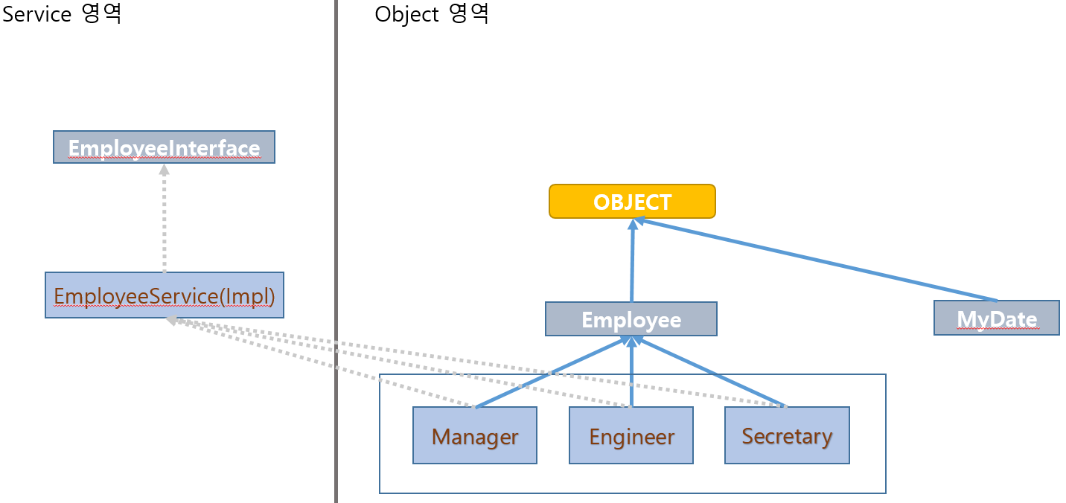
Class Relation

Slide 3
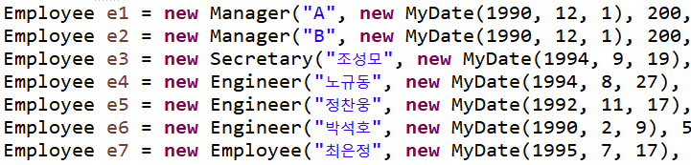
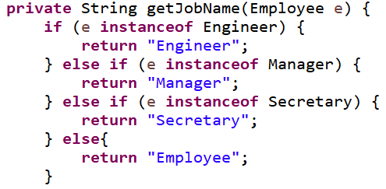
Code Explanation
Polymornphism

Slide 4
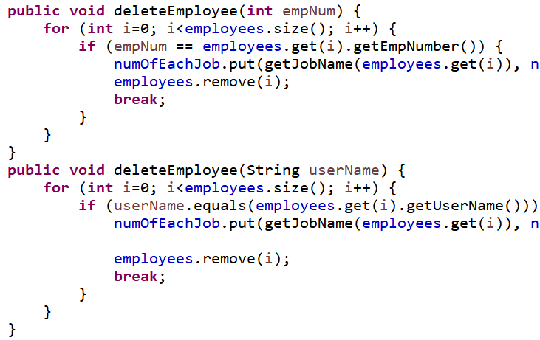
Code Explanation
Overloading

Slide 5
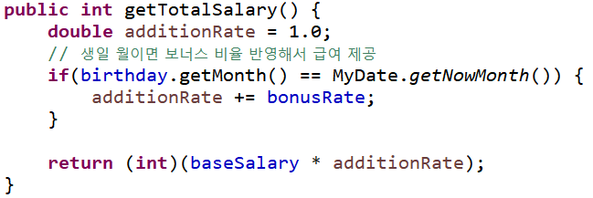

Code Explanation
Overriding
Employee Class
Engineer Class

Slide 6
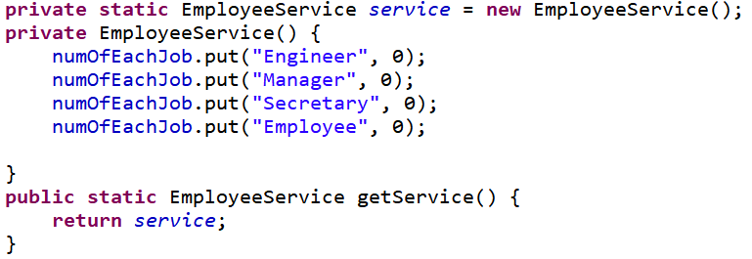
Code Explanation
Static
Singleton Pattern

Slide 7
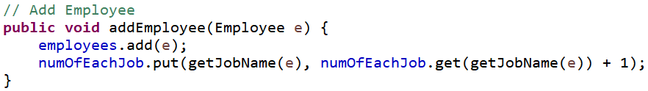
Code Explanation
Collection API

Slide 8
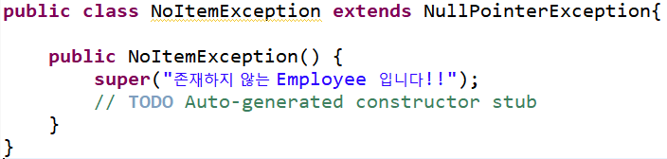
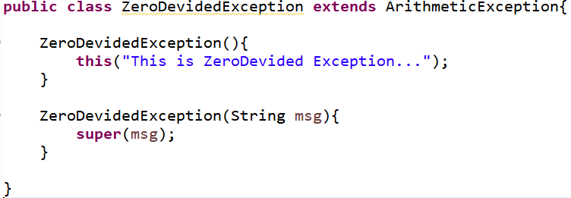
Code Explanation
Exception Define

Slide 9
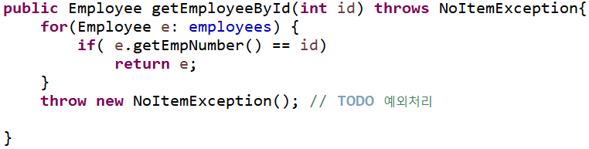
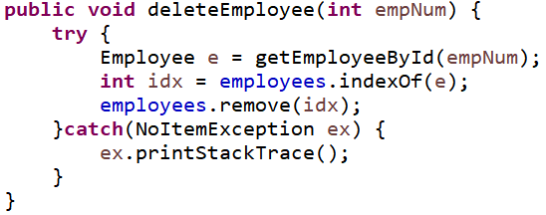
Code Explanation
Exception Using Case

Slide 10
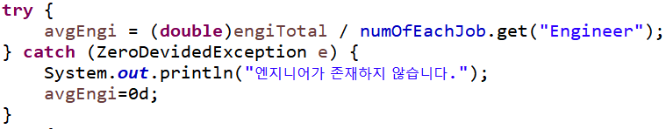
Code Explanation
Exception Using Case

Slide 11
Thank U
얏호~!

