Slide 1
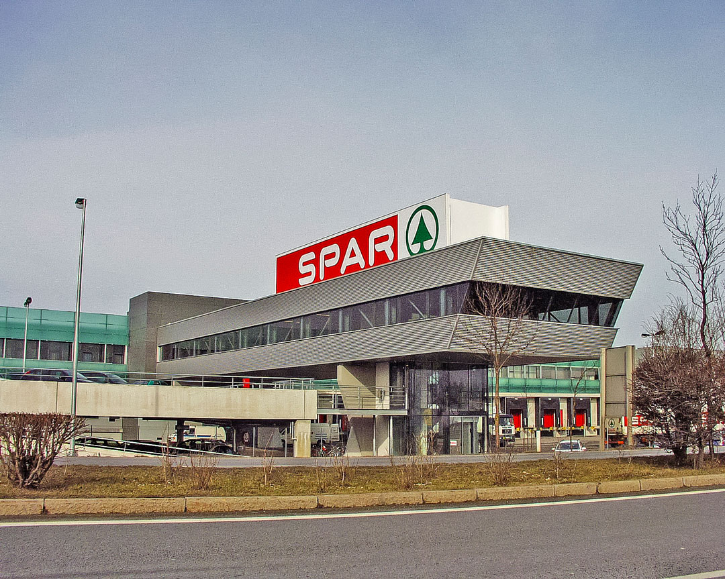
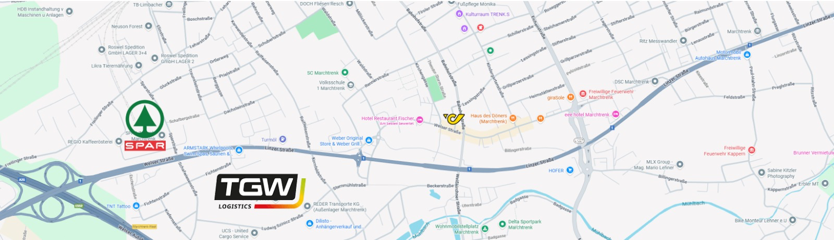
Project 1:
Marchtrenk -
Wels
Alexander Moser K12105209
Jose Pablo Alarcon Estrada K12525966
Aleksa Kostresevic K1172206

Slide 2
Objective and research questions
A more specific and concrete goal was defined:
Use SUMO to compare the current operation of the Wels–Marchtrenk corridor with an electrified version, on roundabouts, measuring both road performance and emissions.
Research questions:
How much are CO₂ emissions reduced if diesel trucks from our fleet are replaced by e-trucks charged with the PV from the depot?
How much more are emissions and travel times reduced if roundabouts are also implemented at major intersections?

Slide 3
SUMO model characteristics
Modeled corridor: ~6.5 km of Linzer–Welser Straße between the SPAR hub in Wels and the Marchtrenk industrial zone.
Network source: OSM import + cleaning in netedit (irrelevant residential streets were removed, intersections and priorities were fixed).
Signalized intersections: manually verified and aligned to ensure traffic signal coordination makes sense in the optimized scenario.

Slide 4
Simulation parameters (SUMO 1.24)
Duration: 7200s = 2 morning rush hour.
Network speeds: 50–70 km/h depending on the segment.
Simulated traffic: 40 heavy trucks (those from the SPAR/Marchtrenk scenario) + background traffic to represent the actual load of the corridor.
Emissions/Energy Models: HBEFA + EV to compare diesel vs. electric.

Slide 5
Scenarios to compare:
Baseline scenario (current situation):
Diesel fleet.
Fixed-time traffic lights as in the original network.
Times, stops, and emissions are recorded.
Alternative scenarios (optimized):
Implementation of roundabouts on sectors where jams occur during peak hours (travel times)
Converting half of the truck logistics fleet to electrical vehicles (reduction of CO2 emission)
Converting of the whole truck logistics fleet to electrical vehicles (further CO2 reduction)
Same demand as the baseline scenario → the comparison is direct.

Slide 6
Model KPIs
Vehicles finished
Average travel time for freight trucks.
Total emissions per simulation: CO₂
Energy consumption: fuel or kWh.
Emission reduction
Share of emission by fleet type

Slide 7
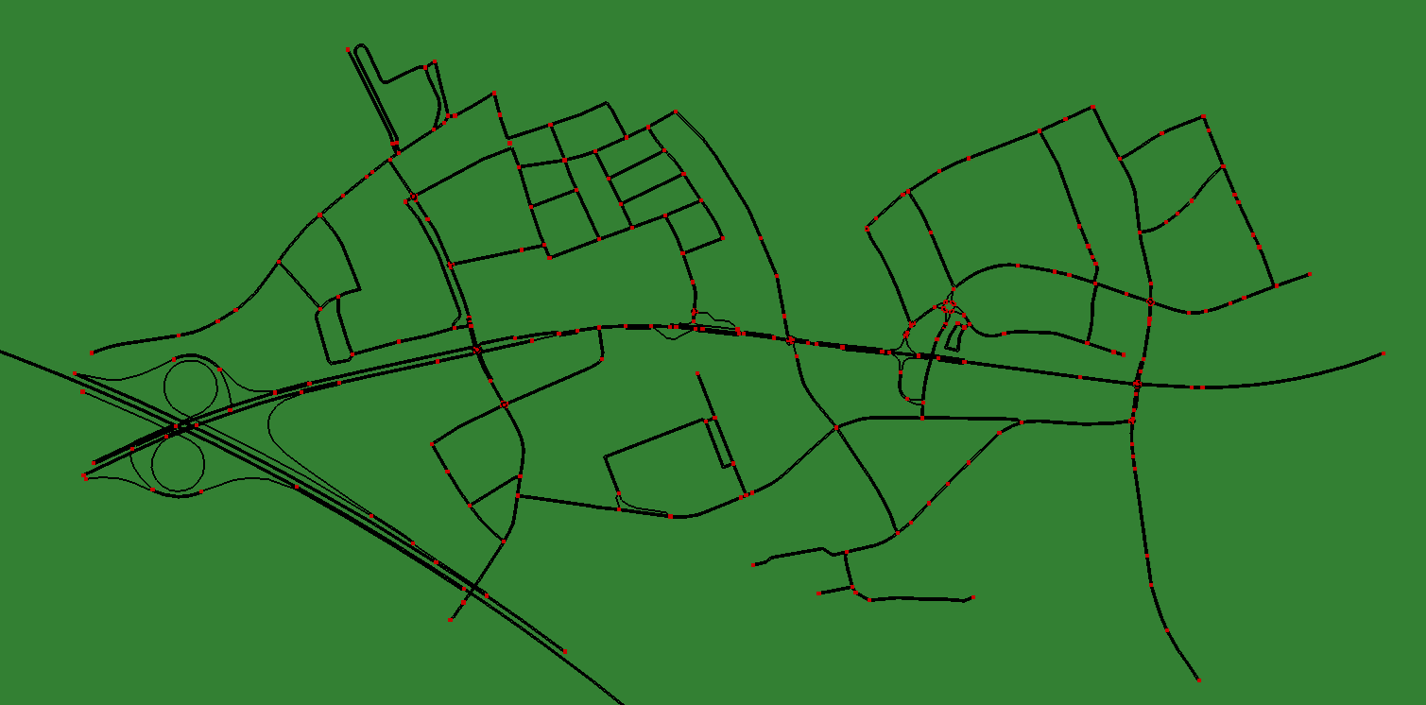
Cleaned Network

Slide 8
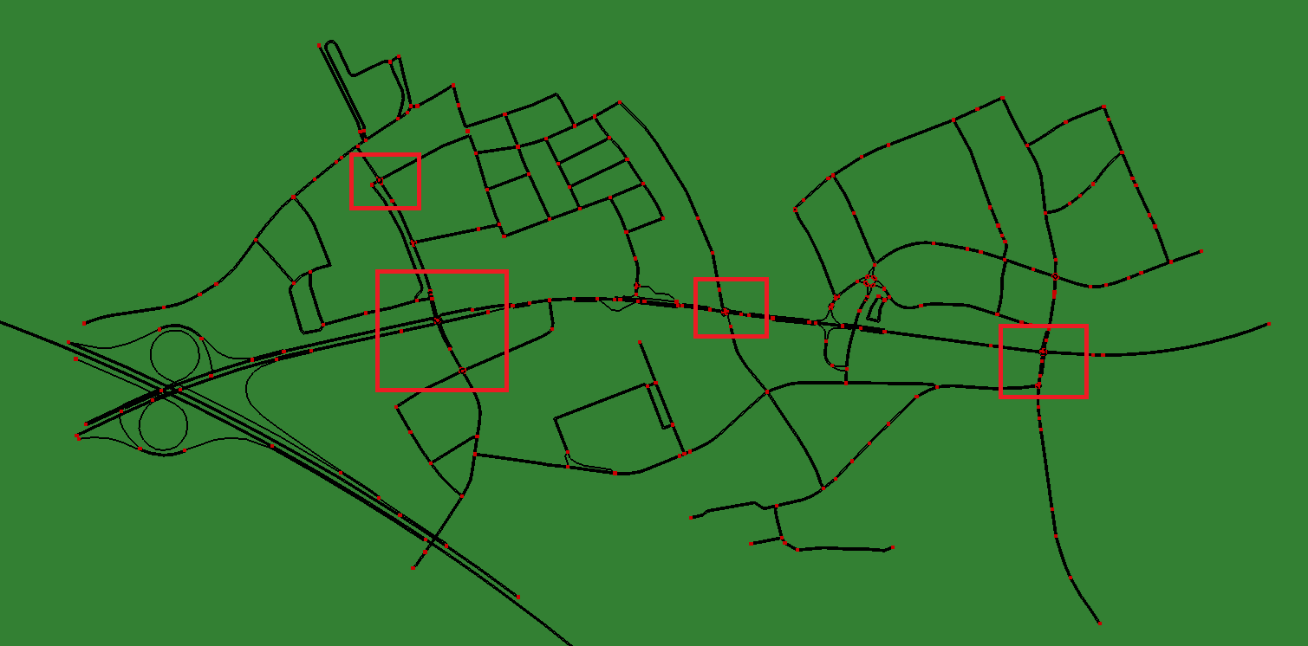
Changes (Roundabout)

Slide 9
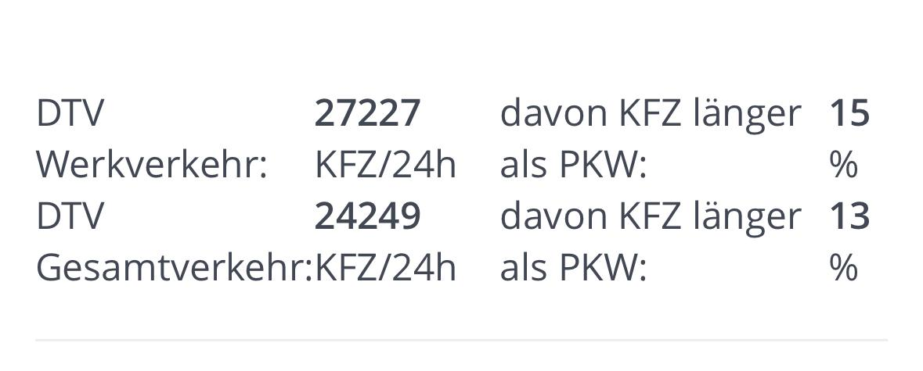
Number of vehicles for scenario (peak hours 7-9 am)
Estimation -> About 15% of the traffic occurs during the peak hours
With randomtrips.py, background car and background truck trips were implemented
Trucks consist about 15% of the traffic

Slide 10
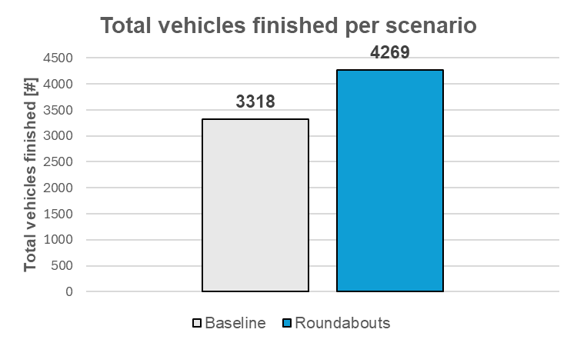
Results: Finished vehicles

Slide 11
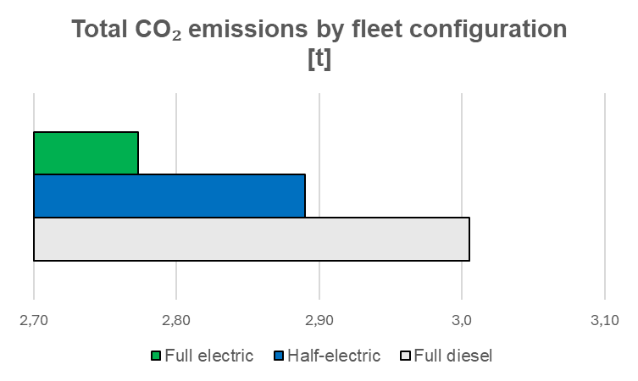
Results: Total CO2 emissions

Slide 12
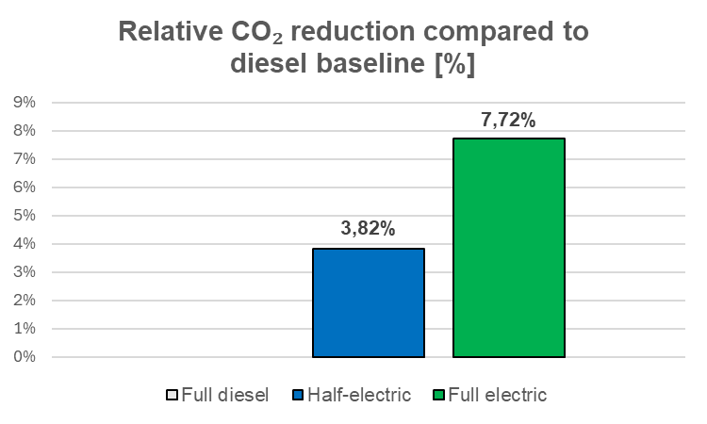
Results: Relative CO2 reduction

Slide 13
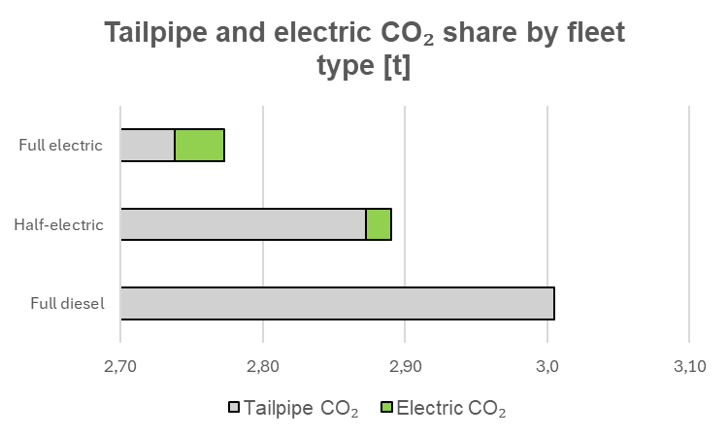
Results: Tailpipe and electric CO2 share by fleet type

