Slide 1


Lagopus handson
NTT Network Innovation lab
version 0.5
Last Update : 01/18/2016

Slide 2


Today’s Goal
Step1
Install and set up OpenFlow switch (Lagopus) and OpenFlow controller (Ryu) in your virtual machine
Run sample application
Target PC (Server/VM)
Ryu
OpenFlow
Step2
Lagopus
DPDK
Run lagopus on mininet
nic
nic
#mininet: SDN-based network emulation tool

Slide 3
Preparation for Installing Lagopus and Ryu

Slide 4
Which do you choice as a target system ?
Bare metal system (PC or server)
You must choice the DPDK available hardware
2. Virtual machine
You must choice the DPDK available virtual
hardware
Server
Server
Server
Ryu
Ryu
Ryu
Lagopus
Lagopus
VM
Lagopus
Linux
Linux
OS
KVM
VMware
Linux
Windows/OS X
1. Bare metal
2. Virtual machine

Slide 5
1. Bare metal system requirements
CPU
Type
It is better that 64-bit instruction is available.
The latest Intel CPUs are better
#A little old cpu may be supported because DPDK is
available from 2009 year(#1).
Code Name
Broadwell/Haswell/Ivy Bridge/Sandy Bridge/Nehalem
Cores
>= 2 CPU cores
Server
Ryu
Memory
Size
>= 1Gbytes
Lagopus
OS
#1: http://www.intel.com/content/dam/www/public/us/en/documents/presentation/dpdk-packet-processing-ia-overview-presentation.pdf
Notice: We can not guarantee the complete combination of hardwares.

Slide 6
1. Bare metal system requirements
Network Interface Card (NIC)
Supported network drivers in DPDK
e1000
82540, 82545, 82546
e1000e
82571-82574, 82583, ICH8-ICH10, PCH-PCH2
Igb
82575..82576, 82580, I210, I211, I350, I354, DH89xx
Ixgbe
82598..82599, X540, X550
I40e
X710, XL710
Fm10k
The number of NICs
>= 3 (2 NICs for Lagopus, 1 NIC for management)
Server
Ryu
Lagopus
OS
Notice: We can not guarantee the complete combination of hardwares.

Slide 7
1. Bare metal system requirements
Operating system
Supported OS in DPDK
- Linux
#Operation checked OS
- Ubuntu 14.04 LTS/Ubuntu 12/04 LTS
- Cent OS 6.5
- Free BSD
Server
>= lagopus version 0.2
Ryu
Lagopus
OS
Notice: We can not guarantee the complete combination of hardwares.

Slide 8
2. Virtual machine requirements
vCPU
Type
Some CPU flags may be set on booting VM. (The next page shows the instruction to specify such CPU flags)
Cores
>= 2 cores
Size
>= 1Gbytes
Server
Server
vMemory
Ryu
Ryu
Lagopus
Lagopus
VM
Linux
Linux
KVM
VMware
Linux
Windows/OS X
Notice: We can not guarantee the complete combination of hardwares.

Slide 9
2. Virtual machine requirements
vNIC
e1000 device
#KVM/Vmware supports e1000 virtual device
Server
Server
Ryu
Ryu
Lagopus
Lagopus
VM
Linux
Linux
KVM
VMware
Linux
Windows/OS X

Slide 10
2. Virtual machine requirements
vNIC
Sample Vmware Fusion configuration on OS X.
ethernet0.present = "TRUE"
ethernet0.connectionType = "bridged"
ethernet0.virtualDev = "e1000"
ethernet0.wakeOnPcktRcv = "FALSE"
ethernet0.addressType = "generated"
ethernet0.linkStatePropagation.enable = "TRUE"
ethernet0.generatedAddress = "00:0c:29:67:06:91"
ethernet0.pciSlotNumber = "33"
ethernet0.generatedAddressOffset = "0"
ethernet1.present = "TRUE"
ethernet1.connectionType = "hostonly"
ethernet1.virtualDev = "e1000"
ethernet1.wakeOnPcktRcv = "FALSE"
ethernet1.addressType = "generated"
ethernet1.linkStatePropagation.enable = "TRUE"
ethernet1.generatedAddress = "00:0c:29:67:06:9b"
ethernet1.generatedAddressOffset = "10"
ethernet1.pciSlotNumber = "37"
ethernet2.present = "TRUE"
ethernet2.connectionType = "hostonly"
ethernet2.virtualDev = "e1000"
ethernet2.wakeOnPcktRcv = "FALSE"
ethernet2.addressType = "generated"
ethernet2.linkStatePropagation.enable = "TRUE"
ethernet2.generatedAddress = "00:0c:29:67:06:a5"
ethernet2.generatedAddressOffset = "20"
ethernet2.pciSlotNumber = "38”
vNIC0
for management
virtualDev=“e1000”
vNIC1
for Lagopus
vNIC2

Slide 11
2. Virtual machine requirements
OS
Supported OS in DPDK
- Linux
#Operation checked OS
- Ubuntu 14.04 LTS/Ubuntu 12/04 LTS
- Cent OS 6.5
Server
Server
Ryu
Ryu
Lagopus
Lagopus
VM
OS
OS
KVM
VMware
Linux
Windows/OS X

Slide 12
Handson Start!
1: Install Lagopus
2: Install Ryu
3: Run Lagopus with Ryu

Slide 13
Handson Start!
1: Install Lagopus
2: Install Ryu
3: Run Lagopus with Ryu

Slide 14
1: Install Lagopus
Environment
Server
Version 3.26
Ryu
VM
Lagopus
Version 0.2.3
OS
DPDK
Hypervisor
Ubuntu 14.04 LTS
OS
Version 2.0.0

Slide 15
1: Install Lagopus
Download lagopus and Intel DPDK
Download “Lagopus”
$sudo apt-get git
$git clone https://github.com/lagopus/lagopus
You must move to your home directory
Download “Intel DPDK”
$wget http://dpdk.org/browse/dpdk/snapshot/dpdk-2.0.0.zip
$unzip dpdk-2.0.0.zip
Need unzip(sudo apt-get install unzip)

Slide 16
Setup essential software packages
1: Install Lagopus
$ sudo apt-get update
$ sudo apt-get install make gcc git build-essential libxpat-dev libgmp-dev libssl-dev libpcap-dev byacc flex python-dev python-pastedeploy python-paste python-twisted python-setuptools python-pip libxml2-dev libxslt-dev

Slide 17
Setup essential software packages
1: Install Lagopus
Make
gcc
Git
build-essential
libxpat-dev
libgmp-dev
libssl-dev
libpcap-dev
byacc
10. Flex
11. python-dev
12. python-pastedeploy
13. python-paste
14. python-twisted
15. python-setuptools
16. python-pip
17. libxml2-dev
18. libxslt-dev

Slide 18
For DPDK version
1: Install Lagopus
Setup intel DPDK
Compile DPDK libraries
$ cd ~/dpdk-2.0.0
$ cd tools
$ ./setup.sh
[9] x86_64-native-linuxapp-gcc
:
[30] Exit Script
Option:9

Slide 19
For DPDK version
1: Install Lagopus
Setup intel DPDK
Loading kernel module
[12] Insert IGB UIO module
:
[30] Exit Script
Option:12
[14] Insert KNI module
:
[30] Exit Script
Option:14

Slide 20
For DPDK version
1: Install Lagopus
Setup intel DPDK
Setup hugepages
[15] Setup hugepage mappings for non-NUMA systems
:
[30] Exit Script
Option:15
Input the number of 2MB pages
Example: to have 128MB of hugepages available, enter '64' to
reserve 64 * 2MB pages
Number of pages:256

Slide 21
For DPDK version
1: Install Lagopus
Setup intel DPDK
Bind NiCs to DPDK
[18] Bind Ethernet device to IGB UIO module
:
[30] Exit Script
Option:18
Network devices using kernel driver
===================================
0000:03:00.0 '82545EM Gigabit Ethernet Controller (Copper)' if=eth10 drv=e1000 unused=
0000:03:00.1 '82545EM Gigabit Ethernet Controller (Copper)' if=eth11 drv=e1000 unused=
0000:05:00.0 '82545EM Gigabit Ethernet Controller (Copper)' if=eth12 drv=e1000 unused=
0000:05:00.1 '82545EM Gigabit Ethernet Controller (Copper)' if=eth13 drv=e1000 unused=
0000:07:00.0 '82545EM Gigabit Ethernet Controller (Copper)' if=eth0 drv=igb unused= *Active*
Other network devices
=====================
<none>
Enter PCI address of device to bind to IGB UIO driver:eth10
You must choice 2 NiCs

Slide 22
For DPDK version
1: Install Lagopus
Compile
$ cd lagopus
$ ./configure
$ make
Install
$ sudo make install

Slide 23
1: Install Lagopus
Compile
$ cd lagopus
$ ./configure –-disable-dpdk
$ make
Install
$ sudo make install

Slide 24
Handson Start!
1: Install Lagopus
2: Install Ryu
3: Run Lagopus with Ryu

Slide 25
2: Install Ryu
$ sudo pip install ryu
$ sudo pip install six –-upgrade
Notes:
$ sudo pip install stevedore -upgrade

Slide 26
Handson Start!
1: Install Lagopus
2: Install Ryu
3: Run Lagopus with Ryu

Slide 27
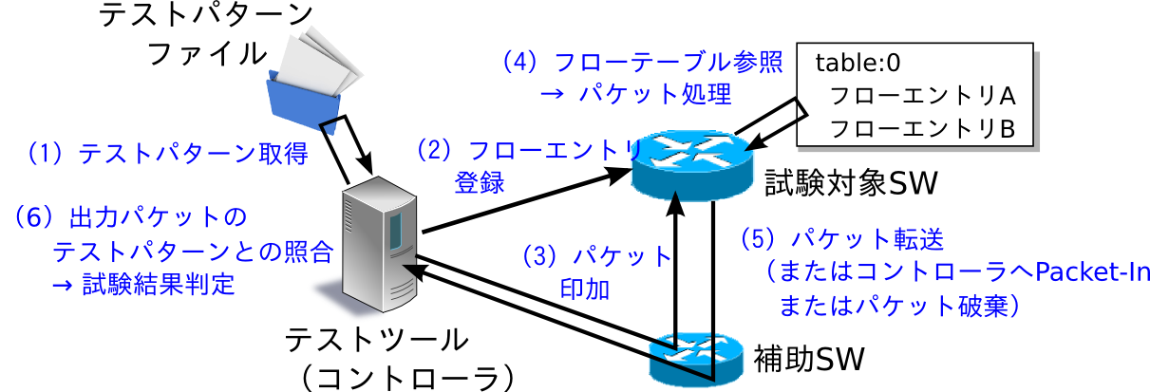
3: Run lagopus with Ryu
$cd /usr/local/lib/python2.7/dist-packages/ryu/tests/switch
$ ryu-manager --test-switch-dir of13 tester.py
Ryu Certification
OpenFlowスイッチがどのくらいOpenFlowの仕様に準拠しているかテスト
するためのツール
http://osrg.github.io/ryu-book/ja/html/

Slide 28
3: Run lagopus with Ryu
Setup Lagopus configuration file
Created topology
Ryu
Lagopus
VM
veth0
veth1
br01
veth2
veth3
br02
veth4
veth5

Slide 29
3: Run lagopus with Ryu
Setup network namespace
$ git clone https://github.com/lagopus/handson
$ cd handson
$ ./setup_rawsocket.sh
$sudo ip link add veth0 type veth peer name veth1
$sudo ip link add veth2 type veth peer name veth3
$sudo ip link add veth4 type veth peer name veth5
$sudo ip link set veth0 up
$sudo ip link set veth1 up
$sudo ip link set veth2 up
$sudo ip link set veth3 up
$sudo ip link set veth4 up
$sudo ip link set veth5 up

Slide 30
3: Run lagopus with Ryu
Setup Lagopus configuration file
$ cd /usr/local/etc/
$ mkdir lagopus
$ sudo cp ~lagopus/misc/examples/lagopus.dsl /usr/
local/etc/lagopus/
$ sudo vi/usr/local/etc/lagopus/lagopus.dsl
$ mkdir /usr/local/etc/lagopus
$ git clone https://github.com/lagopus/handson
$ cd handson
$ cp lagopus.dsl /usr/local/etc/lagopus/

Slide 31
For DPDK version
3: Run lagopus with Ryu
Setup Lagopus configuration file
Lagopus.dsl
Network namespaceを活用
channel channel01 create -dst-addr 127.0.0.1 -protocol tcp
channel channel02 create -dst-addr 127.0.0.1 -protocol tcp
controller controller01 create -channel channel01 -role equal -connection-type main
controller controller02 create -channel channel02 -role equal -connection-type main
interface interface01 create -type ethernet-dpdk-phy -port-number0
interface interface02 create -type ethernet-dpdk-phy -port-number1
interface interface03 create -type ethernet-dpdk-phy -port-number2
interface interface04 create -type ethernet-dpdk-phy -port-number3
interface interface05 create -type ethernet-dpdk-phy -port-number4
interface interface06 create -type ethernet-dpdk-phy -port-number5
port port01 create -interface interface01
port port02 create -interface interface02
port port03 create -interface interface03
port port04 create -interface interface04
port port05 create -interface interface05
port port06 create -interface interface06
bridge bridge01 create -controller controller01 -port port01 1 -port port03 2 -port port05 3 -dpid 0x1
bridge bridge02 create -controller controller02 -port port02 1 -port port04 2 -port port06 3 -dpid 0x2
bridge bridge01 enable
bridge bridge02 enable

Slide 32
3: Run lagopus with Ryu
Setup Lagopus configuration file
Lagopus.dsl
Network namespaceを活用
channel channel01 create -dst-addr 127.0.0.1 -protocol tcp
channel channel02 create -dst-addr 127.0.0.1 -protocol tcp
controller controller01 create -channel channel01 -role equal -connection-type main
controller controller02 create -channel channel02 -role equal -connection-type main
interface interface01 create -type ethernet-rawsock -device veth0
interface interface02 create -type ethernet-rawsock -device veth1
interface interface03 create -type ethernet-rawsock -device veth2
interface interface04 create -type ethernet-rawsock -device veth3
interface interface05 create -type ethernet-rawsock -device veth4
interface interface06 create -type ethernet-rawsock -device veth5
port port01 create -interface interface01
port port02 create -interface interface02
port port03 create -interface interface03
port port04 create -interface interface04
port port05 create -interface interface05
port port06 create -interface interface06
bridge bridge01 create -controller controller01 -port port01 1 -port port03 2 -port port05 3 -dpid 0x1
bridge bridge02 create -controller controller02 -port port02 1 -port port04 2 -port port06 3 -dpid 0x2
bridge bridge01 enable
bridge bridge02 enable

Slide 33
For DPDK version
3: Run lagopus with Ryu
Run Lagopus
$ sudo lagopus -d -- -c3 -n1 --vdev eth_pipe0 --vdev eth_pipe1 --vdev eth_pipe2 -- -p3f --core-assign balance
Options
-d: Debug mode (foreground)
-c bitmask: Which CPU cores to use
-n channels: Memory channels
-p bitmask: Number of port
-l filename: Specify a log file path (default:syslog)

Slide 34
3: Run lagopus with Ryu
Run Lagopus
$ sudo lagopus –d
Options
-d : Debug mode (foreground)
-l filename: Specify a log file path (default:syslog)

Slide 35
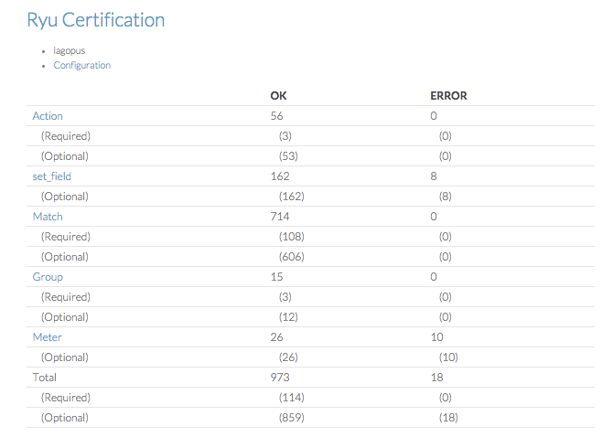
https://osrg.github.io/ryu-certification/switch/lagopus

Slide 36
Further information
より高速にお使いいただくために
gcc4.X, ixgbeを利用する場合
$ sudo vi dpdk-2.0.0/config/common_linuxapp
CONFIG_RTE_LIBRTE_IXGBE_PF_DISABLE_STRIP_CRC=n
CONFIG_RTE_LIBRTE_IXGBE_RX_ALLOW_BULK_ALLOC=y
CONFIG_RTE_IXGBE_INC_VECTOR=n
CONFIG_RTE_IXGBE_RX_OLFLAGS_ENABLE=y

Slide 37
Further information
Lagopusの状態を確認する
$ lagosh
各種情報の表示
$lagosh> Show flow #フロー/フローの統計情報の表示
$lagosh> Show bridge #ブリッジの情報/ブリッジの統計情報の表示
$lagosh> Show controller
$lagosh> Show meter
$lagosh> Show group
:
:
その他
$ lagosh> Configure
Configure# edit #.dslの内容を書き換えたり..
$ lagosh> stop #Lagopusを停止します

Slide 38
Appendix: Install by Ansible
Setup
$ sudo apt-get install git ansible
$ git clone https://github.com/lagopus/lagopus-tools
$ cd lagopus-tools/ansible
$ echo “[target]” > inventories/hosts_setup
$ echo “127.0.0.1” >> inventories/hosts_setup
$ echo “work_dir: /home/lagopus” > playbooks/vars.yml
$ echo “user: lagopus” >> playbooks/vars.yml
$ ansible-playbook -i inventories/hosts_setup playbooks/setup.yml -K --connection local

Slide 39
Appendix: mininet
Setup
$ git clone https://github.com/lagopus/mininet
$ cd mininet
$ git checkout lagopus
$ ./util/install.sh -n
Sample
$ ryu-manager /usr/local/lib/python2.7/dist-packages/ryu/app/simple_switch_13.py
$ sudo ~/mininet/examples/simplelagopus.py
Reference
http://openvswitch.org/support/ovscon2015/16/1305-lantz.pdf

Slide 40
Thank you for your attention
This research is a part of the project for “Research and Development of Network Virtualization Technology” supported by the Ministry of Internal Affairs and Communications.

