Slide 1
ACTIVITY 2
ORGANIC CHEMISTRY
Aaron James F. Lagrimas

Slide 2
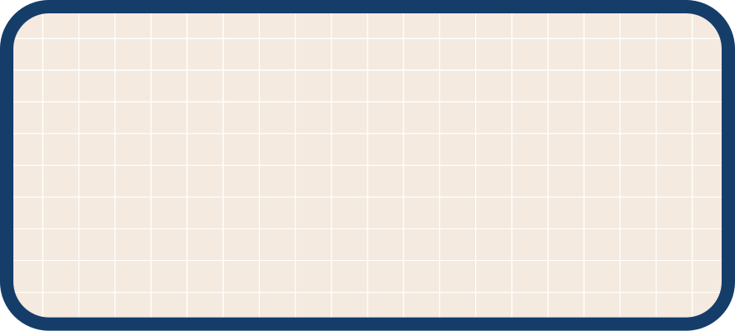

PROPANE
C3H8
H
H
H
H
C
C
C
H
H
H
H
  Molecular Formula
  Lewis Structure
  Molecular Formula
CH3CH2CH3
  Condensed Structural Formula
  Bond Line Formula

Slide 3

ETHANOL
C2H60
H
H
H
C
C
O
H
H
H
  Molecular Formula
  Lewis Structure
  Molecular Formula
CH3CH2OH
  Condensed Structural Formula
  Bond Line Formula

Slide 4
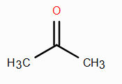
ACETONE
C3H60
H
O
H
H
C
C
C
H
H
H
  Molecular Formula
  Lewis Structure
  Molecular Formula
CH3COCH3
  Condensed Structural Formula
  Bond Line Formula

Slide 5
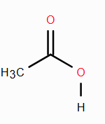
ACETIC ACID
C2H402
H
O
H
C
C
O
H
H
  Molecular Formula
  Lewis Structure
  Molecular Formula
CH3COOH
  Condensed Structural Formula
  Bond Line Formula

Slide 6

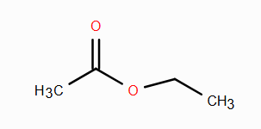
ETHYL ACETATE
C4H802
H
O
H
H
H
C
C
O
C
C
H
H
H
H
  Molecular Formula
  Lewis Structure
  Molecular Formula
CH3COOCH2CH3
  Condensed Structural Formula
  Bond Line Formula

Slide 7
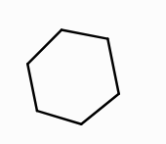
CYCLOHEXANE
H
H
H
H
C6H12
H
C
H
C
C
C
H
H
C
C
H
H
  Molecular Formula
H
H
  Molecular Formula
  Lewis Structure
(CH2)6
  Condensed Structural Formula
  Bond Line Formula

Slide 8
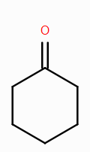
CYCLOHEXANONE
H
H
H
H
C6H10O
H
C
H
C
C
C
H
O
C
C
H
  Molecular Formula
H
H
  Molecular Formula
  Lewis Structure
(CH2)5CO
  Condensed Structural Formula
  Bond Line Formula

Slide 9
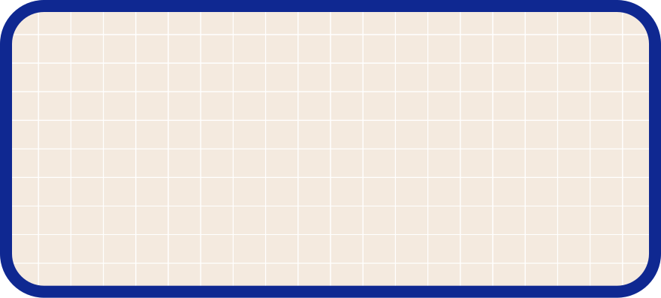
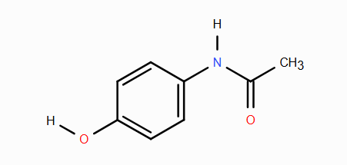
ACETAMINOPHEN
H
H
H
H
C
C8H9NO2
C
C
N
C
C
H
H
O
C
C
O
C
H
H
H
  Molecular Formula
  Lewis Structure
  Molecular Formula
HOC₆H₄NHCOCH₃
  Condensed Structural Formula
  Bond Line Formula

Slide 10
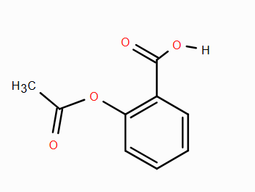
ASPIRIN
O
H
O
C9H8O4
H
C
C
H
H
C
O
C
C
H
C
O
C
C
C
H
H
  Molecular Formula
H
  Molecular Formula
  Lewis Structure
CH3COOC6H4COOH
  Condensed Structural Formula
  Bond Line Formula

Slide 11
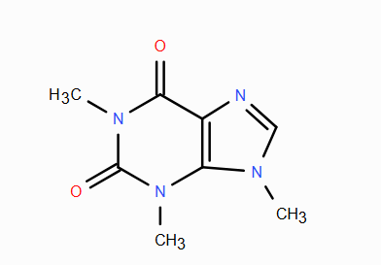
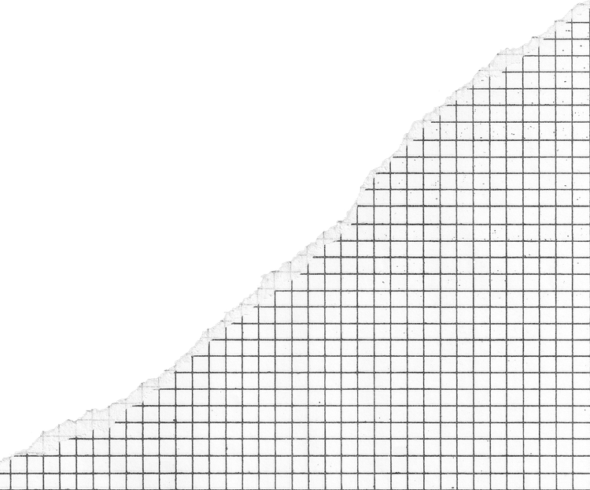
CAFFEINE
O
C8H10N4O2
H
C
H
H
C
N
N
C
H
H
C
H
C
O
C
N
H
H
C
N
C
H
H
  Molecular Formula
  Lewis Structure
  Molecular Formula
C8H10N4O2
  Condensed Structural Formula
  Bond Line Formula

