Slide 1


ORG CHEM
ACTIVITY 3

Slide 2
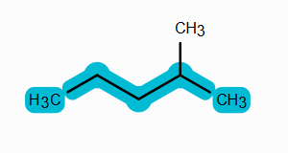
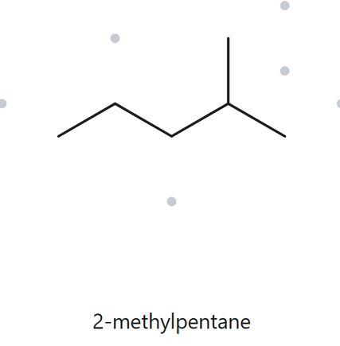
C6H14
Naming trail:
Parent: 5 Carbons (Pentane chain)
Numbering: 5,4,3,2,1 (From the left)
Substituent: Methyl at C-2
Alphabetical: methyl (only present)
5
1
4
2
3
NAME:
2-methylpentane
THE ALKANE CHECK
Source:https://thealkane.com
Verification strip:[PARENT: 5 Carbons (Pentane chain)][LOCANTS: 2][SUBSTITUENT: Methyl][ALPHABETICAL: methyl][FORMULA:C6H14]

Slide 3
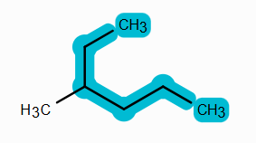
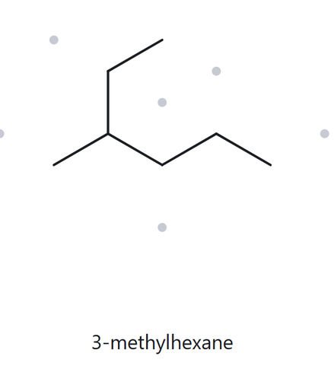
C7H16
1
Naming trail:
2
Parent: 6 Carbons (Hexane chain)
Numbering: 1,2,3,4,5,6 (From the top-right)
Substituent: Methyl at C-3
Alphabetical: methyl (only present)
4
6
3
5
NAME:
3-methylhexane
THE ALKANE CHECK
Source:https://thealkane.com
Verification strip:[PARENT: 6 Carbons (Hexane chain)][LOCANTS: 3][SUBSTITUENT: Methyl][ALPHABETICAL: methyl][FORMULA:C7H16]

Slide 4
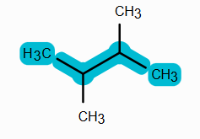
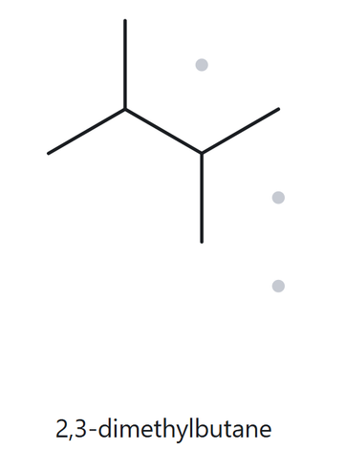
C6H14
Naming trail:
1
Parent: 4 Carbons (Butane chain)
Numbering: 1,2,3,4 (From the right)
Substituent: Methyl at C-2,3
Alphabetical: methyl (only present)
4
2
3
NAME:
2,3-dimethylbutane
THE ALKANE CHECK
Source:https://thealkane.com
Verification strip:[PARENT: 4 Carbons (butane chain)][LOCANTS: 2,3][SUBSTITUENT: Methyl][ALPHABETICAL: methyl][FORMULA:C6H14]

Slide 5
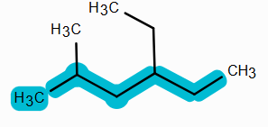
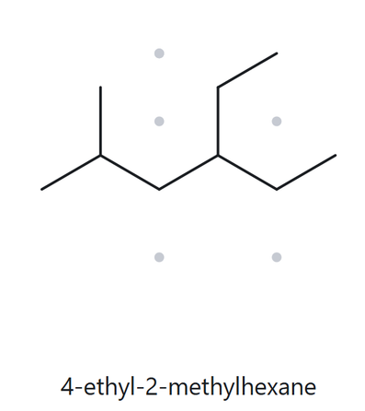
C9H20
Naming trail:
Parent: 6 Carbons (Hexane chain)
Numbering: 1,2,3,4,5,6 (From the left)
Substituent: Methyl at C-2, Ethyl at C-4
Alphabetical: ethyl and methyl
1
3
5
6
2
4
NAME:
4-ethyl-2-methylhexane
THE ALKANE CHECK
Source:https://thealkane.com
Verification strip:[PARENT: 6 Carbons (Hexane chain)][LOCANTS: 2,4][SUBSTITUENT: methyl and ethyl][ALPHABETICAL: ethyl and methyl][FORMULA:C9H20]

Slide 6
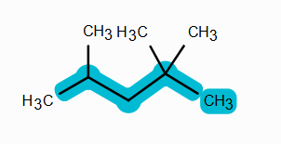
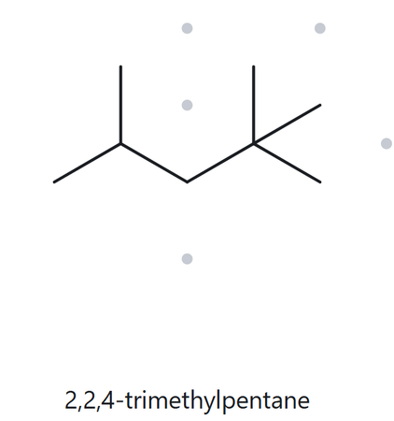
C8H18
Naming trail:
Parent: 5 Carbons (pentane chain)
Numbering: 1,2,3,4,5, (From the right)
Substituent: Methyl at C-2,2,4
Alphabetical: methyl
5
3
1
4
2
NAME:
2,2,4-trimethylpentane
THE ALKANE CHECK
Source:https://thealkane.com
Verification strip:[PARENT: 5 Carbons (pentane chain)][LOCANTS: 2,2,4][SUBSTITUENT: methyl][ALPHABETICAL: methyl][FORMULA:C8H18]

Slide 7
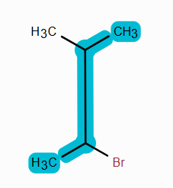
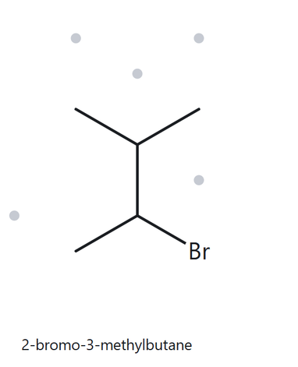
C5H11Br
4
Naming trail:
3
Parent: 4 Carbons (butane chain)
Numbering: 1,2,3,4, (From the bottom left)
Substituent: Bromo at C-2, Methyl at C-3
Alphabetical: bromo and methyl
2
1
NAME:
2-bromo-3-methylbutane
THE ALKANE CHECK
Source:https://thealkane.com
Verification strip:[PARENT: 4 Carbons (butane chain)][LOCANTS: 2,3][SUBSTITUENT: methyl and bromo][ALPHABETICAL: bromo and methyl][FORMULA:C5H11Br]

Slide 8
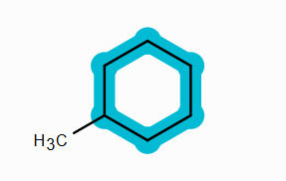
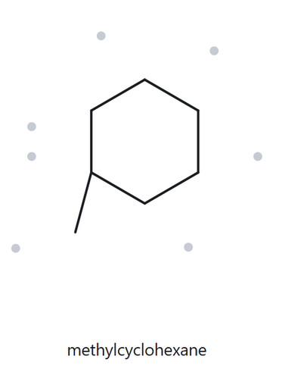
C7H14
3
Naming trail:
2
4
Parent: 6 Carbons (Cyclohexane chain)
Numbering: 1,2,3,4,5,6 (From the bottom left, clockwise)
Substituent: Methyl at C-1
Alphabetical: methyl
1
5
6
NAME:
methylcyclohexane
THE ALKANE CHECK
Source:https://thealkane.com
Verification strip:[PARENT: 6 Carbons (Cyclohexane chain)][LOCANTS: 1][SUBSTITUENT: methyl][ALPHABETICAL:methyl][FORMULA:C7H14]

Slide 9
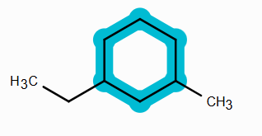
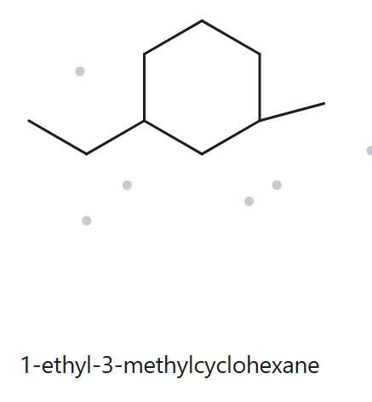
C9H18
5
Naming trail:
6
4
Parent: 6 Carbons (Cyclohexane chain)
Numbering: 1,2,3,4,5,6 (From the bottom left, counterclockwise)
Substituent: Methyl at C-3, ethyl at C-1
Alphabetical: ethyl and methyl
1
3
2
NAME:
1-ethyl-3-methylcyclohexane
THE ALKANE CHECK
Source:https://thealkane.com
Verification strip:[PARENT: 6 Carbons (Cyclohexane chain)][LOCANTS: 1 and 3][SUBSTITUENT: methyl and ethyl][ALPHABETICAL:ethyl and methyl][FORMULA:C9H18]

Slide 10
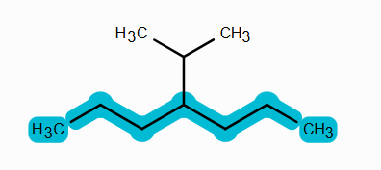
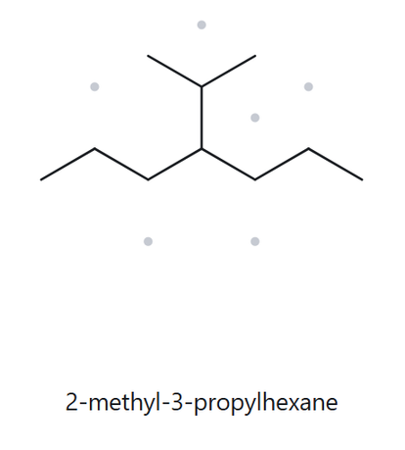
C10H22
Naming trail:
Parent: 7 Carbons (heptane chain)
Numbering: 1,2,3,4,5,6,7 (From the left)
Substituent: isopropyl at C-4
Alphabetical: isopropyl
7
1
3
5
4
6
2
NAME:
4-isopropylheptane
THE ALKANE CHECK
(WRONG NAMING)
Source:https://thealkane.com
Verification strip:[PARENT: 7 Carbons (heptane chain)][LOCANTS: 4][SUBSTITUENT:isopropyl][ALPHABETICAL:isopropyl][FORMULA:C7H14]

Slide 11
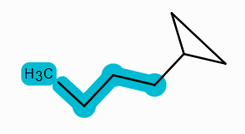
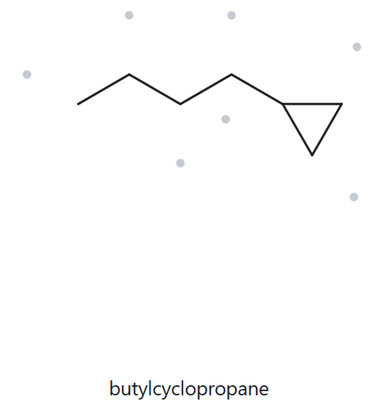
C7H14
Naming trail:
Parent: 4 Carbons (butane chain)
Numbering: 1,2,3,4 (From the right)
Substituent: cyclopropyl at C-1
Alphabetical: cyclopropyl
2
4
1
3
NAME:
cyclopropylbutane
THE ALKANE CHECK
Source:https://thealkane.com
Verification strip:[PARENT: 4 Carbons (butane chain)][LOCANTS: 1 ][SUBSTITUENT: cyclopropyl ][ALPHABETICAL: cyclopropyl][FORMULA:C7H14]

