Slide 1


ACTIVITY 3 B
ORGANIC
CHEMISTRY
BOLD DESIGN STUDIO

Slide 2
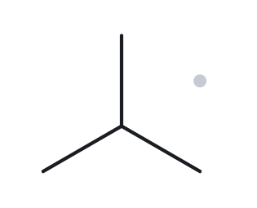
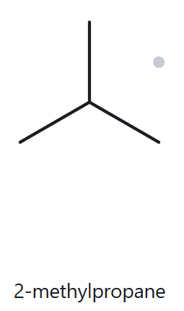
2-methylpropane
Name decoded
Bond line structure
Parent chain: 3 Carbon
Substituent: Methyl on C-2
Expected Formula: C4H10
Formula Check
Counted from the drawing
C-4
H-10
Back check
✓ parent length matches ✓ substituent positions match ✓ formula agrees ✓ back-check recorded

Slide 3
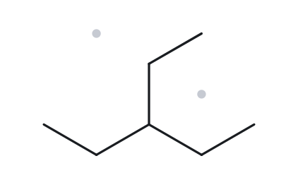
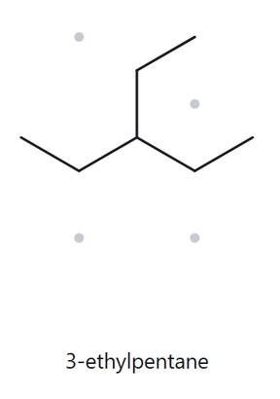
3-ethylpentane
Name decoded
Bond line structure
Parent chain: 5 Carbon
Substituent: Ethyl on C-3
Expected Formula: C7H16
Formula Check
Counted from the drawing
C-7
H-16
Back check
✓ parent length matches ✓ substituent positions match ✓ formula agrees ✓ back-check recorded

Slide 4
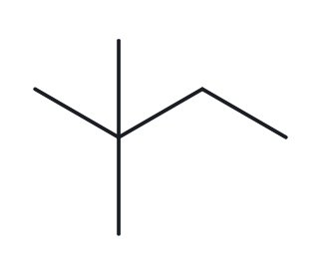
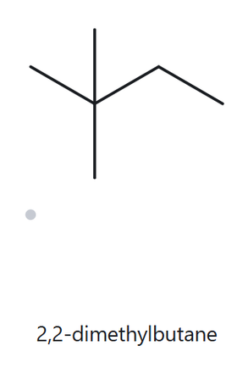
2,2-dimethylbutane
Name decoded
Bond line structure
Parent chain: 4 Carbon
Substituent: 2 methyl on C-2
Expected Formula: C6H14
Formula Check
Counted from the drawing
C-6
H-14
Back check
✓ parent length matches ✓ substituent positions match ✓ formula agrees ✓ back-check recorded

Slide 5
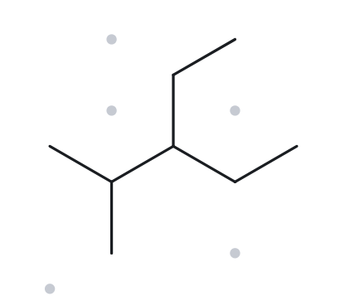
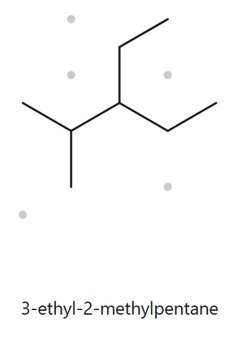
3-ethyl-2-methylpentane
Name decoded
Bond line structure
Parent chain: 5 Carbon
Substituent: ethyl on C-3, methyl on C-2
Expected Formula: C8H18
Formula Check
Counted from the drawing
C-8
H-18
Back check
✓ parent length matches ✓ substituent positions match ✓ formula agrees ✓ back-check recorded

Slide 6
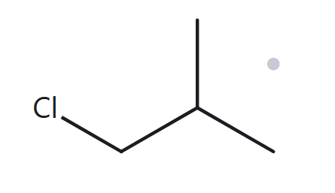
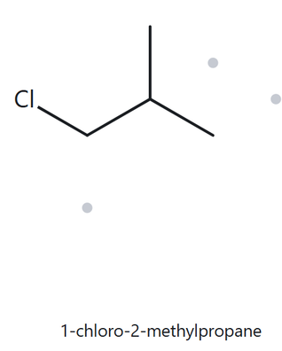
1-chloro-2-methylpropane
Name decoded
Bond line structure
Parent chain: 3 Carbon
Substituent: Chloro on C-1, methyl on C-2
Expected Formula: C4H9Cl
Formula Check
Counted from the drawing
C-4
H-9
Cl-1
Back check
✓ parent length matches ✓ substituent positions match ✓ formula agrees ✓ back-check recorded

Slide 7
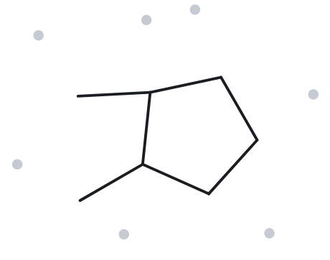
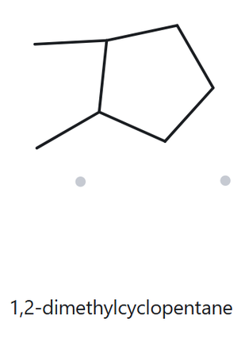
1,2-dimethylcyclopentane
Name decoded
Bond line structure
Parent chain: 5 Carbon ring
Substituent: methyl on C-1, and C-2
Expected Formula: C7H14
Formula Check
Counted from the drawing
C-7
H-14
Back check
✓ parent length matches ✓ substituent positions match ✓ formula agrees ✓ back-check recorded

Slide 8
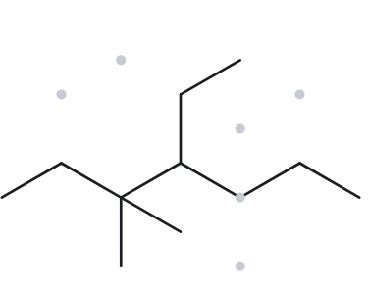
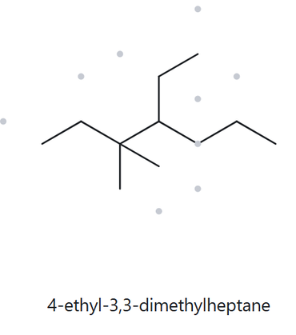
4-ethyl-3,3-dimethylheptane
Name decoded
Bond line structure
Parent chain: 7 Carbon
Substituent: ethyl on C-4, and 2 methyl on C-3
Expected Formula: C11H24
Formula Check
Counted from the drawing
C-11
H-24
Back check
✓ parent length matches ✓ substituent positions match ✓ formula agrees ✓ back-check recorded

Slide 9
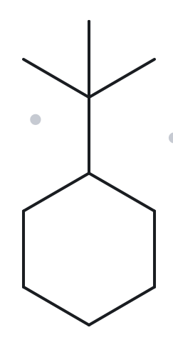
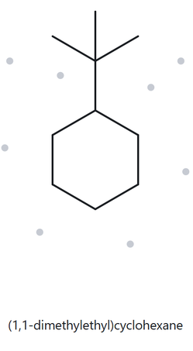
tert-butylcyclohexane
Name decoded
Bond line structure
Parent chain: 6 Carbon ring
Substituent: tert-butyl group
Expected Formula: C₁₀H₂₀
Formula Check
Counted from the drawing
C-10
H-20
Back check
✓ parent length matches ✓ substituent positions match ✓ formula agrees ✓ back-check recorded

Slide 10
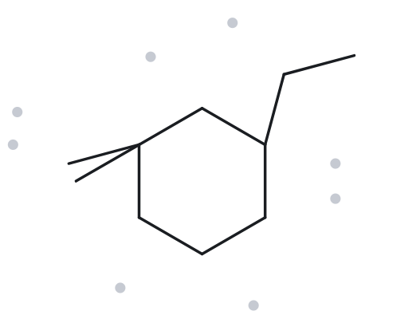
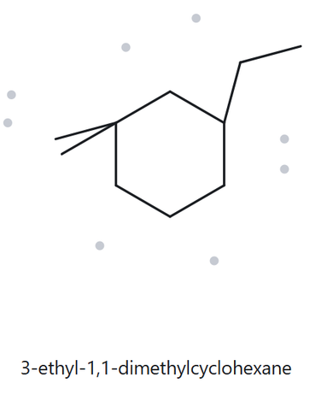
3-ethyl-1,1- dimethylcyclohexane
Name decoded
Bond line structure
Parent chain: 6 Carbon ring
Substituent: ethyl on C-3, 2 methyl on C-1
Expected Formula: C₁₀H₂₀
Formula Check
Counted from the drawing
C-10
H-20
Back check
✓ parent length matches ✓ substituent positions match ✓ formula agrees ✓ back-check recorded

Slide 11
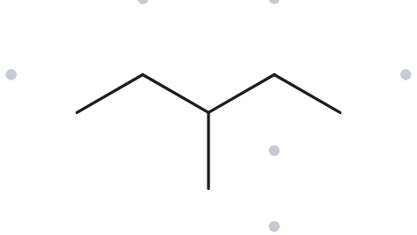
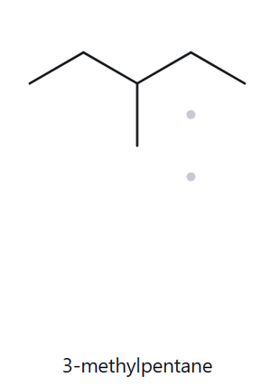
2-ethylbutane(3-methylpentane)
Name decoded
Bond line structure
Parent chain: 5 Carbon
Substituent: methyl on C-3
Expected Formula: C₆H₁₄
Formula Check
Counted from the drawing
C-6
H-14
Back check
✓ parent length matches ✓ substituent positions match ✓ formula agrees ✓ back-check recorded

