Slide 1
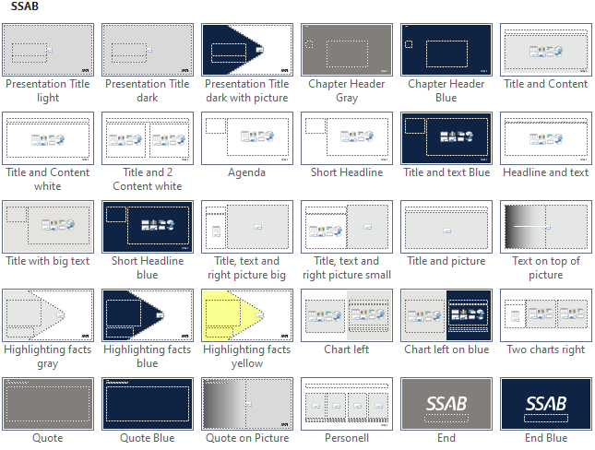
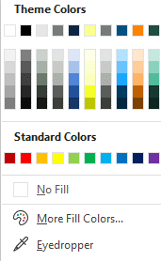

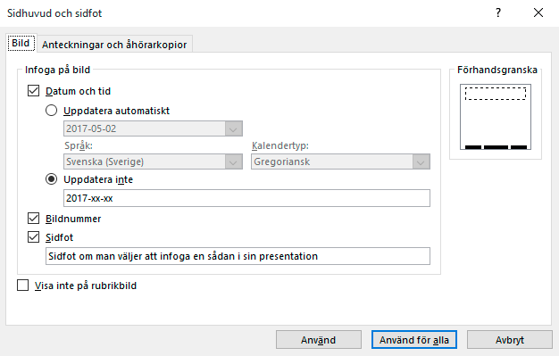

Instructions
Hidden page and will not show in print
Layouts
Theme colors
Header and footer
1. New Slide, shows all layouts available.
2. Layout, changes the appearance of the current slide.
Current layouts in the template
Objects will be coloured in the colors that follow SSAB visual identity.
Under the Insert tab, choose Header & Footer. Change the dialogue box to your preference and click on Apply to all to use this on all pages with footer in the presentation or Apply if you wish to only change the slide that you are currently on.
3. Reset, the slide is shown in the original format. Can be used e.g. to restore a bullet list if you previously removed the bullet.
Do not use the standard palette! Use theme colors.
Cut and paste
When updating presentations to the new template it is preferable to copy content & not slides. To do this, navigate to your presentation, copy content you would like to insert & paste using corresponding placeholders. Pictures should be pasted in picture placeholders, text in text etc. If you are unfamiliar with the placeholder types, hover over a placeholder icon to view the tooltip explaining its purpose.

Slide 2
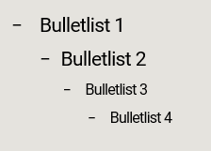


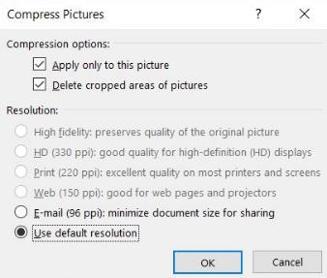
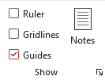
Instructions
Hidden page and will not show in print
Bullet list and format
Do not use these functions to make a bullet or numbered list.
Images
The different levels available in the template.
If the file is too heavy and you would like to reduce the size, choose an image and select Compress Pictures.
Important! Compressed pictures can not
be undone.
In that case, the pictures have to be inserted again.
To change the level of formatting, press Increase/Decrease List Level or Tab/Shift+Tab.
If you wish to perform this on all images in the presentation, uncheck Apply only to this picture.
Guides
Make sure that objects/text are all placed within the slide margins. To show the guides, go to View tab in the menu and check the box for Guides.
Choose resolution.

Slide 3


